Slide 1
JinFlux-1.0
Time Series Data Recording And Visualization

Slide 2
What We Want
Historical storage of metrics
Interactive analyses of metrics
Scalable and performant

Slide 3
InfluxDB:Time Series Database
Optimized handling sequence of data points, measured at successive points in time at uniform time intervals.
HTTP(S) interface for reading and writing data
Down-sample data on different windows of time
Compute statistics on fly
Horizontally scalable
Designed for high transaction volumes.

Slide 4
Grafana
Open source Javascript dashboard
Drug and drop panels
Click and select region to zoom
Bars, Lines, Points
Mix liners, bars and points
InfluxDB query editor
Annotation lines, and more…

Slide 5
InfluxDB Driver: JinFlux API
JinFlux(String influxDbHost, int port, String user, String password)
ping(int timeout)
createDB(String dbName, int retentionTime, JinTime tm, String rpName)
showRP(String dbName)
removeDB(String dbName)
listDB()
existsDB(String dbName)
openTB(String tbName, java.util.Map<String,String> tags)
removeTB(String dbName, String tbName)
dumpTB(String dbName, String tbName)
addDP(Point.Builder point, java.util.Map<String,Object> dpNames)
write(String dbName, Point.Builder spot)
read(String dbName, String tbName, String tag)
readTags(String dbName, String tbName)

Slide 6
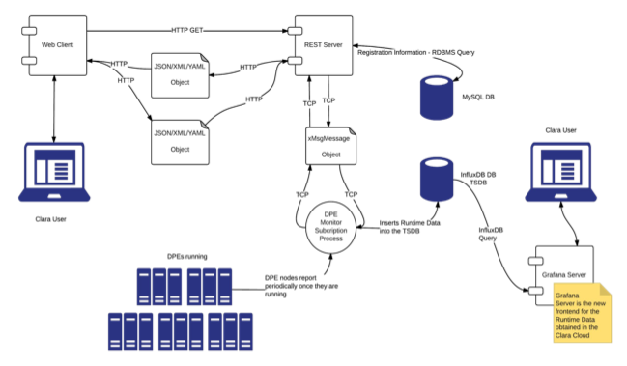
CLARA Front-End

Slide 7
Example code: AFECS supervisor
try {
if (jinFxConnected) {
if (!component.getExpid().equals(AConstants.udf) &&
!component.getName().equals(AConstants.udf)) {
// define table tags
Map<String, String> tags = new HashMap<>();
tags.put(AConstants.RUNTYPE, component.getRunType());
tags.put(AConstants.CODANAME, component.getName());
// open a table
Point.Builder p = openTB(component.getExpid(), tags);
// add data points
addDP(p, AConstants.TYPE, component.getType());
addDP(p, AConstants.SESSION, component.getSession());
addDP(p, AConstants.STATE, state);
addDP(p, AConstants.EVENTRATE, component.getEventRate());
addDP(p, AConstants.EVENTRATEAVERAGE, component.getEventRateAverage());
addDP(p, AConstants.DATARATE, component.getDataRate());
addDP(p, AConstants.DATARATEAVERAGE, component.getDataRateAverage());
addDP(p, AConstants.NUMBEROFLONGS, component.getNumberOfLongs());
addDP(p, AConstants.EVENTNUMBER, component.getEventNumber());
addDP(p, AConstants.LIVETIME, component.getLiveTime());
addDP(p, AConstants.RUNNUMBER, component.getRunNumber());
// add input buffers
Map<String, Integer> ib = component.getInBuffers();
for (String s : ib.keySet()) {
addDP(p, "I." + s, ib.get(s));
}
// add output buffers
Map<String, Integer> ob = component.getOutBuffers();
for (String s : ob.keySet()) {
addDP(p, "O." + s, ob.get(s));
}
write(dbName, p);
}
}
} catch (Exception e) {
System.out.println("DDD: Error writing into influxDB");
}
// creates a table with data retention time = 1 hour
try {
if (!existsDB(dbName)) {
createDB(dbName, 1, JinTime.HOURE);
}
} catch (Exception e) {
jinFxConnected = false;
}

Slide 8
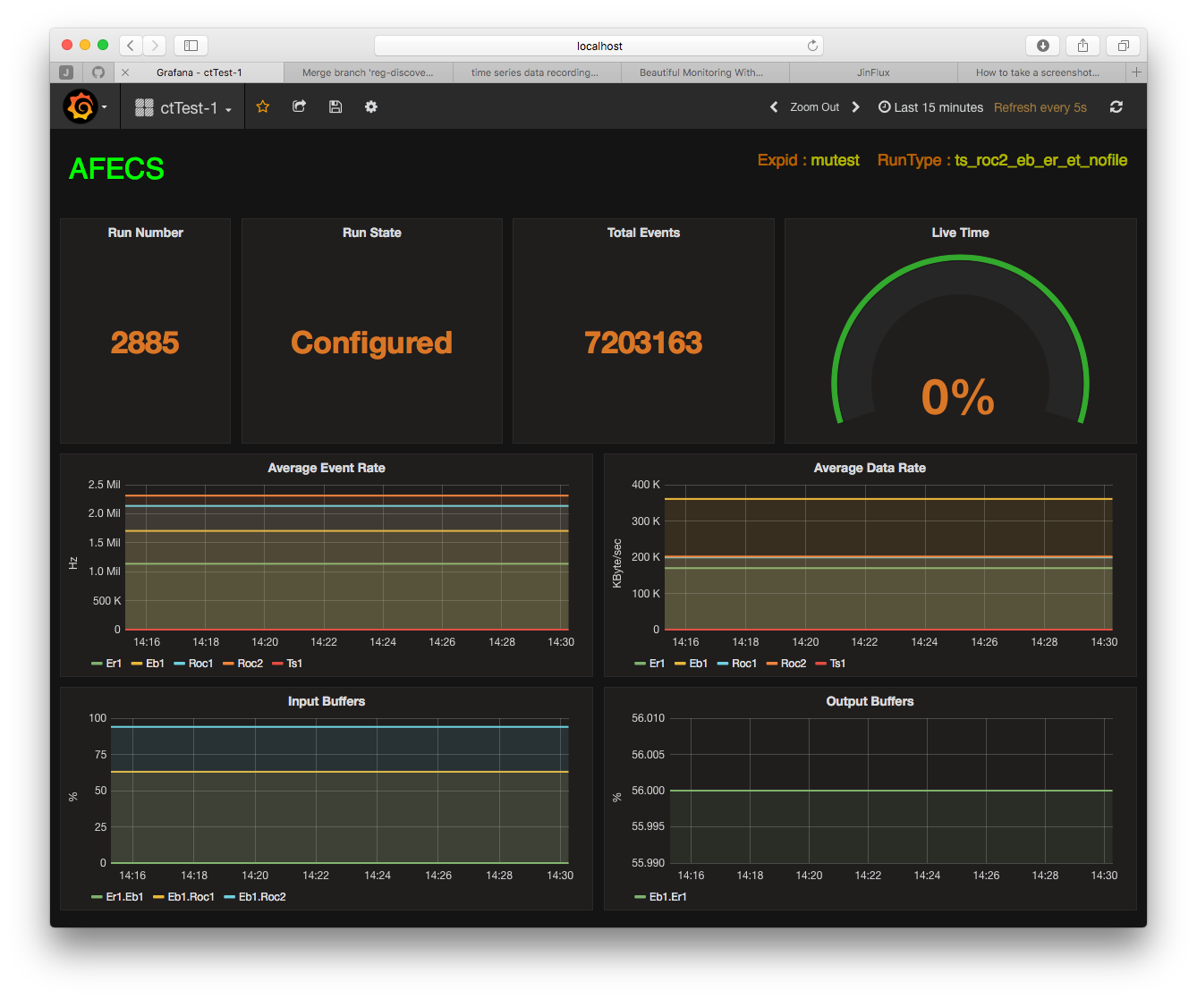
CODA WEB Dashboard: Expid = emutest

Slide 9
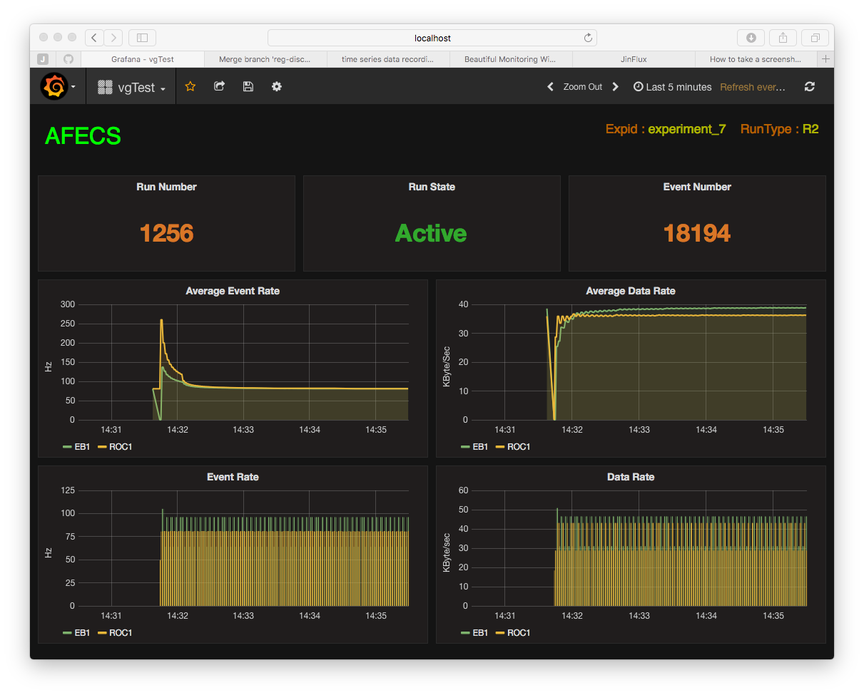
CODA WEB Dashboard: Expid = experiment_7

Slide 10
Conclusion
Lightweight Java API is developed to record time series data into an open source, no-SQL database: InfluxDB
JinFlux package can be used to monitor wide variety metrics, reported from processes such as slow control, data acquisition and physics data processing.
JinFlux is a general purpose, self contained package (no external dependencies) and is not part of CLARA or AFECS projects.
Code is available at:https://github.com/gurjyan/JinFlux.git
InfluxDB is installed on claraweb.jlab.org and is open to all users.
Grafana server is installed and running at http://claraweb.jlab.org:3000
For more info contact gurjyan@jlab.org

