Slide 1
Diamond Radiator Development
Brendan Pratt
University of Connecticut
GlueX Collaboration Meeting, Jefferson Lab, February 2011

Slide 2
Overview
Quick Project Recap
Laser Status
UConn Diamond Ablation Facility
Diamond Mounting
CHESS and SINMAT

Slide 3
Diamond Radiators
Thin diamond crystals prove as a more efficient source of linearly polarized coherent bremsstrahlung for photonuclear experiments such as GlueX.
Large mosaic spreads within diamond samples limit coherence in bremsstrahlung production.
Machining using current industry techniques leaves diamonds with large rocking curves.
Our plan is to machine the diamond to the desired 20 micron thickness via laser ablation at 193nm wavelength.

Slide 4
A Piece of Work

Slide 6
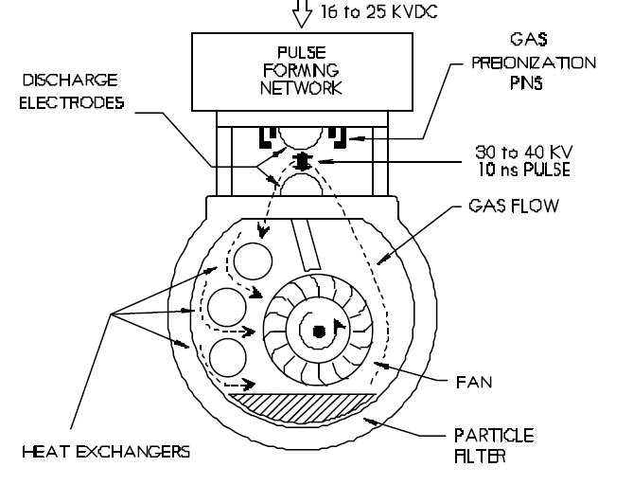
Entire Lasing cavity disassembled and cleaned.
Major deposits found in Particulate Filters.
Once cleaned, gas lifetime increased from 30 minutes to over 4 hours.
New problem arose from circulating fan bearings.

Slide 9
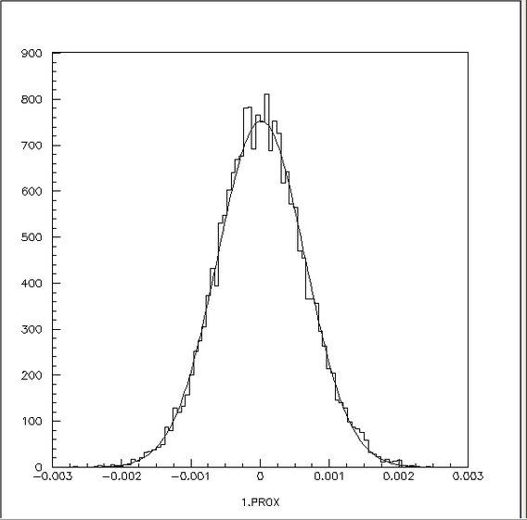
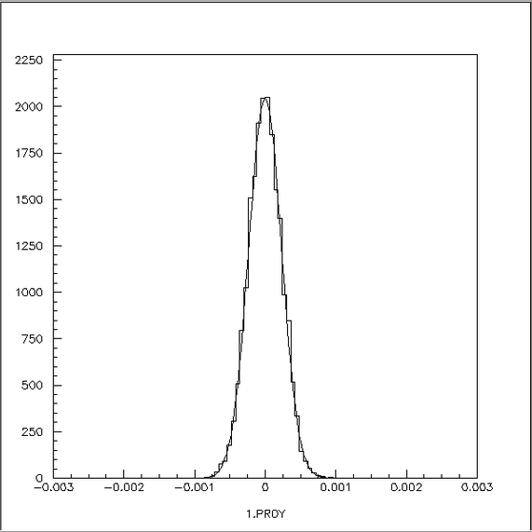
FORTRAN Simulated Beam Waist
Cross Section of Raw Beam from Excimer Laser
Cross Section of Focused Beam using 2”Fused Silica Lens
X Projection with Gaussian Fit of Focused Beam
Y Projection with Gaussian Fit of Focused Beam

Slide 10
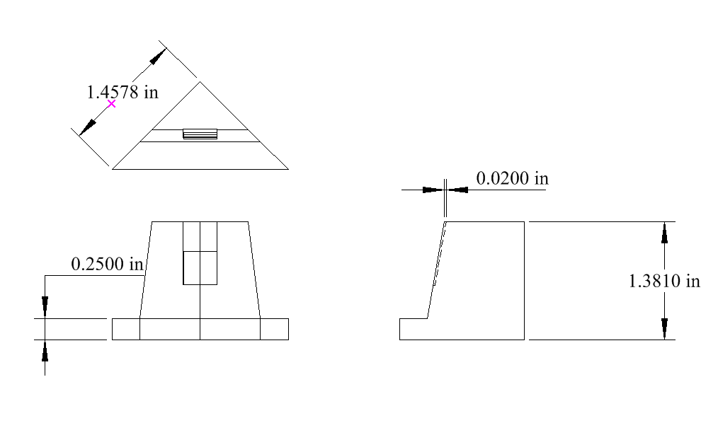
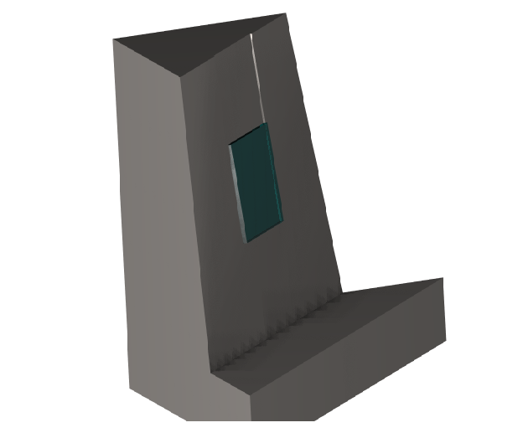
Diamond Mount
Design for easy installation/removal to ensure safety of the diamond work piece.
Diamond will be secured to “shelf” using thermal paste. Mount will also act as a thermal sink during the machining process.
Mount orients diamond 45⁰ to the incident beam keeping plume away from the entrance window of the chamber.
X Y translation stage keeps diamond in the waist of the focused beam.
10x10x0.2mm
Diamond Shelf

Slide 11
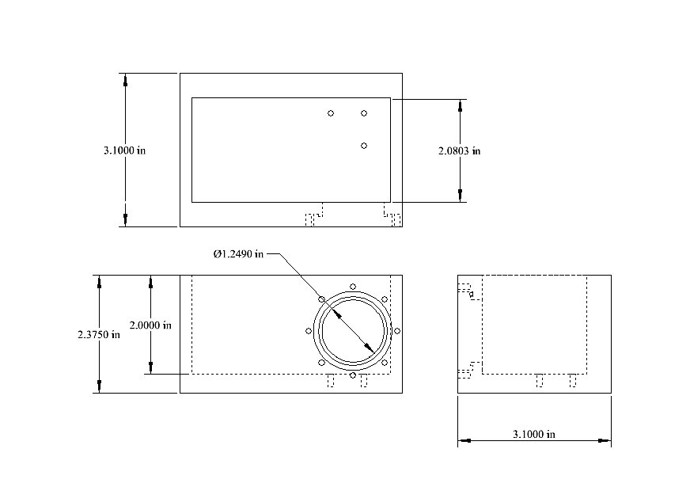
Ablation Chamber
6061 Aluminum Stock
Designed to be well within the weight limit of our translation stages and confidently expect smooth motion
Mounted to X Y translation (already purchased)
Ablation will occur under a vacuum of 0.1 mTorr
UV opaque Plexiglass will seal the top, serving as a viewing port.

Slide 12
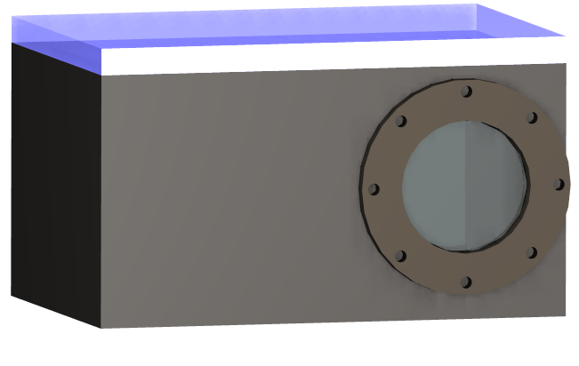
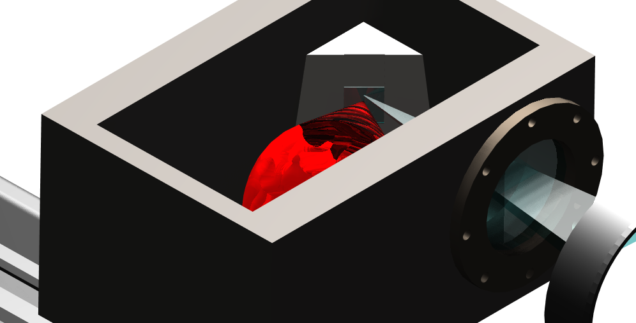
Ablation Chamber
UV fused silica entrance window.
Window piece designed for easy replacement in likely case of plume deposits.
Focused beam incident on 10x10mm diamond target.
Realistic plume (red) ejecting normal to the diamond blast zone.

Slide 13
Diamond Ablation Facility
Work now underway
Chilled water recirculator just received and to be installed this week.
Precision stages for raster have been purchased and tested using simple translation exercises.
Labview software for raster control is in development
Without major delays, ablation tests will begin by the end of the month.
increases maximum pulse rate to 50 Hz

Slide 14
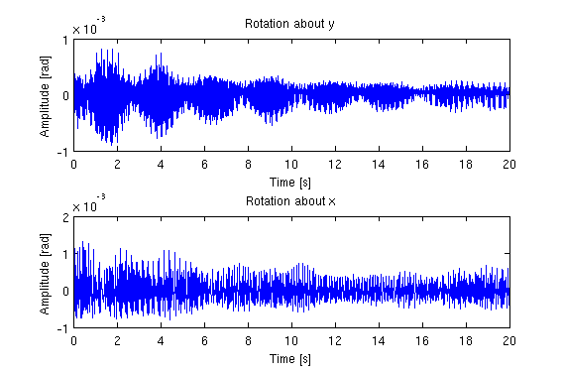
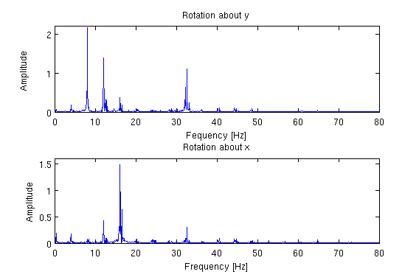
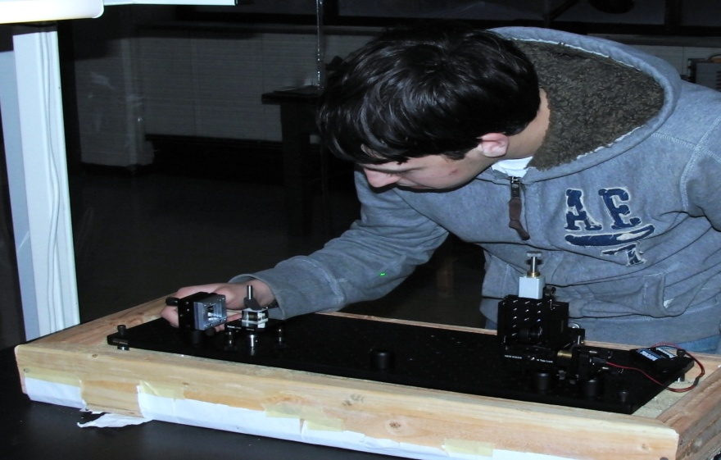
Vibrational Analysis of Wire Mounted Diamond
Developed a direct imaging technique to analyze vibration for different tensions
Constructed a wire tensioning apparatus to aid in analysis
Began analysis of vibration spectrum at different wire tensions
Vibration amplitude and frequency for T=.055N
Undergraduate research assistant Chris Pelletier

Slide 15
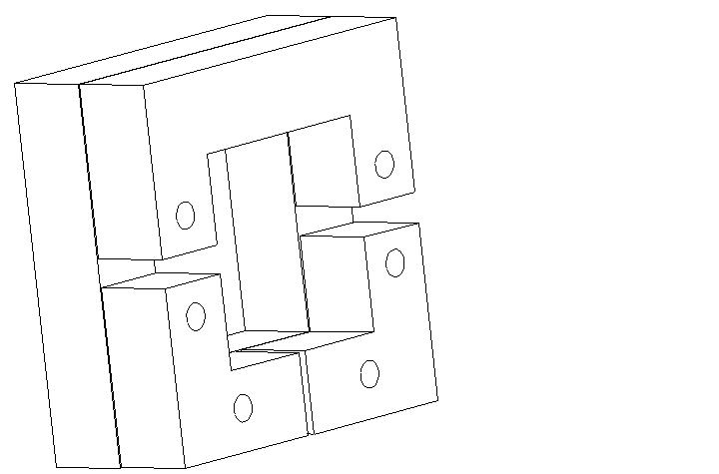
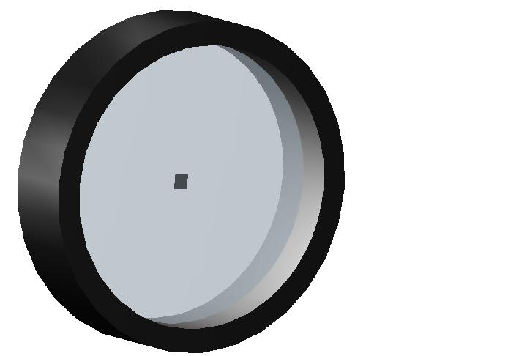
Mount for Crystallography at CHESS
Develop a Mylar mount for diamond x-ray analysis at CHESS
Allow for diamond to be mounted without stressing diamond
Cad image of new diamond mounts
Construction of smaller mounts to raise vibration frequency
Analyze vibration at differing wire configurations
Will analyze both different applied tensions (.055N to .35 N) and different number of fibers(5-15 fibers)
Rendered CAD image of ring mount for diamond analysis

Slide 16
Diamond assessment at CHESS
New run planned for March, 2011
Element Six 10 micron diamond (1)
Element Six 500 micron type IIa crystals (2)

Slide 17
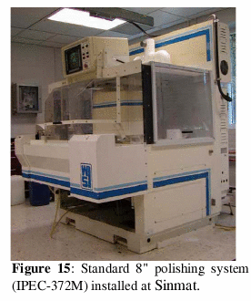
Parallel Radiator Developments
Small Business Innovation Research (SBIR) grant proposal submitted to DOE in November, 2009.
Phase I – one year, feasibility studies, $100K total with $30K for UConn to carry out assessment with X-rays at CHESS
Notice of grant awarded: April 2010 !
Commencing with phase II with more money for development
Company: Sinmat Inc
2153 SE Hawthorne Road, Suite 124 (Box 2)
Gainesville Fl 32641-7553
Phone / Fax : 352-334-7270
Principal Investigator: Arul Arjunan
Project Title: Defect Free, Ultra-Rapid Thinning/Polishing (20μm) of Diamond Crystal Radiator
Topic Number: 46 - Nuclear Physics Instrumentation, Detection Systems and Techniques
Sub-topic: e - Specialized Targets for Nuclear Physics Research

