Slide 1
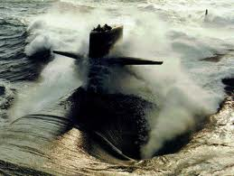
Spring 2011
Beam Test in Hall B
GlueX Collaboration Meeting
JLab, Feb. 2-4, 2011
James M^{c}Intyre
University of Connecticut

Slide 2
Outline
Update on Delivered Prototype to JLab
  Preparations for Beam Test
  Lessons Learned
Beam Test in Hall B
  Tagger Microscope
    Testing:
      Detector Alignment
      Readout
      Time Resolution
      Efficiency
      Cross-talk

Slide 3
Outline
Beam Test in Hall B (cont.)
  Active Collimator
    Overview of Design
    Goal:
      Determine Bandwidth Limits of the Position Readout
      Test Updated Readout
      Test the Spatial Resolution
      Confirm Diagnosis of Anomalies from 2007 Beam Test
J. M^{c}Intyre, GlueX collaboration meeting, JLab, Feb. 2-4, 2011

Slide 4
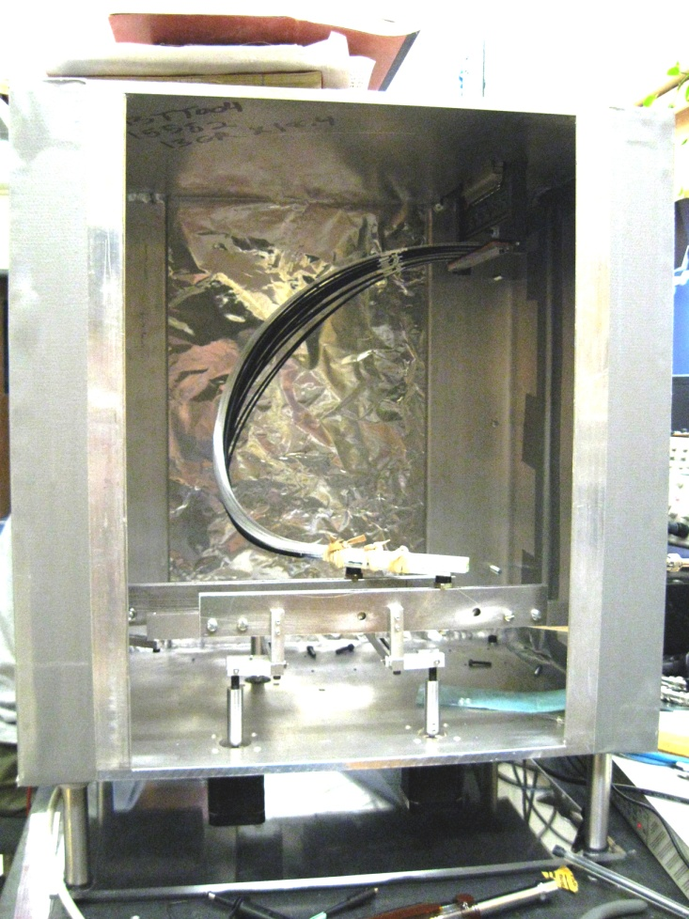
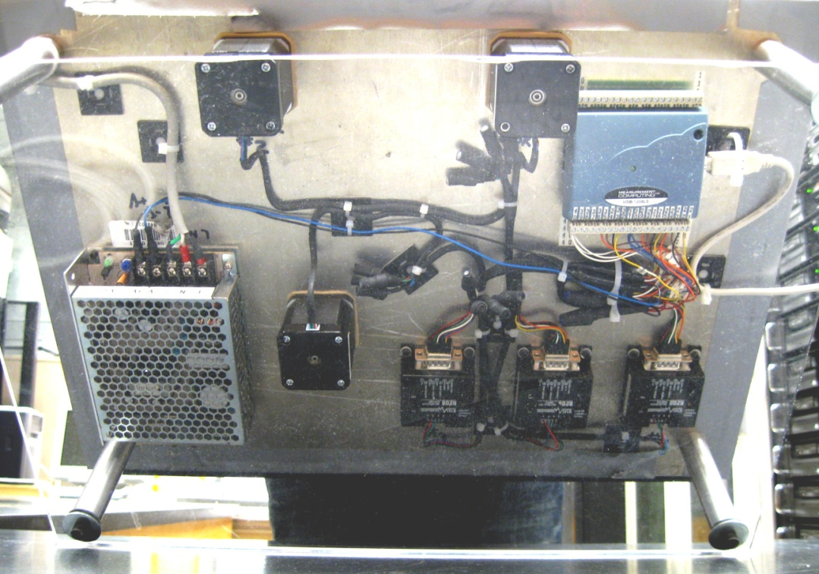
Update on Delivered Prototype to JLab
http://zeus.phys.uconn.edu/wiki/index.php/Delivery_of_the_Tagger_Microscope_Prototype_to_JLab
► Delivered to JLab on Oct. 7, 2010 ◄
Bottom: Electronics
Front: Interior View

Slide 5


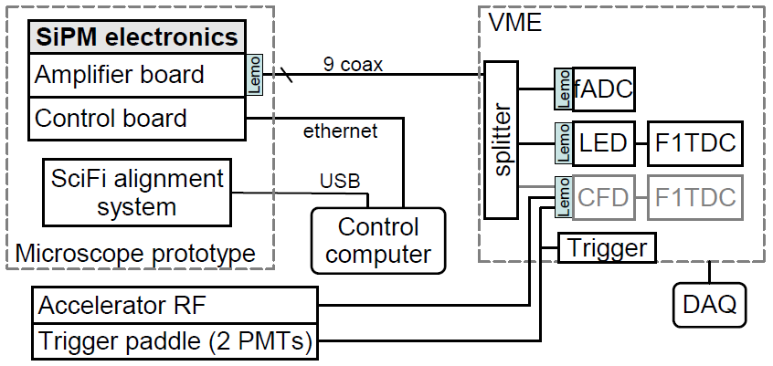
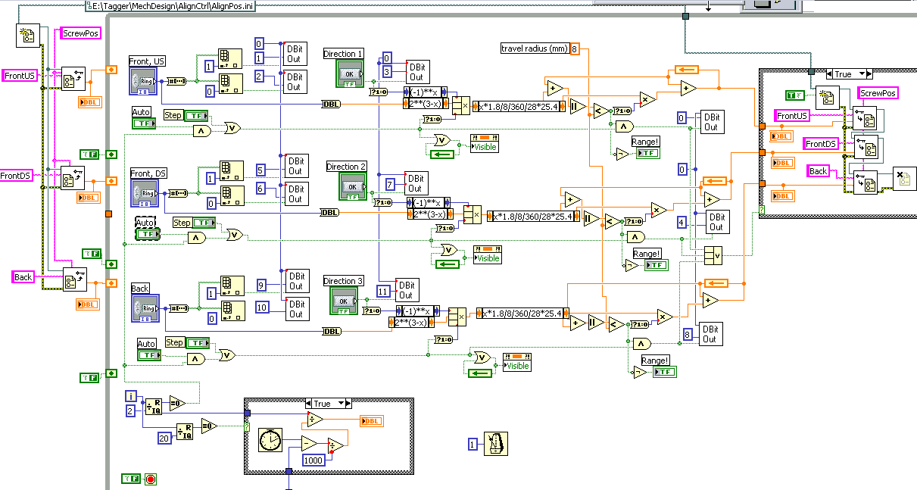
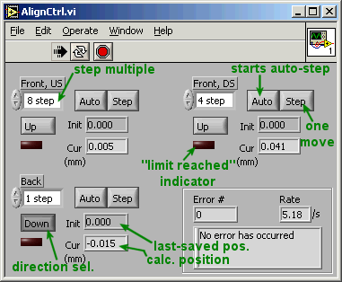
Update on Delivered Prototype to JLab
Preparations for Beam Test
Setup Control Computer
(Software setup on JLab computer as per JLab requirements)
    Setup Readout/Control for Tagger Microscope
      Installed controls for SiPM electronics
      Motor controls for alignment of SciFi focal plane

Slide 6
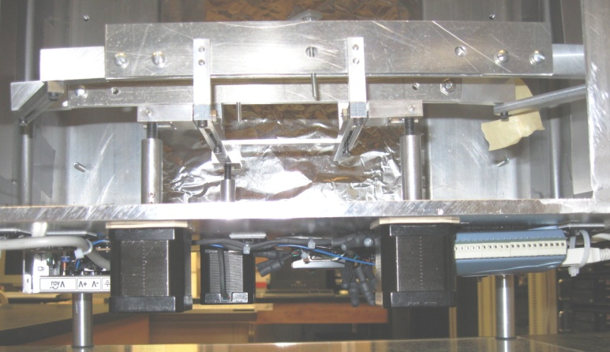
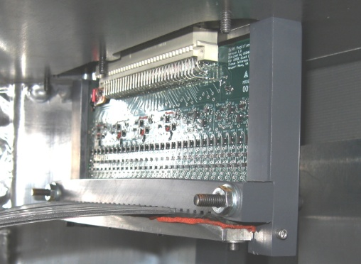
Update on Delivered Prototype to JLab
Preparations for Beam Test
Bench Tests Performed
  Verified:
    Ability to remotely control the step motors
    Appropriate implementation of motor limits
    Readout of the individual channels (pulse shape)
    Readout via fDAC and F1TDC

Slide 7
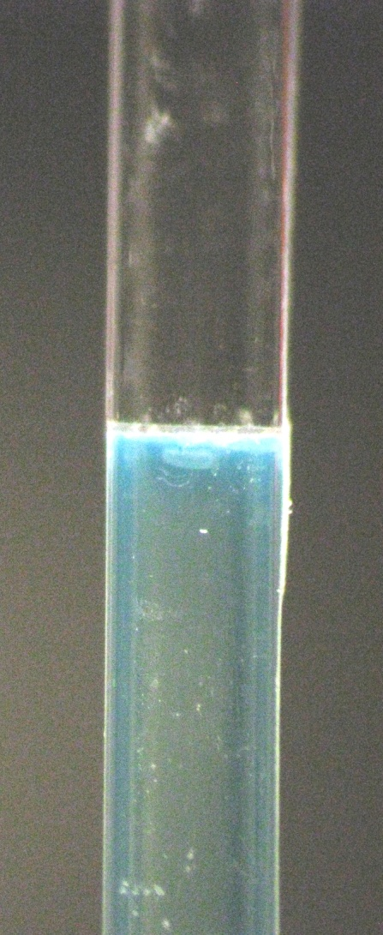
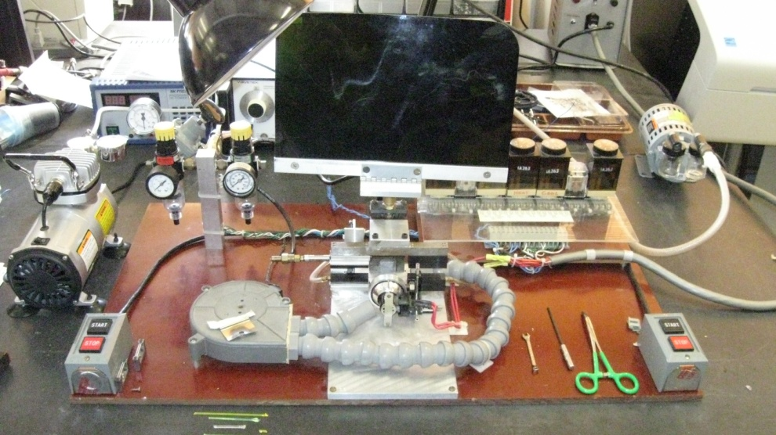
Update on Delivered Prototype to JLab
Lessons Learned
Fusing vs. Gluing of Fibers (MSU Splicing Unit)
  Discussed during May 2010 Collaboration Meeting
  Stronger SciFi/waveguide joint
  Better light transmission
    Air bubbles in glue & gluing gaps avoided
  Specialized glass ferrules designed & ready to order

Slide 8
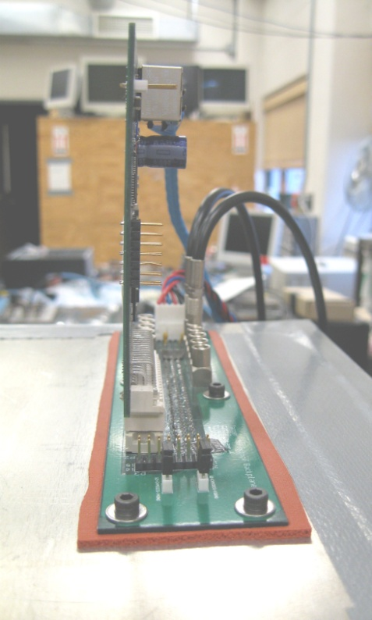
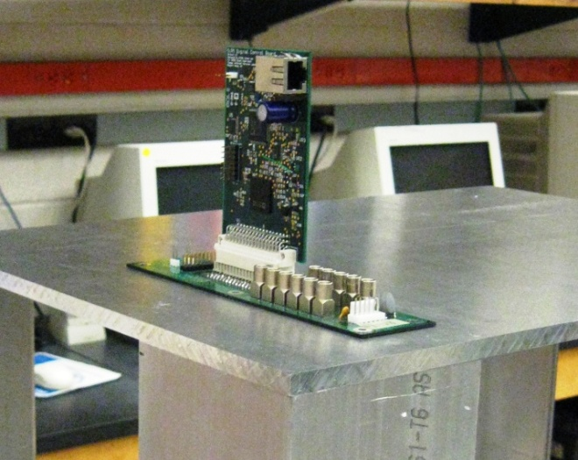
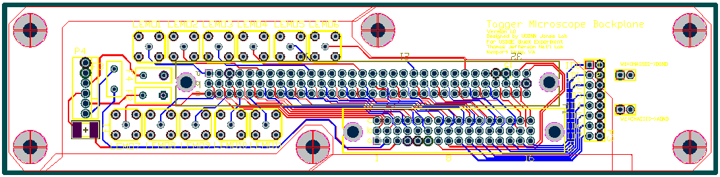
Update on Delivered Prototype to JLab
Lessons Learned
Board Layout Changes for Electronics
  Backplane Board
    Component clearances – Too conservative
    Components rearranged to provide better clearance through prototype top-plate

Slide 9

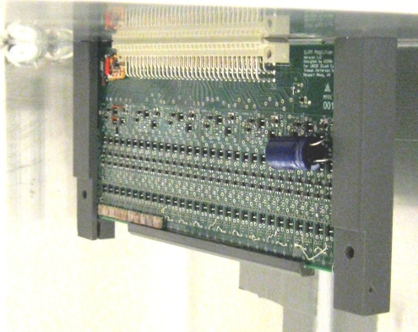
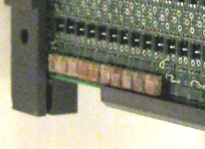
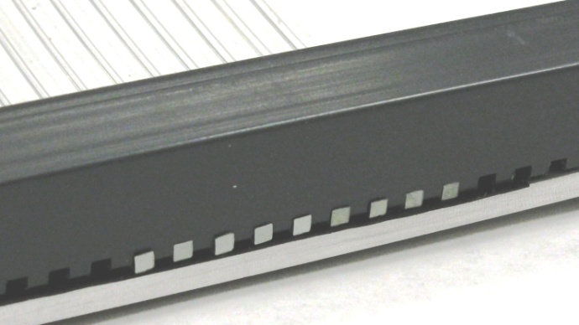
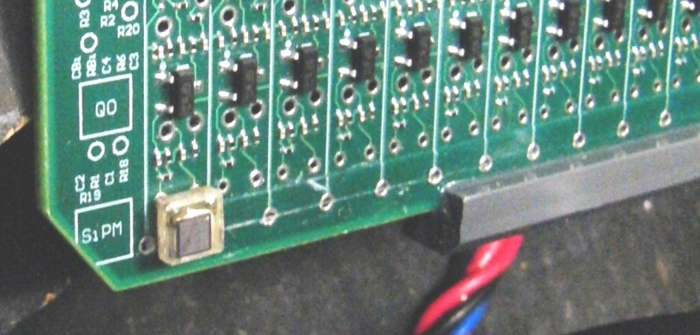
Update on Delivered Prototype to JLab
Lessons Learned
Board Layout Changes for Electronics
  Amplifier Board
  Changes to the board’s layout are being implemented:
  (Based on Fernando Barbosa’s recommendations)
    Decrease inductance by ...
      Optimization of layout/interconnections
        We saw some resonances in the amplifier spectrum & distinct ringing in the tail of the signals indicating inductance

Slide 10
Update on Delivered Prototype to JLab
Lessons Learned
Board Layout Changes for Electronics
  Amplifier Board
    Decrease cross-talk by...
      Optimize ground traces to improve Amp. circuit isolation
      Improved layout of transistor DC level distribution islands
      Spacing out the circuits, which is now possible due the new more spacious radiation-conscious chamber design

Slide 11
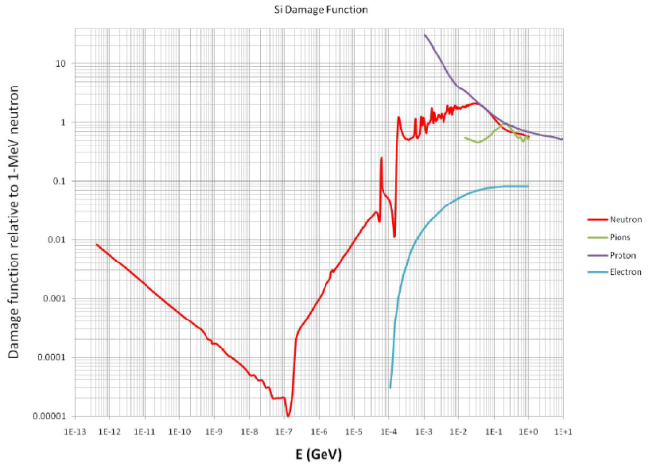
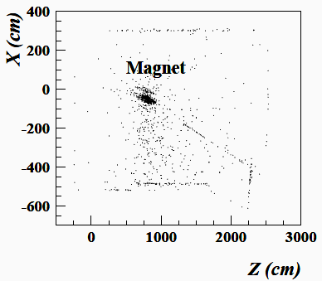
Update on Delivered Prototype to JLab
Lessons Learned
Neutron Radiation Damage to SiPMs
  SiPMs sensitive to neutron radiation
  GlueX-doc-1660-v2 ⇒ Calc. of radiation damage of SiPM in GlueX
  SiPM Radiation Hardness Test ⇒ To predict life-time of SiPM detectors
  Neutron background estimates
  GlueX-doc-1646-v1 ⇒ Neutron background estimates in tagger hall
  Solution ⇒ Separate and Shield Electronics (i.e. SiPMs)
Effective Damage to Si Detector
Relative to 1MeV neutron
Electron vacuum pipe to beam dump
Origin of neutrons which arrive in the Tagger Microscope area

Slide 12
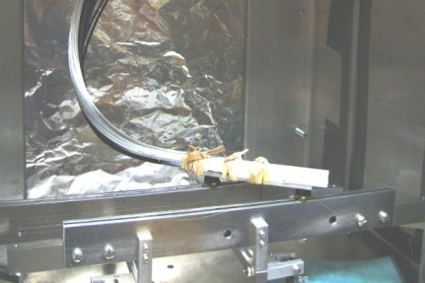
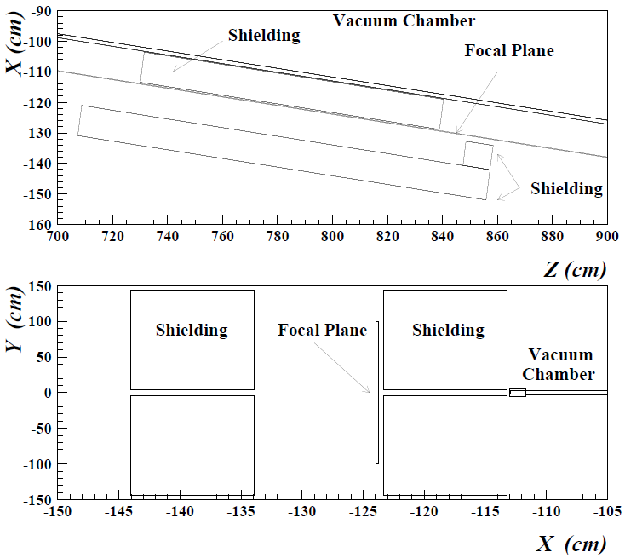

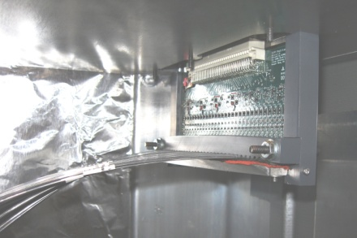
Update on Delivered Prototype to JLab
Lessons Learned
Neutron Shielding
Shielding Material
(Polyethylene)
Use concrete floor as shielding

Slide 13
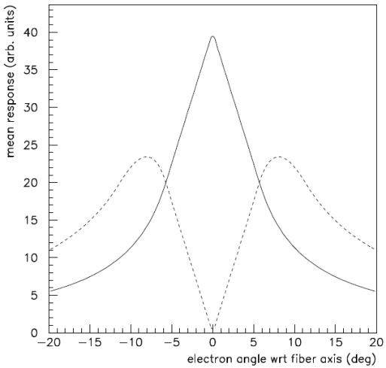
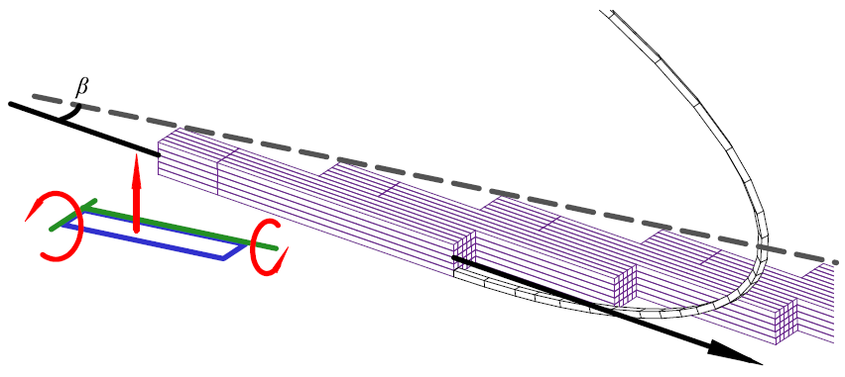
Beam Test in Hall B for Tagger Microscope
Tagger Microscope:
Performance Features Under Test
  Detector Alignment
    Simulations show that when fiber axis is aligned to < 3º of the e⁻ trajectory ⇒ Adjacent signal amplitudes have a factor of 3 separation
    Bench tests demonstrate alignment < 0.2º
  Readout
      First time SiPM signal will be read out with the designated GlueX fADC and F1TDC modules
      Examine the output on the equipment actually intended for reading out this detector
Fiber Bundle D.o.F.
e⁻
Trajectory

Slide 14
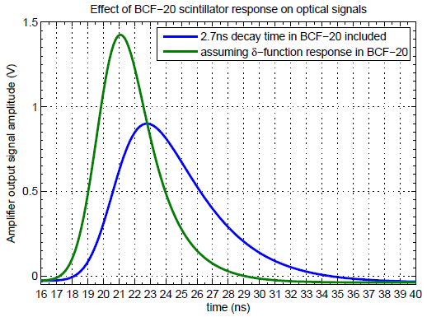
Beam Test in Hall B for Tagger Microscope
Tagger Microscope:
Performance Features Under Test
  Time Resolution
    Requirement: 200ps time resolution
    BCF-20 SciFi → decay time 2.7ns
    Collective photon emission time uncertainty goes as:
          2.7ns / √(N_{γ})
    ⇒ Minimum of 183 detected photons is required to meet 200ps time resolution specification
    Simulations predict the mean photoelectron count > 300

Slide 15
Beam Test in Hall B for Tagger Microscope
Tagger Microscope:
Performance Features Under Test
  Efficiency
    Random arrival, in a single channel, of tagging e⁻ result in the occasional overlap of these finite pulses
      ⇒ Resulting in the inability to resolve the two leading edges
    While calculations are effective → measurement of the pulse selection efficiency fed by pulses from an e⁻ beam would be extremely useful
  Cross-talk
      Need to investigate the degree of cross-talk between channels in a live beam
      Measure electronic cross-talk on the Amp. Board
      Measure optical cross-talk between adjacent fiber-SiPM junctions

Slide 16
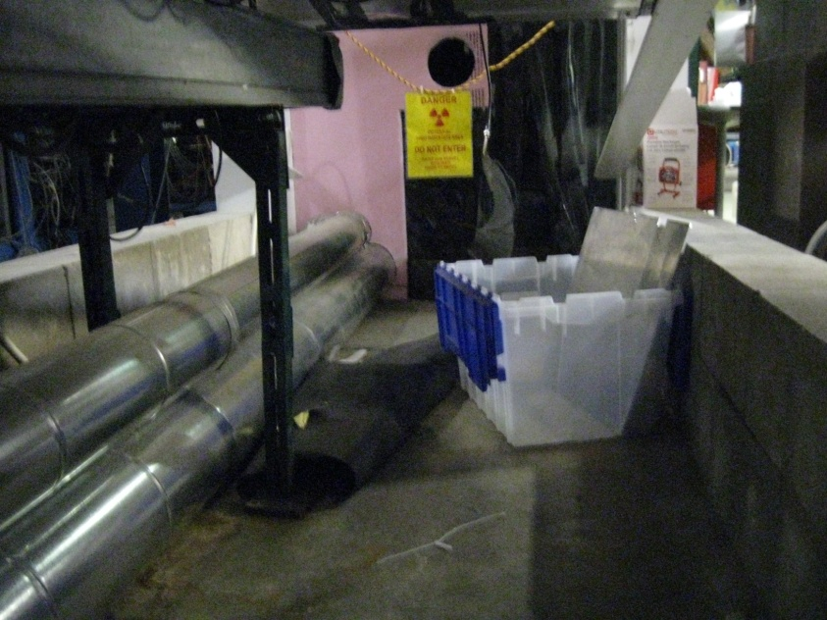
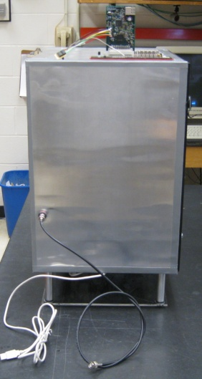
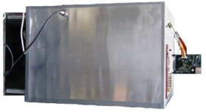
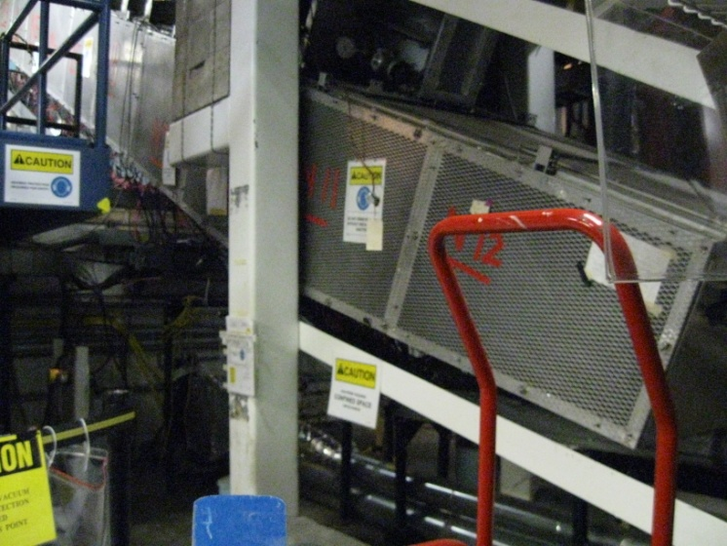
Beam Test in Hall B for Tagger Microscope
x

Slide 17
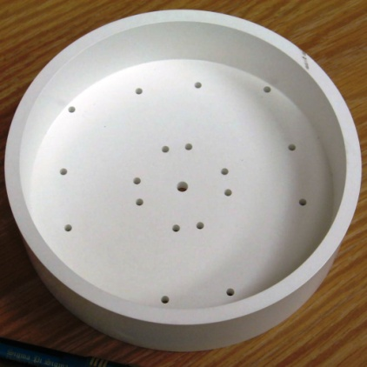
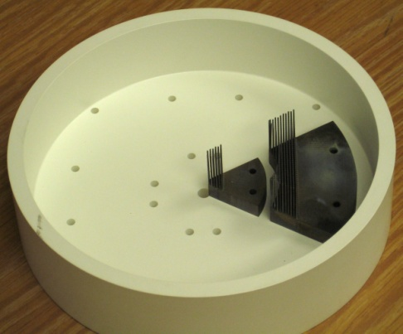
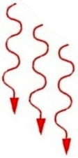
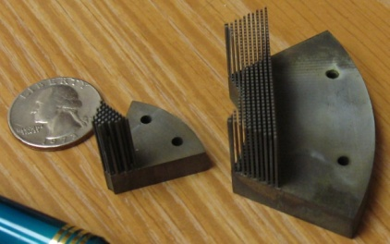

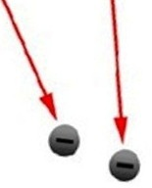
Active Collimator
γ Beam
Insulator
γ Beam
Φ 5mm.
Cathode
(+)
Tungsten
Tungsten Wedges
Active Collimator ▶ Photon beam position monitor which will provide feedback to magnets upstream to ensure we thread through the collimators to the target.
Ejected e⁻
Anode
(-)

Slide 18
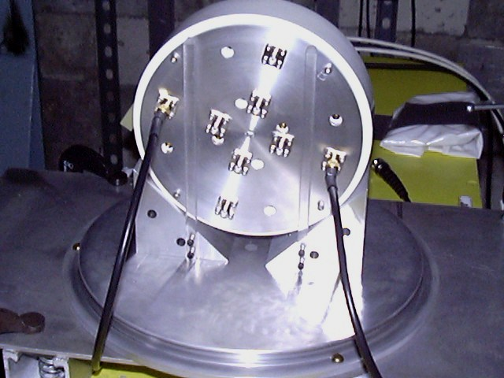
Beam Test in Hall B for Active Collimator
Active Collimator:
Parasitic Beam Test
    Goals:
      Test the readout which was updated to 4 of 8 instruments (Since 2007 beam test)
        Permits 2 complete opposing quadrants to be monitored continuously
      Test the spatial resolution of the device
        In absence of narrow upstream collimator
            (Present in 2007 beam test)

Slide 19
Beam Test in Hall B for Active Collimator
Active Collimator:
Parasitic Beam Test
    Goals:
      Determine the bandwidth limits of the position readout (signal noise vs. bandwidth of the detector signals)
        Will be used to stabilize the photon beam position in Hall D using a controlled feedback loop to electron beam correctors up stream of the radiator

Slide 20
Beam Test in Hall B for Active Collimator
Active Collimator:
Parasitic Beam Test
    Goals:
      Confirm anomalies in the 2007 beam test were correctly diagnosed and remedied successfully
        Larger than predicted currents (Good thing)
        (By Geant3 simulation)
          Factor of 3.5 higher
          Geant3 result was sensitive to the lower cutoff on the energy of the shower particles and deltas in the simulation
          The P.E.E. that dominates photon absorption at energies < 100 keV is a complex Z-dependent function of energy that is described in an average way by Geant3

Slide 21
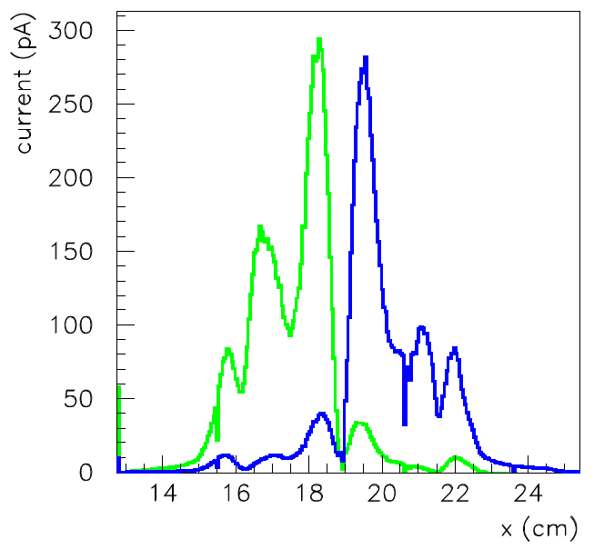
Beam Test in Hall B for Active Collimator
Active Collimator:
Parasitic Beam Test
    Goals:
      Confirm anomalies in the 2007 beam test were correctly diagnosed and remedied successfully
        Cross-talk
          Relatively large response on inner wedge when the photon beam interacts in the outer wedge
          (peaks at 15.5cm & 22.0cm)
          Simulation < 5% of peak current vs. ~ 25% during beam test
          Possibility that the photon beam directed on the wedge not being readout caused charges to built up to a high voltage . Surface leakage currents drained the charge along the insulator to the nearest path to ground (which was through the adjacent wedge connected to the readout).

Slide 22
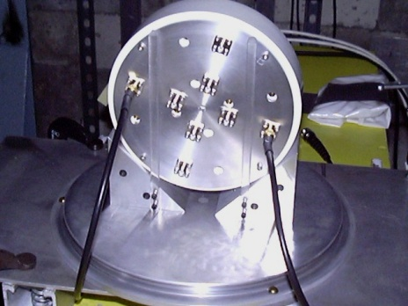
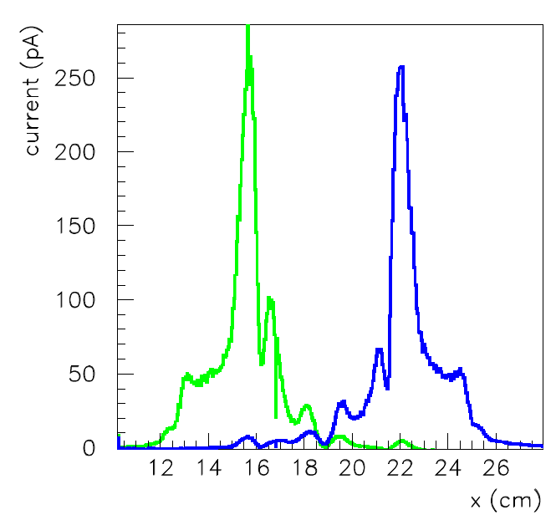
Beam Test in Hall B for Active Collimator
Active Collimator:
Parasitic Beam Test
    Goals:
      Confirm anomalies in the 2007 beam test were correctly diagnosed and remedied successfully
        Middle Peaks (Remedy: Use of 90º Connectors)
          Peaks seen at 16.5cm & 21.0cm on both the inner and outer wedge readouts
          Possibility that the readout cables hanging down in front of the detector acted as a pre-shower. The asymmetry between left and right most likely comes from the fact that one cable (16.5cm) hangs down from above, while the other (21.0cm) starts out from below, the center of the photon beam. Therefore one interacts with a smaller fraction of the beam than the other.
Current measured on two outer wedges

Slide 23
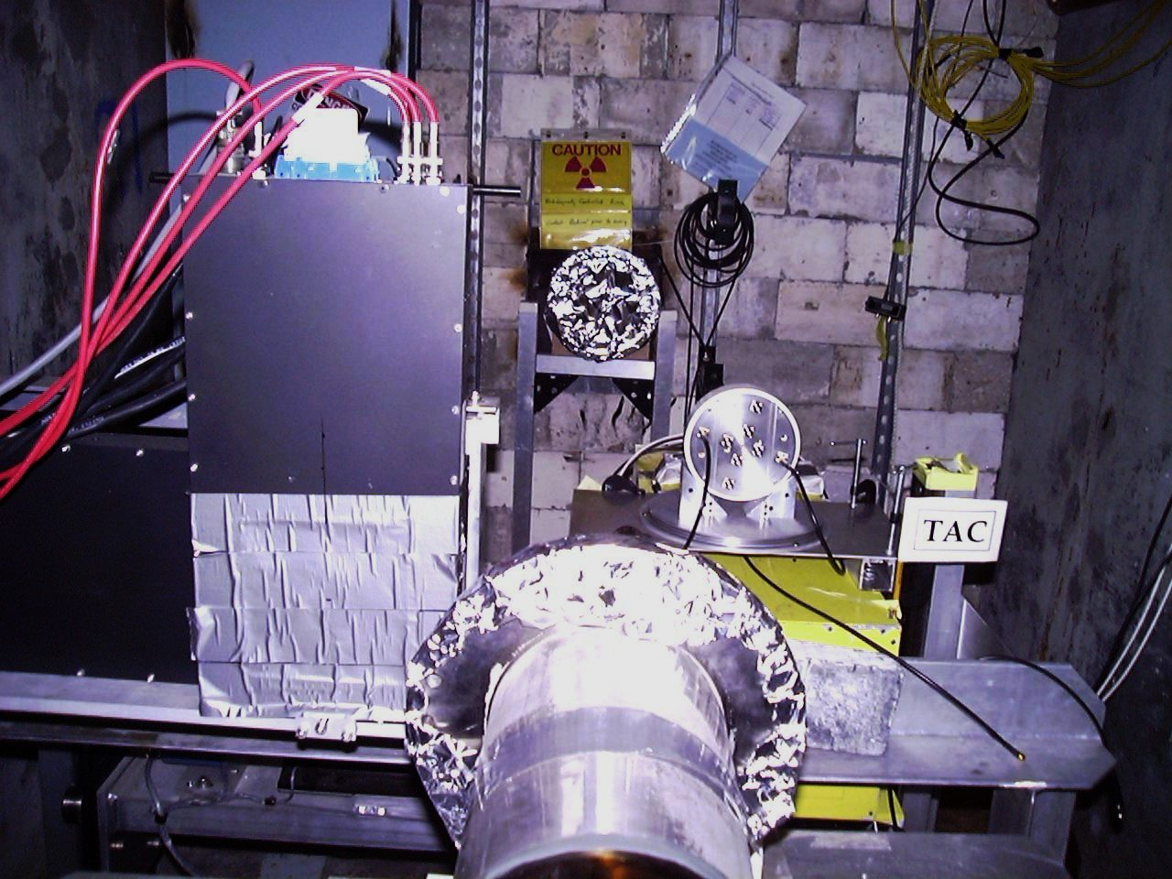
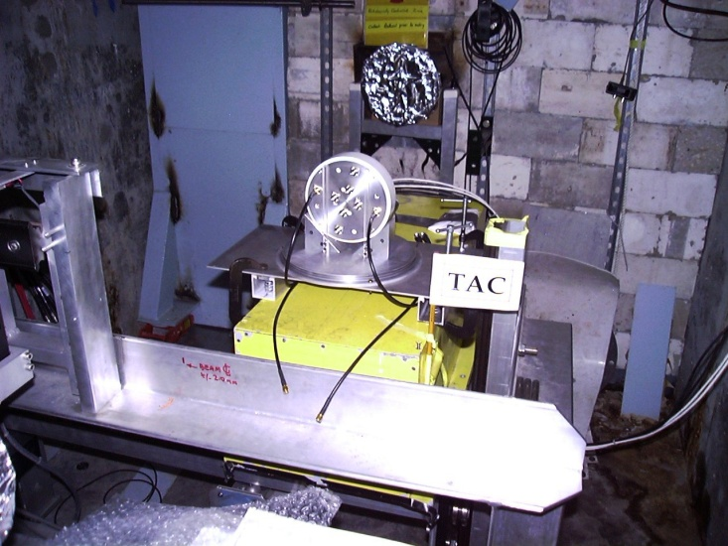
Beam Test in Hall B for Active Collimator
Beam Dump
Beam line

Slide 24
Questions?

