Slide 1
Geant4: CAD generated volumes & Lightguides
SiLab UTFSM
November 2009

Slide 2
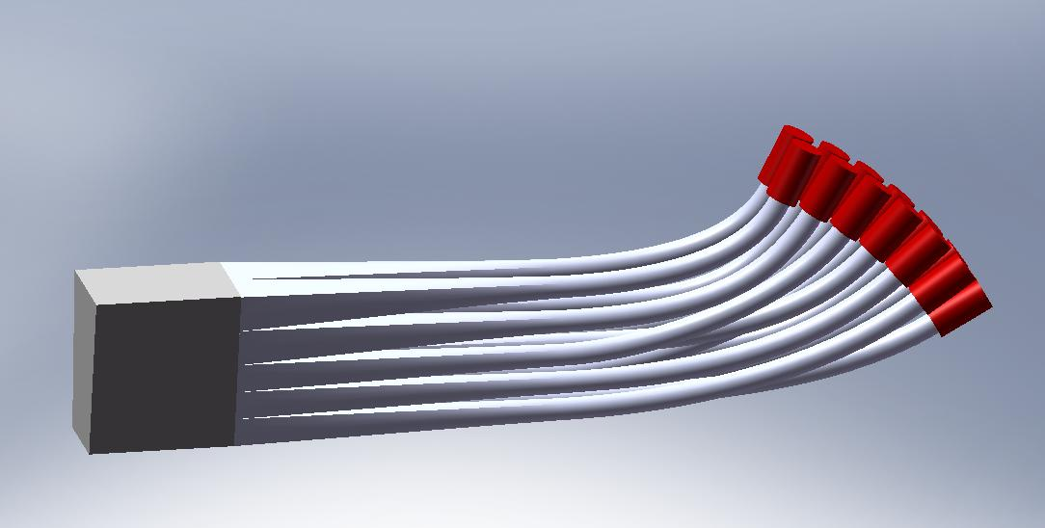
Solidworks: Lightguide proposal (Pedro Toledo’s geometry description in Solidworks)

Slide 3
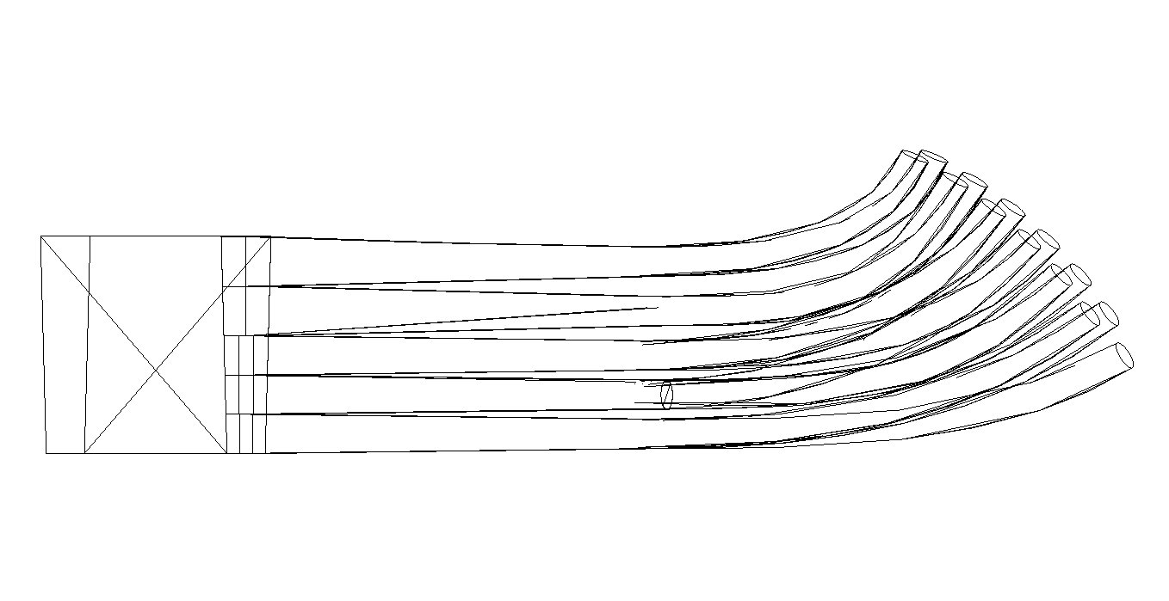
Solidworks export & Geant4 GDML import
Solidworks allows STEP export (Standard geometry description).
Using Fastrad, it is possible to tessellate the volume and import into a Geant4 using GDML.
Geant4 output:

Slide 4
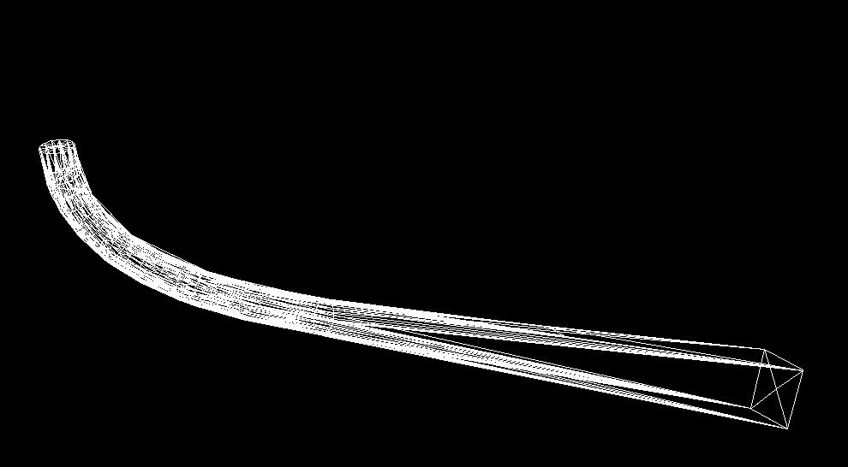
One Lightguide.
Geant4 output image of a section.

Slide 5
Optical photons
A source is placed inside the lightguide
Rays are generated inside a solid angle.
Energy of 3[eV] per photon
Random polarization.
Next image shows simulation:

Slide 6
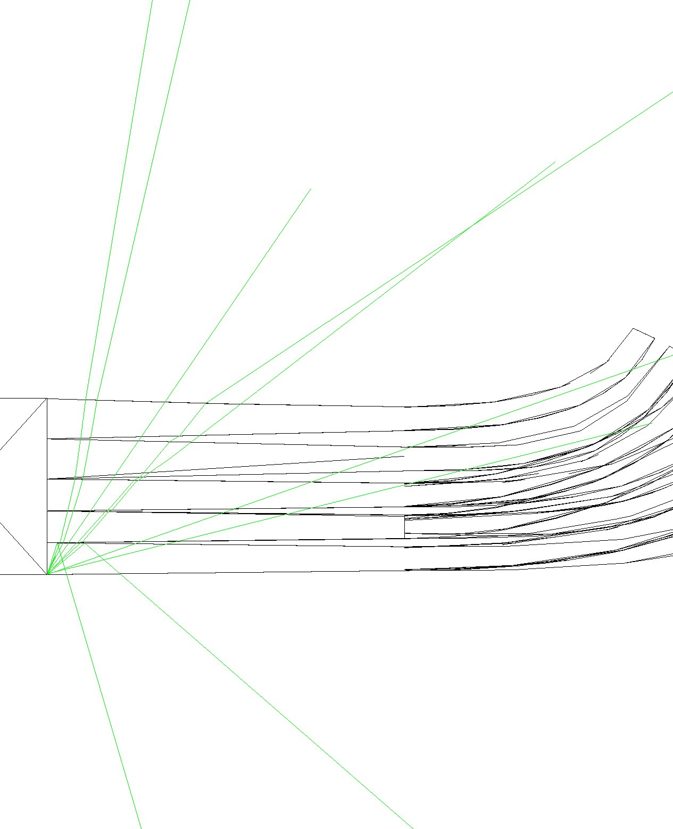

Slide 7
Optical photons inside Lightguide. Simulations don’t work?!
Lightguide material: Plexiglas (index of refraction used 1.5)
Outside material: Air (index of refraction used 1.0)
In the previous image there should be more internal reflections. This is not happening - there is a serious problem.
No bugs reports about this problem, neither persons with the same problem in the official discussion list.
Tests are made to find the problem.

Slide 8
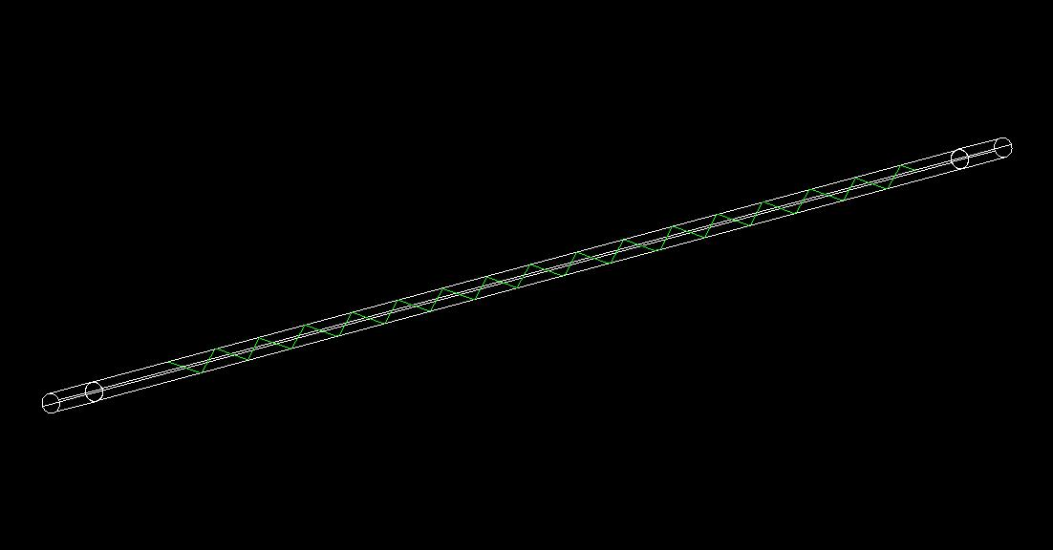
Simple simulations:
Geometry description: G4Tube
Same materials description
Same optical photon source.
Results:
Working. Showing plexiglas photon absorption.

Slide 9
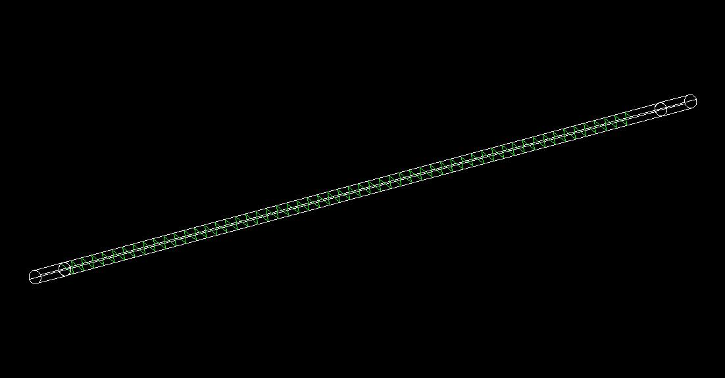
Simple simulations:
Geometry description: G4Tube
Same materials description
Same optical photon source.
Results:
Working. Showing PMT photon detection (And absorption in it).

Slide 10
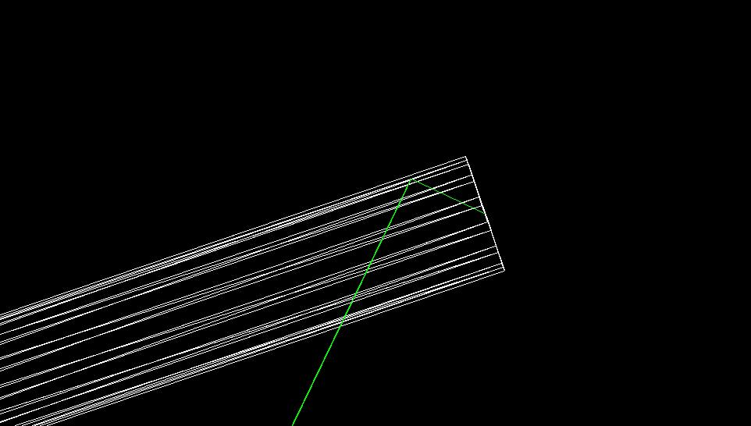
Simple simulations:
Geometry description: CAD description imported to GDML Geant4
Same materials description
Same optical photon source.
Results:
Not Working. There should be a reflection there.
Photon Source

Slide 11
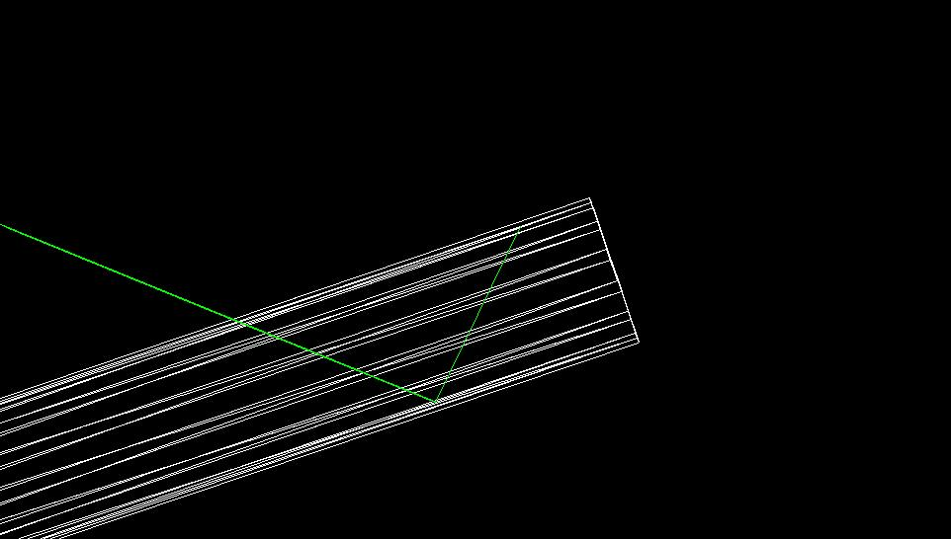
Simple simulations: Forcing photon where the internal reflection is expected in previous simulation
Geometry description: CAD description imported to GDML Geant4
Same materials description
Results:
Not Working. There should be a reflection there.
Photon Source

Slide 12
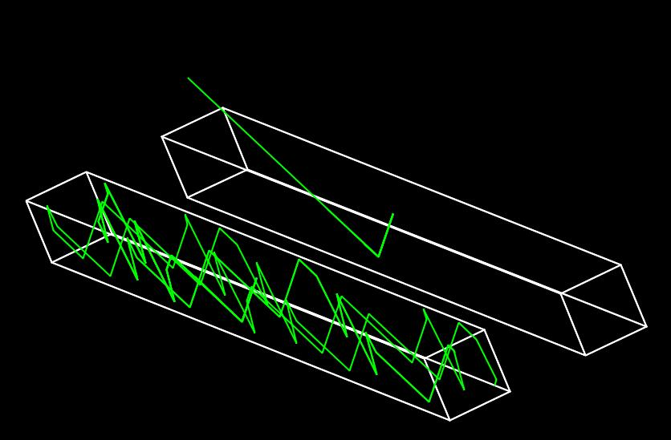
Finally: G4Box vs G4TessellatedSolid Exact same conditions. G4TessellatedSolid do not work with optical photons correctly.

Slide 13
Conclusions:
We have geometry imported from SolidWorks output in GDML format.
There is implementation problem with optical photons with objects of type G4TessellatedSolid, which will be solved by Geant4 development team.
Once the previous is done we will have a complete simulation of the lightguide in Geant4.

