Slide 1
Trigger Interface and Distribution
1. What is TID
2. TID Structure and functions
3. Possible usage in the system
4. TID related boards (Mezz and FANIO)
5. Status
J. William Gu
Jefferson Lab

Slide 2
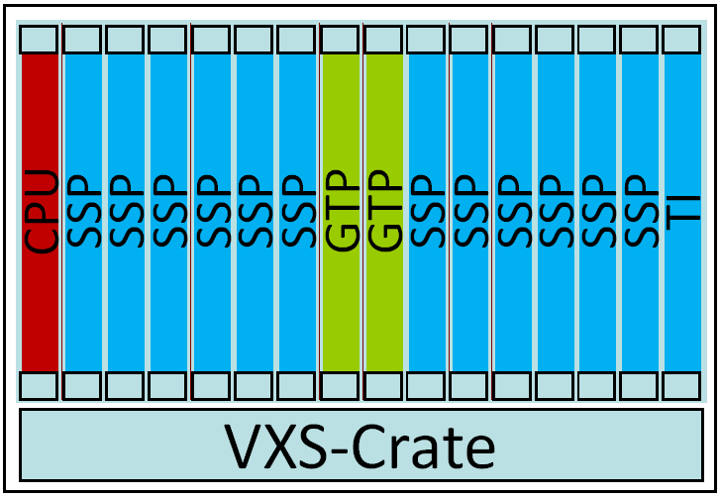
1. What is TID
V
M
E
T
ID
T
ID
T
ID
T
ID
T
ID
T
ID
T
ID
T
ID
SD
T
ID
T
ID
T
ID
T
ID
T
ID
T
ID
T
ID
T
ID
TS
V
M
E
ADC/TDC
ADC/TDC
ADC/TDC
ADC/TDC
ADC/TDC
ADC/TDC
ADC/TDC
ADC/TDC
CTP
SD
ADC/TDC
ADC/TDC
ADC/TDC
ADC/TDC
ADC/TDC
ADC/TDC
ADC/TDC
ADC/TDC
T
ID
V
M
E
ADC/TDC
ADC/TDC
ADC/TDC
ADC/TDC
ADC/TDC
ADC/TDC
ADC/TDC
ADC/TDC
CTP
SD
ADC/TDC
ADC/TDC
ADC/TDC
ADC/TDC
ADC/TDC
ADC/TDC
ADC/TDC
ADC/TDC
T
ID
Upto 127 front end crates
Trigger Interface (TI) + trigger Distribution (TD) = TID
TID has some Trigger Supervisor functions

Slide 3
2. TID Structure and functions
VME→PROM
(FPGA firmware)
Emergency/remote
re-programming
TrgSv Rev. 2 interface
Xilinx Virtex-5
LX30T-FG665
VME 64x
Optical IO
HFBR-7924
#1,#2,#3,#4,
#5,#6,#7,#8
VXS P0
TD mode: from SD
TI/TS mode: to SD
One dedicated link for redundant data collection
External I/O
(trg, clk…)
Trg/Clk/Syc
outputs
On row_C

Slide 4
2. TID Structure and functions
HFBR_1
MC100LVEP111
HFBR_2
2.1 Clock Distribution
HFBR_3
P0_SD_CLK_IN
HFBR_4
CLK_OSC
HFBR_5
MC100EP57
TID_SELECT
TS_CLK
HFBR_6
HFBR_7
SUBSYS_CLK
CLK250_1
HFBR_8
External_In
AD9510
CLK1_in
SyncCLK
CLKSEL[1:0]
CLK2AD
CLK2_in
CLK2AD
CLKFPGAR
CLK250_2
P0_CLKA
ON_NB4N840
& SY55857
CLKFPGA
CLK125
P0_CLKC
SY58607
CLK250_P2
CLK250_3
ASEL[1:0]
CLKTDC_P2
CLKTDC
CLK_FREQ1
P0_CLKB
CLKADC_P2
CLK3125
P0_CLKD
CLK_FREQ2
CLKADC
BSEL[1:0]

Slide 5
2. TID Structure and functions
MC100LVEP14
HFBR#5
2.2 TD mode, trigger fanout
HFBR#6
P0
SD_TRG_IN
ADN2805
SY58607
HFBR#7
HFBR#8
Sel3
FPGA
GTP#5_TX
MC100LVEP14
HFBR#1
Front Panel
Ex_TRG_IN
GTP#5_RX
HFBR#2
GTP#1_TX
HFBR#3
GTP#1_RX
HFBR#4
Mezz. (Rev2)
TS2_TRG_IN
Sel2
MC100LVEP14
TRG1A
GTP#3_TX
TRG1B
P2_TRG1
FPGA_TRIG_1
F1_TRG
FADC_TRG
Sel1

Slide 6
HFBR-7934
#1
2. TID Structure and functions
RX
TX
GTP connection details:
All the eight fibers are connected to the FPGA, they are status input and trigger output in TD mode; and trigger input and status output in TI mode.
(different FPGA firmware)
FPGA
XC5VLX30T
GTP#1
MC100EP14
GTP#2
GTP#3
HFBR-7934
#4
GTP#4
RX
TX
GTP#5
GTP#6
GTP#7
GTP#8
HFBR-7934
#5
RX
TX
MC100EP14
TRIG1
TRIG2
HFBR-7934
#8
WARNING/BUSY
RX
TX
MC100EP11
TS_SD_P0_FAN_IN

Slide 7
2. TID Structure and functions
2.3 Sync signal distribution
The encoding/decoding is implemented in the FPGA, synchronized to the 250MHz clock
MC100EP14
P0_SyncA
TD_CLKSYNC
SEL
I_delay
Manchester
decoding
Sync
decoding
P0_SyncB
P2_Sync
FP_Sync1
Ext_Sync
Encoding
Mux
O_delay
FP_Sync2
P0_CLKSYNC
I_delay
Manchester
encoding
O_delay
MC100LVEP111
HFBR7924#1
HFBR7924#2
FPGA
HFBR7924#8

Slide 8
2. TID Structure and functions
Trigger synchronization on trigger interface using SYNC signal
A FIFO (built in the FPGA) is used to compensate for the DES. latency
WORD 5
WORD 4
WORD 3
WORD 2
WORD 8
WORD 7
FIFO 1
WORD 6
WORD 1
WORD 0
Fiber 1T
HFBR
Fiber 1R
HFBR
Des.
T-WORD 14
T-WORD 13
T-WORD 12
WORD 11
WORD 10
WORD 9
Ser
WORD 5
FIFO n
WORD 1
WORD 0
Fiber nT
HFBR
Fiber nR
HFBR
Des.
WORD 8
WORD 7
WORD 6
WORD 4
WORD 3
WORD 2

Slide 9
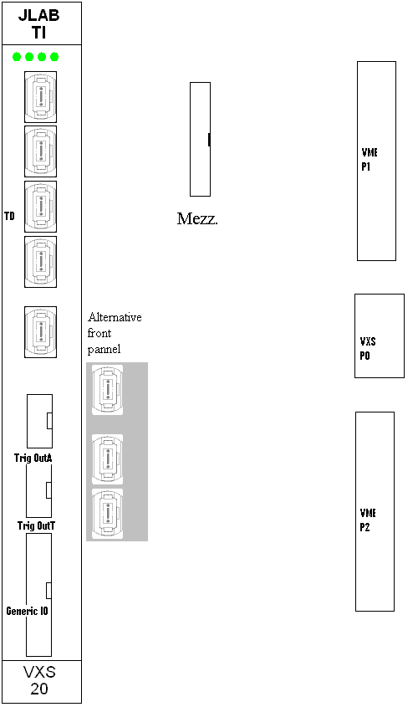
2. TID Structure and functions
2.4 Front panel:
The front panel will look like the drawing at the right. There are eight optical transceivers in TD mode, and one (or two) optical transceivers plus copper cable connectors in TI mode.
2.5 Other features:
(always availableTM ) VME remote loading firmware;
Serial links to switch slot#A, switch slot#B;
Potential fast data link to SD;

Slide 10
3. Possible usage in the system
3.1 Standard experiment setup:
This is the same content drawing as in page 2
Front End Readout Crate
Trg/Clk/Sync
ADC/TDC
BUSY
Trg/Clk/Sync
TID1
Trg/Clk/Sync
TID1
Trg/Clk/Sync
SD
BUSY
BUSY
BUSY
ADC/TDC
TID2
TID2
Up to 16
ADC/TDC
Up to 8
TS
SD
Trg/Clk/Sync
TID8
One Distribution Crate;
Up to 127 Front End Crate,
Plus the global trigger crate.
BUSY
Up to 16
TID16
TID Boards
Global Trigger Distribution Crate

Slide 11
3. Possible usage in the system
3.2 Commissioning/testing setup (or a small DAQ system)
Up to 9 (front end) crates in total
Front End Crates
V
M
E
ADC/TDC
ADC/TDC
ADC/TDC
ADC/TDC
ADC/TDC
ADC/TDC
ADC/TDC
ADC/TDC
SD
ADC/TDC
ADC/TDC
ADC/TDC
ADC/TDC
ADC/TDC
ADC/TDC
ADC/TDC
ADC/TDC
T
ID
Front End Crate
V
M
E
ADC/TDC
ADC/TDC
ADC/TDC
ADC/TDC
ADC/TDC
ADC/TDC
ADC/TDC
ADC/TDC
SD
ADC/TDC
ADC/TDC
ADC/TDC
ADC/TDC
ADC/TDC
ADC/TDC
ADC/TDC
ADC/TDC
T
ID
/TS
Up to 8 crates
TID as TI (this crate)
and TD (up to 8 other crates)
with TS function
V
M
E
ADC/TDC
ADC/TDC
ADC/TDC
ADC/TDC
ADC/TDC
ADC/TDC
ADC/TDC
ADC/TDC
SD
ADC/TDC
ADC/TDC
ADC/TDC
ADC/TDC
ADC/TDC
ADC/TDC
ADC/TDC
ADC/TDC
T
ID

Slide 12
3. Possible usage in the system
3.3 Luxury option: parallel subsystem and global control; doubling the number of optical transceivers (expensive)
V
M
E
T
ID
T
ID
T
ID
T
ID
T
ID
T
ID
T
ID
T
ID
SD
T
ID
T
ID
T
ID
T
ID
T
ID
T
ID
T
ID
T
ID
TS
Global Distribution Crate
Up to 16 TIDs
Front End Crates
V
M
E
ADC/TDC
ADC/TDC
ADC/TDC
ADC/TDC
ADC/TDC
ADC/TDC
ADC/TDC
ADC/TDC
SD
ADC/TDC
ADC/TDC
ADC/TDC
ADC/TDC
ADC/TDC
ADC/TDC
ADC/TDC
ADC/TDC
T
ID
V
M
E
ADC/TDC
ADC/TDC
ADC/TDC
ADC/TDC
ADC/TDC
ADC/TDC
ADC/TDC
ADC/TDC
SD
ADC/TDC
ADC/TDC
ADC/TDC
ADC/TDC
ADC/TDC
ADC/TDC
ADC/TDC
ADC/TDC
T
ID
Up to 8 crates
Up to 8 crates
V
M
E
ADC/TDC
ADC/TDC
ADC/TDC
ADC/TDC
ADC/TDC
ADC/TDC
ADC/TDC
ADC/TDC
SD
ADC/TDC
ADC/TDC
ADC/TDC
TID/TS
ADC/TDC
ADC/TDC
ADC/TDC
ADC/TDC
T
ID
V
M
E
ADC/TDC
ADC/TDC
ADC/TDC
ADC/TDC
TID/TS
ADC/TDC
ADC/TDC
ADC/TDC
SD
ADC/TDC
ADC/TDC
ADC/TDC
ADC/TDC
ADC/TDC
ADC/TDC
ADC/TDC
ADC/TDC
T
ID
One global distribution crate,
Up to 127 front end crates
One TID/TS per subsystem with Up to 8 crates
(It is not required for the subsystem to have
its global inputs from the same TID)

Slide 13
4. TID related boards (Mezz and FANIO)
4.1 Mezzanine board for TS_Rev2 interface
Same connector and jumpers, same component (different package type) as TI_rev2 board;
With the Mezzanine board, this TID will behave like a TI_Rev2 board, to work with TS_rev2.
Board size: 2¼” x 3¼”
How many mezz. Boards do we need?
_____

Slide 14
4. TID related boards (Mezz and FANIO)
4.2 Fan out board (VME sized board) for CAEN 1290 TDC
It fans out the TRIGGER, CLOCK (41.7MHz), RESET signals;
It merges the BUSY signals (OR);
It communicates with VME P2 connectors (with TID);
It supports up to 16 CAEN TDCs;
One 64-pin cable (on FANIO board)
➔ four 16-pin cables (on CAEN 1290)
How many fanout boards do we need?
________
#1 #5
#2 #6
#3 #7
#4 #8
#9 #13
#10 #14
VME P2
#11 #15
#12 #16

Slide 15
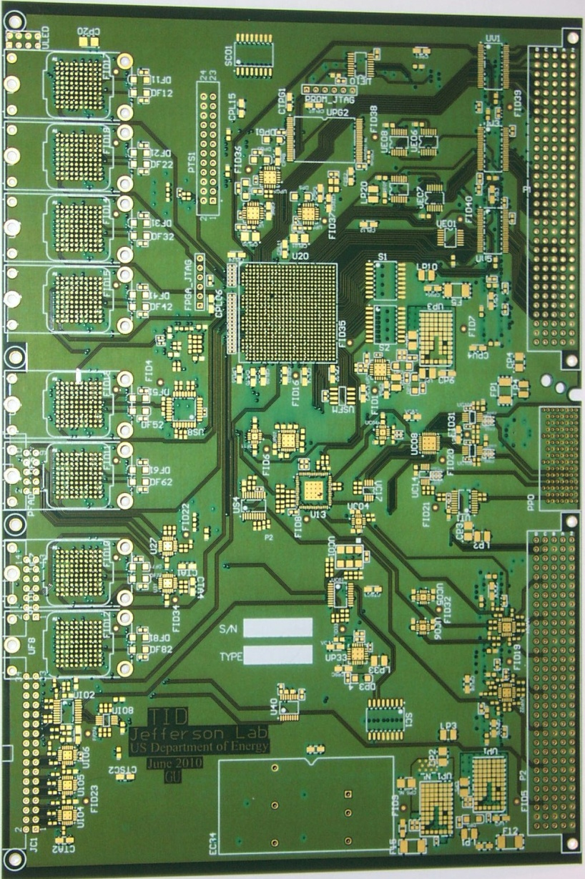
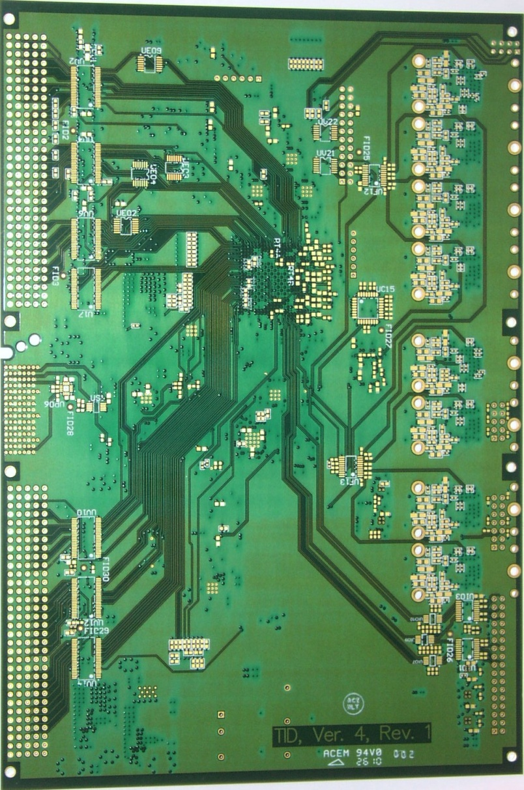
5. Status
4 pieces are manufactured, two PCBs are being assembled;
Board test starts next week

