Slide 1
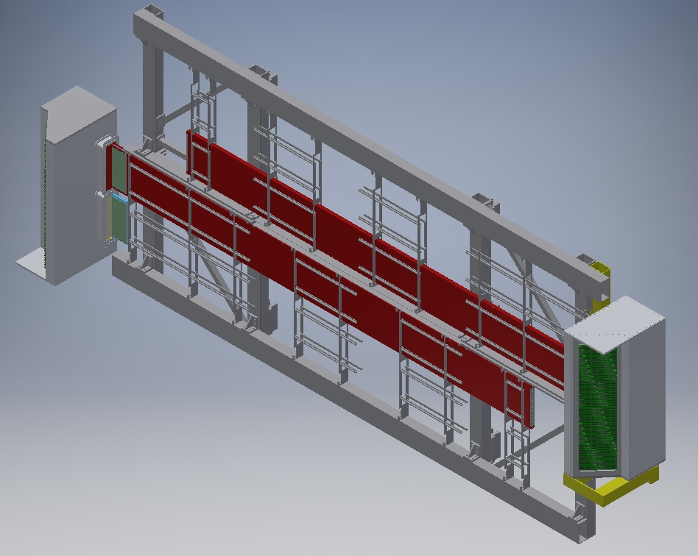
JUNE 30 – DOWNSTREAM VIEW

Slide 2
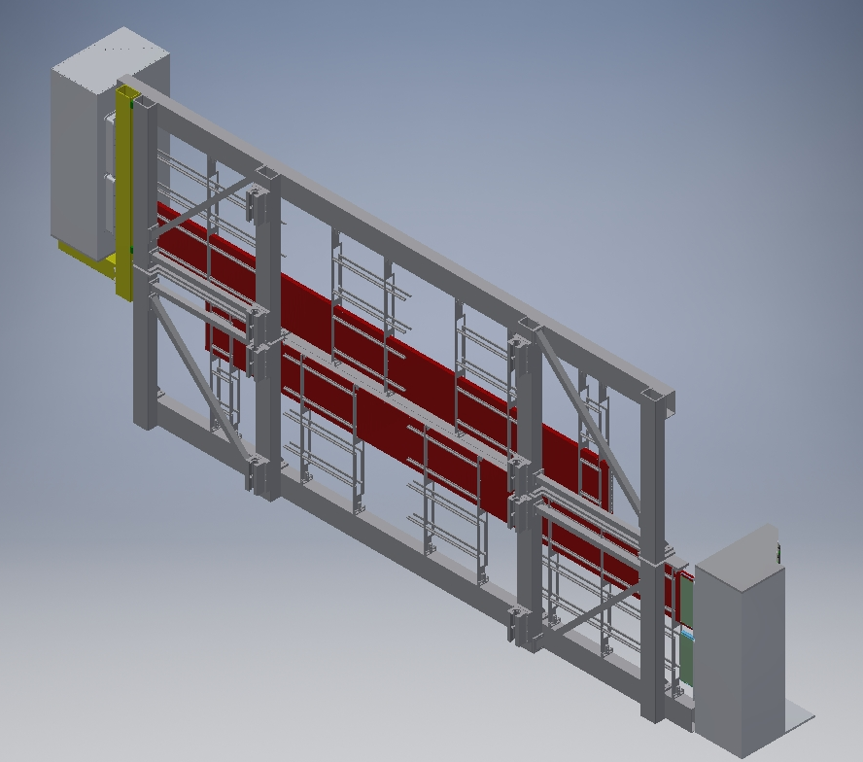
UPSTREAM
BEAM

Slide 3
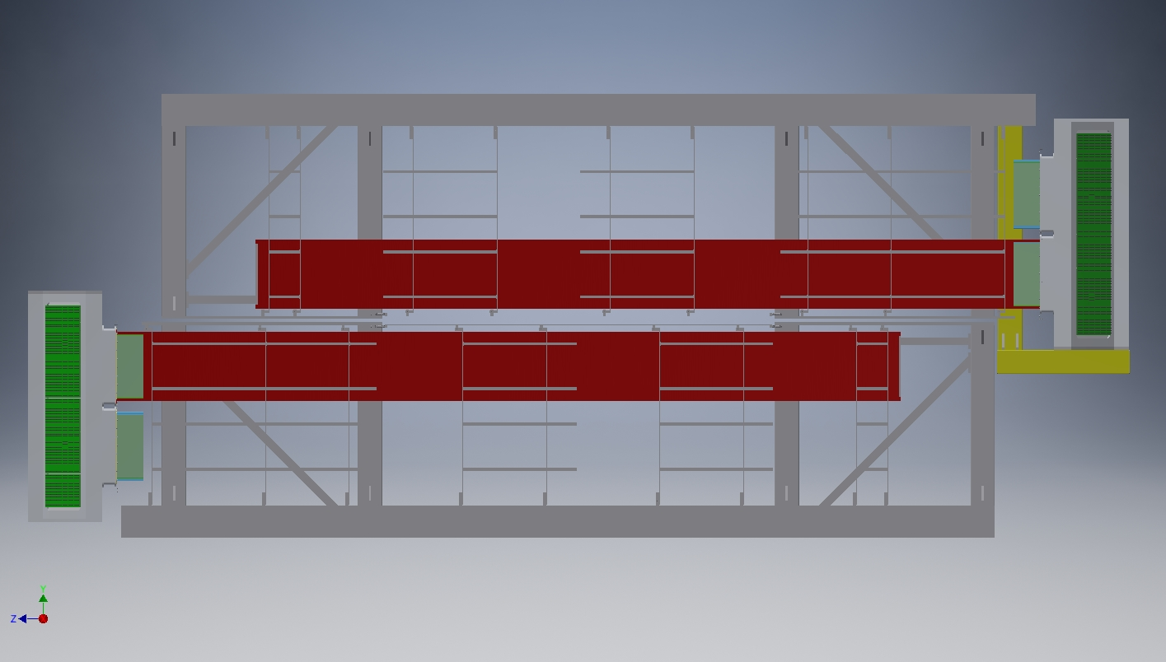
DIMENSIONS
269.463 IN.
~22.5 FT.
96 IN.
108.985 IN.
92.985 IN.

Slide 4
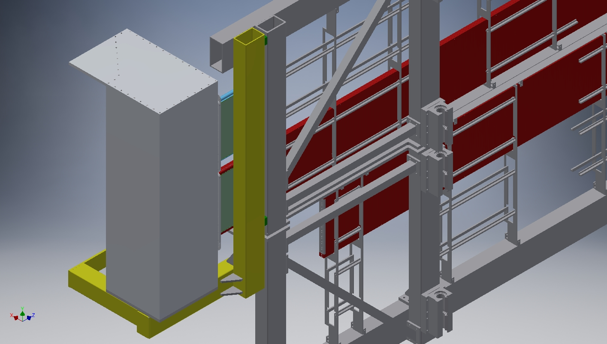
BRACING AND TANK SUPPORT DETAIL

