Slide 1
Trigger Interface and Distribution Module
--- (TID?)
J. William Gu
Dec. 4th, 2009
m:\da\GU\docs\TID.docx
m:\da\GU\docs\TID.pptx

Slide 2
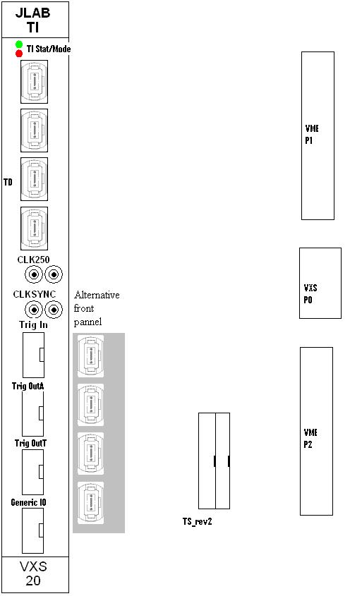
TID design
IO connections to the outside
Functional Diagram

Slide 3
TID Functions and Test Thought
Functions
As a TD, fan clock/trigger/sync from P0 (TS→SD) to eight HFBR-7934;
As a TI, Synced clock/trigger from HFBR-7934 to P0 (Switch slots: SD, CTP, GTP, and front-end modules);
As a TI, Synced clock/trigger from HFBR-7934 to two front panel connectors and VME_P2;
As a subsystem TS, it can easily control up to 8 crates; Calibration etc.;
As a VXS payload module, it will send data to SD using the 250 Mbps (or 500 Mbps using DDR technique) link for event-by-event data acquisition, complimentary to the ROC readout;
As a TI/TD, it merges the status BUSY (add a Warning?) from front-end to TS;
Legacy support: interface with TS_rev2, VME crate System_reset.
Possible System layout
Front-end Crate #1
TID(TI)
Global Clock/Trigger Distribution Crate
TID(TD)
TID(TD)
TID(TD)
TID(TD)
TID(TD)
TID(TD)
TID(TD)
TID(TD)
SD
TID(TD)
TID(TD)
TID(TD)
TID(TD)
TID(TD)
TID(TD)
TID(TD)
TID(TD)
Front-end Crate #8
TID(TI)
TID (Sub_TS)
Front-end Crate #128
TID(TI)

