Slide 1
Run plan, conditions, and configuration
(Charges 1,3 &5)
ERR
Holly Szumila-Vance

Slide 2
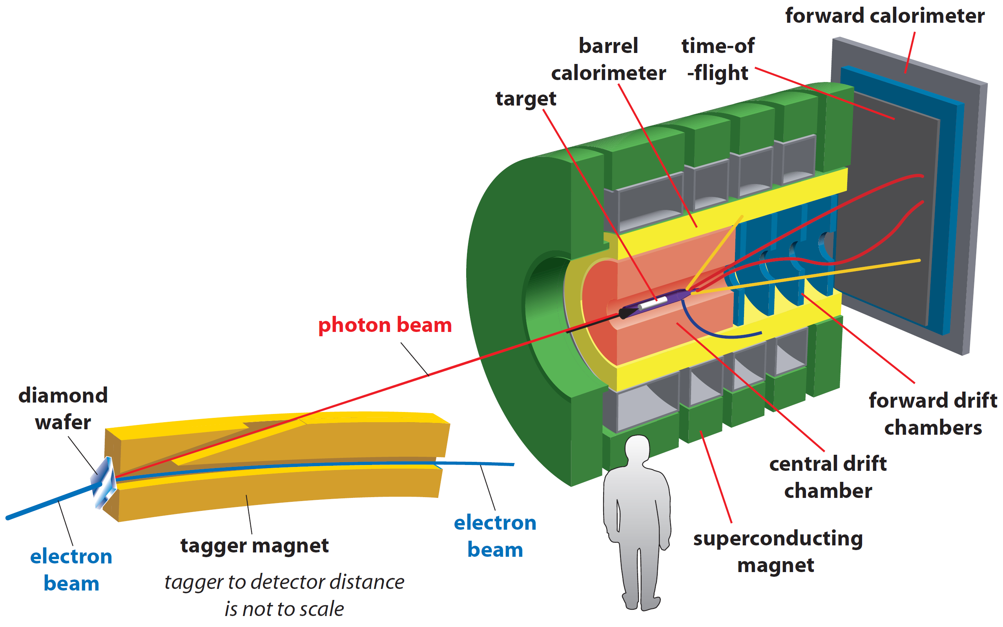
Charge 1: What are the running conditions for the experiment? Please state clearly the target and beamline configurations and operation.
GlueX in standard configuration
diamond radiator (standard 2x10⁻⁴ X₀)
coherent peak at approximately 9 GeV (energy range 8.4 - 9.1 GeV)
2x10⁷ photons/s flux, beam current 140 nA

Slide 3
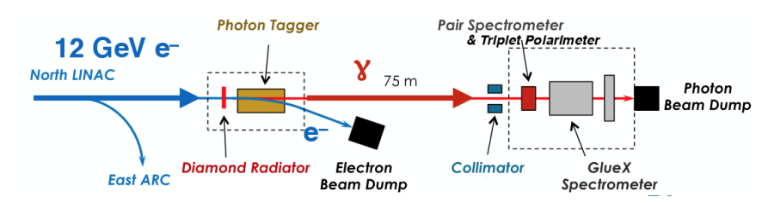
Standard Hall D photon beam line:

Slide 4
Coherent Bremsstrahlung on standard diamond crystal wafer
Collimation -> coherent peak at 8.4-9 GeV
Standard GlueX target
is 30cm LH2
start counter
Hadrons: σ_{p}/p ∼ 1-3%
𝛾: σ_{E}/E ∼ 6%/√E⊕2%
Acceptance 1°-20°
2.2 T solenoid provides field for tracking

Slide 5
Run Plan Summary:
13 days data-taking
+ 8 shifts overhead
Targets: 12C foil, D, and 4He

Slide 6
Run Plan:
Condition | Scheduled Work (Activities) | Total Time | Beam Conditions
Pre-experiment | Install C target | 3 shifts | no beam
 | Disassemble beam pipe. Retract target. Remove Start Counter (ST). Remove vacuum snout. Remove GlueX cell. Mount carbon foils (survey). Attach vacuum snout. Attach ST. Target in place. Assemble beam pipe. Pump vacuum* | 1 shift assembly 1 shift for survey & align 1 shift for pumping vacuum*
Detector checkout |  | 2.5 shifts | 140 nA
 | Establish typical tagged photon beam, check/calibrate sub-detectors, Trigger, and DAQ (some tests can be done during pumping vacuum)
Run with C target |  | 7 days | 140 nA
*Hall in Beam Permit
Notes:
Check final run plan order, and overhead
Pavel’s n bg update

Slide 7
Run Plan (cont.):
Condition | Scheduled Work (Activities) | Total Time | Beam Conditions
Target change | Install liquid D target | 3 shifts | no beam
 | Disassemble beam pipe. Retract target. Remove ST. Remove vacuum snout. Remove carbon foils. Mount GlueX cell. Survey. Mount heat shield (needed for helium). Attach vacuum snout. Attach ST. Target in place. Assemble beam pipe. Pump vacuum*. | 1 shift assembly 1 shift for survey & align 1 shift for pumping vacuum*
Run with empty target |  | 0.5 days | 140 nA
Target preparation | Cool target*. | 1 shift
Run with D target |  | 4.5 days | 140 nA
Target change | Switch to liquid He target | 1.5 shifts
 | Boil LD₂*. Pump D₂ from tanks. Replace with helium. Cool target*.
Run with He target |  | 1 day | 140 nA
*Hall in Beam Permit

Slide 8
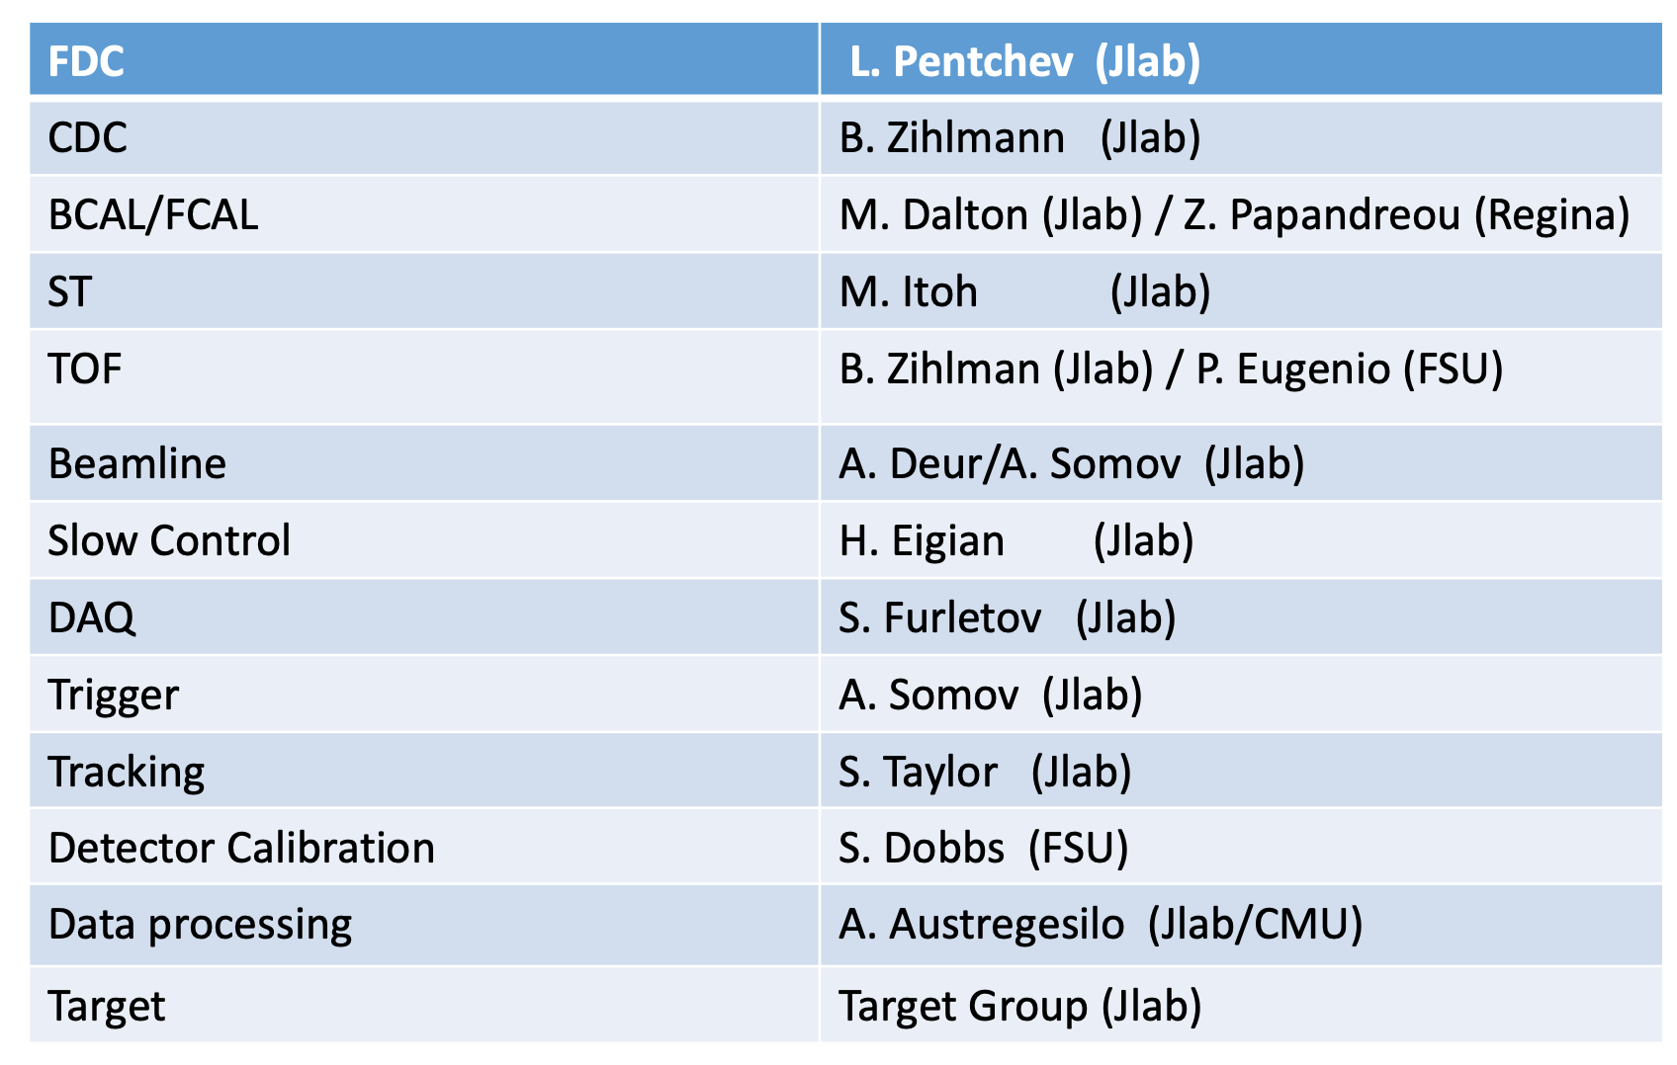
Charge 3: Has the spectrometer, detector configuration been defined, including ownership, maintenance and control during beam operations?
GlueX in standard configuration
detector support will come from Hall D staff members and have confirmed:
https://halldweb.jlab.org/level-1/manpower.pdf
Notes:
Extend this list

Slide 9
Charge 5: What is the expected data rate for the experiments?
Nominal GlueX trigger: 80 kHz, 90% livetime, 1.1 Gb/s
Our trigger configuration: 78 kHz, 90% livetime, 1 Gb/s (5x10⁷ 𝛾/s)
  Tested in spring 2020, see https://halldweb.jlab.org/level-1/src
  Our experiment ~x0.5 𝛾/s, but C target has x2 rad length (EM bg scales by rad length and hadronic bg scales by attenuation)
E_{BCAL}
1 GeV
Nominal GlueX trigger
MIP ~ 300 MeV
Our trigger requirements:
Proton, pion final state -> MIP
Already accept multiparticle final states by default
180 MeV
500 MeV
250 MeV
E_{FCAL}
Our trigger lowers thresholds below MIP and requires one hit in start counter
MIP ~ 400 MeV

Slide 10
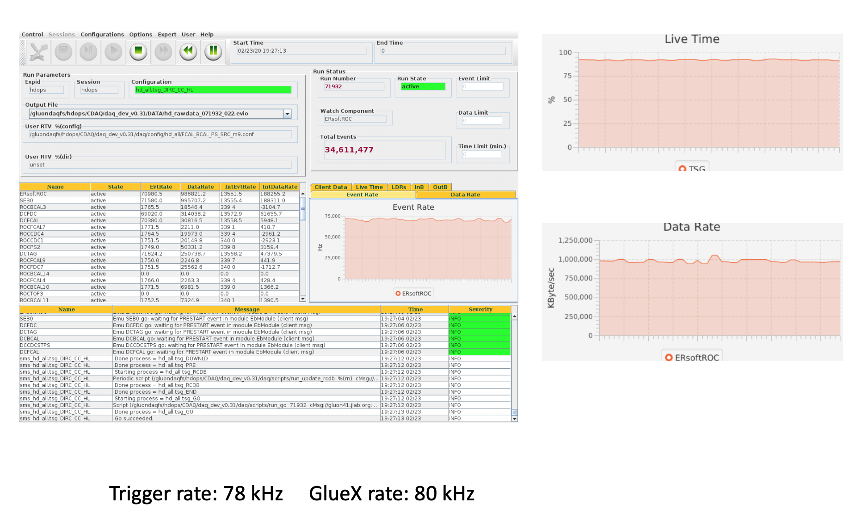

Slide 11
Summary
Charge 1: What are the running conditions for the experiment? Please state clearly the target and beamline configurations and operation.
GlueX in standard configuration, standard diamond radiator
coherent peak at 9 GeV (energy range 8.4 - 9.1 GeV)
x2 lower luminosity than standard GlueX at 2x10⁷ photons/s flux (140 nA)
Run plan for 15 days with 12C, D, 4He targets presented
Charge 3: Has the spectrometer, detector configuration been defined, including ownership, maintenance and control during beam operations?
Spectrometer and detectors in standard GlueX configuration
Detector and beamline support from Hall D staff
Target support from JLab Target Group
Charge 5: What is the expected data rate for the experiments?
78 kHz, 90% live time, data rate of approximately 1 GB/s (tested at 5x10⁷ photons/s)
4He and D comparable, 12C double radiation length (and attenuation effects)
Trigger has lower ECAL and BCAL thresholds, hit in start counter

Slide 12
Back-up slides

Slide 13
Option B: Consideration if neutron rates are too high when running deuterium
Lower intensity
Change to 4He sooner than planned (all physics goals still attainable)
Low XS High XS
γ + n → π⁻ + p
γ + n → ρ⁻ + p
photon flux | MF | SRC | MF | SRC
2x10⁷ | 13600 | 750 | 57000 | 3000
1x10⁷ | 6800 | 375 | 28500 | 1500
MF = mean field
SRC = short-range pairs
Notes:
backup

Slide 14
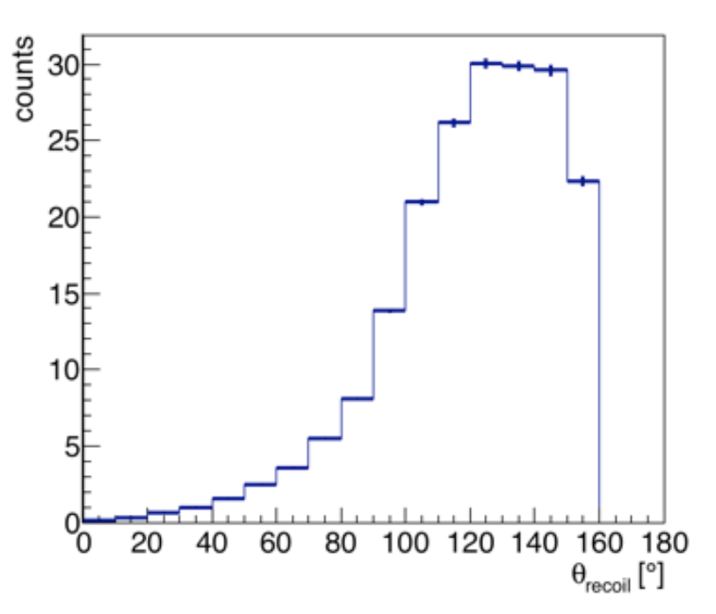
Energy loss in Carbon foil targets:
3 cm vertex resolution
8 foil targets (total is 7% rad length, 1.9 cm total), each is 0.24 cm thick
100MeV-> 6.488 MeV cm2/g, 2 g/cm3-> E loss of 13 MeV/cm
For 100 MeV proton (p=430 MeV/c):
  At thickness, 3 MeV loss per C foil
  At 150 deg, 3.6 MeV loss per C foil
Angular distribution of recoil nucleon
Effects of Cu shielding around cryo target cell:
Thickness is 0.25mm
100 MeV -> 4.852 MeV cm2/g , 8.96 g/cm3->E loss of 43.5 MeV/cm
For 100 MeV proton (p=430 MeV/c):
  At thickness, 1.086 MeV loss
  At 150, 2.17 MeV loss
Cu shielding not a problem for recoiling proton!
Notes:
1/4mm Al heat shield

Slide 15
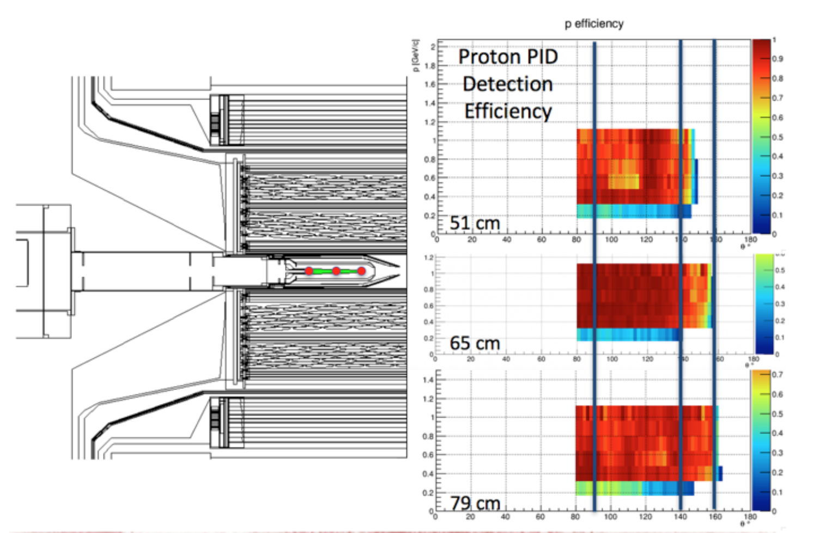
Acceptance and Efficiency for recoil protons in GlueX at different vertex locations

