Slide 1
Run plan, conditions, and configuration
(Charges 1,3 &5)
ERR
Holly Szumila-Vance

Slide 2
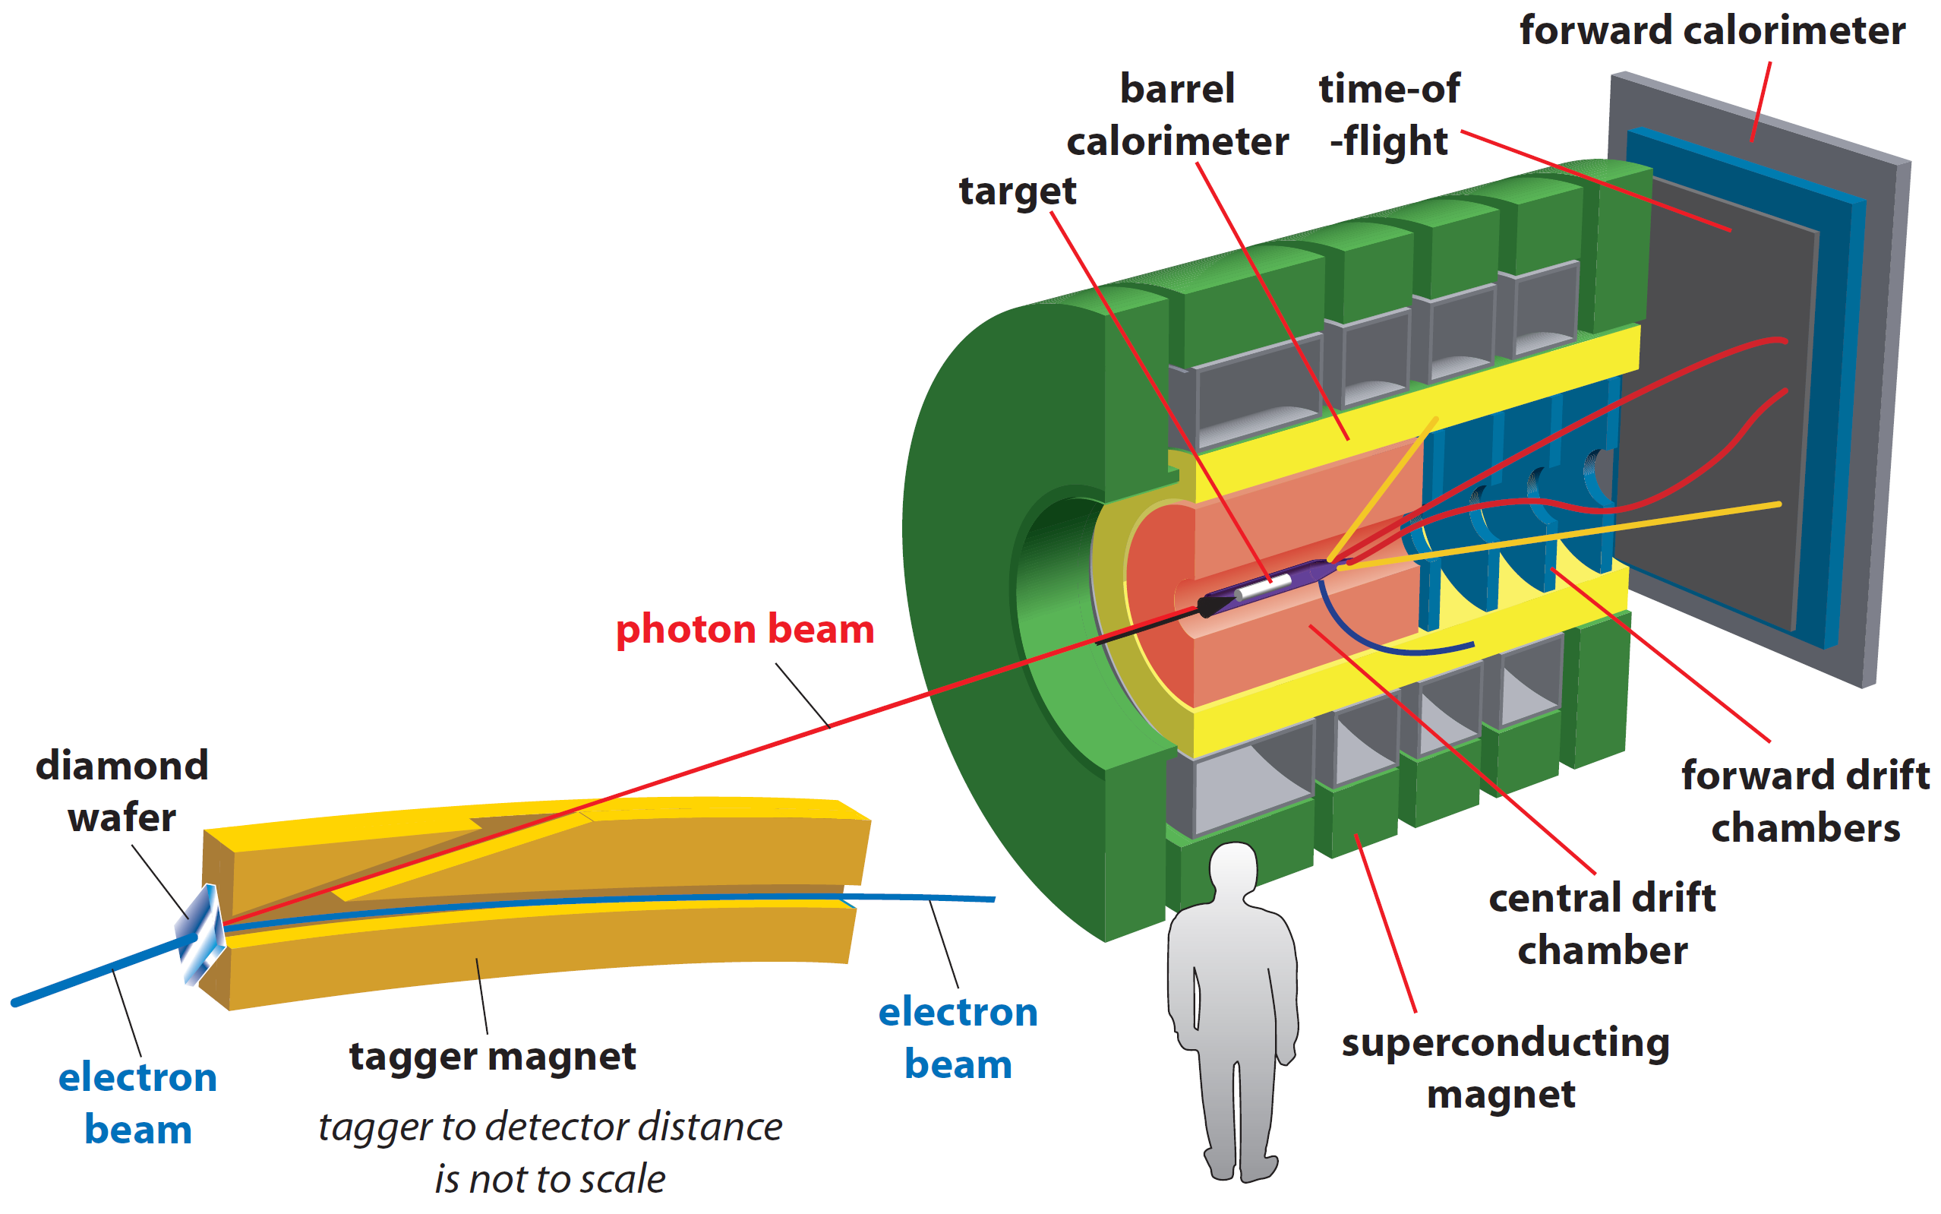
Charge 1: What are the running conditions for the experiment? Please state clearly the target and beamline configurations and operation.
GlueX in standard configuration
diamond radiator with the coherent peak at approximately 9 GeV (energy range 8.4 - 9.1 GeV)
2x10⁷ photons/s flux

Slide 3
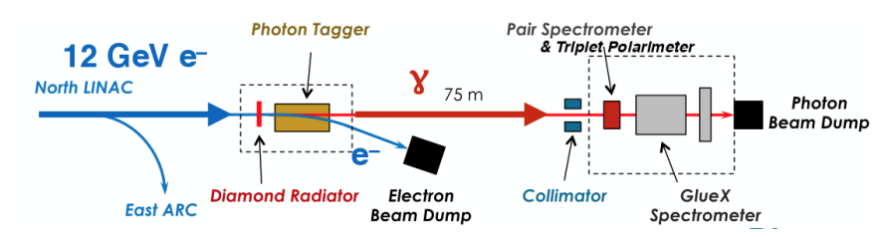
Hall D photon beam line:
Coherent Bremsstrahlung on 20-50 μm diamond crystal wafer
Collimation -> coherent peak at 8.4-9 GeV
start counter
Hadrons: σ_{p}/p ∼ 1-3%
𝛾: σ_{E}/E ∼ 6%/√E⊕2%
Acceptance 1°-20°
Standard GlueX target
is 30cm LH2
2.2 T solenoid provides field for tracking

Slide 4
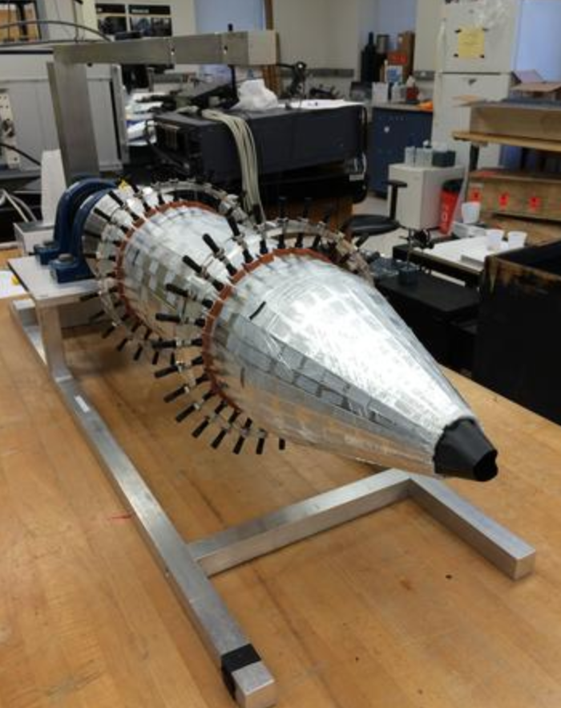
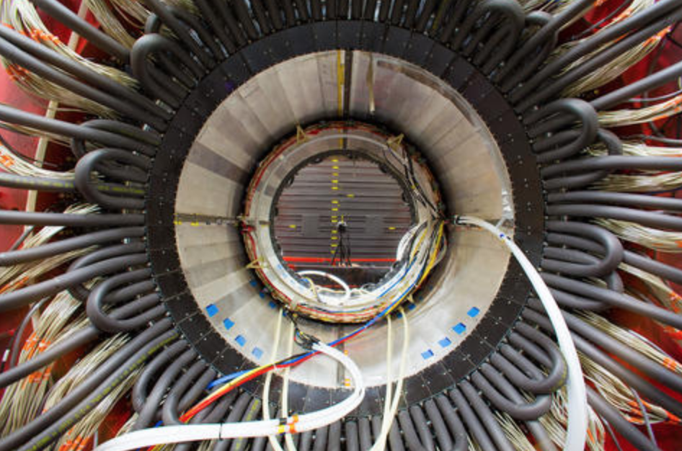
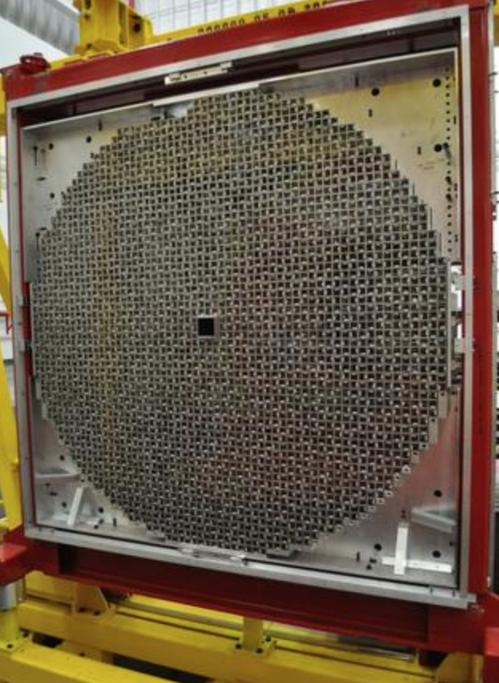
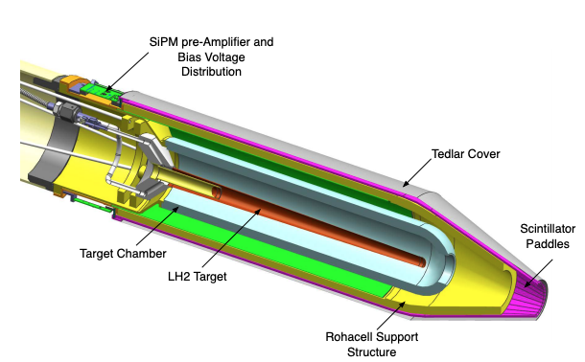
Start Counter
Photons detected through calorimetry:
BCAL and FCAL
BCAL
SiPM for readout
Identifies electron beam buckets
FCAL

Slide 5
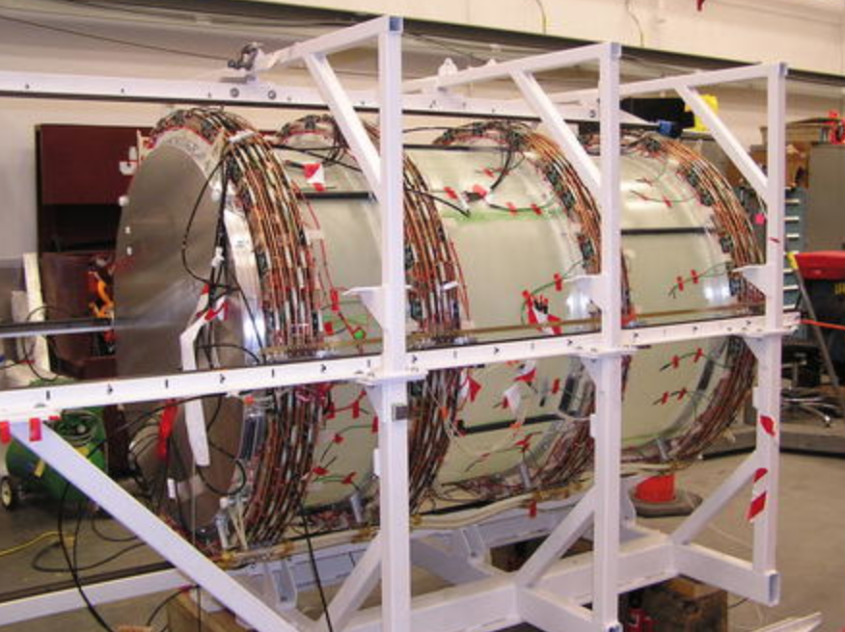
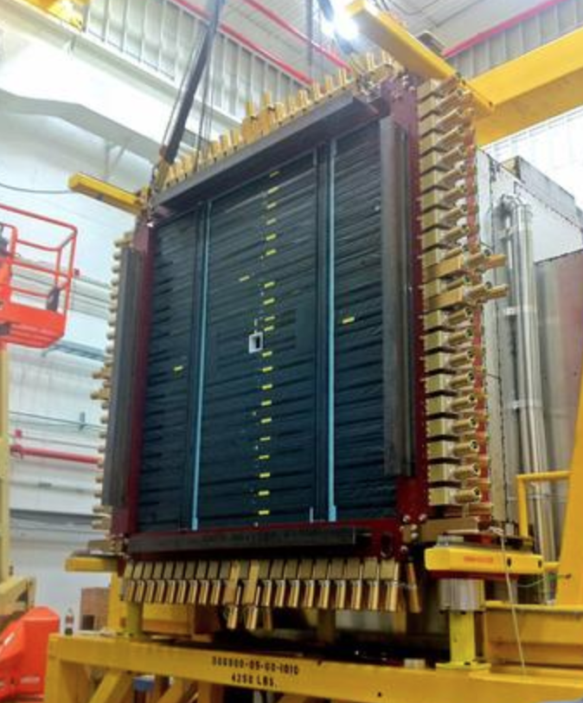
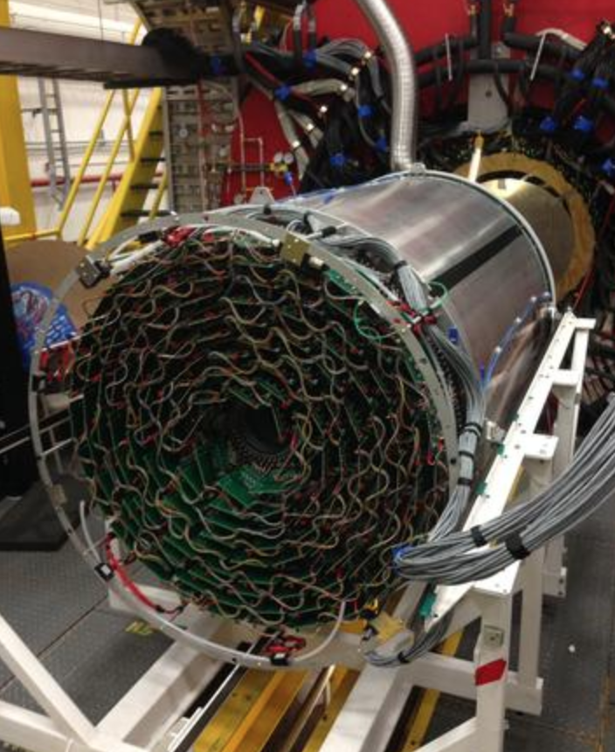
Charged particle tracking:
CDC and FDC
Time-of-Flight
FDC
550 cm from target
TDC 60 ps resolution
TOF 80 ps resolution
CDC

Slide 6
Run Plan:
Time | Target
7 PAC days | 12C | physics
3 shifts | 12C -> deuterium | 1 shift change target and install heat shield, 2 shifts to cool target??
5 PAC days | deuterium | physics, empty target calibration
2 shifts | deuterium -> 4He | ??
1 PAC day | 4He | physics
Targets:
4He and D use GlueX 30cm LH target
Carbon multi-foil (see C. Keith talk next)

Slide 7
Option B: Consideration if neutron rates are too high when running deuterium
Lower intensity
Change to 4He sooner than planned (all physics goals still attainable)
Low XS High XS
γ + n → π⁻ + p
γ + n → ρ⁻ + p
photon flux | MF | SRC | MF | SRC
2x10⁷ | 13600 | 750 | 57000 | 3000
1x10⁷ | 6800 | 375 | 28500 | 1500
MF = mean field
SRC = short-range pairs

Slide 8
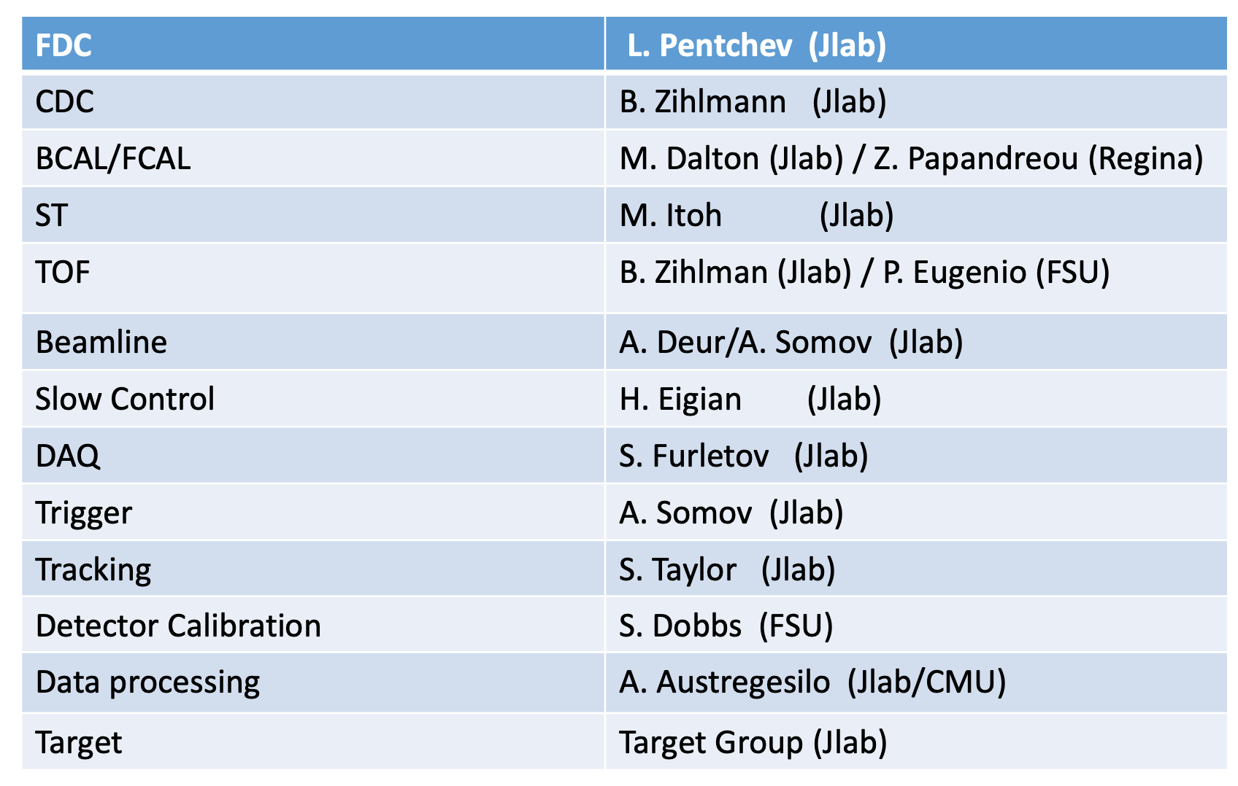
Charge 3: Has the spectrometer, detector configuration been defined, including ownership, maintenance and control during beam operations?
GlueX in standard configuration
detector support will come from Hall D staff members and have confirmed:
https://halldweb.jlab.org/level-1/manpower.pdf
Notes:
Extend this list

Slide 9
Charge 5: What is the expected data rate for the experiments?
Nominal GlueX trigger: 80 kHz, 90% livetime, 1.1 Gb/s
Our trigger configuration: 78 kHz, 90% livetime, 1 Gb/s (5x10⁷ 𝛾/s)
  Tested in spring 2020, see https://halldweb.jlab.org/level-1/src
  Our experiment ~x0.5 𝛾/s, but C target has x2 rad length (EM bg scales by rad length and hadronic bg scales by attenuation)
E_{BCAL}
1 GeV
Nominal GlueX trigger
MIP ~ 300 MeV
Our trigger requirements:
Proton, pion final state -> MIP
Already accept multiparticle final states by default
180 MeV
500 MeV
250 MeV
E_{FCAL}
Our trigger lowers thresholds below MIP and requires one hit in start counter
MIP ~ 400 MeV

Slide 11
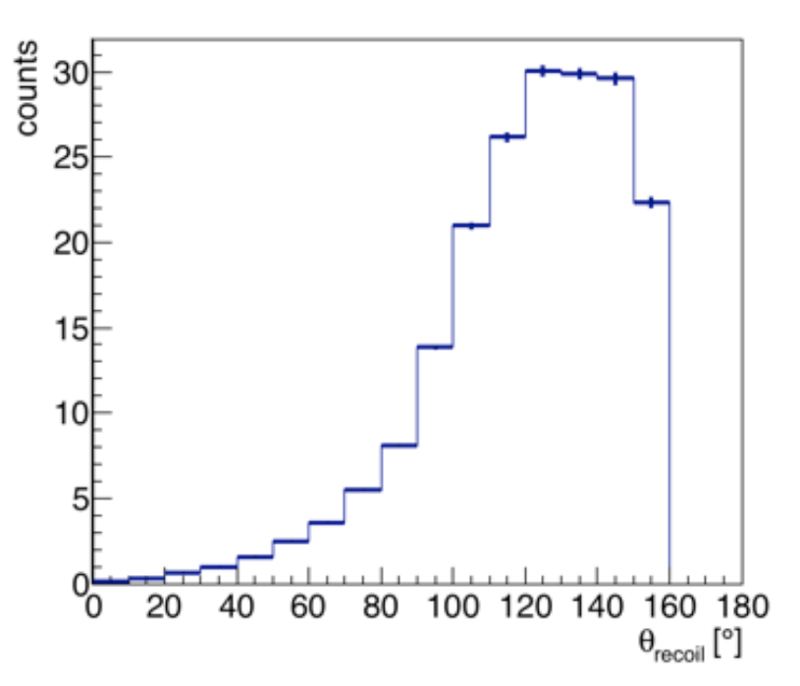
Energy loss in Carbon foil targets:
3 cm vertex resolution
8 foil targets (total is 7% rad length, 1.9 cm total), each is 0.24 cm thick
100MeV-> 6.488 MeV cm2/g, 2 g/cm3-> E loss of 13 MeV/cm
For 100 MeV proton (p=430 MeV/c):
  At thickness, 3 MeV loss per C foil
  At 150 deg, 3.6 MeV loss per C foil
Angular distribution of recoil nucleon
Effects of Cu shielding around cryo target cell:
Thickness is 0.25mm
100 MeV -> 4.852 MeV cm2/g , 8.96 g/cm3->E loss of 43.5 MeV/cm
For 100 MeV proton (p=430 MeV/c):
  At thickness, 1.086 MeV loss
  At 150, 2.17 MeV loss
Cu shielding not a problem for recoiling proton!

Slide 12
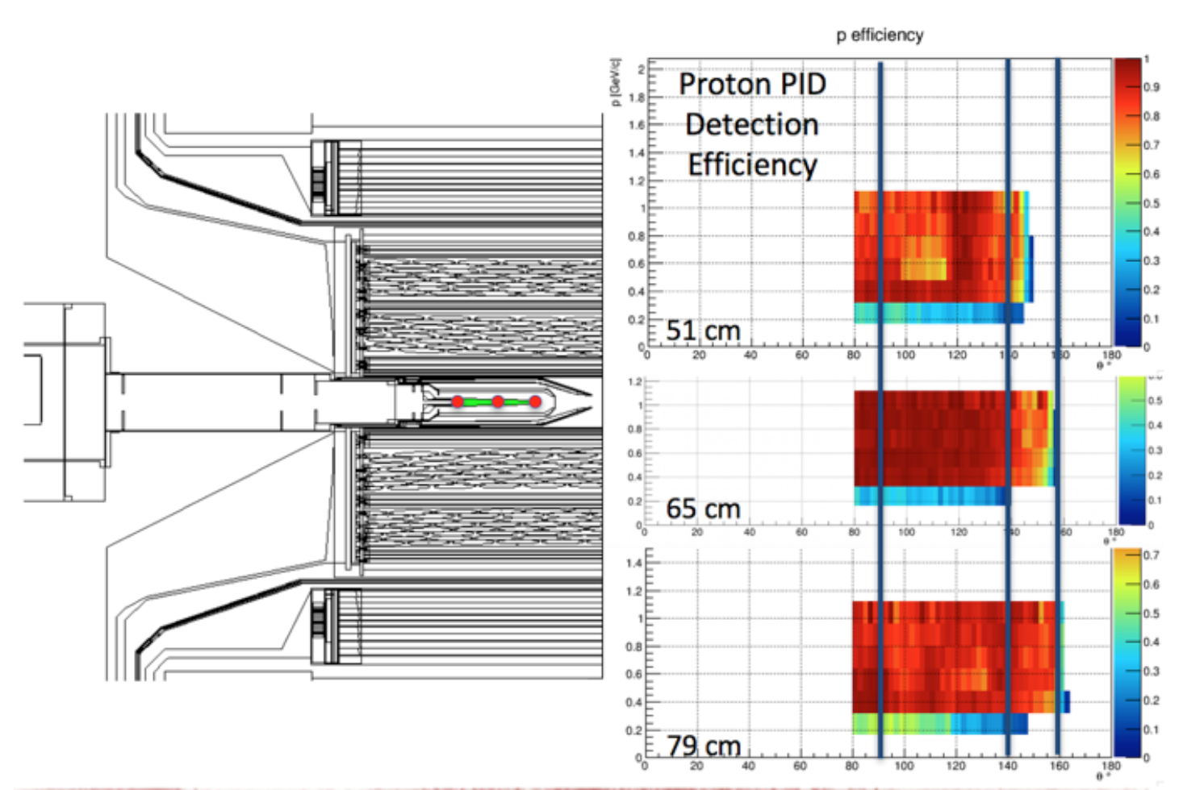
Acceptance and Efficiency for recoil protons in GlueX at different vertex locations

