Slide 1
Status of Level-1 Bitwise Simulation
A. Somov, Jefferson Lab
October 15, 2013

Slide 2
Overview
Detailed simulation of the trigger hardware
- use to calibrate hardware parameters
- verify trigger types
- realistic simulation of the trigger algorithm
Provides input to the hardware debugging tools (Test Vector)
Simulation framework development
Convert Geant hit energies/times into signal waveforms
- convert detector modules into crate/slot/channel (translation table)
Waveform digitization
Add noise, baseline fluctuations.
Save signal waveforms in the format needed by the Test Vector
Simulates CTP/SSP/GTP response (pulse shapes)

Slide 3
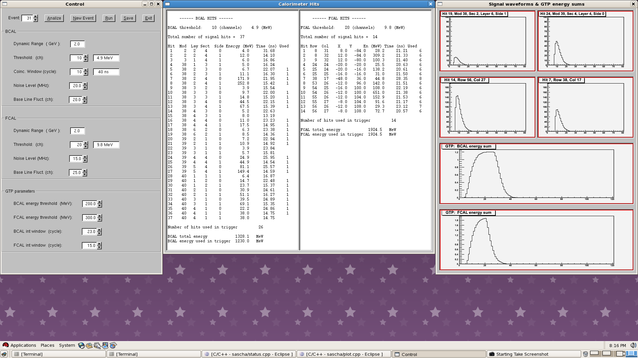
Bitwise simulation: b₁π decays

Slide 4
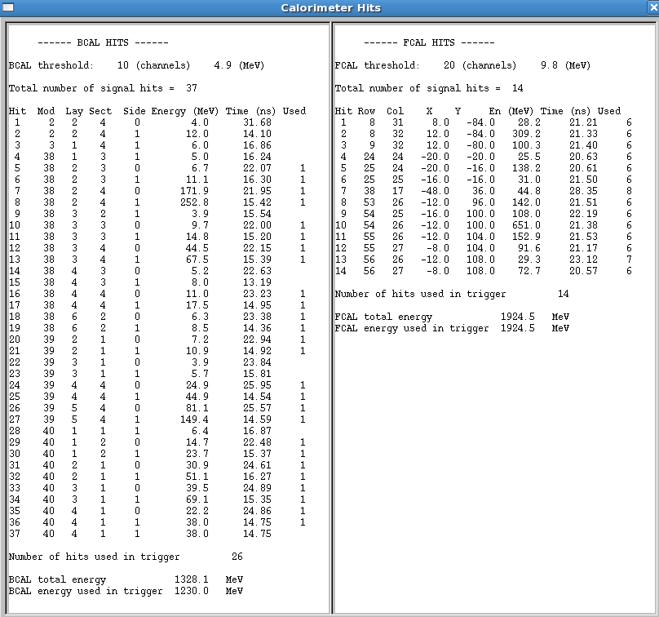
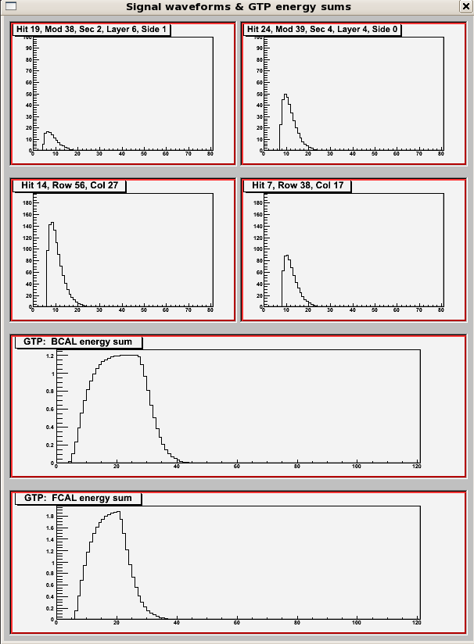
Bitwise simulation: b₁π decays
BCAL T_{MIN}
BCAL T_{MAX}
FCAL T_{MIN}
FCAL T_{MAX}
GTP BCAL Energy Sum
GTP FCAL Energy Sum

Slide 5
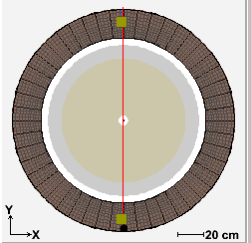
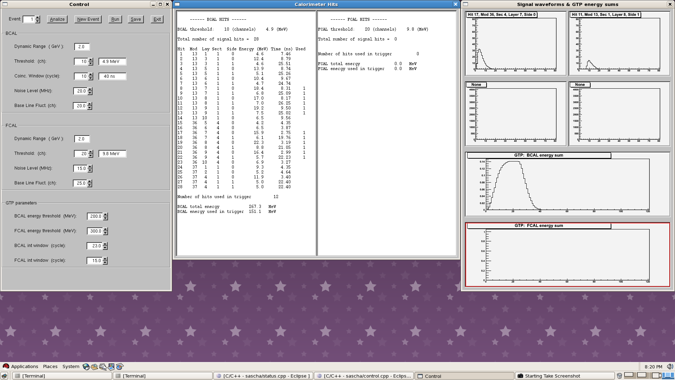
Bitwise simulation: Cosmic Trigger

