Slide 1
Design and Analysis of Structure Intended to Support Proposed Muon Detector and Modifications to Forward Calorimeter Platform
Bobby Smyth
Governor’s School for Science and Technology
2013-2014
Timothy Whitlatch
Thomas Jefferson National Accelerator Facility

Slide 2
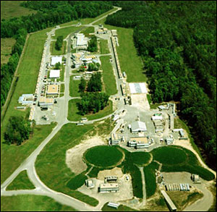
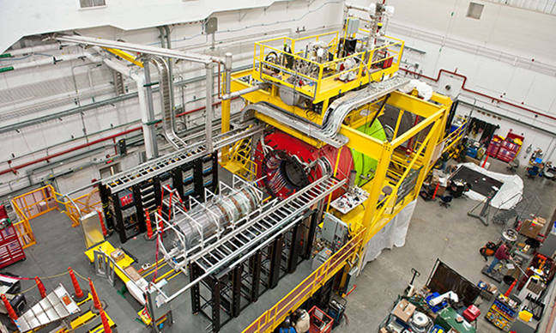
Jefferson Lab
World renowned research center
  Research in the fields of nuclear and particle physics
The Continuous Electron Beam Accelerator Facility (CEBAF)
  Source of a high energy electron beam
  Used to conduct research in the three currently operating experimental halls
Hall D
  Currently in final stages of construction; scheduled to begin operation in 2015
  Photon beam

Slide 3
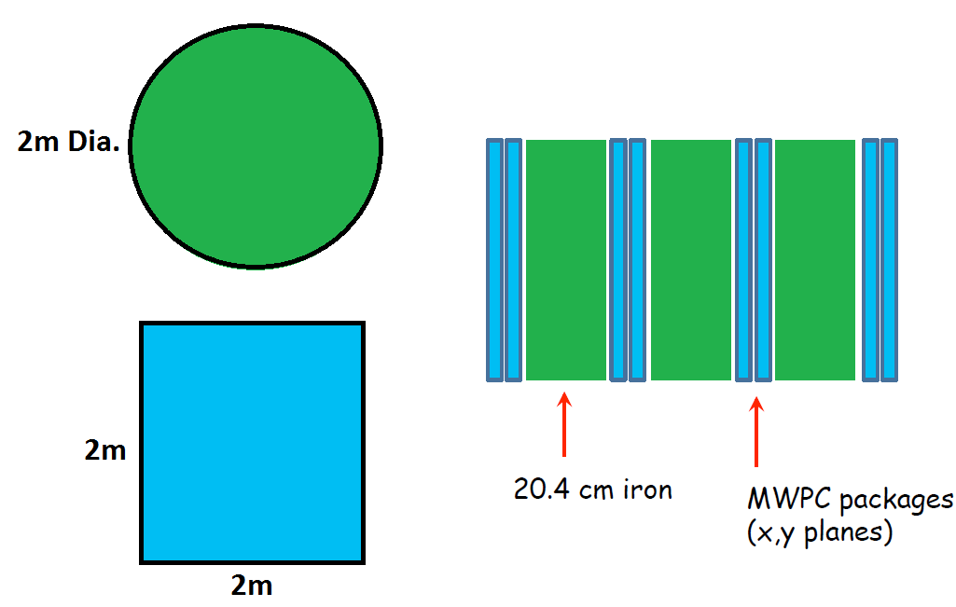
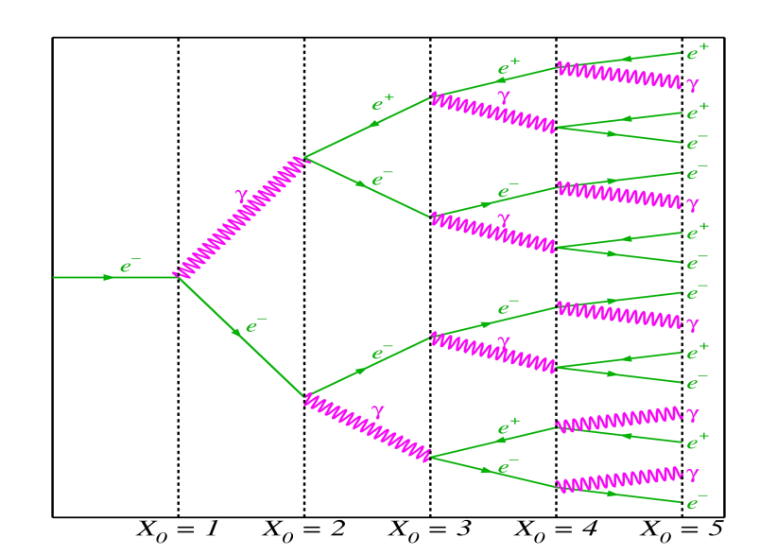
Muon Detector
Approved addition to Hall D
Detector Components
  Steel Disks (2m diameter)
  Multiwire proportional counters (2m*2m)
Allows researchers to distinguish between muons and pions
  Pions cause hadronic showers in steel disks
  Muons do not
The MWPC packages can detect whether hadronic showers occur in steel plates
Projected mass: ~16.5 tons
Supported by the Forward Calorimeter (FCAL) Platform
Electromagnetic shower

Slide 4

Muon Detector Design Requirements
Comprised of 3 steel disks and 8 MWPC packages
Projected mass: ~16.5 tons=33,000lb
  Mainly due to steel disks
Supported by the Forward Calorimeter (FCAL) Platform
Orientation of MWPC packages alternates
Ten centimeters of space reserved on sides of MWPC packages for wiring
Orientation of MWPC packages alternates
Ten centimeters of space reserved on sides of MWPC packages for wiring

Slide 5
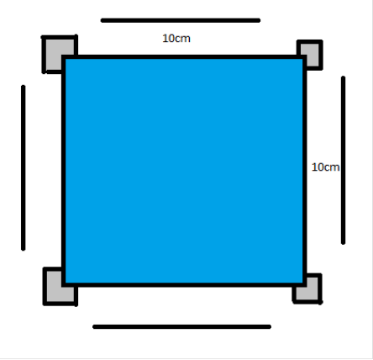
Muon Detector Design Requirements
Individual steel disks and MWPC packages must be secured to Muon Detector Structure
Steel disks to be welded to MDS at 0, pi, and 3pi/2
MWPC packages secured on corners or hung
Extra space between MWPC packages
  Removal and maintenance

Slide 6
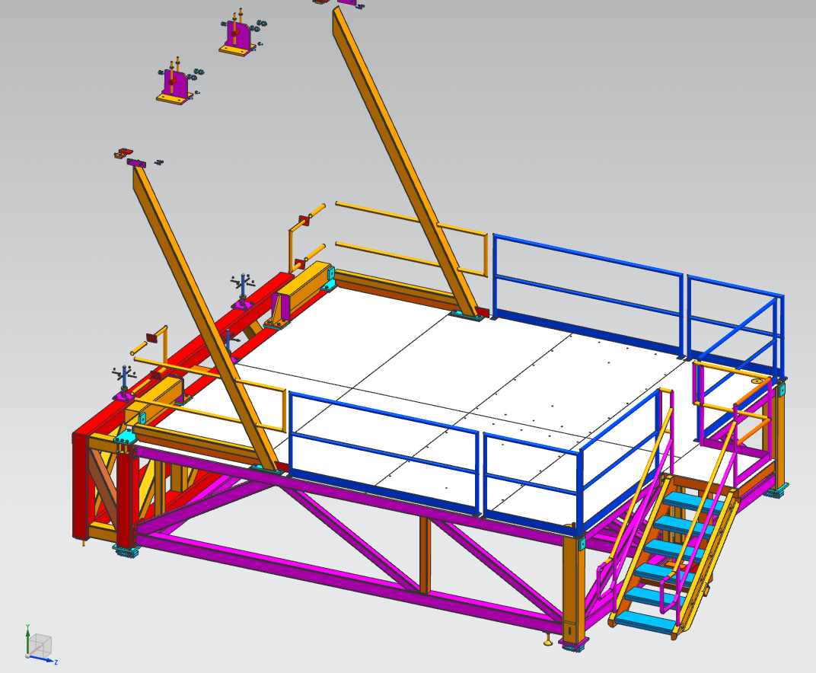
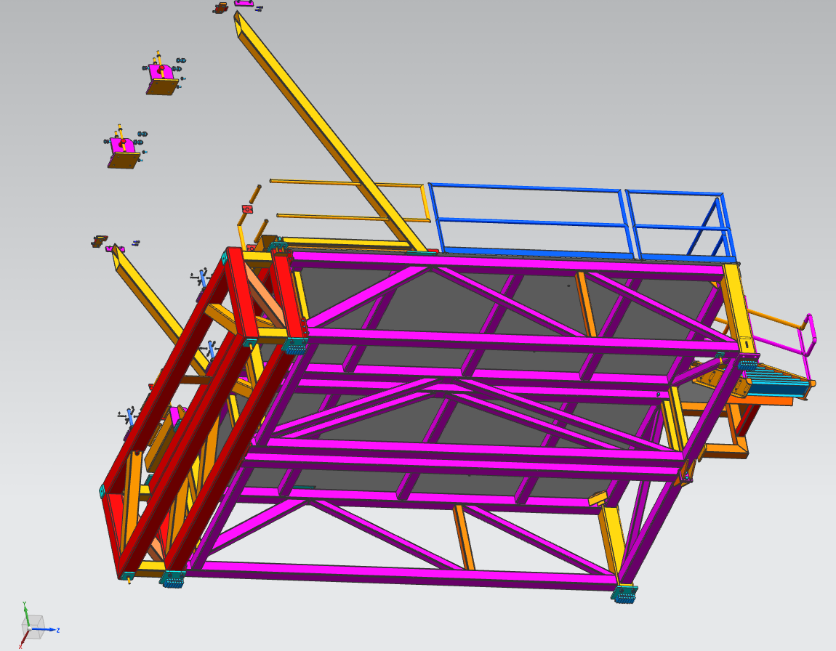
FCAL Platform
The FCAL platform currently supports a dark room and 2 large wiring trays
Limited room on platform
  3’ by 6’11” space
Maximum of 100psf on plates
Not designed to support additional load
Modifications must be made to the existing FCAL structure
  Additional load must be transferred to rollers through the platform truss system
  Add beams underneath deck and on truss

Slide 7
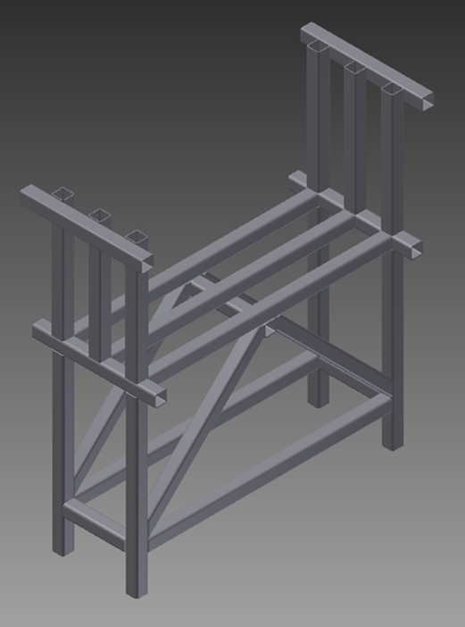
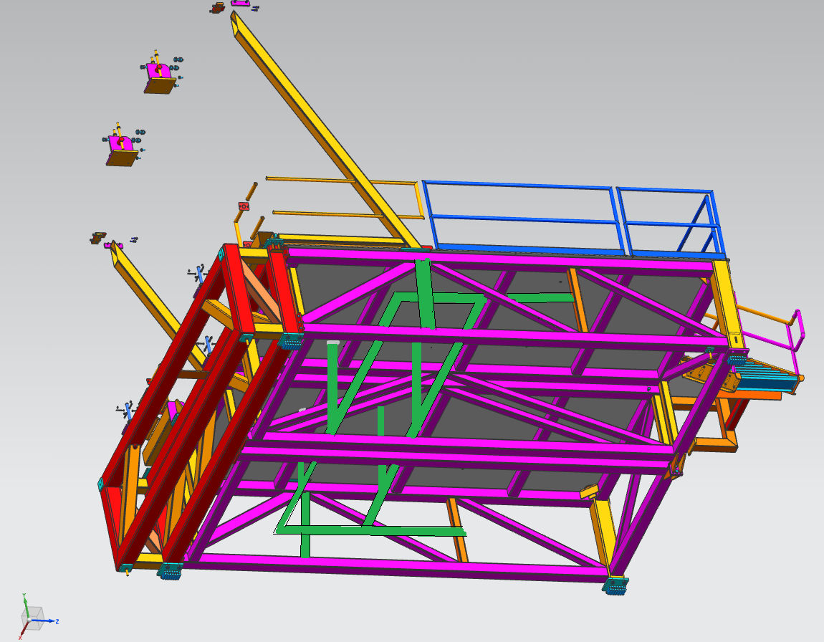
Muon Detector Structure and FCAL Modifications
A structure to support muon detector must be designed
Muon Detector Structure (MDS)
  Secure individual detector components
  Detachable from FCAL platform
  Cost and space efficient
Modifications must be made to existing FCAL platform
  Add members to FCAL to transfer load to rollers
    Truss
    Spanning side to side
  Holes drilled into FCAL plates so beams can past through

Slide 8
MDS Design
List of views of model to be included in powerpoint/autocad publisher
  Include front, top, side, and isometric views
  Include view focused on MWPC package holders
  Include view showing how steel disks will be welded
  Include side and bottom view of FCAL platform
  Explanation of design
  Will be presented over several slides

Slide 9

MDS Design
Rails on either side to stabilize steel disks
Truss system implemented underneath detector
Allows 10 cm of space on sides of MWPC Packages
A500 Steel hollow square tubes
  4” square

Slide 10

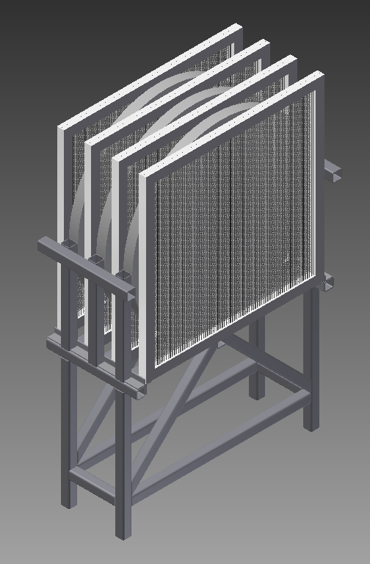
MDS Design- Top left view

Slide 11
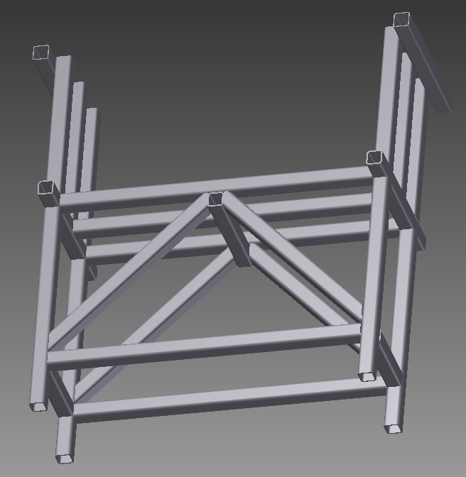
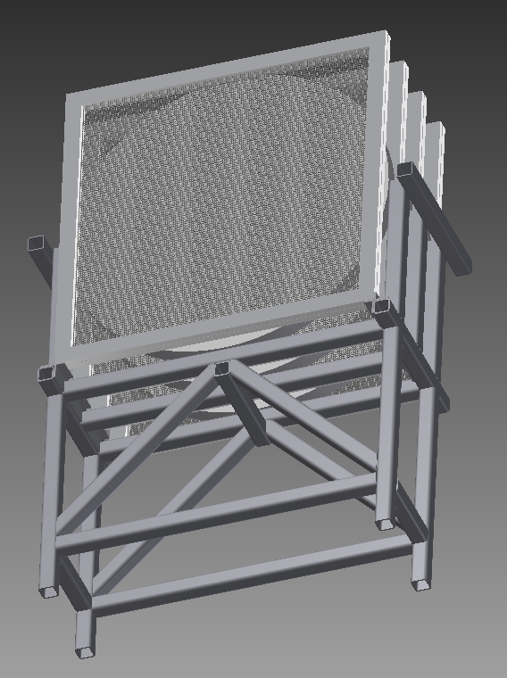
MDS Design-Bottom right view

Slide 12
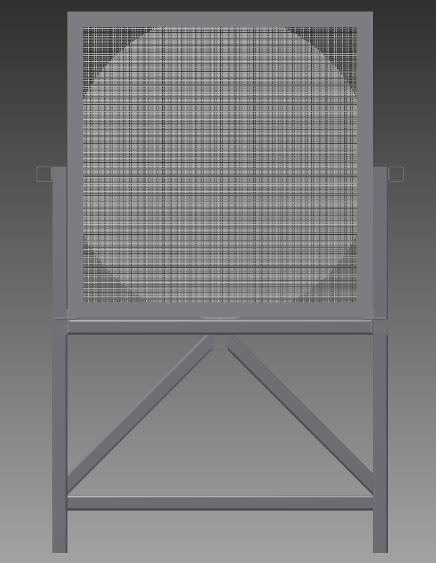
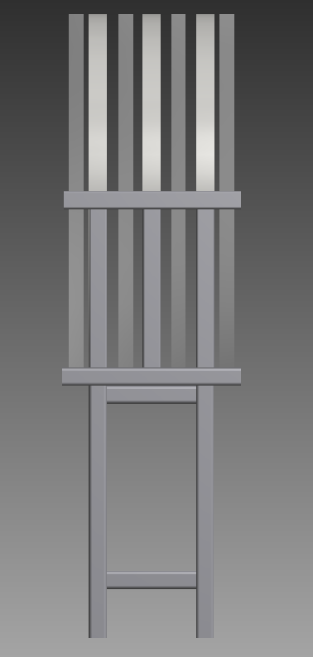
MDS Design-Front and Side views

Slide 13
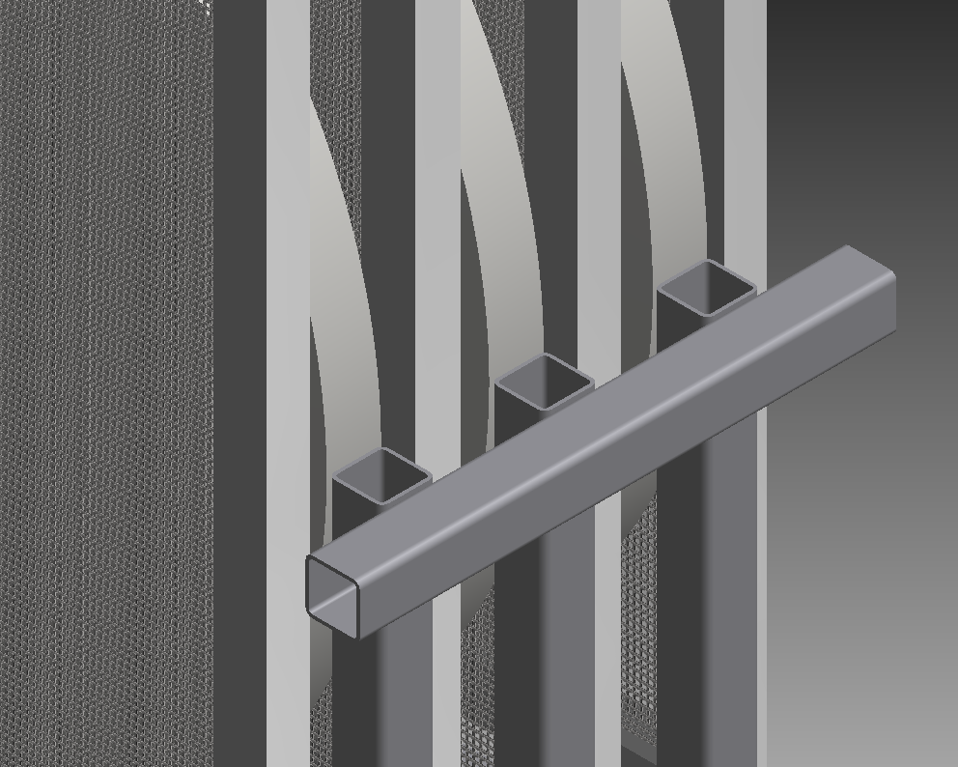
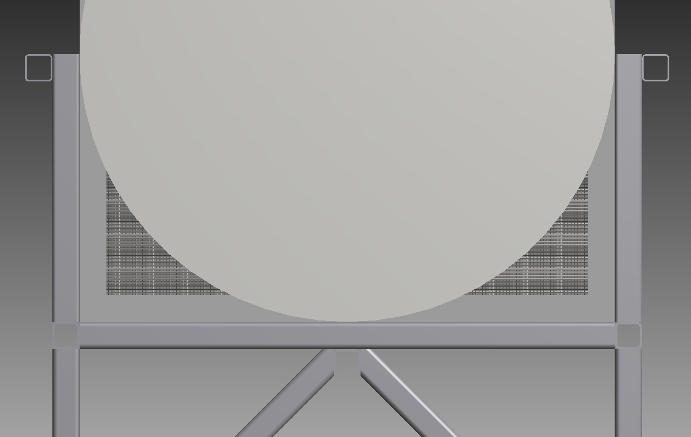
Steel Disk Attachment Views

Slide 14
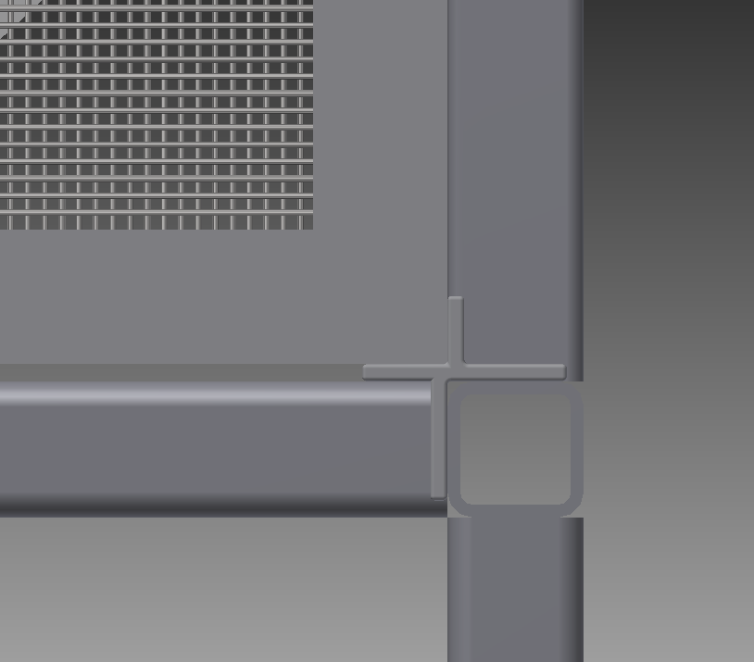
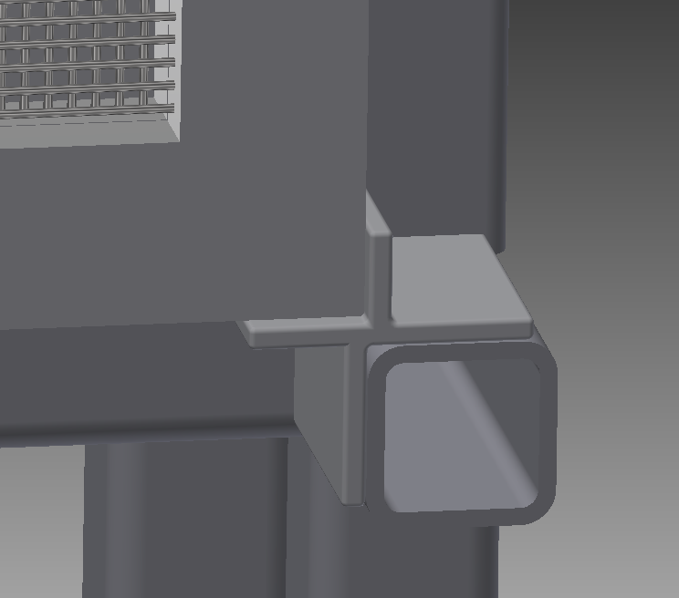
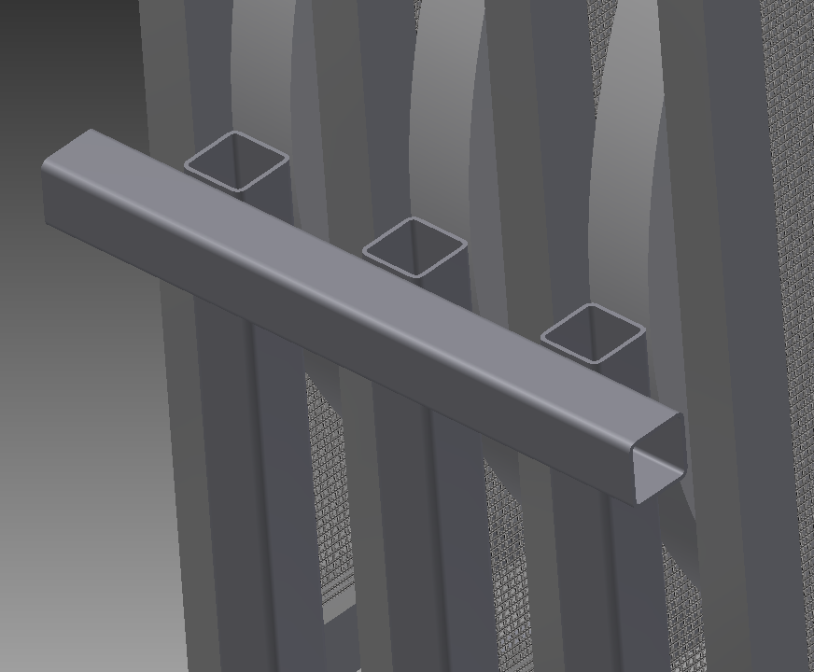
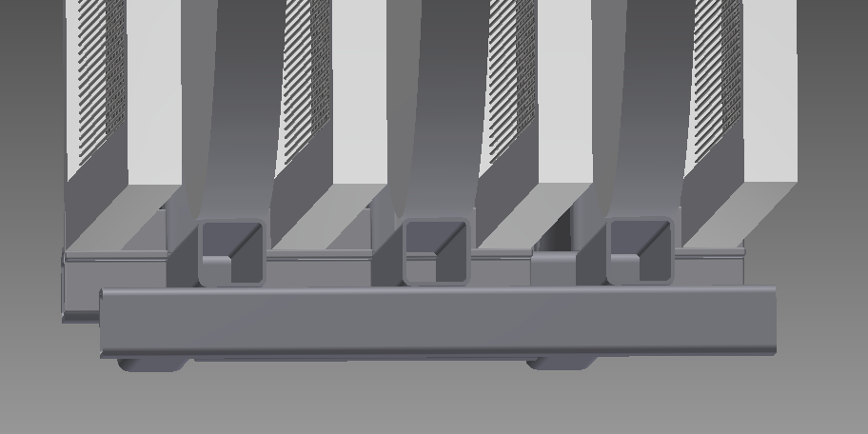
MWPC Packages Attachment Views

Slide 15
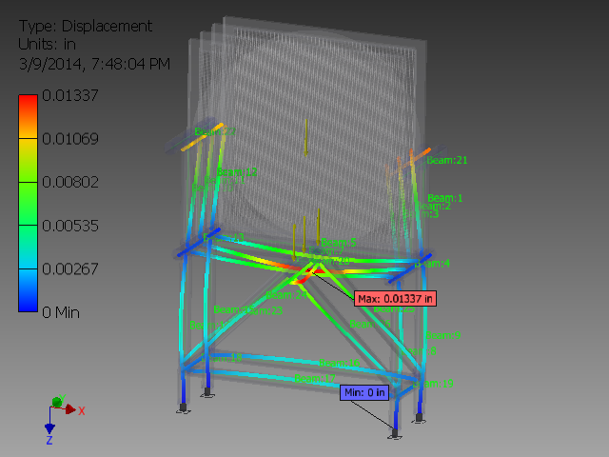
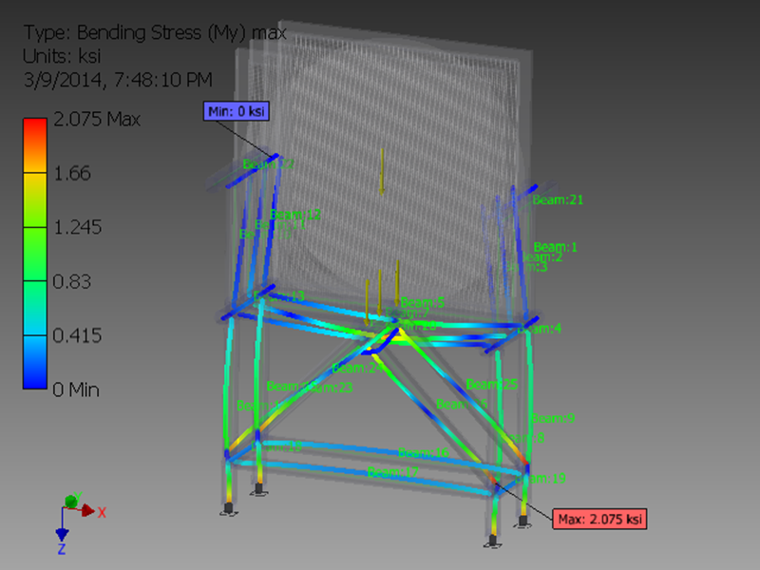
MDS Structural Analysis Overview

Slide 16
MDS Structural Analysis Overview cont.

Slide 17
Methods and Materials
Necessary modifications to the FCAL platform will determined and a final design of the MDS will be created
Structural analysis of the modifications to the FCAL platform as well as the MDS design will be conducted
  Each individual member will be analyzed to determine any weaknesses in the structure
To be determined a success, the design must meet functional requirements and conform to situational constraints
The MDS will be designed such that it’s cost is minimized

Slide 18

Methods and Materials
The MDS will be designed such that the calculated factor of safety of the structure must meet industry standards
  Factor of safety will be calculated according to the formula:
  The industry standard for similar structures is two thirds
3D models of the design will be created in AutoCad Inventor© 2013
The final design of the structure will not be fabricated but scale models may be produced

Slide 19
Expected Results
Schematic views of the 3D models of the final design will be created
Preliminary designs leading up to the final design will also be included and will be presented in chronological order to show progression of design over time
Written explanations of why modifications were made to the design will be provided
Estimated cost of the final design will be provided including material and manufacturing expenses
Tables detailing the results of all structural analysis will be included
No statistical analysis is anticipated

Slide 20
Expected Results - Table
Compressive and Tensile Stress Analysis |  |  |  | Member | Comp/Tens | Force(N) | Force(lb) | Area(in^2)
A36 Steel |  | Units |  | A-C | comp | 15 | 3.372 | 0.0001857851
Tensile Yield Strength | 36300 | psi |  | B-E | comp | 15.00 | 3.37 | 0.0001857851
Compessive Yield Strength | 22000 | psi |  | C-D | comp | 24465.00 | 5499.73 | 0.3030155372
Factor of safety | 0.5 | n/a |  | C-E | tens | 24303.00 | 5463.31 | 0.4966649455
Adjusted tensile strength | 18150 | psi |  | C-F | comp | 34577.00 | 7772.91 | 0.4282594821
Adjusted compressive strength | 11000 | psi |  | E-F | comp | 34577.00 | 7772.91 | 0.4282594821
 |  |  |  | E-G | comp | 24465.00 | 5499.73 | 0.3030155372
Buckling |  | Units |  | Member | Length (m) | Length Adj (in) | End Sit. | K Value | Compressive Force (Newton) | Compresive Force Adj (lb) | Moment of Inertia
A36 Steel |  |  |  | A-C | 1.1 | 43.307 | fixed | 0.5 | 15 | 3.37215 | 1.10483E-05
Necessary Area Moment of Inertia |  |  |  | B-E | 1.1 | 43.307 | fixed | 0.5 | 15 | 3.37215 | 1.10483E-05
Factor of Safety | 0.5 | N/A |  | C-D | 0.33 | 12.9921 | fixed | 0.5 | 24465 | 5499.97665 | 0.00162178
Youngs Modulus | 29000000 | psi |  | C-F | 1.555 | 61.22035 | fixed | 0.5 | 34577 | 7773.25537 | 0.050894048
 |  |  |  | E-F | 1.555 | 61.22035 | fixed | 0.5 | 34577 | 7773.25537 | 0.050894048
 |  |  |  | E-G | 0.33 | 12.9921 | fixed | 0.5 | 24465 | 5499.97665 | 0.00162178
Flexural Strength
A36 Steel |  |  |  |  | Detector Mass | Values | Units |  | Total Mass (kg) | 14971.18082
Flexural Strength(psi) | 46000 |  |  |  | Number of Steel Plates | 3 | N/A |  | Total Mass (lb) | 3300.546523
Force(psi) | 3300.546523 |  |  |  | Material Density | 7.8 | g/cm^3
Total Length(in) | 204 |  |  |  | Radius | 100 | cm
seperation length (in) | 79 |  |  |  | Thickness | 20.3 | cm
Factor of safety | 0.666666667 |  |  |  | Number of MWPC Packages | 8 | N/A
Wall ratio | 0.125 |  |  |  | Weight of MWPC Packages | 6000 | g
Minimum side length (in) | 4
Corresponding Wall size (in) | 0.5
Actual minimum side length (in) | 3.090585943
Wall (in) | 7
Side Length (in) | 0.875
Wall ratio | 0.125
Will these dimensions work? | Yes
Allowable stress (psi) | 30666.66667
Actual Stress | 2639.337495
Percentage of allowable stress | 8.606535308
Table outlining required member properties to achieve standard safety factors, failure probability, and detector mass calculations

Slide 21
Current Status
Geometric approach of MDS design finalized
Method of securing steel disks and MWPC packages nearly finalized
Stresses and deflections have been calculated and accessed
  Deflections less than 1/32”
In process of finalizing beam dimensions
  Wall and side length: Currently 4” square with 3/8” wall
Working to finalize 3D assemblies
Complete Cost analysis yet to be completed

Slide 22
Acknowledgements
I thank my mentor, Timothy Whitlatch, for his guidance and assistance in all stages of the creation and analysis of the final design
I thank Wayne Schleben for guidance in the design and analysis of the structure as well as providing information on the existing FCAL platform
I thank Elton Smith for providing information on the design and operation of the muon detector necessary for defining the problem statement
I thank Narciso Gomez for his assistance in developing my understanding of the mechanical aspects of the design

Slide 23
Discussion and Conclusions
It is possible to support the load of the Muon Detector
Several modifications must be made to FCAL platform structure
Electronics racks on FCAL platform may need to be moved slightly
Mass of MDS will be relatively small
Restrictions for securing MWPC packages poses significant design challenges
  Best solution is to simply secure at bottom corners
Final design and analysis report to be completed by May
Goal: To lay framework for MDS design once detector design is finalized

