Slide 1
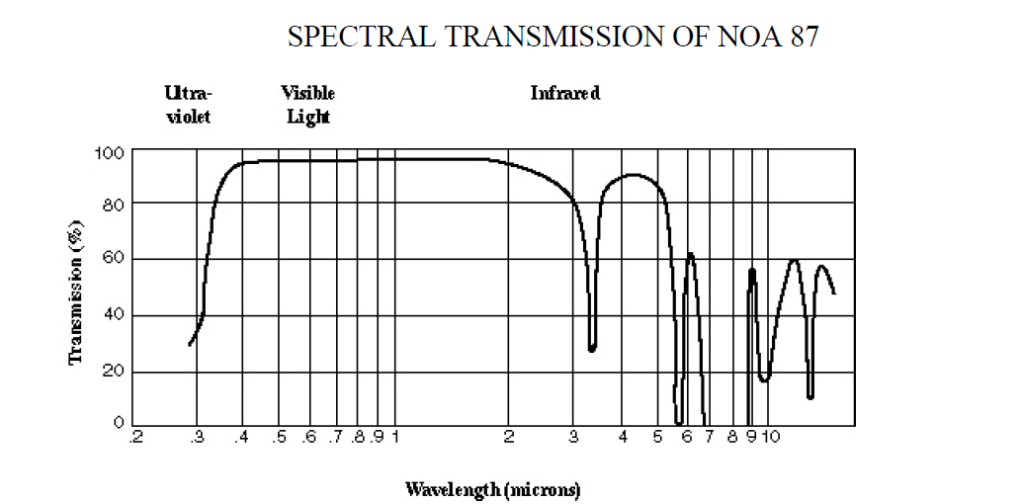
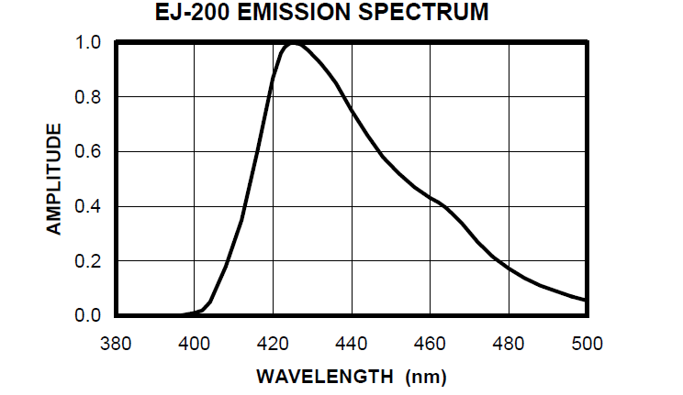
Gluing Light Guide to PMT
NOA 87 by Norland:
- cures when exposed to UV light
- maximum adhesion to glass
after one week at room
temperature
(NOA 87 Data sheet, Norland)
Scintillator: Ej-200 by Eljen Technology
- Maximum Emission at 425nm
(EJ-200 Data Sheet, Eljen Technology)
 | Refractive Index
Scintillator | 1.58
Light Guide | 1.502
PMT window | 1.51 - 1.54
Glue | 1.52

Slide 2
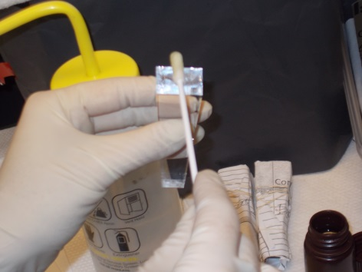
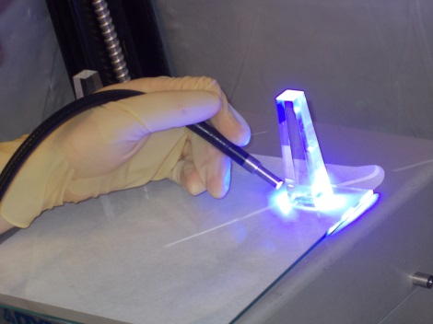
Testing Results
Pros | Cons
Easy application | Samples look good after curing, but form clouds over night
Fast curing
Strong bonding
Update:
More testing showed, that clouds were a result of uneven curing
First to detector counters were glued last week
We are planning on finishing gluing this week

