Slide 1
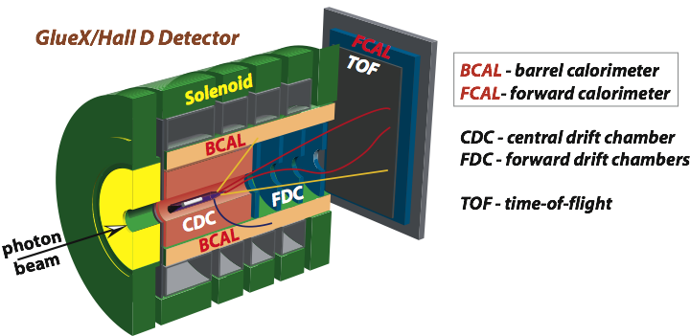
Beamline Commissioning and Radiation
A. Somov, Jefferson Lab
E12-19-003
Experiment Readiness Review
March 31, 2020

Slide 2
Outline
Beam Commissiong (charge 7)
Are the beam commissioning procedures and machine protection systems sufficiently defined for this stage?
Radiation level (charge 4)
What is the impact of the expected neutron radiation on GlueX detector components such as the SiPMs? Is any local shielding required? Are the radiation levels expected to be generated in the hall acceptable?

Slide 3
Photon Beam Requirements
Experiment | Energy Range (GeV) | Polarization | Flux in the energy range of interest γ/ sec | Flux on target (0.012 – 11.7 GeV) γ/ sec
GlueX Design | 8.4 - 9.1 | 40 % | 10⁸ | 1.8 ⋅10⁹
GlueX II | 8.4 - 9.1 | 40 % | 5 ⋅ 10⁷ | 9 ⋅ 10⁸
This experiment | 8.4 - 9.1 | 40 % | 2 ⋅ 10⁷ | 3.6 ⋅ 10⁸
This experiment
GlueX II
Electron beam current: 140 nA 350 nA
Radiator thickness: 4 ⋅ 10⁻⁴ X₀ 4 ⋅ 10⁻⁴ X₀
Collimator diameter: 5 mm 5 mm
Photon flux on target is about 2.5 smaller than GlueX II flux
( 5 times smaller than GlueX designed flux)

Slide 4
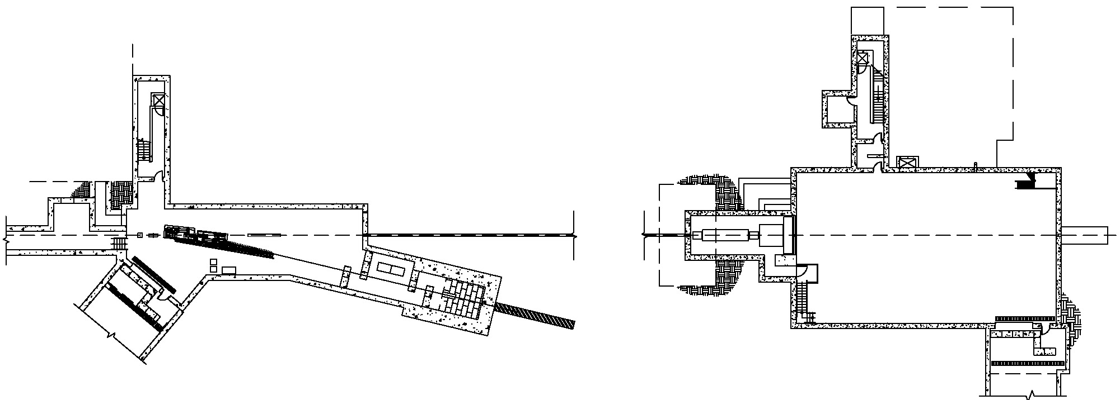
Hall D Photon Beam Line
Use standard Hall D beam line equipment for SRC / CT !
Radiator
GlueX detector
photon beam
Photon
Beam dump
~12 GeV
e⁻
75 m
Collimators
Tagger hodoscope
& microscope
Electron beam dump
Pair
Spectrometer

Slide 5
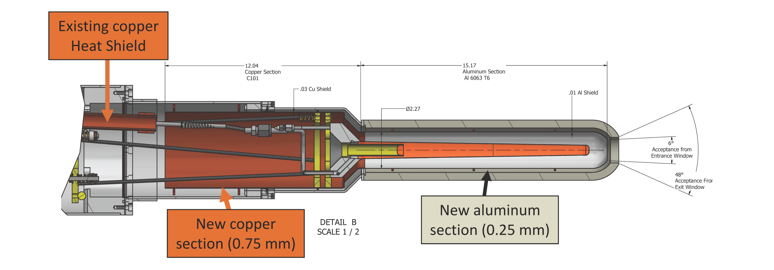
Targets
See C. Keith talk
LD (LHe) target. Standard GlueX target cell and cryogenic system
- LHe targer was used by Hall D PrimEx expeiment
Carbon target
- Similar to PrimEx Be target

Slide 6
SRC/CT Beamline Summary
12 GeV polarized photon beam has been successfully used by the GlueX
experiment in 2016 - 2019
Typical GlueX beam configurations:
- electron beam current 100 – 350 nA (data production)
< 5 nA (PS calibration)
Beamline equipment installed in Hall D is ready to use by the SRC/CT
experiment
Photon beam conditions used for the GlueX data production satisfied
specifications of the RC/CT experiment
Beam delivery/monitoring procedures and machine protection systems are
the same as for the GlueX experiment

Slide 7
Charge 4
Radiation Level
Radiation damage to Silicon Photomultipliers (SiPM)
produced by neutron background
Radiation level in Hall D

Slide 8
SRC Targets and Run Period
Target | Thickness [cm] / % X₀ | Atoms | Run Time (days)
LH | 30 / 3.4 | 1.28⋅10²⁴ | GlueX
D | 30 / 4.1 | 1.51⋅10²⁴ | 4.5
⁴He | 30 / 4.0 | 5.68⋅10²³ | 1
¹²C | 1.9 / 7 | 1.45⋅10²³ | 7
SRC/CT photon flux is 5 times smaller than GlueX designed flux
The largest neutron background will be produced on liquid deuterium and
helium targets

Slide 9
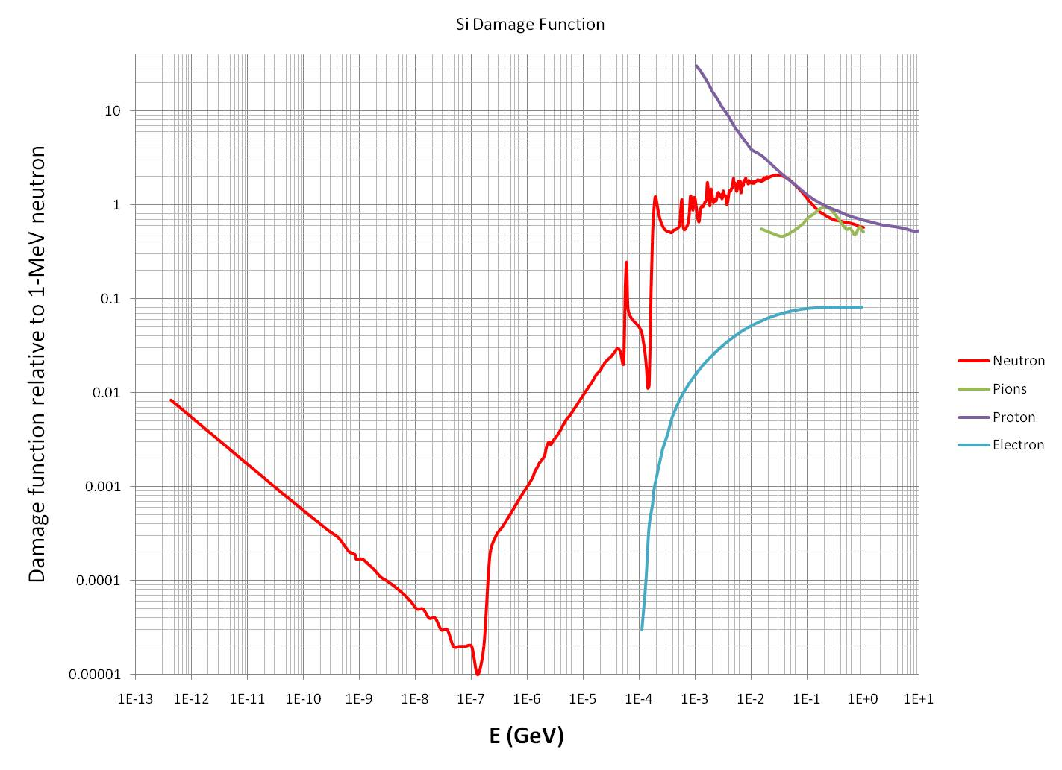
Radiation Damage to SiPM
- displacement of atoms in the lattice
associated with the kinetic energy
release to matter
- characterized by damage function
(similar to biological damage curve)
- in simulation, convert particle fluence
to the equivalent fluence of 1 MeV
neutrons using the damage function
- largest damage is produced by neutrons
with E_{kin} ≥ 1 MeV
1 MeV
Increase of the SiPM dark noise

Slide 10
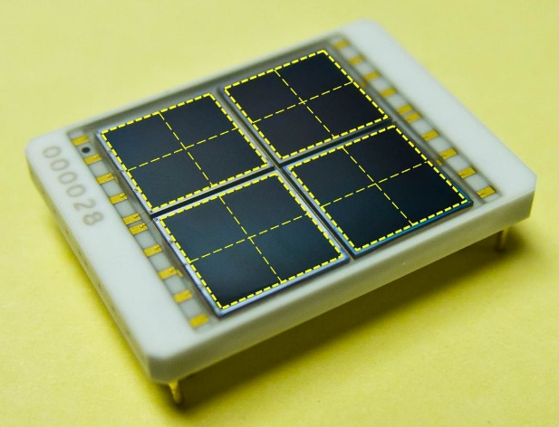
Silicon Photomutipliers in Hall D
Barrel Calorimeter
- array of 3 mm x 3 mm SiPMs (3840 sensors)
- calorimeter design allows for a factor of 5 increase of the dark rate
- radiation hardness studied using Am-Be neutron source and
beam test setup in Hall A
https://halldweb.jlab.org/wiki/index.php/SiPM_Radiation_Hardness_Test
NIM A 698 (2013) 234
(critical dose 32 rem, 1 rem ∼ 3.3⋅ 10⁷ n_{EQ} / cm² neutron 1 MeV equivalent fluence)
expected lifetime at GlueX designed luminosity (10⁸ γ / sec)
8 - 10 years for Hydrogen
5 - 7 years for Helium
(assuming the experiment operation efficiency of 33%)

Slide 11
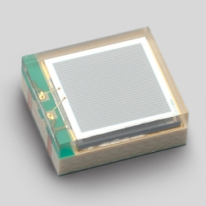
Silicon Photomutipliers in Hall D
Start Counter
3 mm x 3 mm SiPMs (120 sensors)
each ST paddle is instrumented with 4 sensors
Measure similar dependence of the dark rate on the neutron radiation
as for the BCAL sensor
scintillator detector, not very sensitive to the dark current. Large
readout thresholds can be set
- signal pulse amplitude > 100 pixels
- single pixel dark rate: 900 kHz per SiPM at room temperature
(number of noise pixels in 100 ns time window - 0.4, pulse width – 40 ns)
Increase of the dark rate by a factor of 10 is not a problem

Slide 12
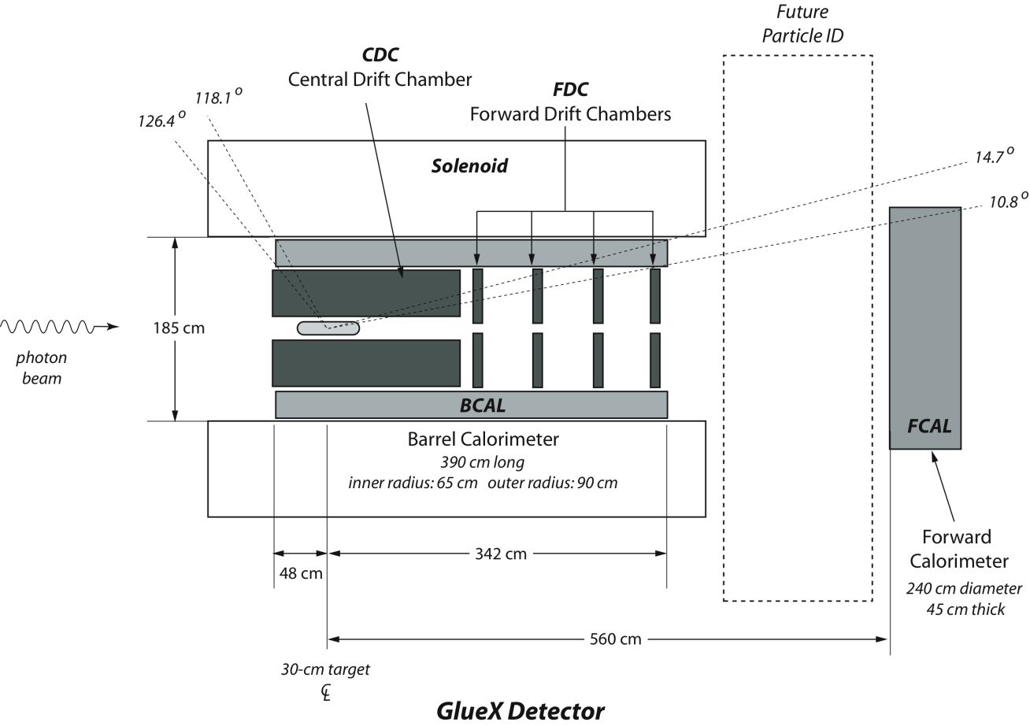
Silicon Photomutipliers in Hall D
BCAL SiPMs
BCAL SiPMs
ST SiPMs
Barrel Calorimeter SiPMs ( 4 x 4 array of 3 mm x 3 mm)
Start Counter SiPMs ( 3 mm x 3 mm )

Slide 13
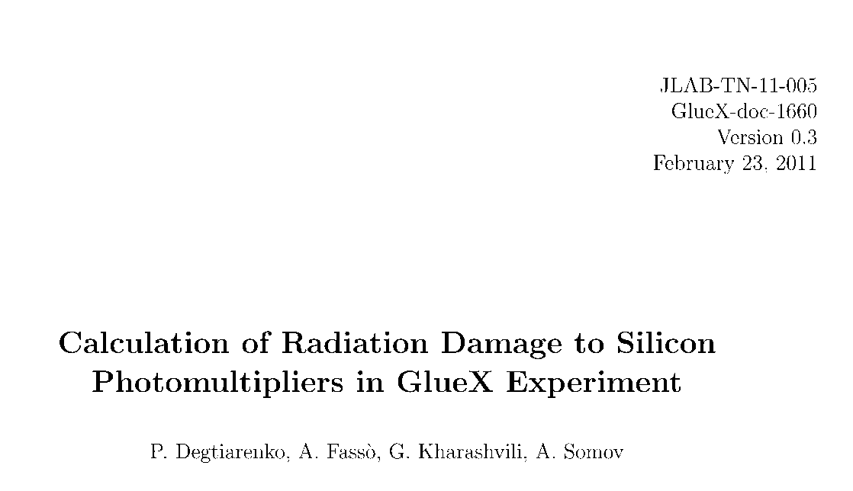
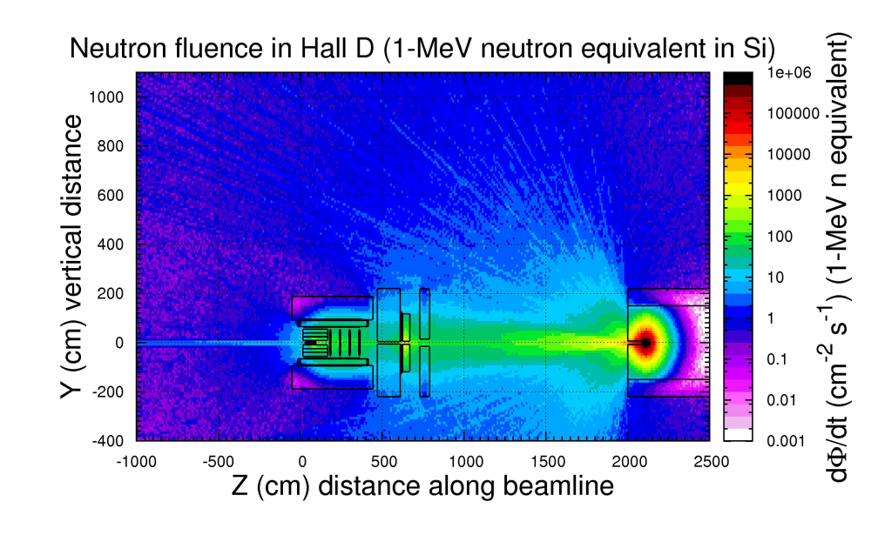
Simulation of the Radiation Level in Hall D
Estimated background from liquid hydrogen, helium, and deuterium targets using
Fluka and Geant simulations provided by the JLab Radiation Control group

Slide 14
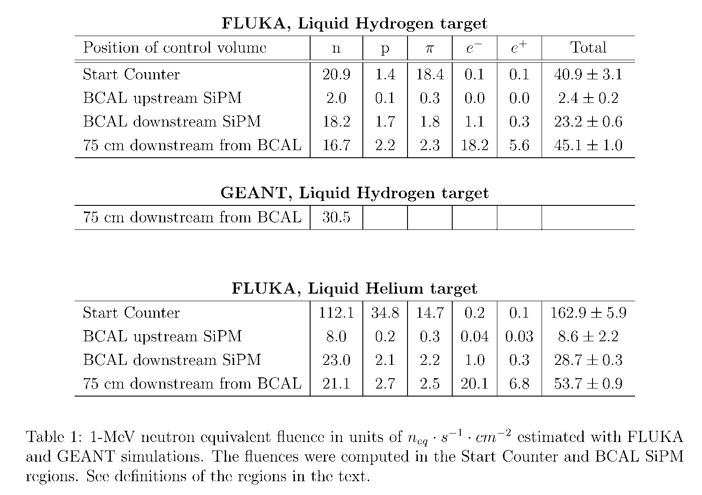
Neutron Background Induced by LH and LHe Targets
Background was evaluated for the GlueX
designed luminosity
In the BCAL, background is larger In the
downstream end
- it increases by about 30 % for the
LHe target
Background is significantly larger in the
Start Counter SiPM region
SRC/CT beam flux on target is 5 times smaller than that for GlueX
Background induced by the LHe target will not exceed the GlueX level

Slide 15
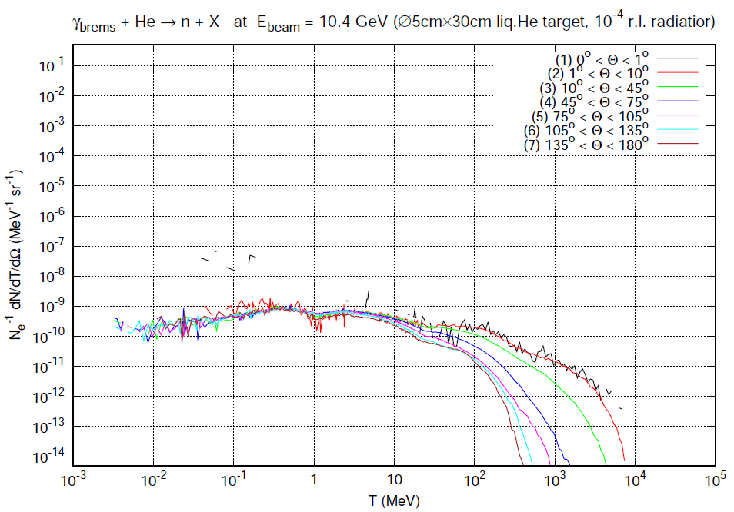
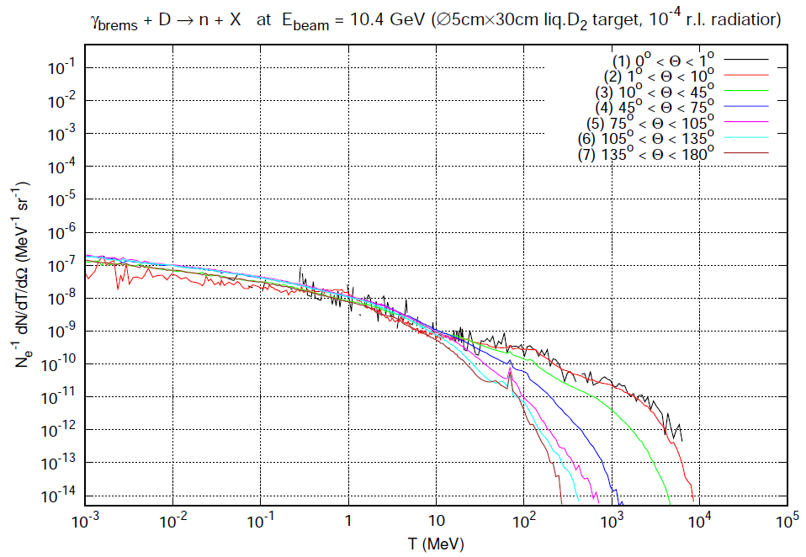
Neutron Flux: Liquid He and D Targets
Neutron flux originated from LHe and LD targets
He
D
Recent calculations by Pavel Degtyarenko
Computed using RadCon Geant and Fluka
- relatively good agreement between Geant and Fluka

Slide 16
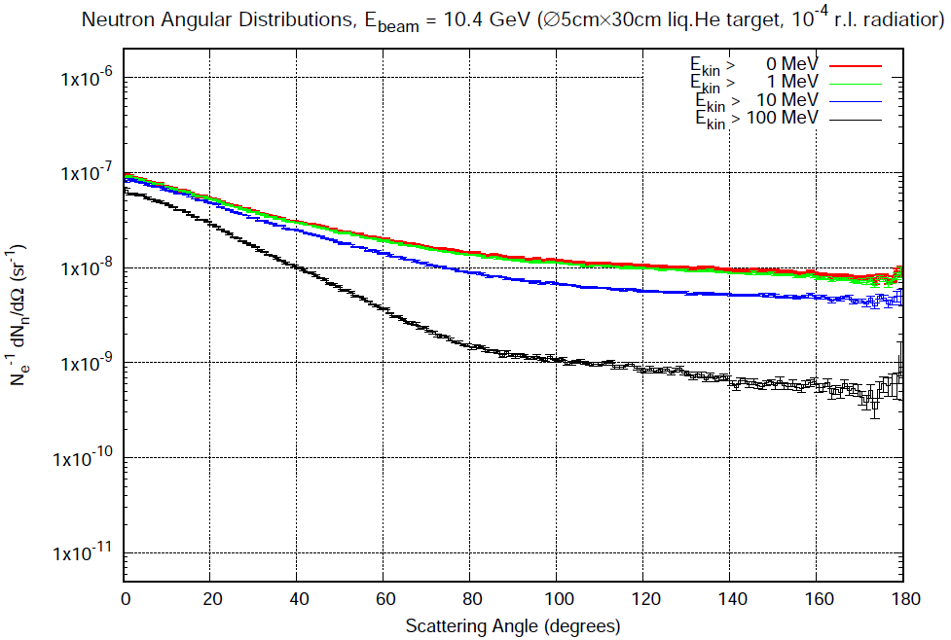
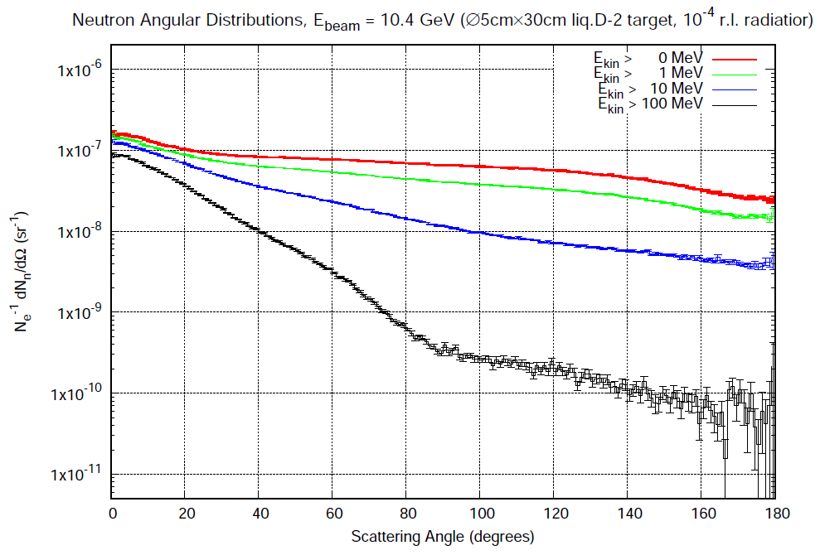
Neutron Flux: Liquid He and D Targets
Helium
Deuterium
ST
BCAL downstream
BCAL upstream

Slide 17
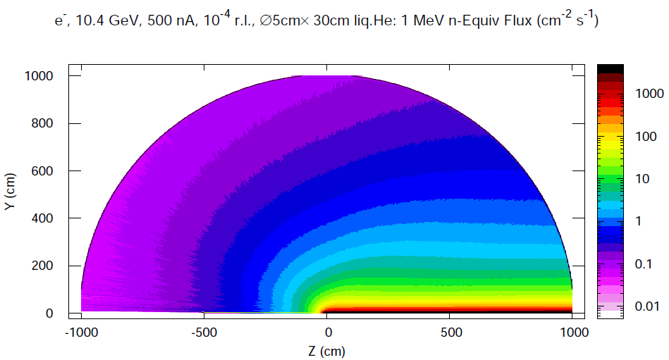
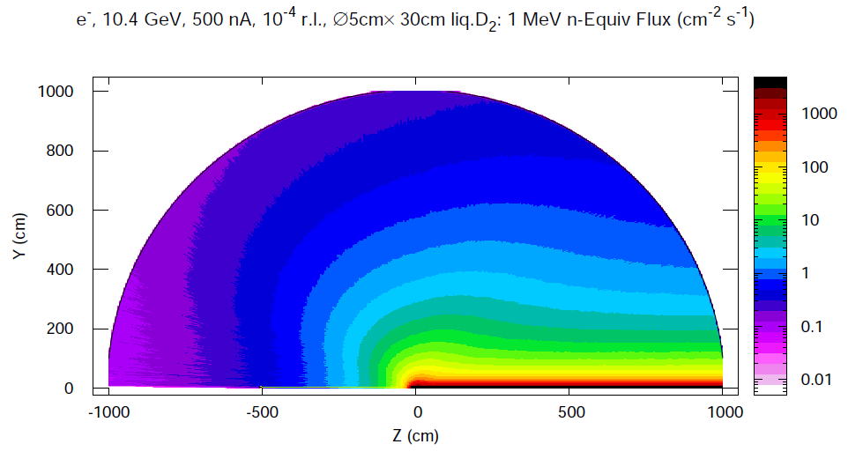
1 MeV Equivalent Flux: He and D Targets
He
D
1 MeV neutron equivalent fluence for the Deuterium target is
larger than that for the He target by about a factor of
- 3 – 4 for the ST SiPM region
- 2 for the BCAL upstream SiPM region

Slide 18
Summary: Radiation Damage to SiPM
Expected life time of SiPMs
 | GlueX Design | SRC/CT
 | LH target | LHe₄ target | LD target
BCAL | 8 years | 25 years | 7.7 years
ST | 5 years | 6.2 years | 1.6 years
SRC/CT run time 1x3 = 3 days 4.5x3 = 13.5 days
Estimate life time using radiation doses estimated RadCon
Conservative assumptions regarding neutron background induced by deuterium target
Assume experiment operation efficiency of 33 %

Slide 19
Monitoring SiPM Dark Current
Reference to PrimEx (2.8 times smaller flux, 20 PAC days on He)
Monitor FADC 250 pedestal width. Pedestal broadening due to the
increase of the dark rate.
No significant increase of the pedestal width observed after taking
data ( < 10 % with large systematic uncertainties)
We will periodically monitor pedestal width during the SRC/CT run
(special 10 min runs with the random trigger).

Slide 20
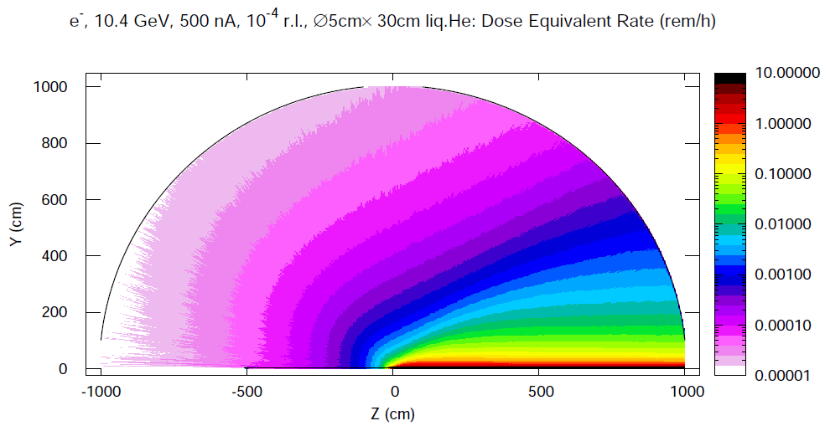
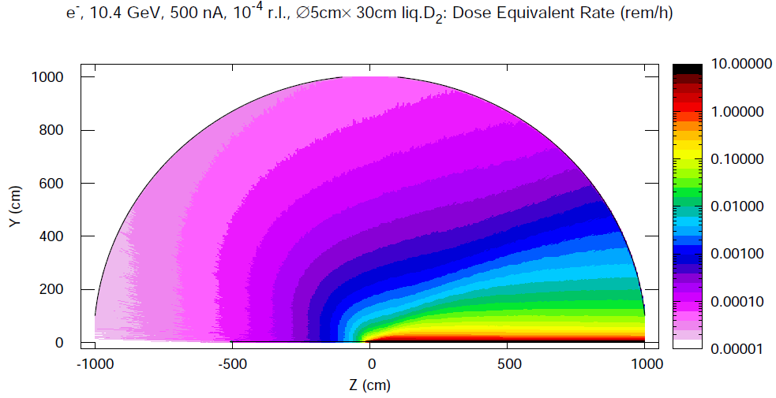
Radiation Level in Hall D
Dose Equivalent Rate: He and D Targets
He
D
Estimated neutron dose equivalent rate in Hall D(ceiling) induced by the deuterium
target is expected to be 3 – 4 times larger than that for helium (conservative assumption)

Slide 21
Radiation Level in Hall D
Experimental Hall D was designed to handle the photon flux about 5 tames larger
than the GlueX nominal flux (corresponding to 108 γ /sec in the energy range
between 8.4 GeV and 9.1 GeV )
The SRC/CT experiment will run at 5 times smaller photon flux
The largest neutron background is expected to be produced on the deuterium
target. This background was estimated to be on the level of the designed GlueX
Background in the experimental Hall will be monitored by RadCon for each target
type

Slide 22
Monitoring Radiation Level in Hall D
Installed quick access ionization chambers (show locations)
Install thermoluminescent dosimeters (TLD) close to the target
Install Bonner spheres (determine the energy spectrum of neutons) close
to the target (coordinate with RadCon group)

Slide 23
Radiation Level Summary

Slide 24
Backup Slides

Slide 25
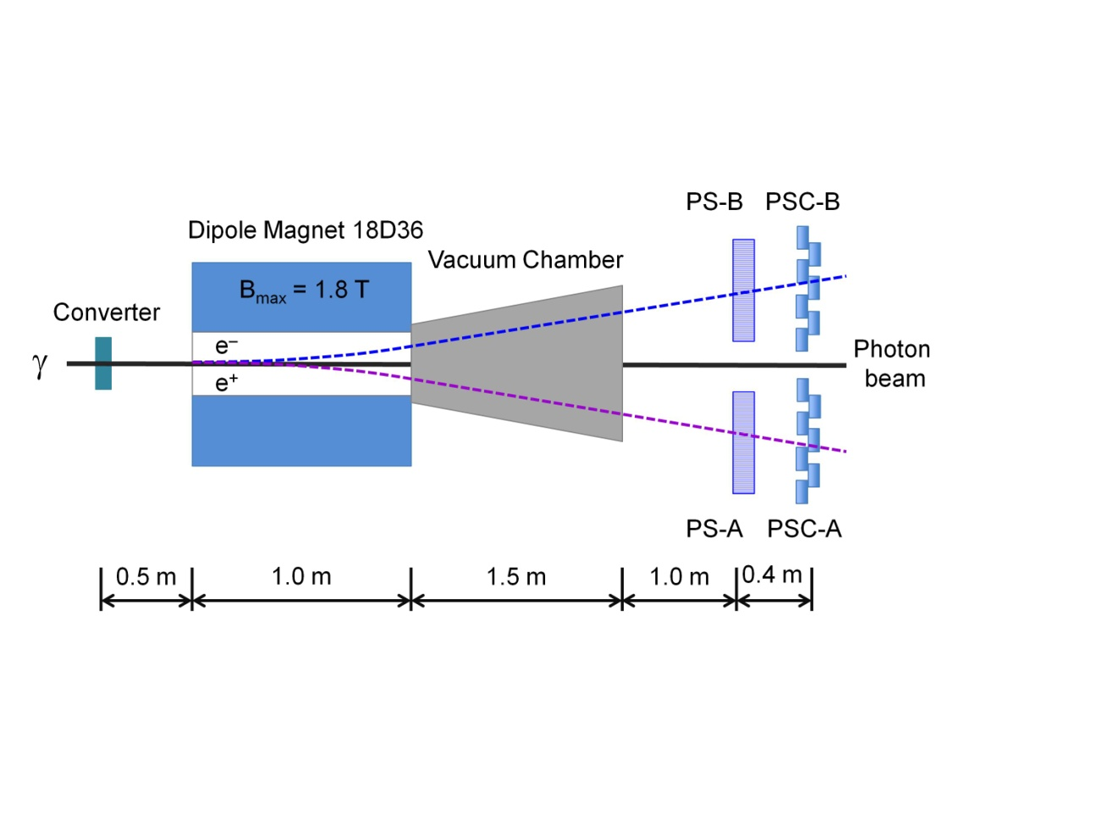
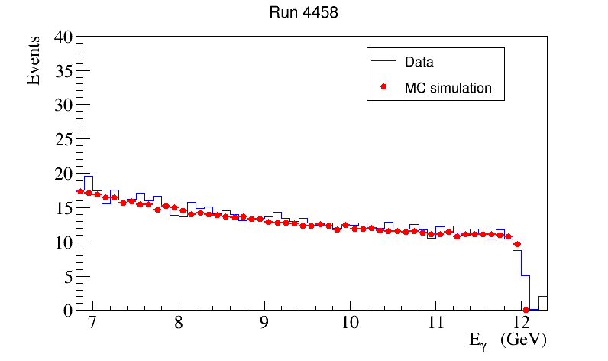
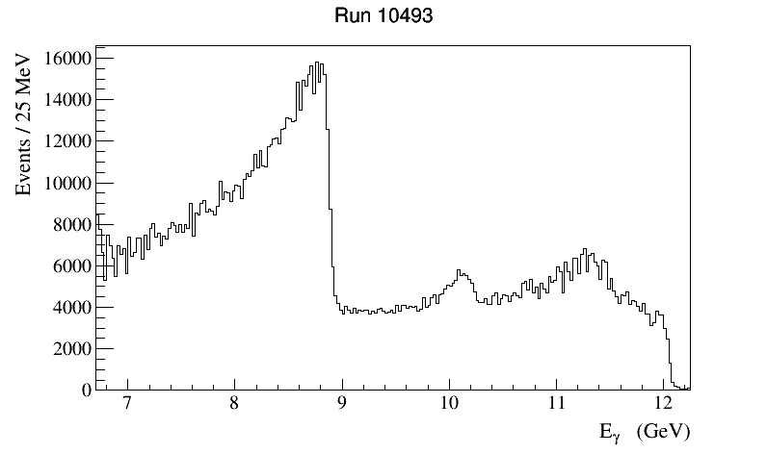
Photon Flux Measurements with Pair Spectrometer
Two layers of scintillator detectors:
High-granularity hodoscope
(measure photon energy in the
range 6 – 12 GeV )
Low-granularity counters (use in trigger)
Reconstruct the energy of a beam photon by detecting e± pairs
- measure the photon beam flux and spectrum of the collimated photon beam
Amorphous Radiator
Polarized Beam

Slide 26
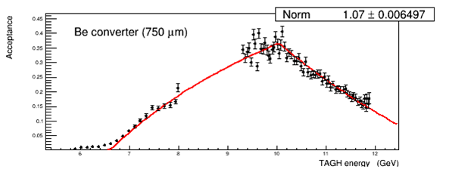
Photon Flux Measurements with Pair Spectrometer
PS acceptance and energy determination
- Ray tracing (measure magnetic field map)
- Calibrate using total-absorption-counters (TAC) at low luminosity
3.4 mm collimator ,
2 ⋅10⁻⁵ X₀ radiator,
2 nA beam current
Calibration is performed regularly; takes 2-6 hours
- will be performed during PrimEx-D run (Recommendation 1.5)
Special trigger type – continuous flux monitor ( typical rate 1 – 3 kHz)
- fadc / CTP scalers inserted to the data stream and EPICS
Monitor the photon flux with the precision < 1 %

Slide 27
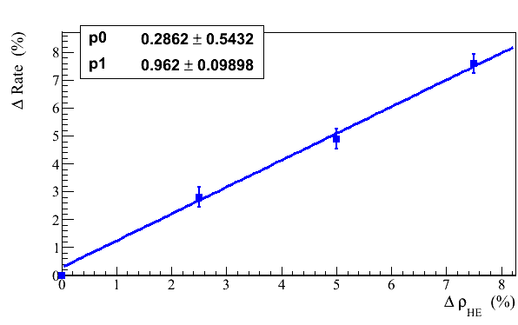
Target Density Monitor
Short term stability control:
- photon beam flux provided by the PS
- rates in the Start Counter (ST) and Time-of-Fight (TOF) wall
ST rate dependence on the target density
ST consists of 30 paddles surrounding the target
ST rate for production runs: 250 kHz / paddle
Coincidence of hits between the ST and TOF
(2 x 2 bars in TOF at R = 30 cm & one ST paddle)
1.5 kHz
Long term stability control:
- monitor using Compton process; expected rate in the photon range of
interest is about 30 Hz

Slide 28
Pair Spectrometer Acceptance Calibration
Calibrate PS acceptance using total-absorption counter (TAC)
Data samples were acquired for three converters
- 5.7 x 10⁻³ R.L. Al (508 μm foil)
- 2.1 x 10⁻³ R.L. Be (750 μm foil)
- 0.21 x 10⁻³ R.L. Be (75 μm foil)
Run conditions
- 3.4 mm collimator , 2 ⋅10⁻⁵ radiator, 2 nA beam current
Trigger
- run two triggers in parallel: PS and TAC (energy sum)
- PS rate: 10 Hz 750 μm Be
- TAC rate: 200 – 300 kHz ( trigger prescaling factor 129 )

Slide 29
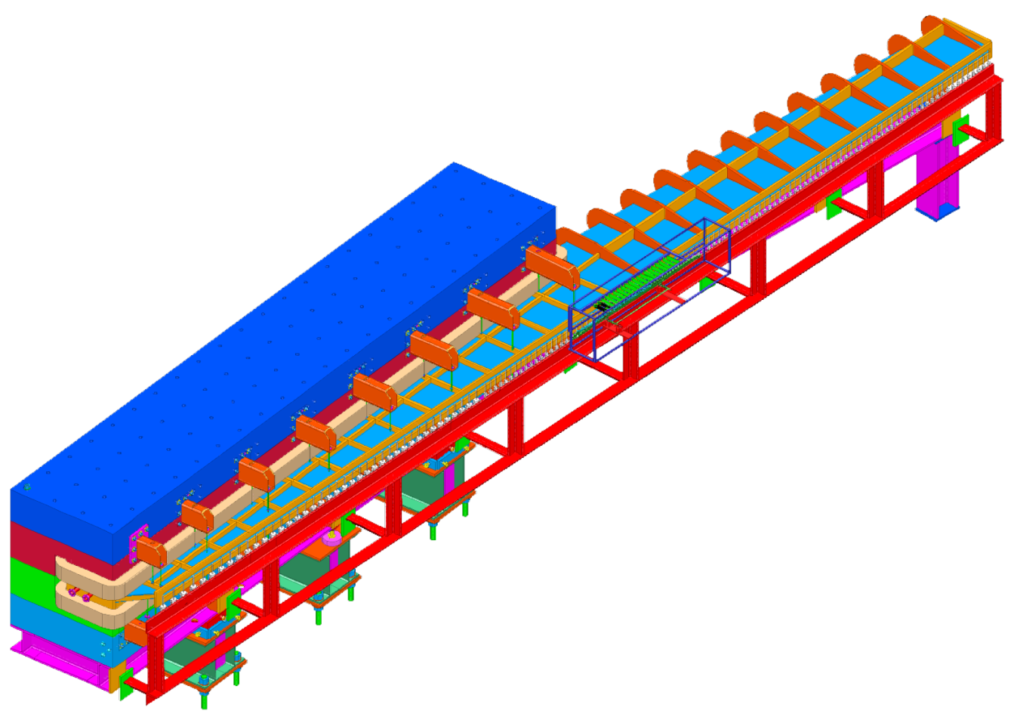
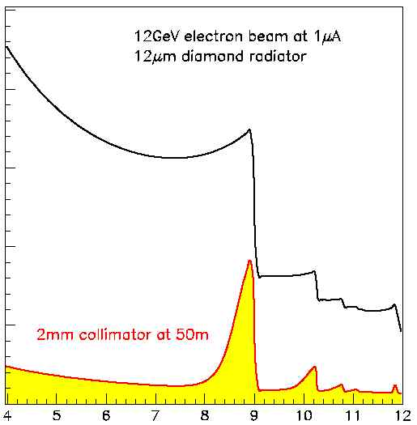
Tagged Photon Beam
Electrons to the
beam dump
Photons to Hall D
Microscope
array 100 x 5 of thin scintillators
detect electrons in the energy
range 8.1 GeV < E _{γ} < 9.2 GeV
12 GeV
e beam
Radiator
Fixed Array Hodoscope
cover large energy range 3 GeV < E _{γ} < 11.7 GeV, Δ E_{γ} / E _{γ} < 0.002
233 counters installed
detect tagged ellectrons with E_{γ} > 9.2 GeV during data runs
accidental background for PrimEx-D < 4 %

