Slide 1
Commissioning Analyses 3
A.A
25 Jun 2019

Slide 2
outline
Event Selection
Timing Correction
Reco. Cherenkov Angle per Track
Photon Yield Study
Cherenkov Track Resolution

Slide 3
Event Selection

Slide 4
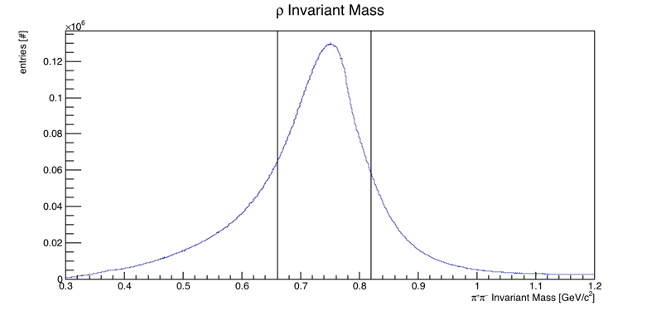
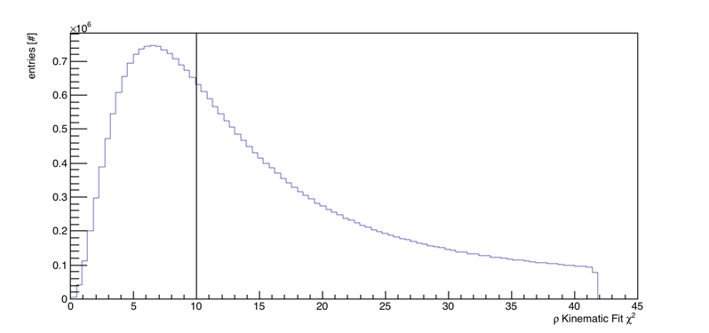
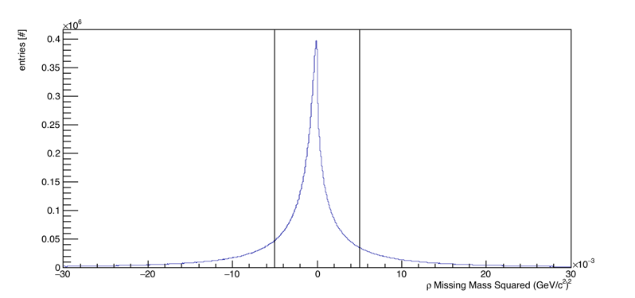
Event Selection
Pion Data
Selected
Selected
Selected

Slide 5
Occupancy
DIRC Wall Occupancy distribution

Slide 6
Timing Correction
Divide DIRC Wall into segments

Slide 7
Timing Correction
Direct
photons
Reflected photons
Draw time spectrum for each cell

Slide 8
Timing Correction
Draw time difference for each cell

Slide 9
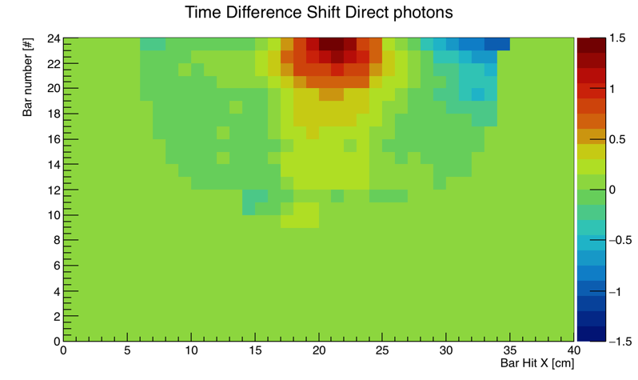
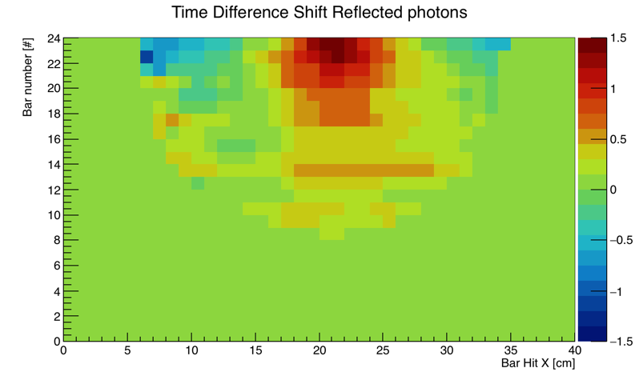
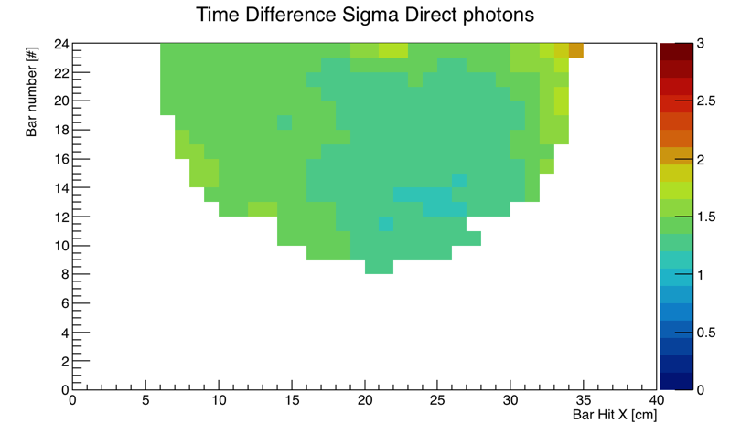
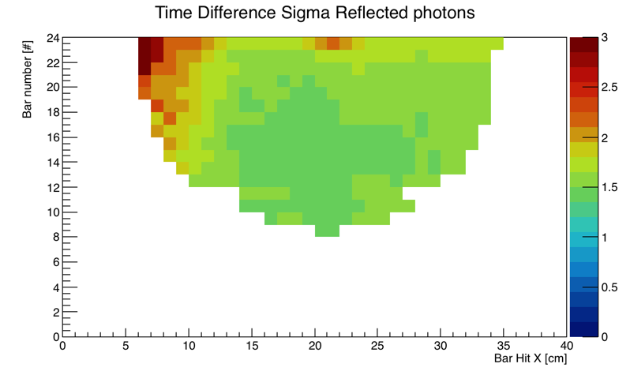
Timing Correction
Maps used to remove the shifts

Slide 10
Reco. Cherenkov distribution per Track

Slide 11
Reco. Cherenkov distribution per Track
One Track

Slide 12
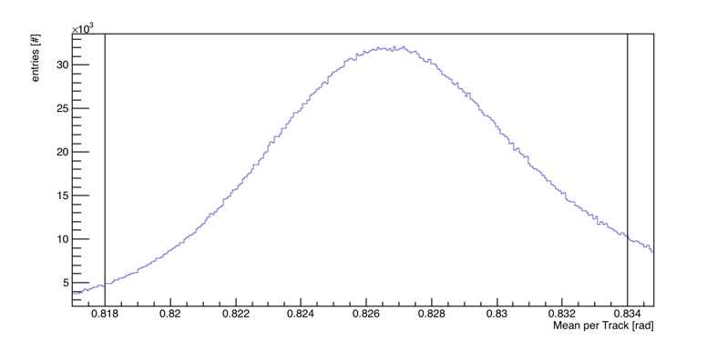
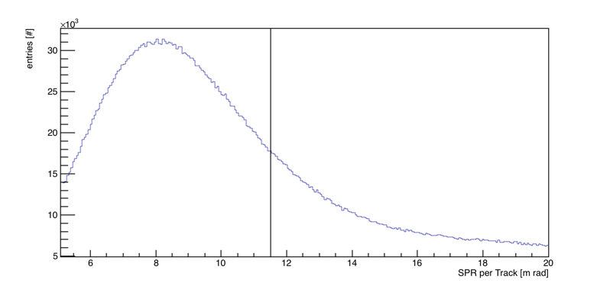
Fitting Parameters
Selected
Selected

Slide 13
Photon Yield Study

Slide 14
Photon yield
Increasing photon yield by increasing momentum

Slide 15
Photon Yield Vs Momentum
Increasing photon yield by increasing momentum

Slide 16
Cherenkov per track vs Yield
Few mrad shift
Expected pion
Expected Kaon
Reco. Cherenkov angel

Slide 17
SPR vs Yield
Single photon resolution per track

Slide 18
Photon Yield Map all Momenta
Photon Yield Map

Slide 19
Cherenkov Track Resolution

Slide 20
Cherenkov Track Resolution
Used as expected value for a given momentum range
Reconstructed Cherenkov angle per track @ momentum 3-4 GeV/c

Slide 21
Cherenkov Track Resolution
Classify tracks based on number of photon yield per track
Photon yield per track @ momentum 3-4 GeV/c

Slide 22
Cherenkov Track resolution
Sigma is the Cherenkov angle resolution per track
Cherenkov angle resolution per track @ momentum 3-4 GeV/c @ a given photon yield bin

Slide 23
Cherenkov Track Resolution
Tracking resolution
Cherenkov angle resolution

Slide 24
Average Cherenkov track resolution map
Region corresponds to photons with the longest path length
Optical Box Side

Slide 25
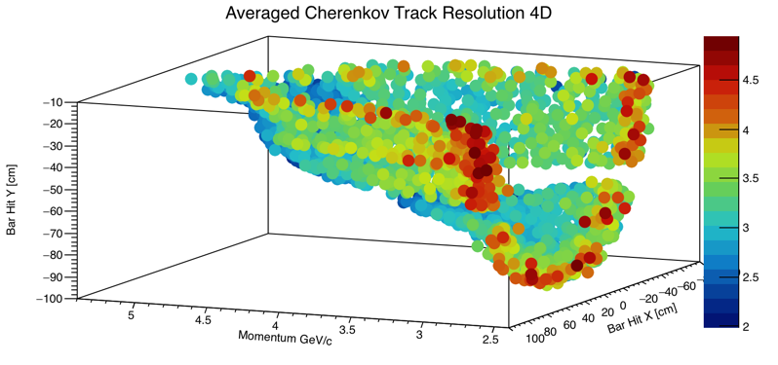
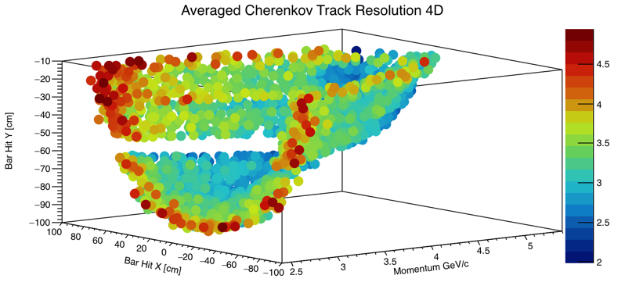
4 D Average Cherenkov track resolution map
Average Resolution (all momentum all photon yield) mrad

Slide 26
Next Step
Cherenkov Systematics Study
Separation power Study

