Slide 1
Engineering/Design Status
We are Here!

Slide 2
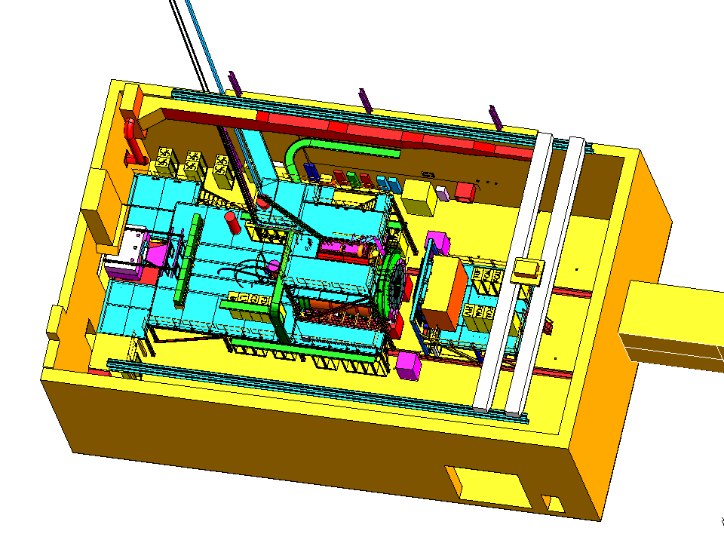
Hall D
AC ducts
Pair Spectrometer
Cryogenics platform
North Wall
Cable trays
Penetrations for gas lines
Beam
Overhead crane
Upstream platform
Photon dump
Downstream platform
Electronics racks
Solenoid
Truck ramp entrance
FCAL/DARK ROOM

Slide 3
What has JLAB Engineering group been working on?
Detail design, fabrication and drawings for CDC
BCAL Wedge detail and assy drawings and supporting fabrication
BCAL readout design layouts
FCAL module details and assembly drawings (IU J. Frye)
Magnetic shield testing (FCAL and TOF)
FDC redesign( 95%) and fabrication/procurement
FDC prototype fabrication
Planning FDC construction site
Tagger redesign, FEA and procurement
Preliminary design for platforms
Preliminary design for Target, start counter
Design and fabrication of Solenoid components
Initial cryogenic supply design
Repair of solenoid coil 1 and coil 2
Design and setup for solenoid coil tests
Staffing up for eng, des and tech (mostly)
Supporting civil construction
Support/setup design reviews (Tagger, Solenoid)

Slide 4
Who is doing Engineering/Fab work at JLAB?
5 Mechanical Engineers – W. Crahen, (FDC, Tagger) T. Whitlatch (overall)
J. Fochtman (Cryogenics)
G. Biallas (Solenoid)
J. Ballard (Solenoid)
New engineer this summer
6 Mechanical Designers – C. Hutton, (FCAL, SiPM, FDC overall) J. Lagner(BCAL, solenoid, Tagger)
V. Razmyslovich (CDC, solenoid)
F. Martin (solenoid)
W. Sachleben (solenoid, platforms)
R. Getz (Cryo)
7 Work Coordinator/Technicians
T. Carstens (overall)
M. Stevens (Solenoid, FDC)
S. Spiegel (Solenoid)
C. Heck (FDC, Solenoid)
G. Humble (Solenoid)
R. Bunton (Solenoid)
K. Sullivan (Solenoid)

Slide 5
Target work remaining
Specification/design
Cooling of liquid H (pulse tube refrig?)
Options for solid, He? (Primex requirements? What shapes?)
JLAB Target group to fabricate target

Slide 6
Start work remaining
Complete specification requirements
Complete design package
Prototyping/testing in Florida International

Slide 7
CDC work remaining
Final straw tube procurements
Upstream gas plenum detail drawings and fabrication
Inner shell fabrication
Crimp pin – procurements
Gas system – detail design

Slide 8
FDC work remaining
Complete final drawing package
Procure production components
Gas system detail design
Set up of fabrication area
Complete fabrication procedures/travelers
Fabrication of FDC

Slide 9
BCAL work remaining
Lead final delivery (additional sheets)
Readout configuration – SiPm’s in work
Temp stabilization of readout (what set point? How stable do we need to be? Can we use a calibration map?)
Assembly tooling design – needs work
Setup and QC wedges

Slide 10
TOF remaining work
Final detail design
Light collection design – prototypes at Florida

Slide 11
FCAL remaining work
Work with IU on “insert” design (if required)
Support frame design (JLAB)
Dark room- cooling – IU

Slide 12
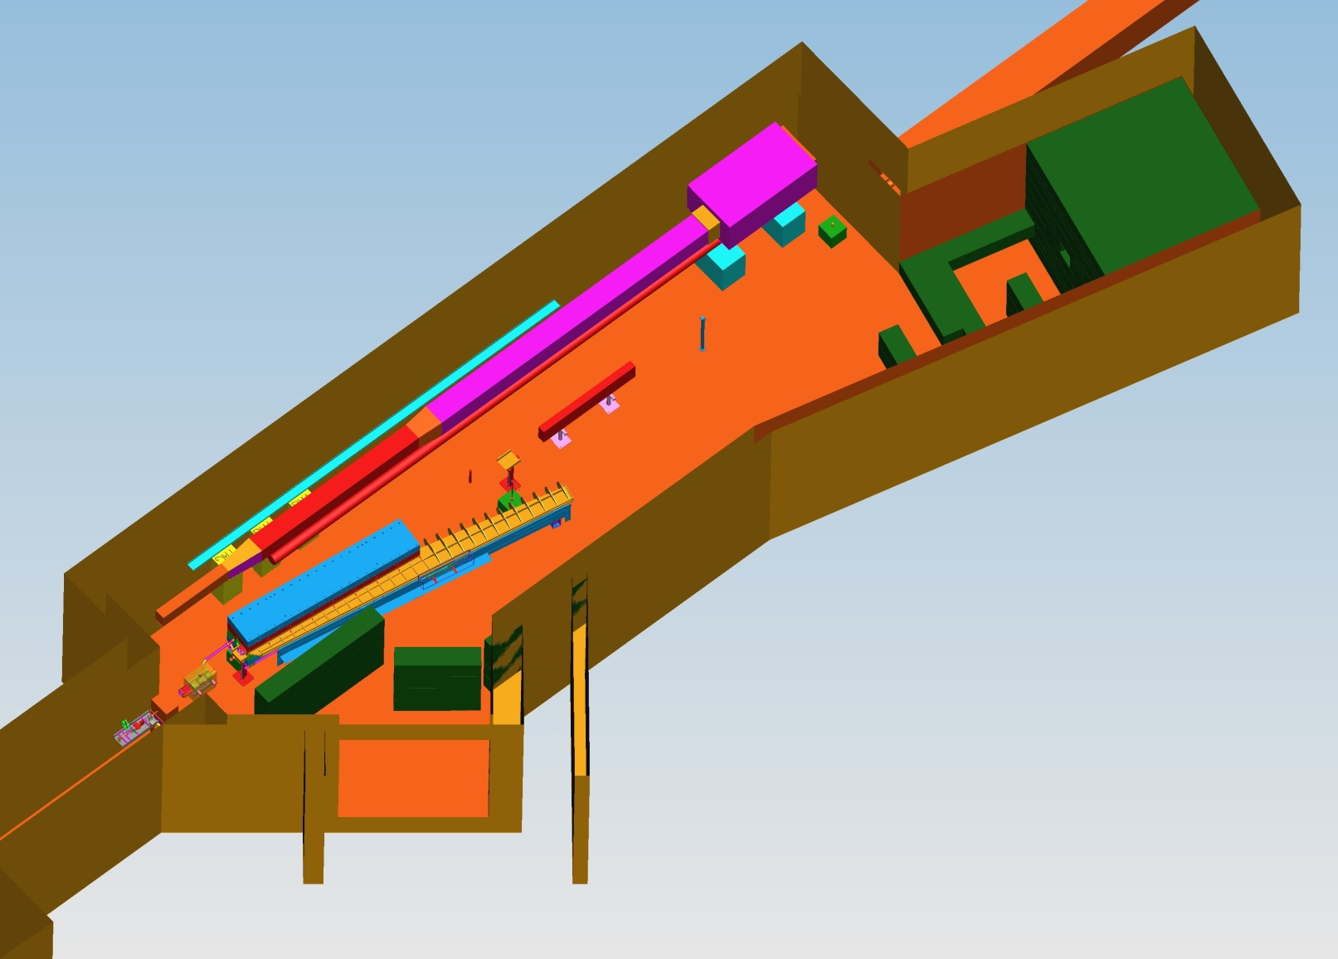
Tagger Area
Permanent Magnet
North Wall
Vacuum gages and pump
AC ducts
Photon Beamline
Beam Current Monitor
Quad
Radiator
Beamline encasement to Hall D
Electron Beamline
Vacuum Chamber
Electron dump
Tagger Magnet
Truck ramp entrance
Shielding

Slide 13
Tagger remaining work
Complete detail designs/drawings for;
Steel
Coils
Support Frame
Vacuum chamber
Procure all items above
Work with Catholic U on modified fixed array
Work with Connecticut U on Microscope mounting

Slide 14
New Tagger Magnet Model

Slide 15
Collimator Cave Layout
Pair Spectrometer Radiator
Permanent Sweep Magnet
Secondary Collimator
Lead Wall
Active/Primary collimator
Concrete Shielding Wall
Second Sweep Magnet
Kapton Windows
Shielding

Slide 16
BeamLine remaining work
Radiator/Goniometer – requirements/design
Beamline component details – mostly designed
Complete support stand details
Pair spectrometer Magnet– work with North Carolina on modifications
Pair converter – requirements/design
PS Detector detail design

Slide 17
Solenoid remaining work (more detail from George)
Complete remaining detail designs and get parts fabricated for test
Coil 2 repair/design
Testing of coils – to start Jun 2010 – April 2011
Complete final drawings for installation in Hall

Slide 18
Infrastructure remaining work
Tooling design – needs lots of work
Cooling systems design (liquid and air) – needs work, and there are many systems to design!
Gas system design – details needed (Beni has started)
Platform designs – details needed
Electrical layouts - details needed
Cable runs/support layouts - details needed
Meetings, reviews, scheduling, procedures
Cryogenics transfer line and can – almost complete

Slide 19
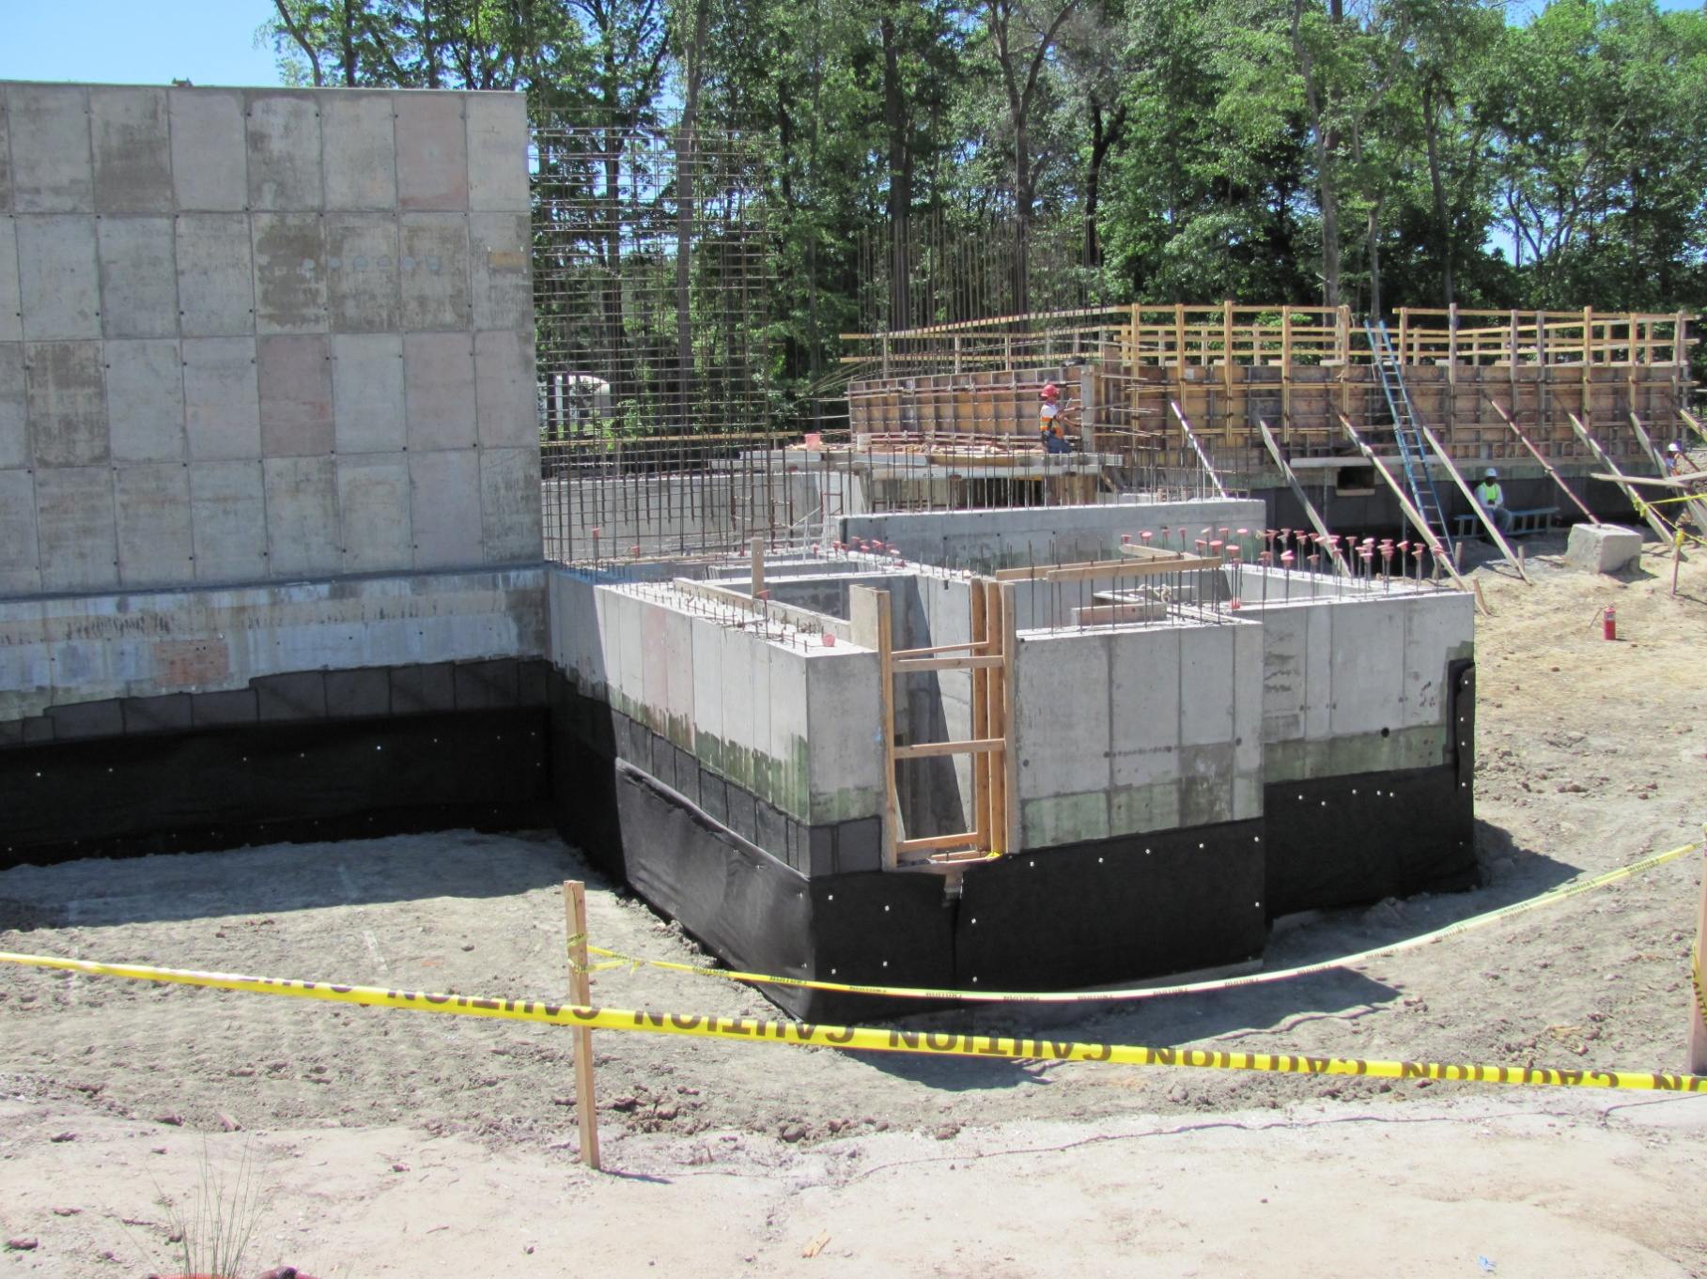
Civil Construction
Collimator cave
Water pump sump
North wall towards counting house

Slide 20
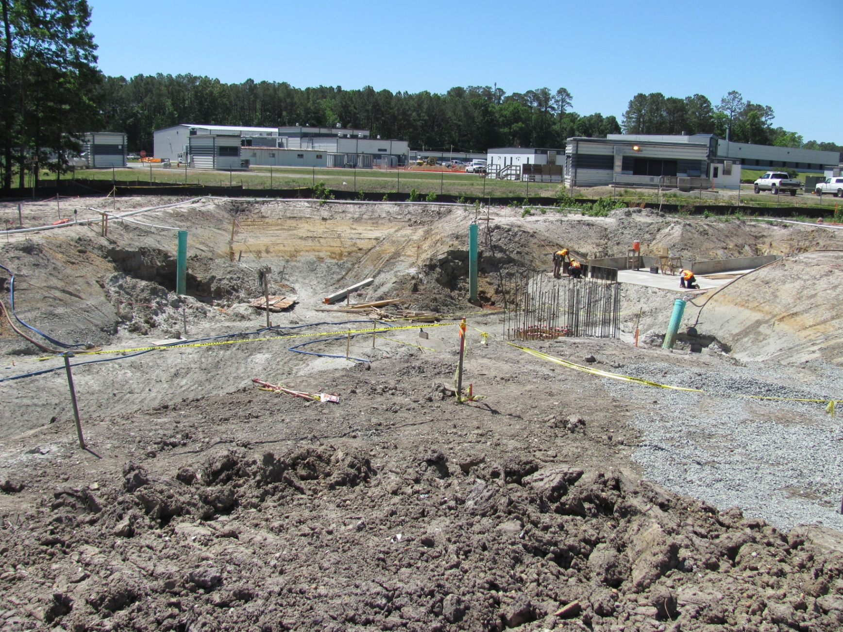
Tagger Pit
Beamline

Slide 21
Installation Support Required2011-2014
Update drawings/specs
Review procedures
Resolve ESH&Q issues
In process inspection
Additional planning
Actual hands on labor
Infrastructure design

Slide 22
Remaining Reviews for 2010
Solenoid Repair/Test/ES&H (Internal) (May)
Tagger Magnet Design (June)
Cryogenic Design (June)
Solenoid External (Aug/Sep)
Lehman (Sept)

Slide 23
Installation Schedule

Slide 24
How do we get there from here?
Keep Focused!

