Slide 1
PWO Crystal Production and Quality Control at SIC
Dr. Hui YUAN
SIC and JLab. Collaboration meeting, Shanghai, 2018.07.23

Slide 2
Outline
Modified Bridgman method
PWO crystals production
PWO quality control
Summary

Slide 3
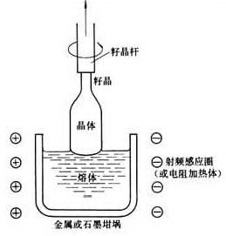
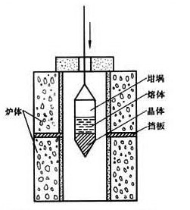
Crystal Growth
Czochralski
Bridgman
High quality
High cost
High temperature
High efficiency
Low cost
High flexibility

Slide 4
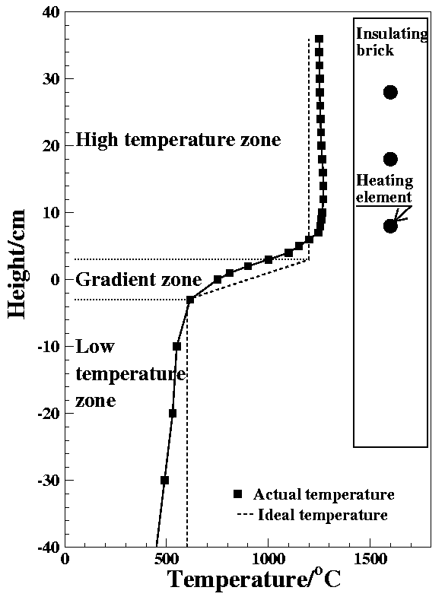
Modified Bridgman Method
PWO Crystal Growth Parameters
Speed：0.4-0.6 mm/h
Gradient：20-50 C/cm
Furnace temp：1170 C
Seeding temp: 1045 C
Furnace temperature profile

Slide 5
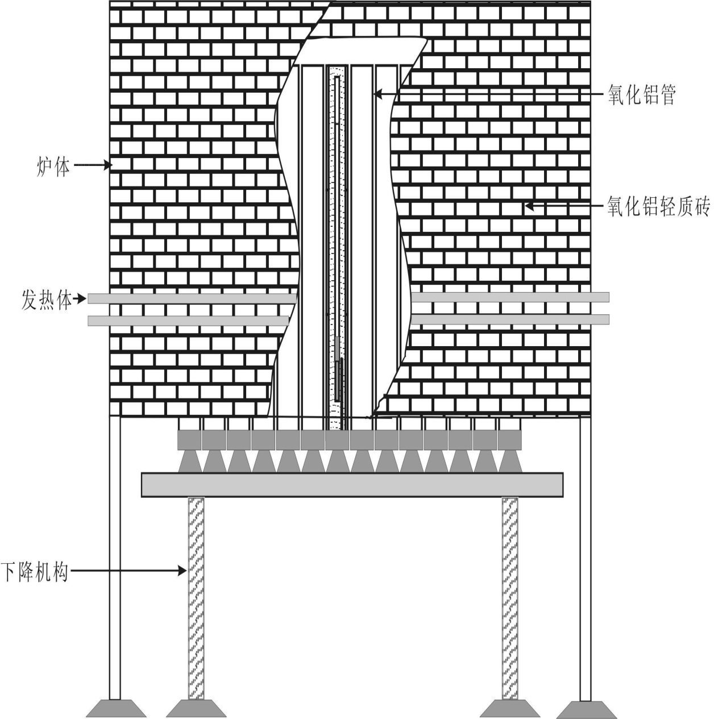
Modified Bridgman Method
Profile of modified multi-crucibles Bridgman furnace

Slide 6
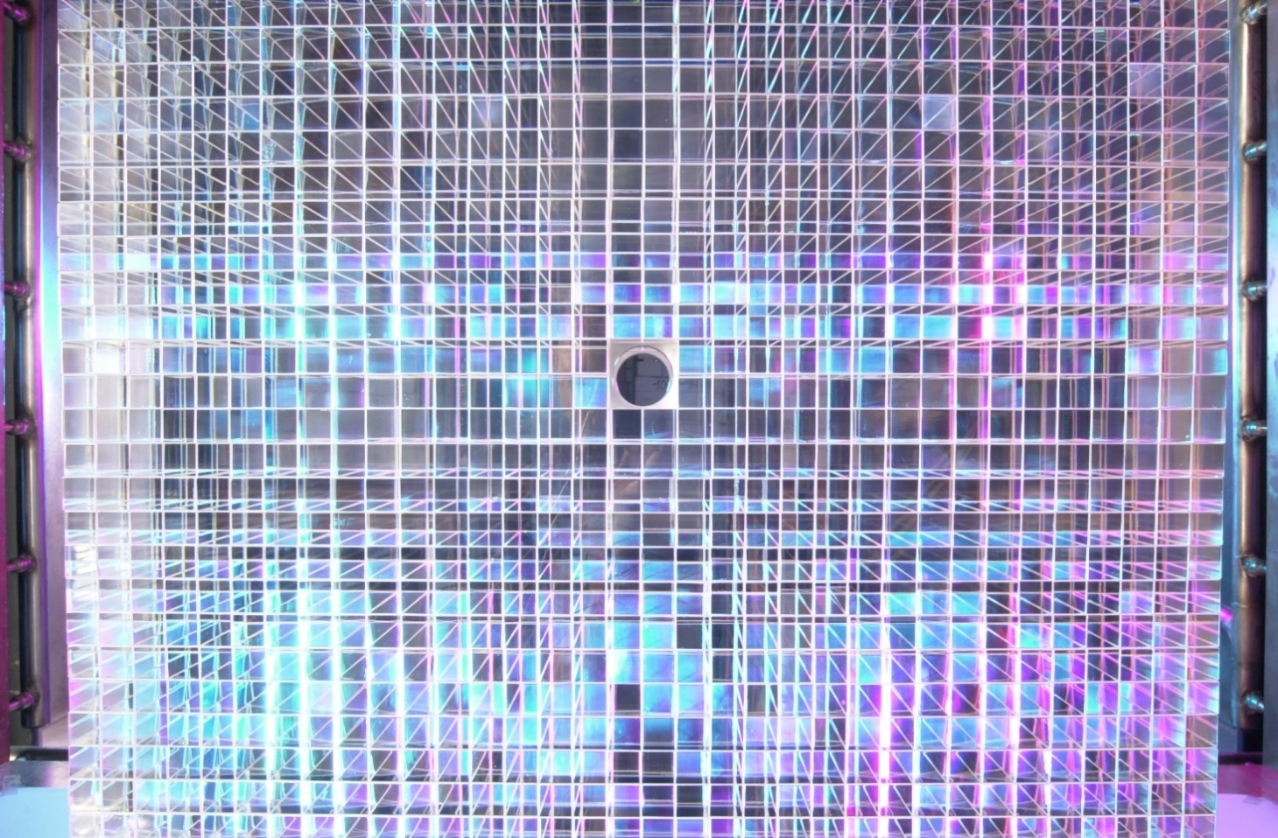
PWO CX for PrimEx
2001.5-2002.6, SICCAS provided PrimEx all 1275 PWOs.

Slide 7
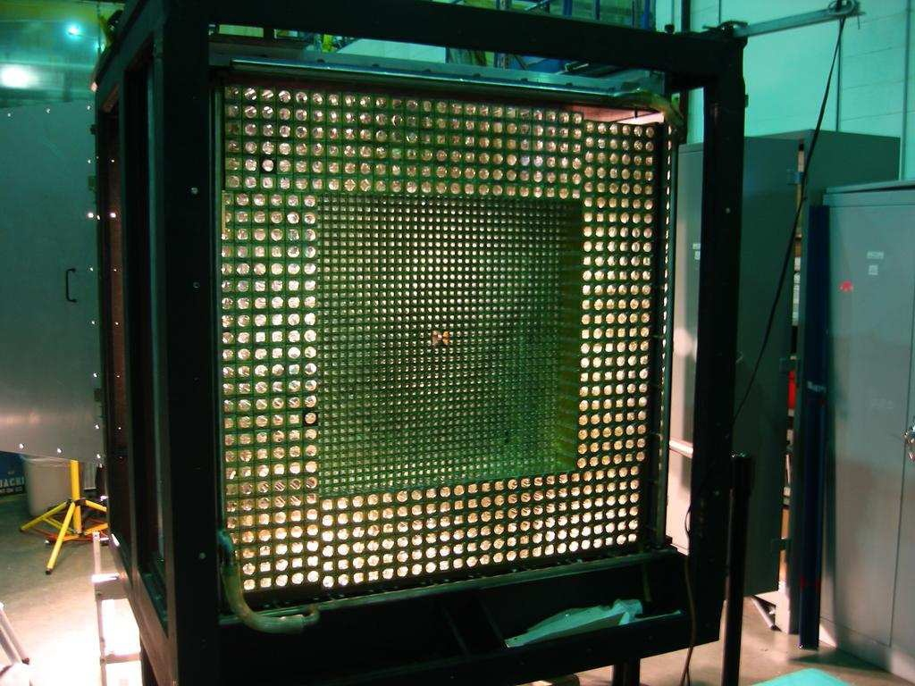
PWO CX for PrimEx

Slide 8
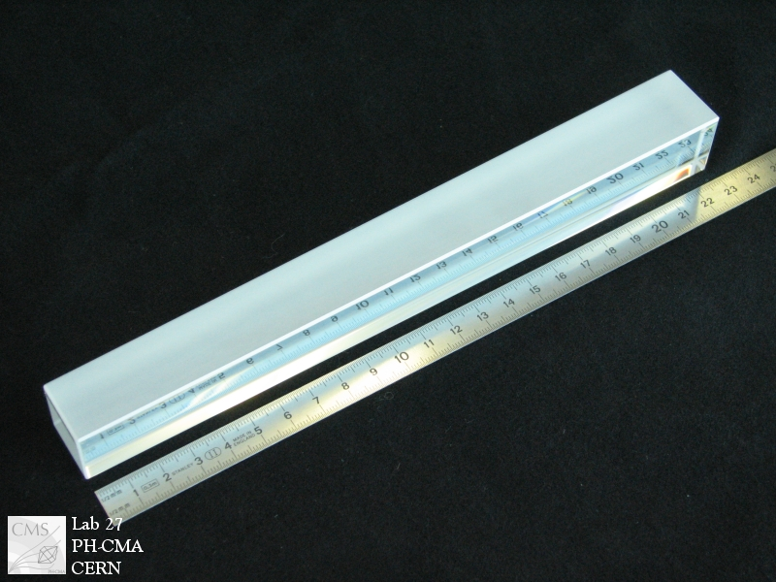
PWO CX for CMS
2005.6-2008.3, SICCAS provided CMS more than 5000 PWO crystals, totally about 7.6 tons.

Slide 9
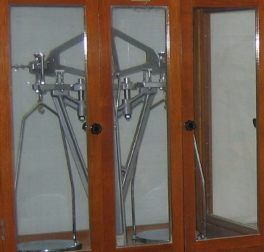
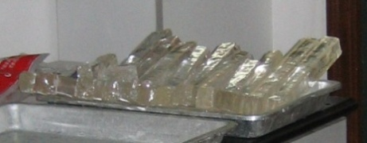
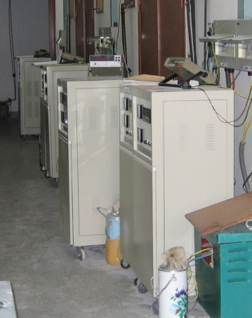
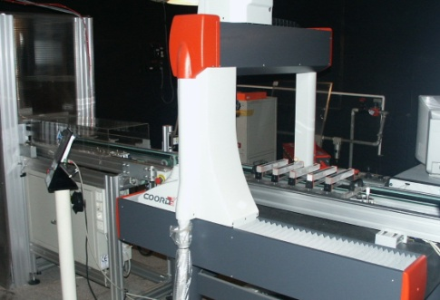
PWO Production
Process flow diagram
Weighting
Polycrystalline
Shaping
Leak Checking
Seeding
Crucibles
Crystal Growth
Refining
Ingots
Pt Fragments
Recycle
Annealing
Machining
Test Bench
Products

Slide 10
PWO Production
Production procedures:
Weighting
PbO/WO₃ + 150ppm Y
Polycrystalline
Mixture sintered/melted
Shaping
Compounds into crucibles with seeds
Seeding
Crucibles into furnace and heated
Crystal growth
Seeding temp reach and growth starts

Slide 11
PWO Production
Production procedures:
Ingots
After finish, ingots got from crucibles
7. Annealing
Low temp annealing to remove tension
8. Machining
Cutting, grounding and polishing
Test bench
Transmittance, light yield and RH
10. Products
About 8 weeks needed

Slide 12
PWO Production
Key points:
Lead time: 3-6 months
Furnace tuning, raw material ordering, Pt rental
PbO material
Environmental policy restrict the PbO production
Uniformity
30 cx in one growth, no forced convention
4. Crystal yield
Growth * machining * performance

Slide 13
PWO Quality Control
PbO material
For each batch, to grow one sample to verify the quality. Second source may be needed.
2. Uniformity
New furnaces are planned to be set up.
3. Radiation hardness
Gamma-ray irrad facility has been moved. UV irrad will be applied to the ingots to verify its RH.

Slide 14
PWO Quality Control
PbO material
For each batch, to grow one sample to verify the quality. Second source may be needed.
2. Uniformity
New furnaces are planned to be set up.
3. Radiation hardness
Gamma-ray irrad facility has been moved. UV irrad will be applied to the ingots to verify its RH.

Slide 15
Summary
1. The PWO crystals can be produced with the Bridgeman technique.
2. Due to the environmental policy, PbO material supply is being reduced, and there is no nearby Gamma ray irrad facility.
3. New furnaces are planning to be set up.

Slide 16
Thanks!

