Slide 1
GlueX FCAL
FCAL FOUR-LED BOARDS
E.G.Anassontzis, P.Ioannou, E.Kappos, C.Kourkoumelis, G.Vasileiadis, G.Voulgaris
University of Athens
Notes:
1

Slide 2
1. 50 FOUR-LED BOARDS (4 SETS of ten+article one)
2. SORTED BASED ON GREEN-GREEN
COLOUR INTENSITY
3. SEPARATED IN GROUPS OF TEN
BOARDS EACH
4. OUTCOME: 5 UNIFORM GROUPS OF
TEN BOARDS EACH
Notes:
2

Slide 3
1.EVERY BOARD AND EVERY COLOUR WAS MEASURED WITH PM ALWAYS AT SAME POSITION “central” (tables at the end)
2. AFTER SORTING (as above)THE BOARDS OF EACH GROUP WERE
PLACED AT THE LED HOLDERS ON THE
PLEXIGLAS BOARD
3. MEASUREMENTS WERE TAKEN FOR
EACH GROUP AND EACH LED COLOUR
AT DIFFERENT CELLS OF THE
PLEXIGLAS BOARD
Notes:
3

Slide 4
Notes:
4

Slide 5
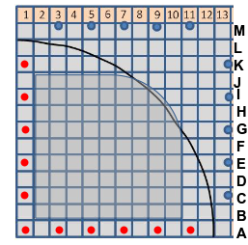
COORDINATE SYSTEM
BLUE DOTS: POSITION OF BOARDS
RED DOTS: MEASURED CELLS
Notes:
5

Slide 6
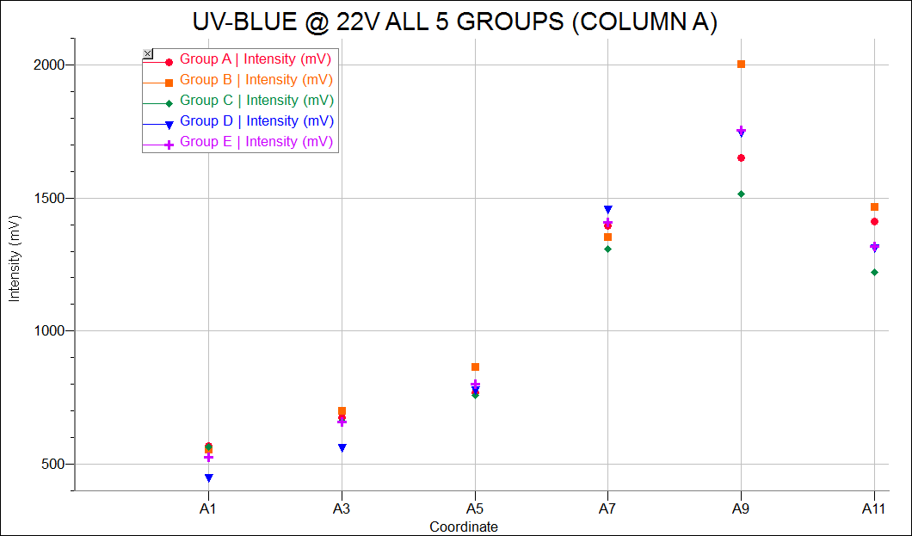
Notes:
6

Slide 7
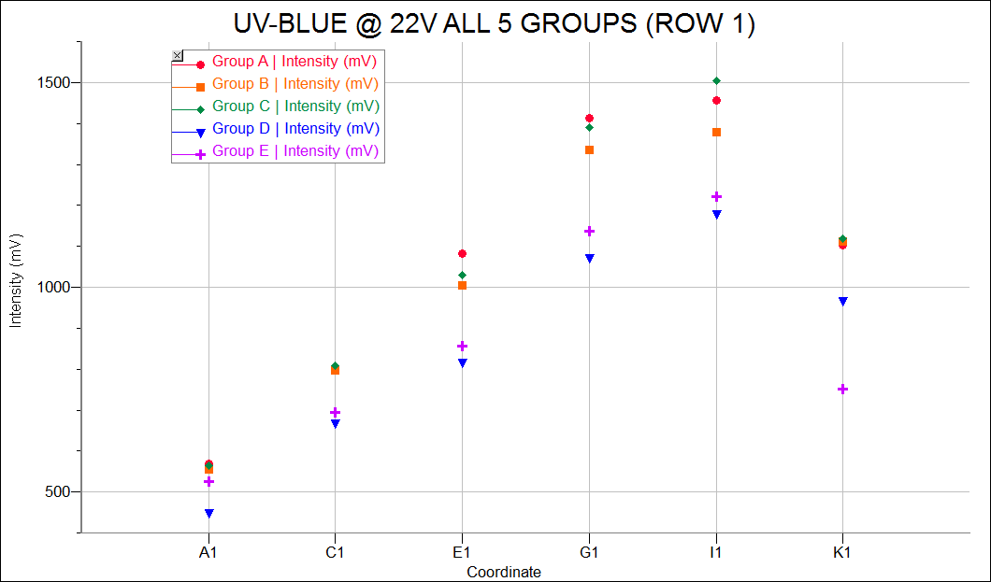
Notes:
7

Slide 8
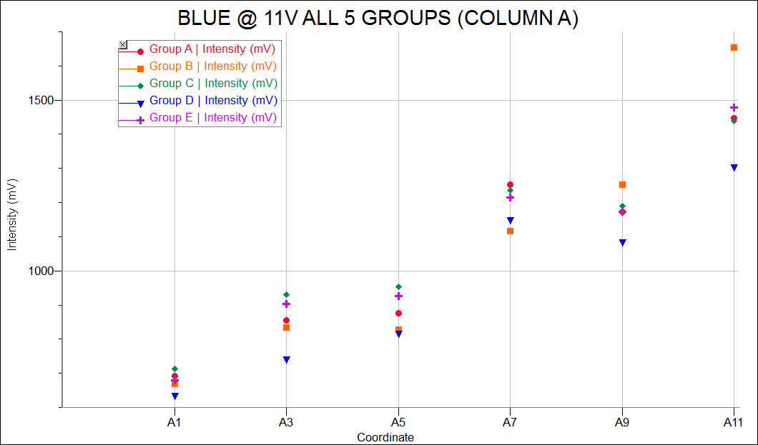
Notes:
8

Slide 9
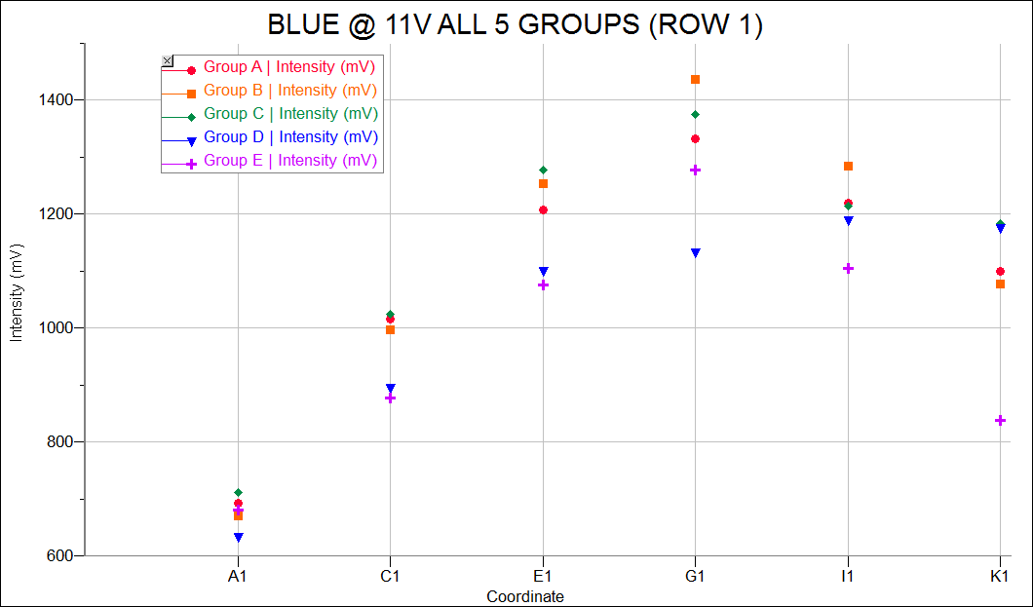
Notes:
9

Slide 10
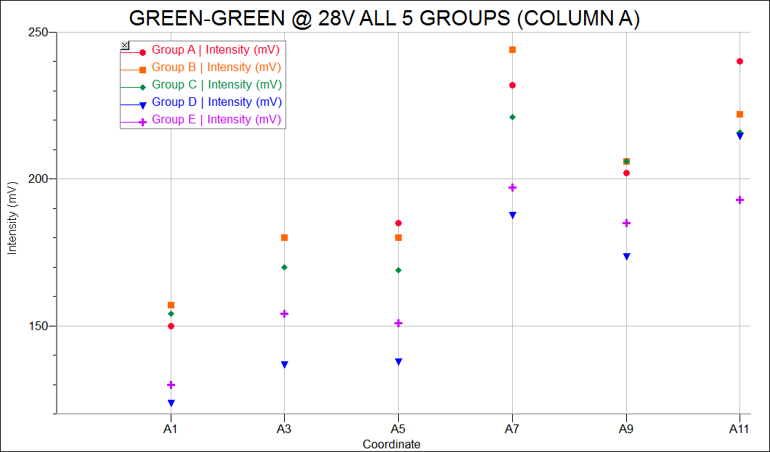
Notes:
10

Slide 11
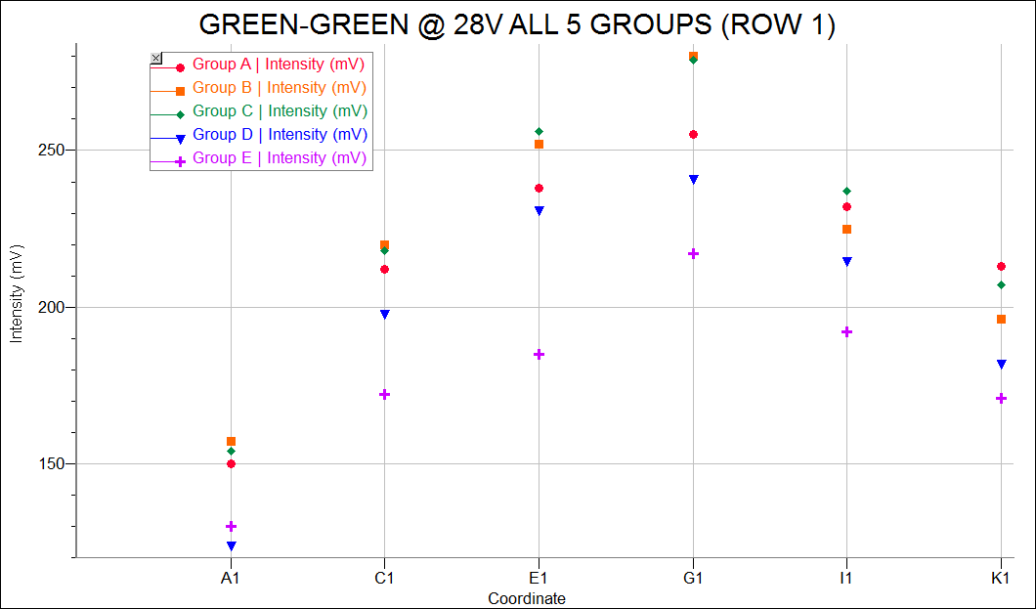
Notes:
11

Slide 12
Notes:
12

Slide 13
Normalization at further corner not using weakest group (Group D)
Colour | Bias Voltage (V) Value with small PM | Ratio of small PMT/array | Predicted light output with array at the far corner
Violet @390nm | 22 V 525mV | 6.8 +-1.3 | ~77 mV
Blue @470nm | 11 V 680mV | 5.4 +-1.0 | ~125mV
Green +Green@574nm | 28 V 130mV | 2.3 +-0.4 | ~60mV *marginal but doable
* The green+green of Group C was double checked at the far corner with the full array and found to produce a ~60mV pulse as expected

Slide 14
Conclusions
All four groups behave as expected
We ready to ship them
GroupD will remain as spare
Notes:
14

Slide 15
Back up
Notes:
15

Slide 16
GROUP A
COORDINATE | MEASUREMENT (mV) |  |  | COORDINATE | MEASUREMENT (mV)
 | UV-BLUE (mV) | BLUE (mV) | GREEN (mV) |  | UV-BLUE (mV) | BLUE (mV) | GREEN (mV)
A1 | 568 | 693 | 150 | A1 | 568 | 693 | 150
A3 | 675 | 856 | 180 | C1 | 798 | 1016 | 212
A5 | 770 | 877 | 185 | E1 | 1081 | 1207 | 238
A7 | 1396 | 1253 | 232 | G1 | 1412 | 1333 | 255
A9 | 1650 | 1172 | 202 | I1 | 1457 | 1219 | 232
A11 | 1410 | 1446 | 240 | K1 | 1103 | 1099 | 213
Notes:
16

Slide 17
GROUP B
COORDINATE | MEASUREMENT (mV) |  |  | COORDINATE | MEASUREMENT (mV)
 | UV-BLUE (mV) | BLUE (mV) | GREEN (mV) |  | UV-BLUE (mV) | BLUE (mV) | GREEN (mV)
A1 | 556 | 670 | 157 | A1 | 556 | 670 | 157
A3 | 700 | 834 | 180 | C1 | 797 | 997 | 220
A5 | 866 | 828 | 180 | E1 | 1005 | 1254 | 252
A7 | 1353 | 1117 | 244 | G1 | 1335 | 1437 | 280
A9 | 2003 | 1252 | 206 | I1 | 1379 | 1285 | 225
A11 | 1466 | 1653 | 222 | K1 | 1112 | 1077 | 196
Notes:
17

Slide 18
GROUP C
COORDINATE | MEASUREMENT (mV) |  |  | COORDINATE | MEASUREMENT (mV)
 | UV-BLUE (mV) | BLUE (mV) | GREEN (mV) |  | UV-BLUE (mV) | BLUE (mV) | GREEN (mV)
A1 | 564 | 712 | 154 | A1 | 564 | 712 | 154
A3 | 661 | 931 | 170 | C1 | 808 | 1025 | 218
A5 | 759 | 954 | 169 | E1 | 1029 | 1277 | 256
A7 | 1307 | 1235 | 221 | G1 | 1389 | 1375 | 279
A9 | 1516 | 1189 | 206 | I1 | 1505 | 1214 | 237
A11 | 1221 | 1439 | 216 | K1 | 1119 | 1183 | 207
Notes:
18

Slide 19
GROUP D
COORDINATE | MEASUREMENT (mV) |  |  | COORDINATE | MEASUREMENT (mV)
 | UV-BLUE (mV) | BLUE (mV) | GREEN (mV) |  | UV-BLUE (mV) | BLUE (mV) | GREEN (mV)
A1 | 451 | 635 | 124 | A1 | 451 | 635 | 124
A3 | 565 | 743 | 137 | C1 | 670 | 896 | 198
A5 | 780 | 818 | 138 | E1 | 817 | 1101 | 231
A7 | 1459 | 1149 | 188 | G1 | 1072 | 1134 | 241
A9 | 1747 | 1085 | 174 | I1 | 1180 | 1191 | 215
A11 | 1315 | 1305 | 215 | K1 | 967 | 1176 | 182
Notes:
19

Slide 20
GROUP E
COORDINATE | MEASUREMENT (mV) |  |  | COORDINATE | MEASUREMENT (mV)
 | UV-BLUE (mV) | BLUE (mV) | GREEN (mV) |  | UV-BLUE (mV) | BLUE (mV) | GREEN (mV)
A1 | 525 | 680 | 130 | A1 | 525 | 680 | 130
A3 | 657 | 903 | 154 | C1 | 694 | 878 | 172
A5 | 802 | 926 | 151 | E1 | 856 | 1075 | 185
A7 | 1409 | 1215 | 197 | G1 | 1138 | 1278 | 217
A9 | 1754 | 1174 | 185 | I1 | 1221 | 1105 | 192
A11 | 1318 | 1478 | 193 | K1 | 751 | 837 | 171
Notes:
20

Slide 21
GROUP A
# OF BOARD | UV-BLUE (mV) | BLUE (mV) | GREEN (mV)
8 | 724 | 982 | 250
13 | 996 | 1056 | 250
5 | 1121 | 1363 | 201
6 | 920 | 951 | 201
28 | 753 | 952 | 192
29 | 705 | 1115 | 192
42 | 742 | 1127 | 182
57 | 957 | 1238 | 181
34 | 773 | 847 | 174
43 | 802 | 1131 | 174
Notes:
21

Slide 22
GROUP B
# OF BOARD | UV-BLUE (mV) | BLUE (mV) | GREEN (mV)
3 | 972 | 1195 | 244
9 | 804 | 1059 | 244
37 | 776 | 1027 | 199
41 | 899 | 1297 | 199
14 | 718 | 928 | 190
18 | 667 | 1068 | 189
24 | 817 | 1011 | 180
17 | 893 | 1068 | 179
19 | 930 | 964 | 173
50 | 945 | 1175 | 173
Notes:
22

Slide 23
GROUP C
# OF BOARD | UV-BLUE (mV) | BLUE (mV) | GREEN (mV)
48 | 640 | 1085 | 224
1 | 960 | 1114 | 221
54 | 898 | 1280 | 198
36 | 757 | 1216 | 197
10 | 855 | 862 | 188
22 | 846 | 1395 | 188
32 | 899 | 1125 | 176
47 | 788 | 914 | 176
20 | 812 | 1163 | 170
35 | 747 | 1067 | 170
Notes:
23

Slide 24
GROUP D
# OF BOARD | UV-BLUE (mV) | BLUE (mV) | GREEN (mV)
7 | 891 | 1134 | 214
4 | 810 | 1000 | 210
59 | 893 | 1175 | 196
52 | 634 | 869 | 193
31 | 654 | 1056 | 186
27 | 636 | 879 | 185
58 | 752 | 1391 | 176
21 | 933 | 1125 | 175
25 | 866 | 1074 | 169
30 | 946 | 909 | 169
Notes:
24

Slide 25
GROUP E
# OF BOARD | UV-BLUE (mV) | BLUE (mV) | GREEN (mV)
2 | 898 | 1136 | 208
51 | 839 | 1309 | 205
55 | 894 | 1101 | 193
56 | 850 | 1410 | 193
60 | 732 | 1111 | 184
23 | 846 | 980 | 182
38 | 830 | 898 | 175
39 | 1052 | 1212 | 175
40 | 390 | 722 | 169
11 | 891 | 917 | 168
Notes:
25

