Slide 1
Measuring the Charged Pion Polarizability
in the γγ->π+π- Reaction
Presented by
Ebode Onyie Fabien
Under the supervision of
Dr. David Lawrence
Staff Scientist
Jefferson Lab Newport News VA, USA
Notes:
<number>

Slide 2
THE DIFFERENTS STEPS OF THE WORK REALIZED AT JEFFERSON LAB
The visite of the Jefferson Lab with Dr. DAVID Lawrence
THE SIMULATION OF THE PIONS IN THE FOWARD ELECTROMAGNETIC CALORIMETER(FCAL)
RESPONSE OF THE HADRONS IN THE FCAL DETECTOR
THE VISITE OF THE GLUEX DECTECTOR WITH Pr. ELTON SMITH
ANALYSIS OF PIONS IN FCAL AND THEIR PROPERTIES

Slide 3
Introduction
Electromagnetic polarizabilities are fundamental properties of composite systems such as molecules, atoms, nuclei, and hadrons.
Among the hadron polarizabilities, the charged pion polarizability is of extensive importance because it tests fundamental symmetries to leading order.
Because a free pion target does not exist, the measurements to date of the charged pion polarizability have been plagued by uncertainties.
Hadronic physics is an area of research on the boundary between
particle physics and nuclear physics, which studies
the systems of quarks and gluons confined by the strong interaction.
Notes:
<number>

Slide 4
Motivation to Study the Charged Pion Polarizability in the γγ->π+π- Reaction
The theory for the charged pion polarizability results directly from chiral perturbation theory (ChPT) by Gasser and Leutwyler [Ga84].
For example, the transition π₀→γγ is not allowed at leading order O(p⁴ ) [Ho92]. For this reason
the Lagrangian must be increased by the Wess-Zumino-Witten anomaly [We71].
Recently the PrimEx experiment at JLab made a precision test of the intrinsic odd-parity
(anomalous) sector of low-energy QCD by measuring the radiative width for π₀→γγ [La11].
The Partially Conserved Axial Current (PCAC) and leading order O(p⁴ ) ChPT both predict that the electric and magnetic polarizabilities of the charged pion (α_{π} and β_{π} ) are related to the charged pion weak form factors F_{V} and F_{A} in the decay π⁺ → e+ νγ.
Notes:
<number>

Slide 5
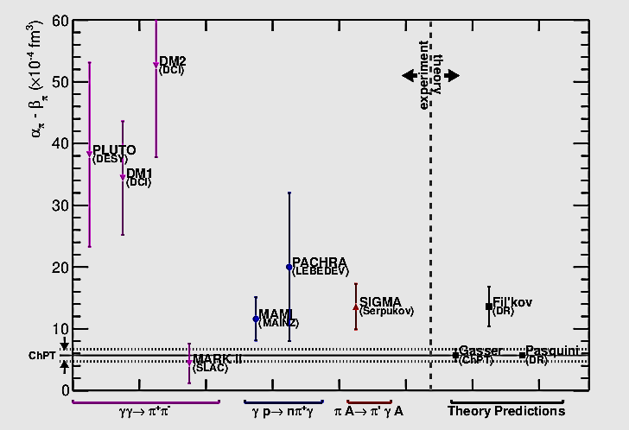
previous study of the Charged Pion Polarizability
Notes:
<number>

Slide 6
Planned Future Measurements of the Pion Polarizability
There have had two efforts under-way to remeasure the charged pion polarizability: (1) COMPASS using the hadronic Primakoff effect with an incident pion beam, where they look for an exclusive γπ final state at very low t; (2) measurements of γγ →π+π- at energies near threshold at Frascati.
COMPASS uses a 190 GeV pion beam on nuclear (Ni) targets.
Collider experiments, Frascati, have an advantage in that there is no nuclear background,
The GluexTime Of Flight detector will not be useful for the measurement of the charged pion polarizability at Jefferson Laboratory because of the extreme relativistic velocities of the pions. The plan instead is to use a system of hadronic absorbers with MWPC’s to distinguish pions from muon. This measurement will utilize linearly polarized incident photons, and the (1 − cos 2φ_{μμ} ) azimuthal dependence of the μμ system can be used to help identify muon backgrounds.
Notes:
<number>

Slide 7
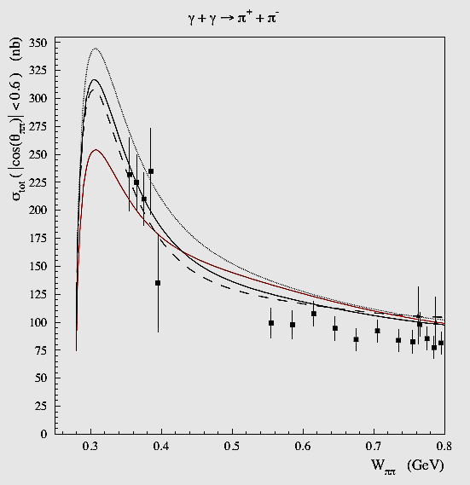
Comparison between predicted cross section of pions and the simulation of reconstructed of response of pions in FCAL
γγ→π⁺π⁻ cross sections. Red curve: Born approx. (no polarizability effect);
black solid: unsubtracted DR calculation with α_{π}−β_{π} = 5.7; dashed: subtracted DR with
α_{π}−β_{π} = 5.7; dotted: subtracted DR with α π − β π = 13.0. Data points are from MARK-II
Notes:
<number>

Slide 8
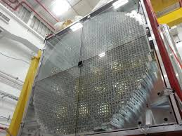
FOWARD ELECTROMAGNETIC CALORIMETER (FCAL)
Notes:
<number>

Slide 9
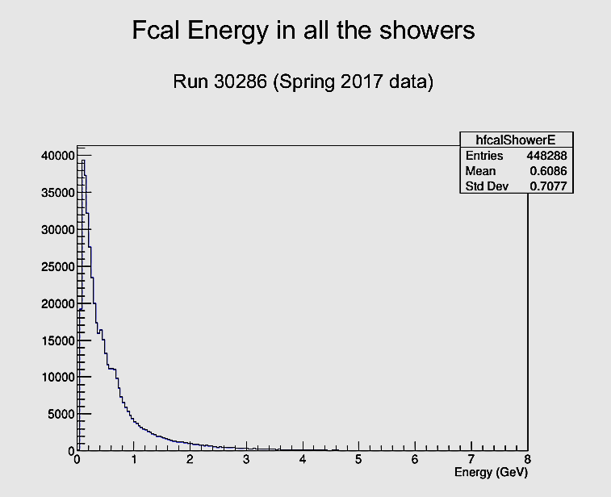
EXPERIMENTATION AND ANALYSE: RESPONSE OF
HADRONS IN FCAL
Notes:
<number>

Slide 10
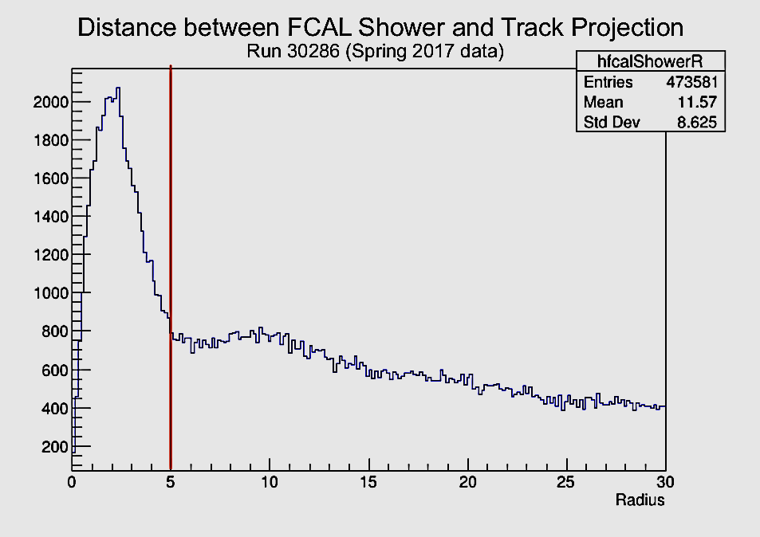
EXPERIMENTATION AND ANALYSE: RESPONSE OF
HADRONS IN FCAL
Notes:
<number>

Slide 11
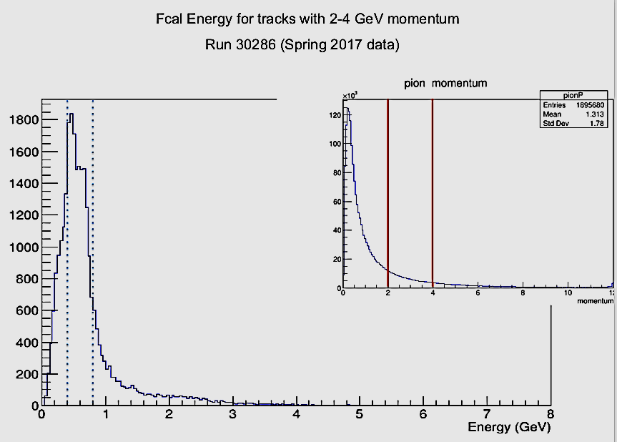
EXPERIMENTATION AND ANALYSE: RESPONSE OF
HADRONS IN FCAL
Notes:
<number>

Slide 12
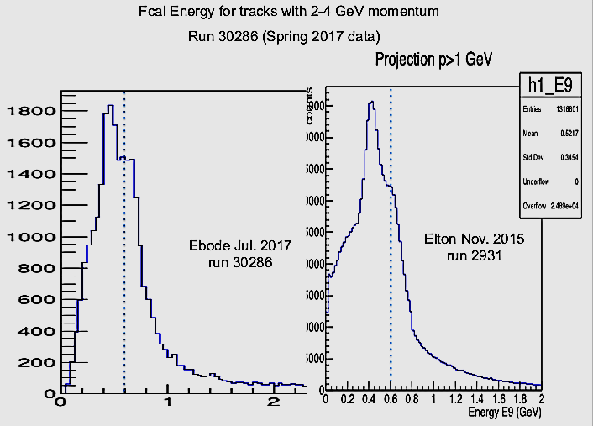
EXPERIMENTATION AND ANALYSE: RESPONSE OF
HADRONS IN FCAL
Notes:
<number>

Slide 13
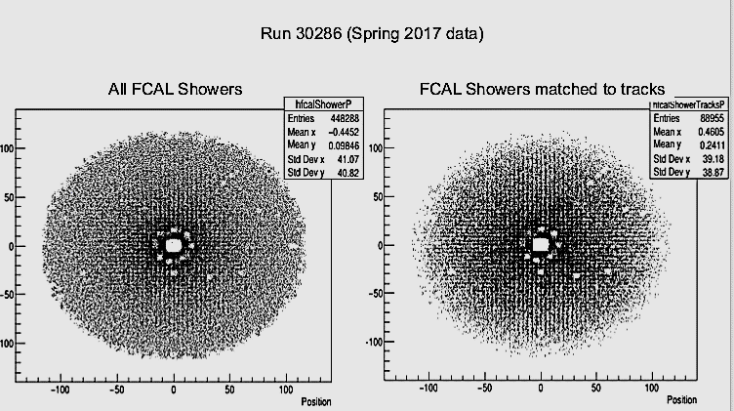
EXPERIMENTATION AND ANALYSE: RESPONSE OF
HADRONS IN FCAL
Notes:
<number>

Slide 14
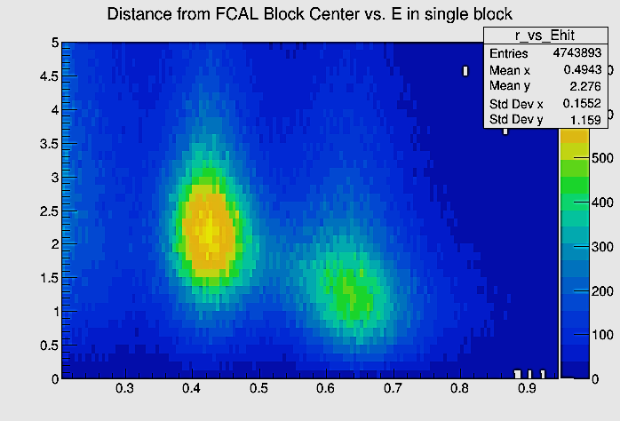
EXPERIMENTATION AND AALYSE: RESPONSE OF HADRONS IN FCAL
EXPERIMENTATION AND ANALYSE: RESPONSE OF
HADRONS IN FCAL
Notes:
<number>

Slide 15
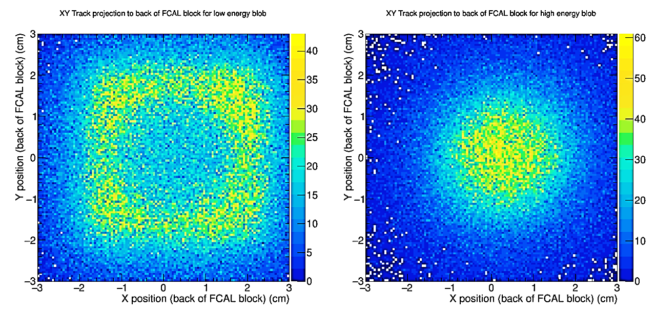
EXPERIMENTATION AND ANALYSE: RESPONSE OF
HADRONS IN FCAL
EXPERIMENTATION AND ANALYSE: RESPONSE OF HADRONS IN FCAL
Notes:
<number>

Slide 16
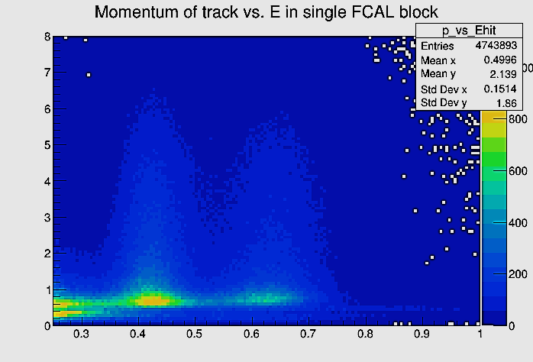
EXPERIMENTATION AND ANALYSE: RESPONSE OF
HADRONS IN FCAL
Notes:
<number>

Slide 17
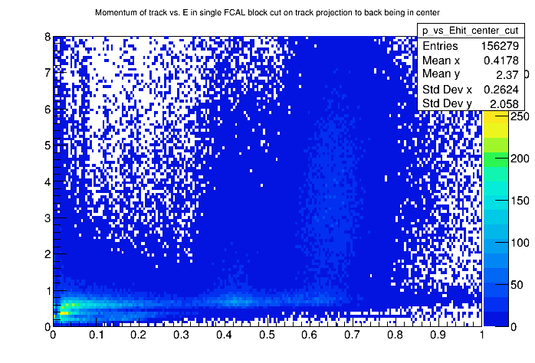
EXPERIMENTATION AND ANALYSE: RESPONSE OF
HADRONS IN FCAL
Notes:
<number>

Slide 18
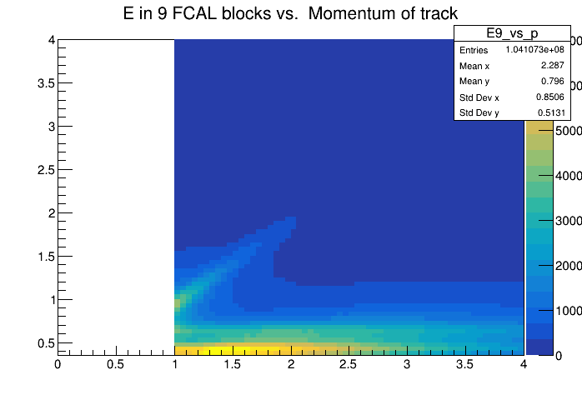
EXPERIMENTATION AND ANALYSE: RESPONSE OF
HADRONS IN FCAL
Notes:
<number>

Slide 19
SUMMARY AND PERSPECTIVES
With the FCAL of the GLUEX DETECTOR, we can identify the pion and all their properties.
We will use the GEANT4 in to study the the charged particles with their properties

Slide 20
THANKS FOR YOUR ATTENTION

