Slide 1
Trigger Database
Dmitry Romanov

Slide 2
Write Configuration
tag – run number
Run Control
Run Config
DB
Copy config files, add run number
Hardware Configuration (COOL )
FCAL_N6
FCAL_S6
Run Configuration
(new requested feature
implemented in coda 3.01)
fcal_pulser_ti.cnf
fcal_led_ti.cnf
Super-visor
Configuration Name (path to configuration files)
Read config file
Agent
Agent
• • •
CODA ROC
• • •
CODA ROC
5/17

Slide 3
Configuration File Examples
# fadc250 config file - example # # this file contains settings for # fADC250 - JLAB VXS Flash ADC 12-bit 250 Msps 16 ch # # ~~~~~~~ # CRATE rocbcal1 <- ROC name, crate name, usually IP name # FADC250_ALLSLOTS <- just keyword - all settings after this line will be implemented # for all slots, till FADC250_SLOTS will be met # FADC250_SLOTS 3 8 15 <- slot_numbers - in which next settings will be implemented # till file ends or next FADC250_SLOTS will be met # # FADC250_F_REV 0x0216 <- firmware revision (0x0 Bits:7-0) # FADC250_B_REV 0x0908 <- board revision (0x0 Bits:15-8) # FADC250_ID 0xfadc <- board type (0x0 Bits:31-16) # # FADC250_MODE 1 <- process mode: 1-4 (0x10C Bits:2-0) # FADC250_W_OFFSET 50 <- number of sample back from trigger point. (0x120) # (in Manual it is PL=Trigger_Window(ns) * 250MHz) # FADC250_W_WIDTH 49 <- number of ADC sample to include in trigger window. (0x11C) # (in M: PTW=Trigger_Window(ns) * 250MHz, minimum is 6) # FADC250_NSB 3 <- number of sample before trigger point to include in data processing. (0x124) # This include the trigger Point. (minimum is 2 in all mode) # FADC250_NSA 6 <- number of sample after trigger point to include in data processing. (0x128) # Minimum is (6 in mode 2) and ( 3 in mode 0 and 1). # Number of sample report is 1 more for odd and 2 more for even NSA number. # FADC250_NPEAK 1 <- number of Pulses in Mode 2 and 3. (0x10C Bits:6-5) # # 0 1 2 3 4 5 6 7 8 9 10 11 12 13 14 15 - channels ## # FADC250_ADC_MASK 1 0 1 0 1 0 1 0 1 0 1 0 1 0 1 0 <- channel enable mask (0x110) # FADC250_TRG_MASK 1 1 1 1 1 1 1 1 1 1 1 1 1 1 1 1 <- trigger enable mask # (channel includes in global trigger, if bit set to 1) # FADC250_TET 110 <- board Trigger Energy Threshold (TET), same for all 16 channels # FADC250_CH_TET 0 110 <- channel# and TET_value for this channel # FADC250_ALLCH_TET 111 222 2 3 4 5 6 7 8 9 10 11 12 13 14 15 <- 16 TETs (0x12C - 0x148) # # FADC250_DAC 3300 <- board DAC, one and the same for all 16 channels # FADC250_CH_DAC 0 3300 <- channel# and DAC_value for this channel # FADC250_ALLCH_DAC 3300 3280 3310 3280 3310 3280 3310 3280 3300 3280 3300 3280 3310 3280 3310 3280 <- 16 DACs # # FADC250_PED 210 <- board Pedestals, same for all channels # FADC250_CH_PED 0 210 <- channel# and Pedestal_value for this channel # FADC250_ALLCH_PED 210 220 210 215 215 220 220 210 210 215 215 220 220 210 215 220 <- 16 PEDs
S.Pozdnyakov
Configuration files prepared for:
FADC250, F1TDC, CAEN 1290
TDC, LE Discriminator
Use configuration file parameters in
ROLs
Configuration files are used in the
FCAL setup
7/17

Slide 4
Configuration File Structure
bcal_fdc_cosmic.cnf
bcal_fdc_cosmic_run20.cnf
TRIGGER
GTP
TS
BCAL
FADC common
fadc250_mode
fadc250_w_offset
fadc250_w_width
• • •
LE common
F1 common
Create Specific
FADC250_DAC: ver1
FADC250_TRG_MASK: ver1
rocbcal1_dac_ver1.cnf
• • •
rocbcalN_dac_ver1.cnf
FDC
8/17

Slide 5
What does it do?
CODA
RUN INFO
(config files,
time,
statistics,
…)
DETAILS
(Boards,
thresholds,
parameters
GUI
(Web)
XML
Parse
Python API
Save
Save
MySQL

Slide 6
Passing data to DB
Coda calls a script (runs a process)
Passing data with XML
Data: run, time, used configuration files, comments, etc.
More data at the end
Populate db through python api

Slide 7
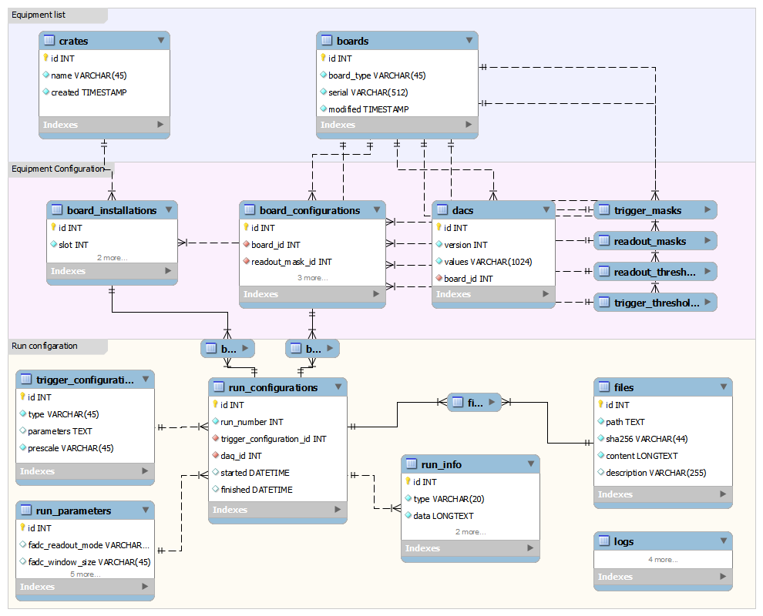

Slide 8
Python API
SQL Alchemy
Model that represents DB
API class with all functions

Slide 9
GUI
Web site
Can be started at local machine and viewed in browser
Or run on server
Uses:
Flask (python web framework)
JINJA2 (template engine)
JQuery (Client library)
Bootstrap3 (GUI elements)

Slide 10
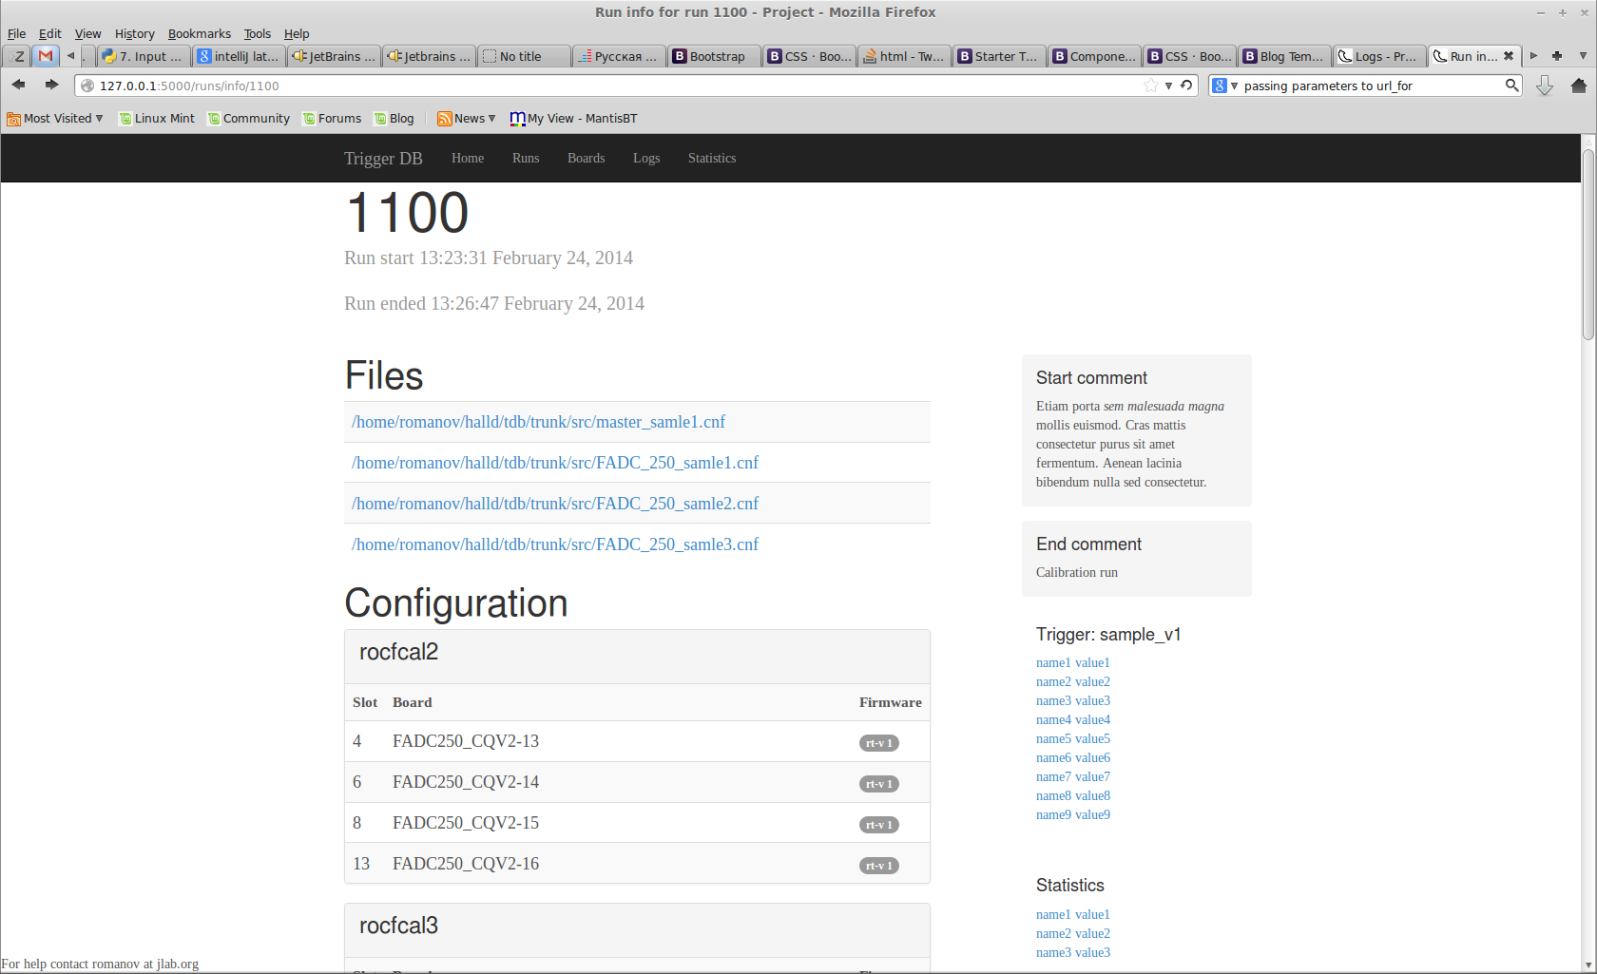

Slide 11
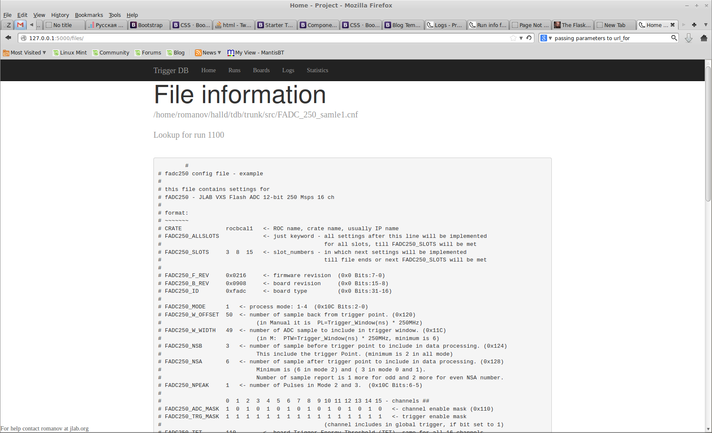

Slide 12
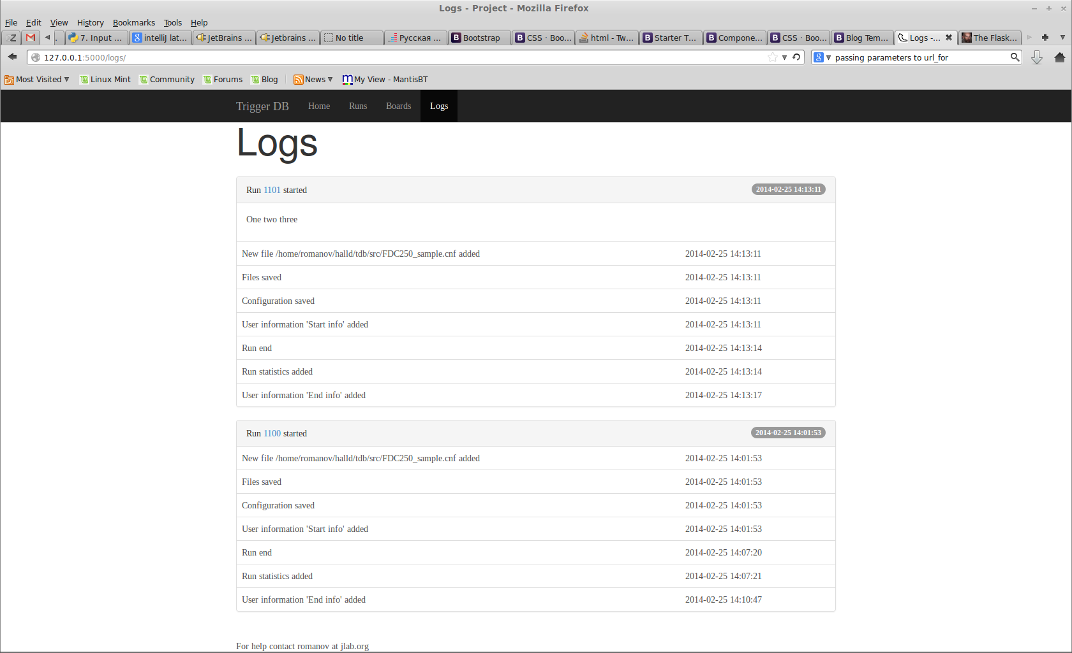

Slide 13
Thank you

