Slide 1
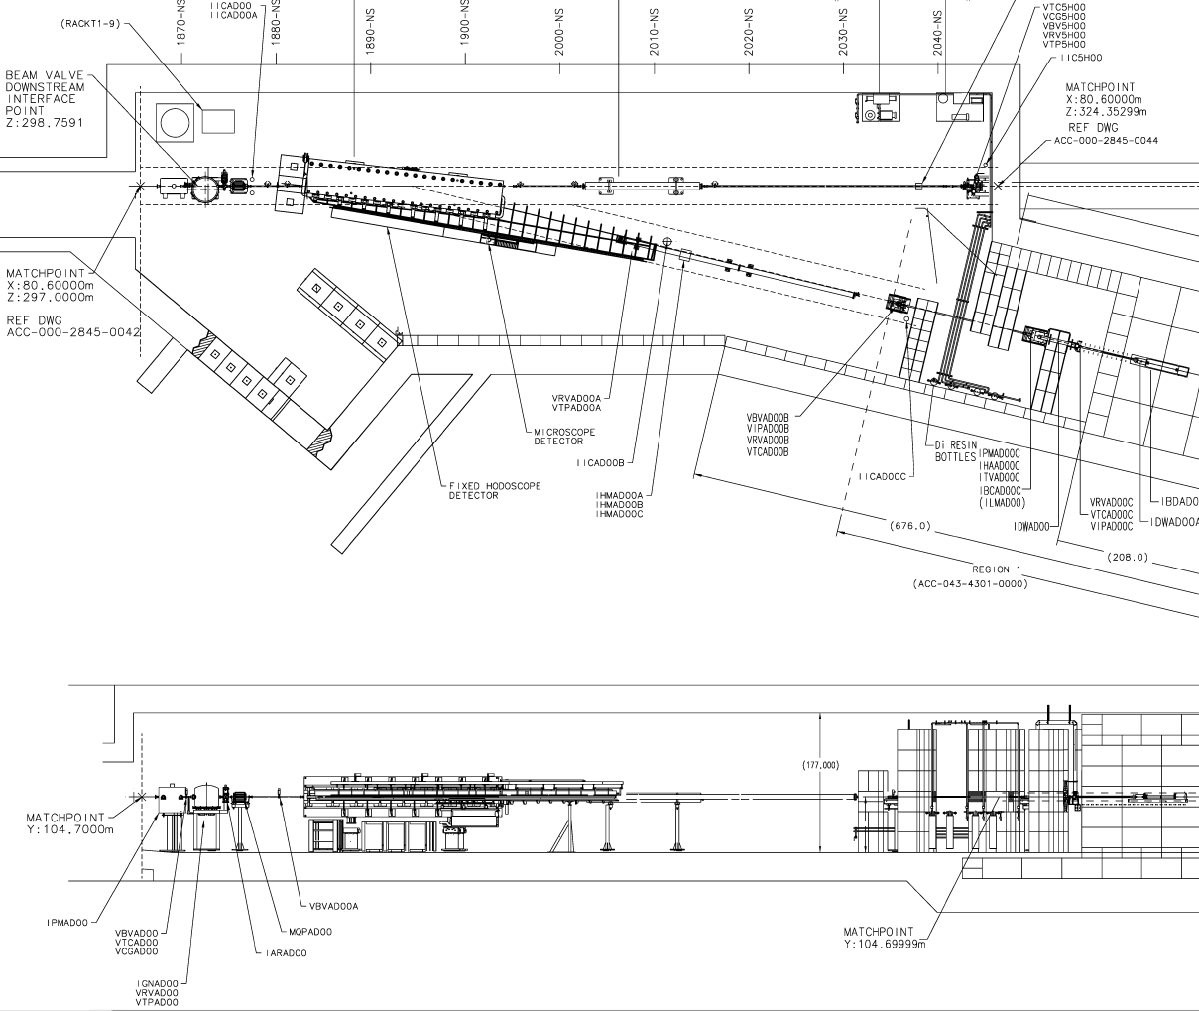
Tagger Songsheet

Slide 2
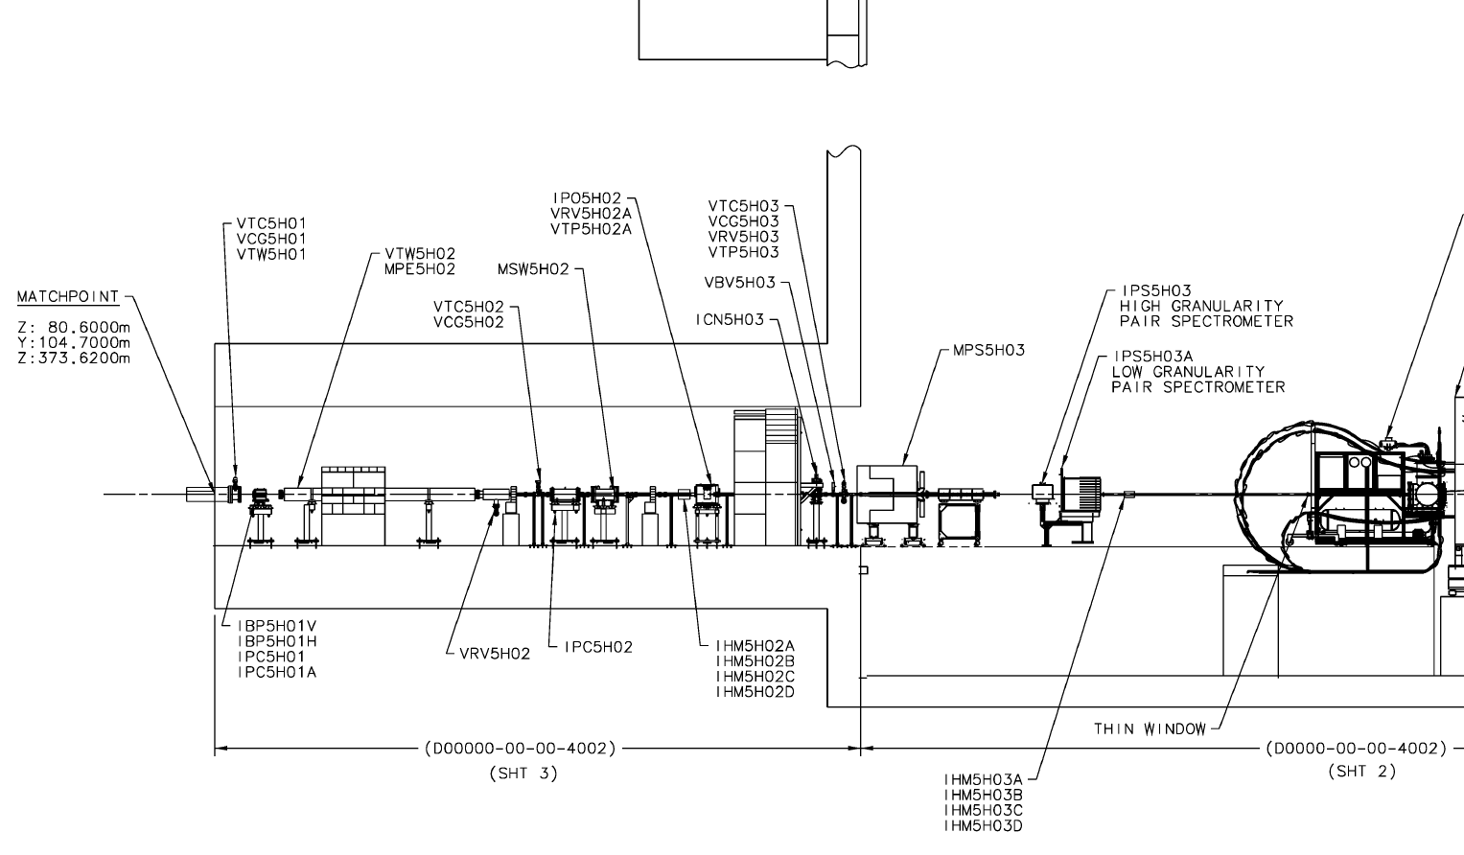
Hall D Songsheet
VTC = Vacuum ThermoCouple Gauge
VCG = Vacuum Cold Cathode Gauge
VTP = Vacuum Turbo Pump
VTW = Vacuum Thin Window
VRV = Vacuum Roughing Valve

Slide 3
Accelerator Tagger Screen

Slide 4
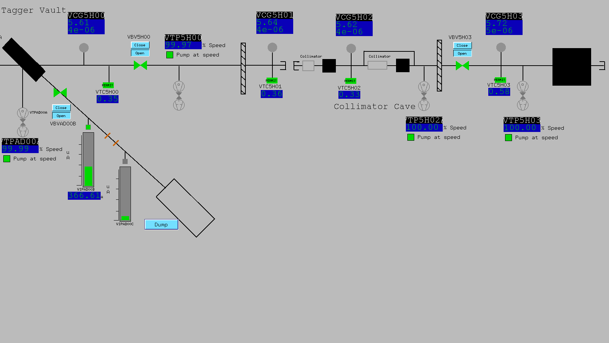
Accelerator Hall D Screen

Slide 5
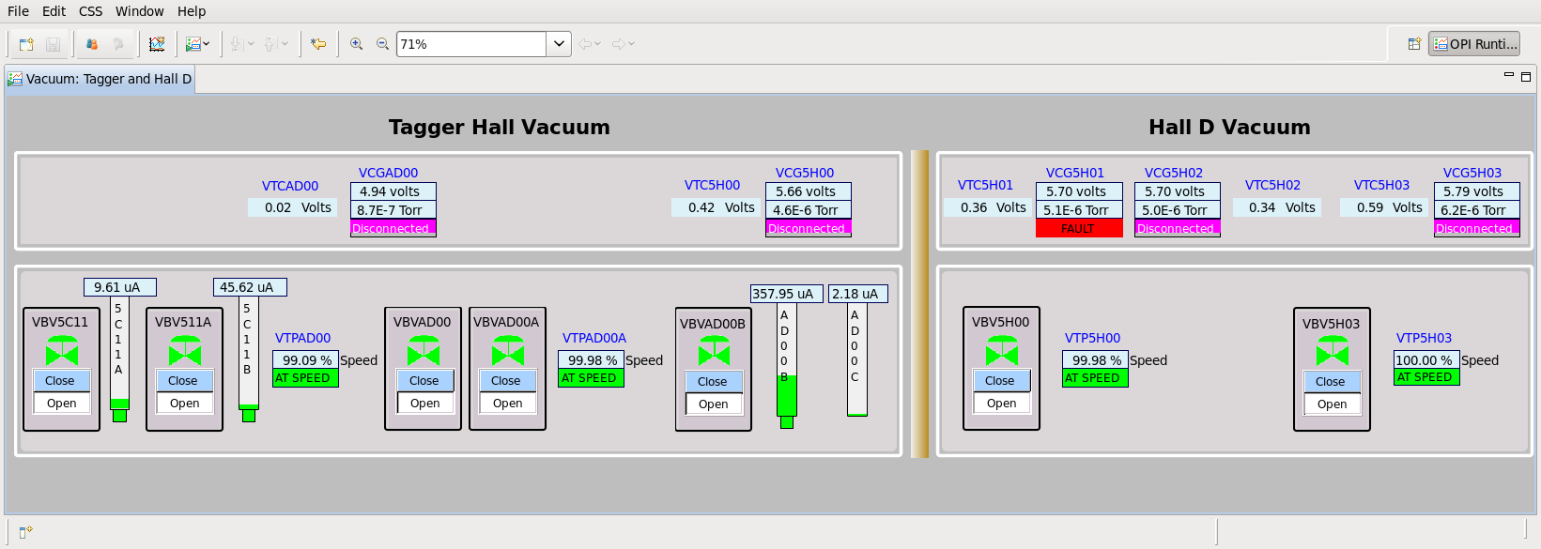
Hall D CSS Screen

Slide 6
Tagger area vacuum
Missing VBV5H00 and VTP5H00
These 3 signals belong between these valves

Slide 7
Collimator cave and US platform
Should show vacuum thin window between these 2 gauges
Should show shield wall between these 2 gauges and valve
VBV5H00 and VTP5H00 are in Tagger bldg
Missing VTP5H02A on polarimeter
Collimaror Cave
US Platform
Collimaror Cave

