Slide 1
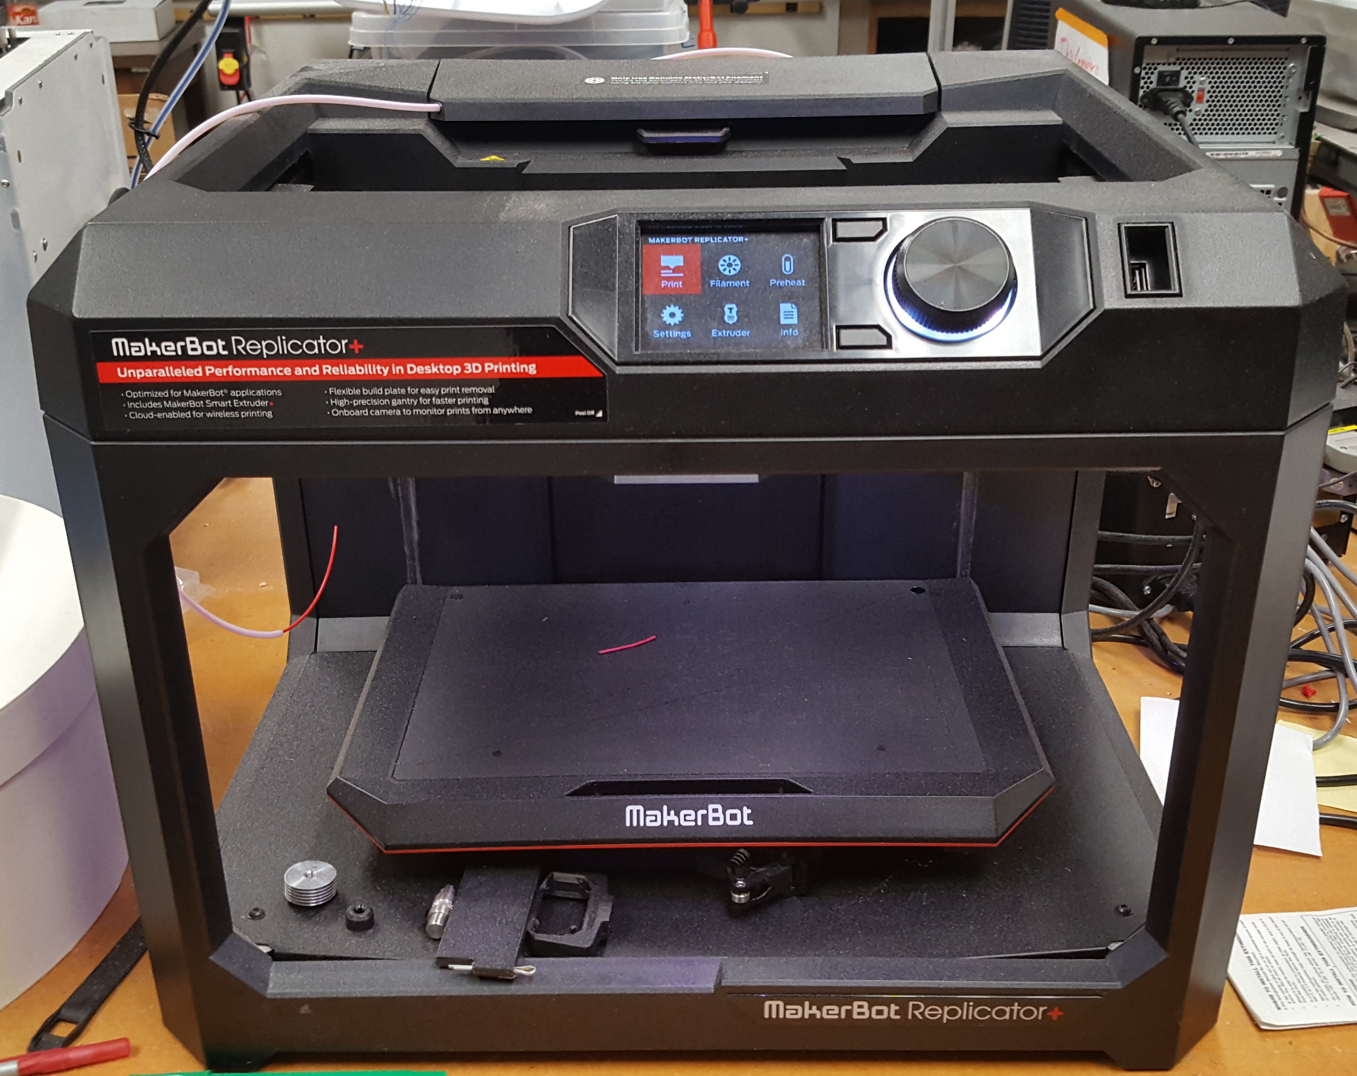
Makerbot Replicator+
Build Volume: $29.5 L ×19.5 W ×16.5 H {cm}^{3}$
File types: STL, OBJ
Material: PLA

Slide 2
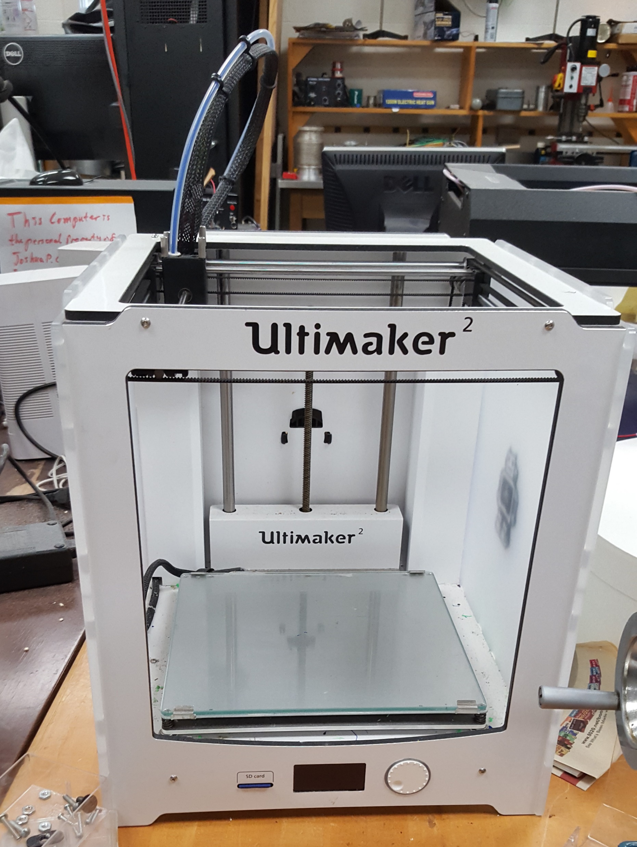
Ultimaker 2
Build Volume: $23 L ×22.5 W ×20.5 H {cm}^{3}$
File types: STL (convert to Cura)
Material: PLA, ABS

Slide 3
Software
We use Autodesk Inventor Pro at UNCW.
Inventor can import and export files in a number of formats.
Given specifications, we can generate models and create STL files.

