Slide 1
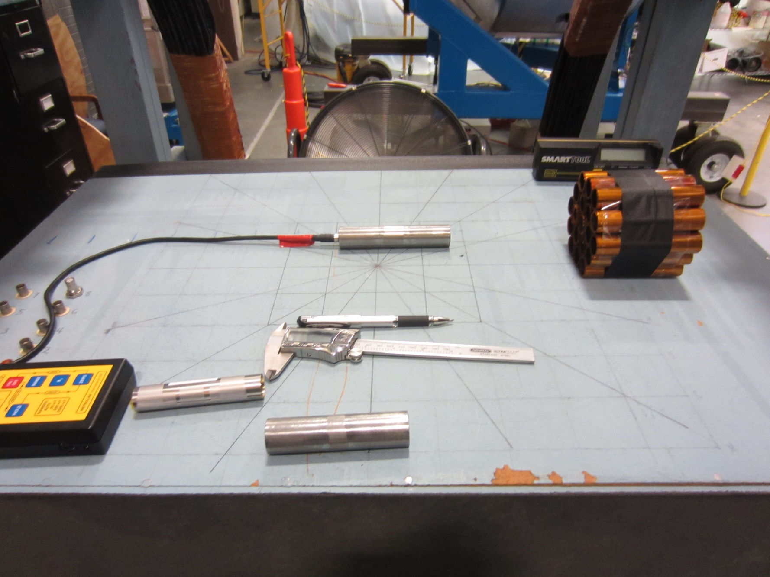
Magnetic Field Test Setup

Slide 2
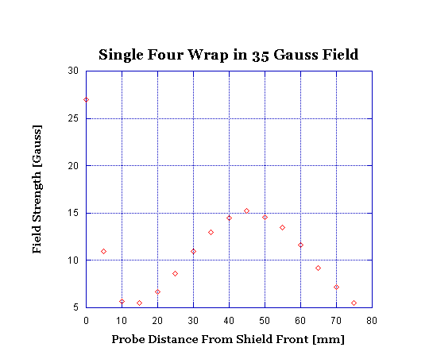
Magnetic Shielding Results from First Test Run

Slide 3
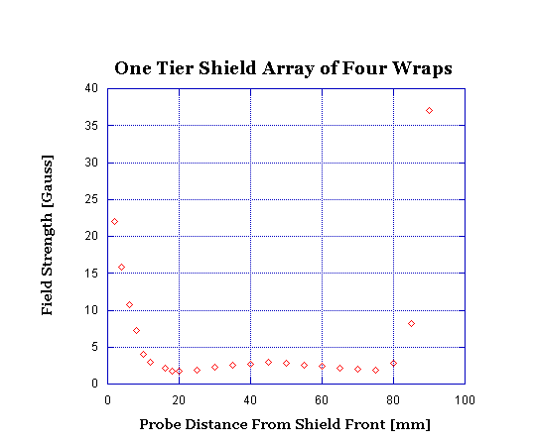
Shielding Array Test: One Tier

Slide 4
Shield Array Test: Two Tiers

Slide 5
Region of Interest

Slide 6
Introduction of Soft: Iron 100mm

Slide 7
Introduction of Soft: Iron 125mm

Slide 8
Introduction of Soft: Iron 150mm

Slide 9
Soft Iron with μMetal 24mm Insertion

Slide 10
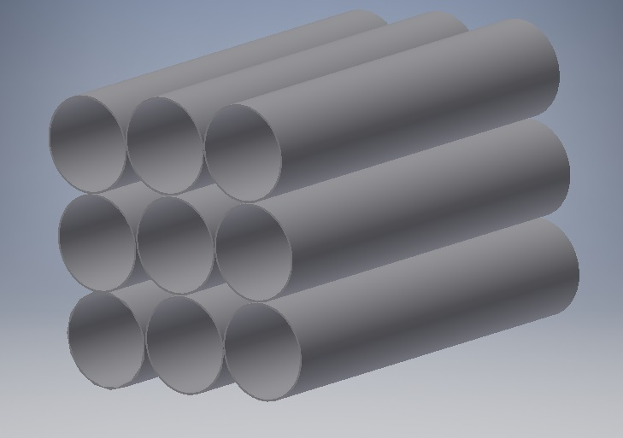
Soft iron Shield Array

Slide 11
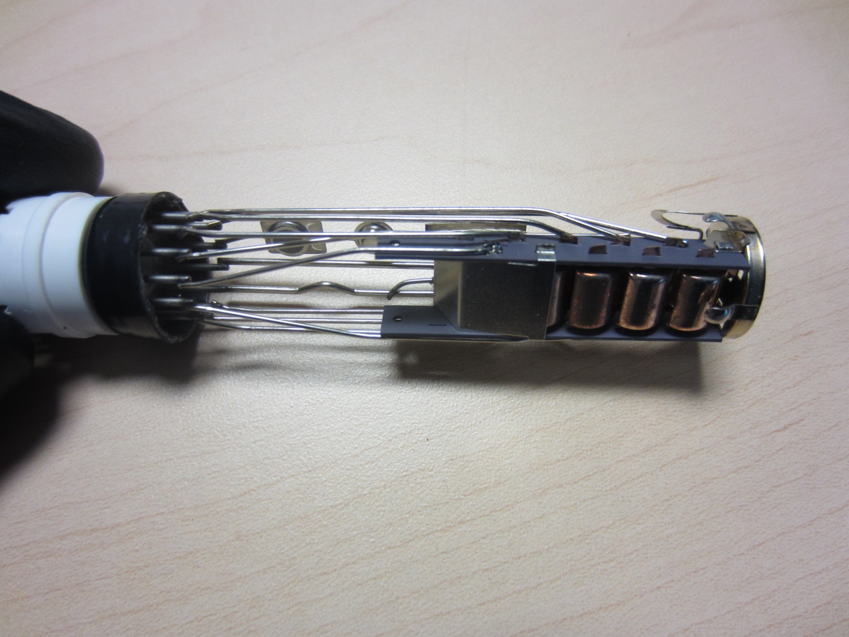
Next Steps
Continue mixing soft iron and μMetal tubes to determine best combination.
Adjust μMetal insertion depth.
Introduce PMT.

Slide 12
Conclusion

Slide 13
Shielding Array
1,849 Individual Cells
480lb Net Weight
Dimension:
Length 0.991 m
Height 0.991 m
Depth 0.10 m

