Slide 1
New Graphs Based on The Rectangular Shield

Slide 2
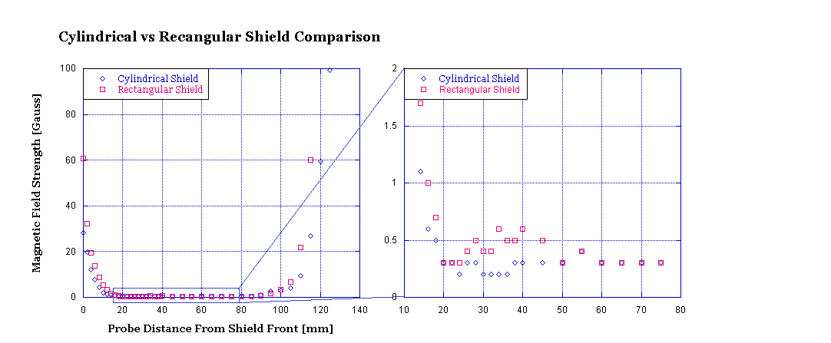
The graph compares the effects of the rectangular shield as compared to the old cylindrical shield. The zoom is on the region of significance.

Slide 3
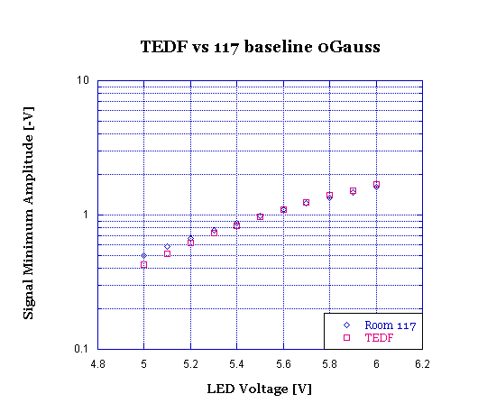
The graph shows the difference between our initial tests in room 117 to the baseline test preformed in TEDF both were conducted with no magnetic field.

Slide 4
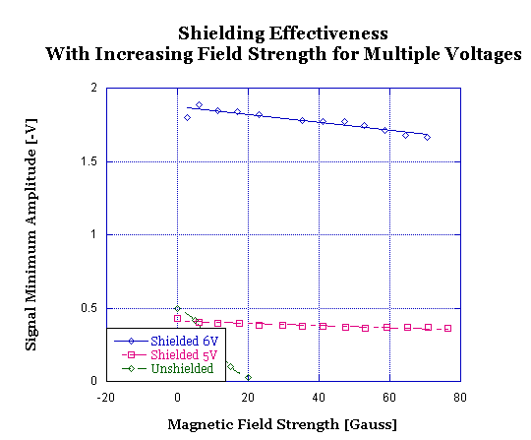
This graph is from data taken while the field was increasing in strength to observe the effect of the field on the PMT signal amplitude. The test was conducted at 5 volts and 6 volts. The unshielded value was taken at 5 volts.

Slide 5
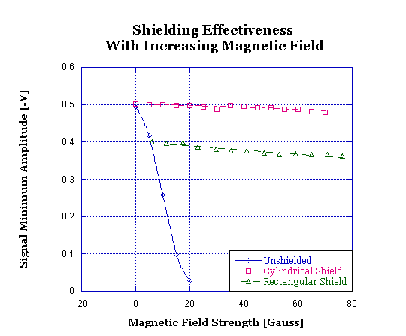
The graph shows the comparison between the cylinder and rectangular shield in with respect to their effectiveness at shielding the PMT taken at 5 volts on both runs.

Slide 6
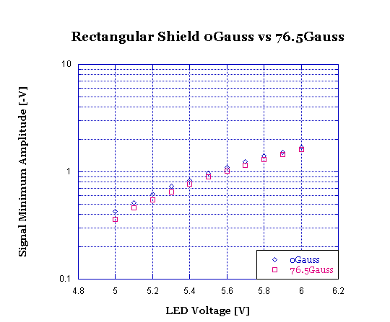
The graph shows the comparison of the PMT signal amplitude at both 0 Gauss and 76.5 Gauss the percent difference in this graph is an average of $9.0±_{4.3}^{7.2}$ % and a minimum of $4.$7%.

Slide 7
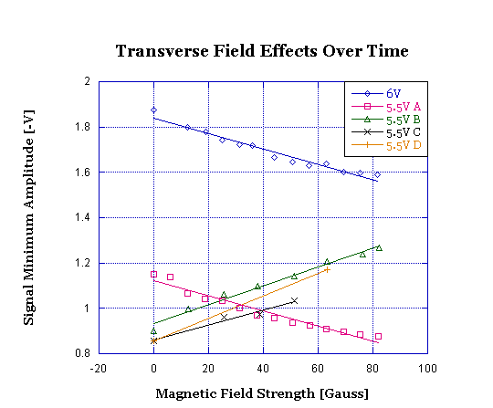
The above graph shows the comparison of the transverse field effects the first data set in the legend was taken first, the time proceeding with the descending data sets.

