Slide 1
Status of CDC Stereo/Axial configuration MC Study
David Lawrence Jlab
August 25, 2008

Slide 2
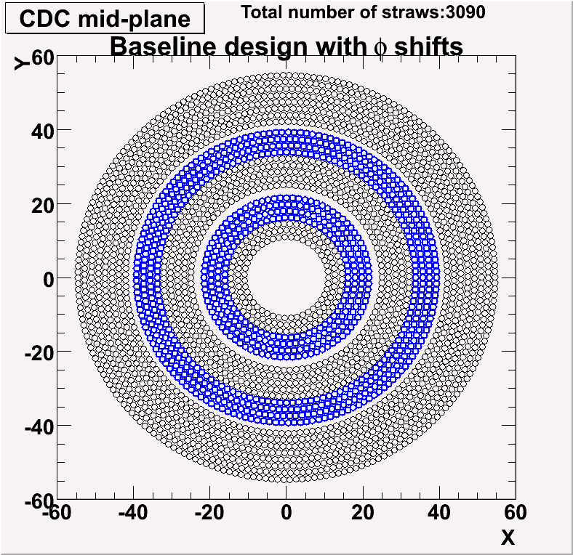
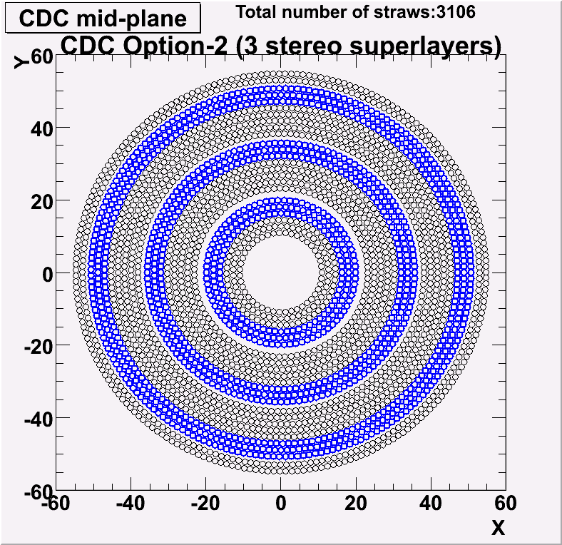
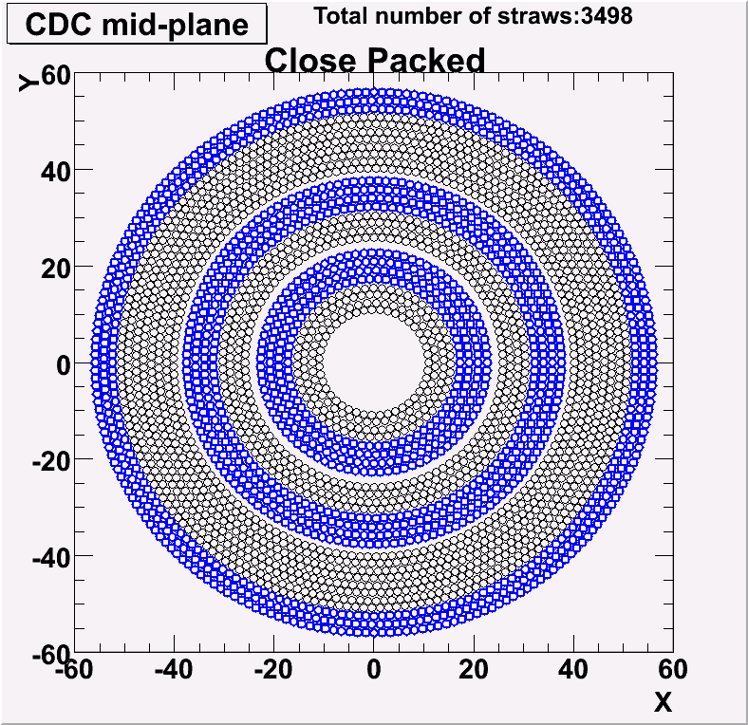
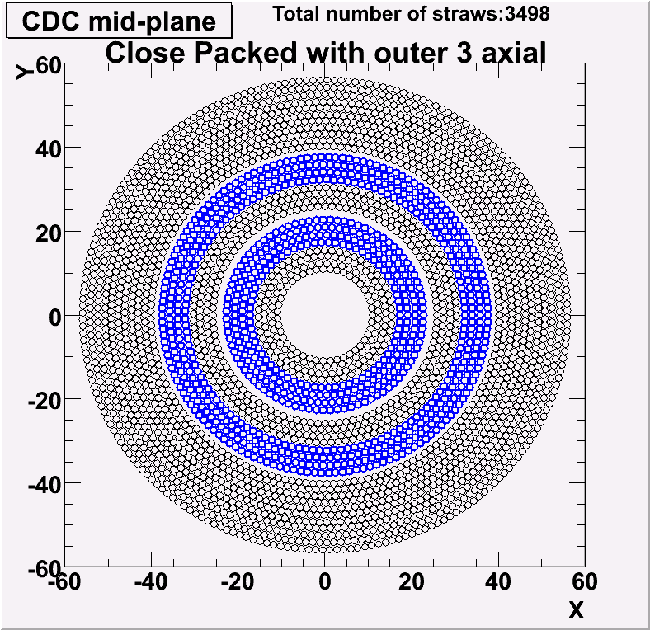
5 CDC configurations studied (yes, only 4 are shown)
24 layers
27 layers

Slide 3
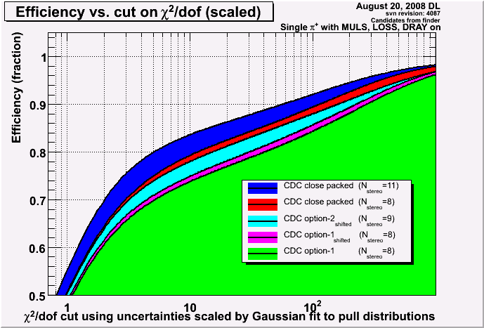
Tracking Efficiency for Several CDC Configurations
Phasespace: range

Slide 4
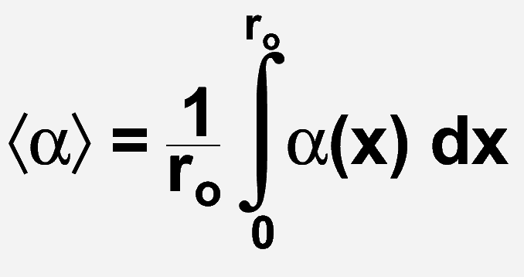
Expected energy loss in CDC gas
 | dE/dx (MeV/g cm²) | ρ (g/l) | dE/dx (keV/cm)
Ar (85%) | 1.519 | 1.622 | 2.464
CO₂(15%) | 1.819 | 1.842 | 3.351
Total for CDC gas dE/dx = 2.597 keV/cm
α
= 1.26cm
3.27 keV
x
Note: for a 1 keV energy loss, expect x=7.8mm or about 2.45% inefficiency

Slide 5
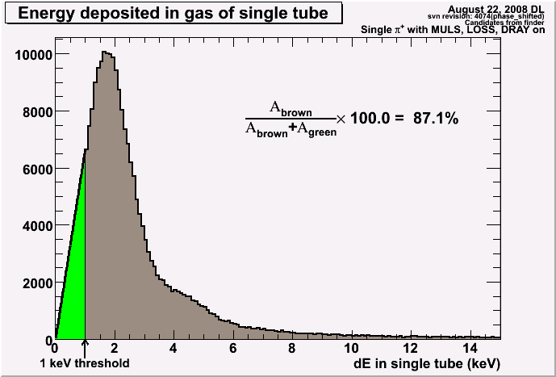
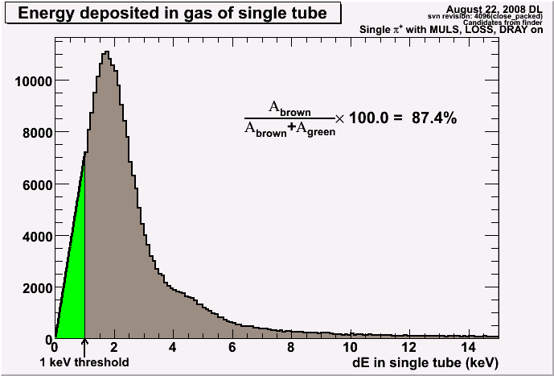
dE in single tube reported by hdgeant
Phasespace: 1 GeV/c ; 90º
Nominal Geometry
Close Packed
Green regions are estimates of hits discarded by dE threshold. Estimate is made by straight line from 0,0 to 1keV point. This likely overestimates the below-threshold contribution.
NOTE: Max energy deposition at 90º : (1.6 cm)(2.6 keV/cm) = 4.16 keV

Slide 6
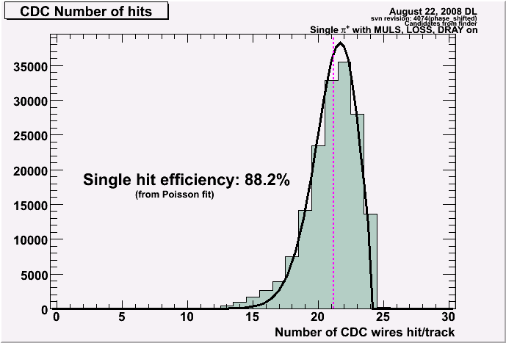
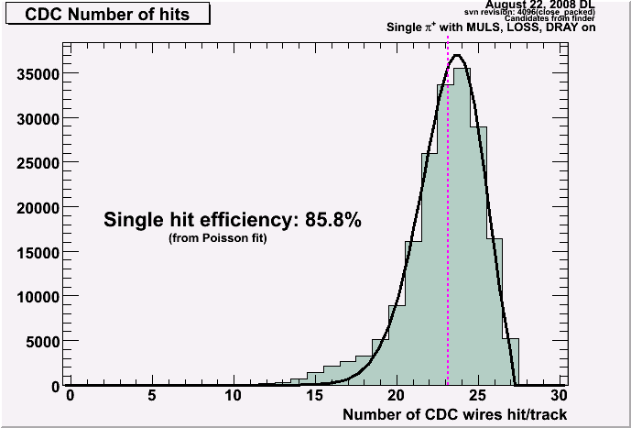
CDC hits per track
Phasespace: range
Nominal Geometry
Close Packed
The number of missing hits was fit to a Poisson and the mean taken as the average number of missed hits.
The Nominal Geometry is consistent with the single hit efficiency derived from the dE plots.
The Close Packed geometry is consistent with ~9% inefficiency on average due to gaps in the “close-packed” axial layers.

Slide 7
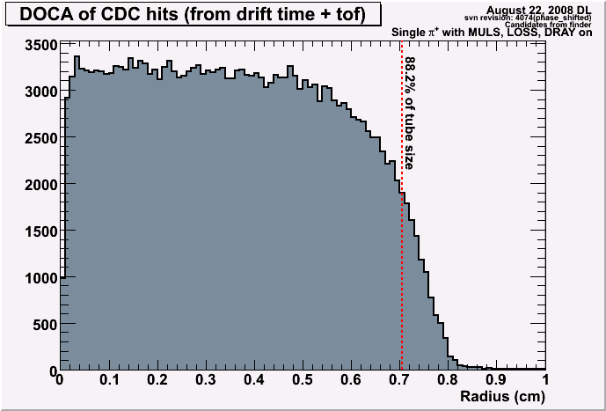
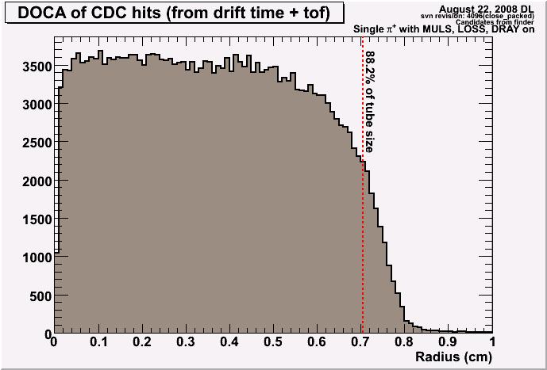
Distance of Closest Approach (DOCA) (calculated from t_{drift}-tof)
Phasespace: 1 GeV/c ; 90º
Nominal Geometry
Close Packed
DOCA distributions seem consistent with the 88.2% single hit efficiency and cut on dE which corresponds to the outer part of the tube.

Slide 8
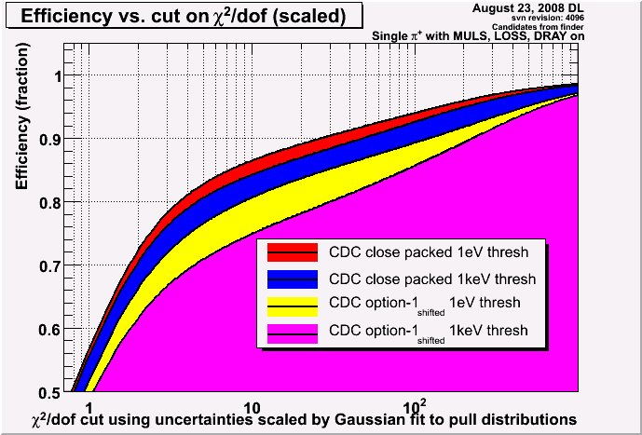
Tracking Efficiency with and without dE threshold
Phasespace: range

Slide 9
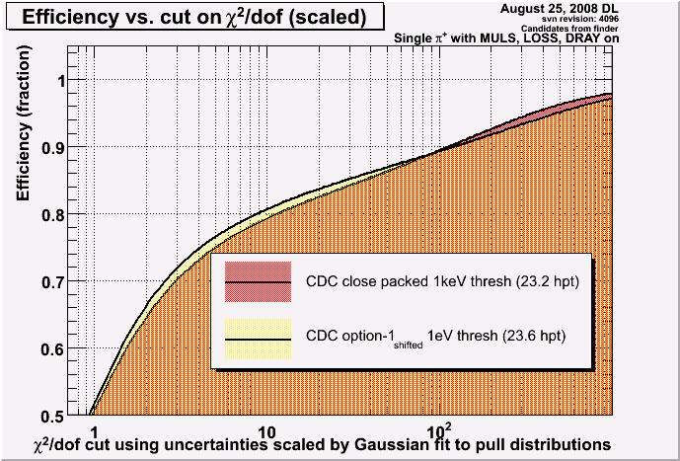
Close packing vs. extra layers
The low-threshold baseline design (shifted) has approximately the same number of hits per track as the close packed design with a high threshold. This gives a suggestion as to how much close packing buys vs. extra layers.

Slide 10
Summary
3 stereo superlayers improves tracking efficiency
Additional layers improves tracking efficiency (we seem to be in a region of high sensitivity)
Single hit efficiency due to 1keV threshold is ~88%. The energy distribution from hdgeant needs to be verified and then the threshold examined more closely.

