Slide 1
Hall C Software Development
From the perspective of a user

Slide 2
Outline
Version management with Git
Overview of git in practice
Examples of pushing/pulling updates
Issue tracking
Development of a new build system – SCons
Overview of SCons
Current status of build/configure system

Slide 3
Git
Free and open source distributed version control system
Created by the Linux development community (primarily for version control of the Linux kernel), with a focus on:
Speed
Simple design
Strong support for non-linear development (1000’s of branches)
Fully distributed
Able to handle large projects efficiently

Slide 4
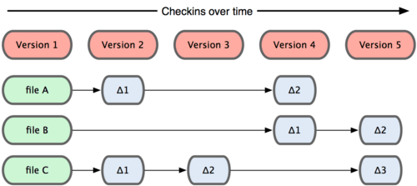
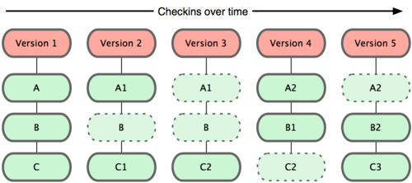
Git Philosophy
CVS, Subversion, etc.
Based on “changes” to files
Difficult to “back out” once changes are committed
Git
Based on “snapshots” of filesystems
Trivial to back out changes
This is hugely important for large parallel development, as well as for newbie users!

Slide 5
Github.com
Online project hosting using git
Developers use their own account on github.com to create “forks” of JeffersonLab repositories
Changes are committed to a developer’s forked repository, and at some point may be merged with the main JeffersonLab repository, via a pull request.
The “gatekeeper” for the Jefferson Lab repository governs this process.

Slide 6
Current JLab Git Projects
Hall A C++ Analyzer
Hall C C++ Analyzer
Hall C Fortran engine
Hall C Replay x 2 (for comparisons)
Hall C Geant simulation of Compton Polarimeter
SIMC (Monte Carlo for Halls A and C)
MC_SHMS_SINGLE
TreeSearch (Hall A TreeSearch track reconstruction

Slide 7
Development under Git
Easy to install and update code on JLab systems as well as on local (Mac and Linux) machines
git clone git@github.com:brash99/analyzer.git
git branch –a
Master
remotes/origin/HEAD -> origin/master
remotes/origin/Release-070
remotes/origin/Release-100
remotes/origin/Release-110
remotes/origin/Release-120
remotes/origin/Release-130
remotes/origin/Release-140
remotes/origin/Release-150
remotes/origin/master
remotes/origin/scons_final_change
remotes/origin/scons_link_develop
remotes/origin/scons_link_develop_150
git pull origin <branch-name>

Slide 8
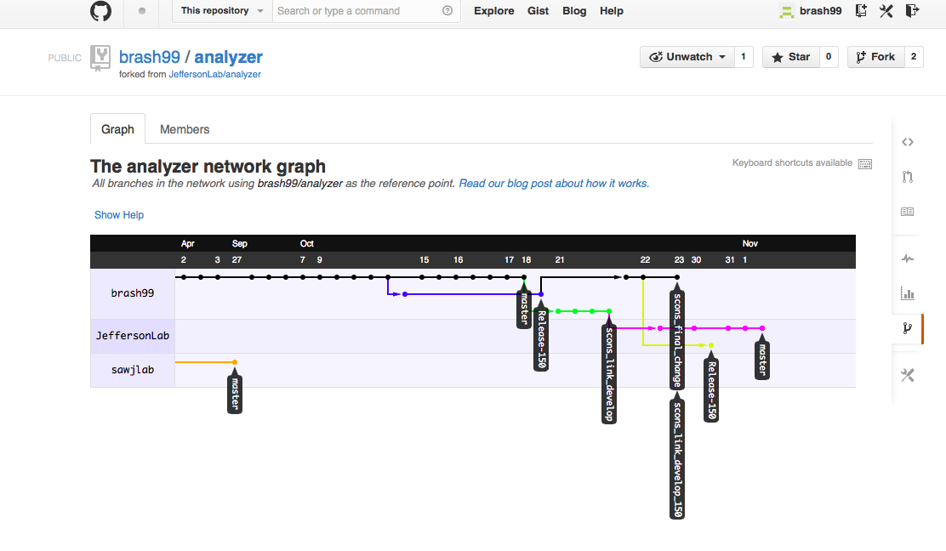
Example Network Graph
$ git checkout –b scons_final_change
(make changes)
$ git commit –a
$ git push origin scons_final_change
Analyzer Network

Slide 9
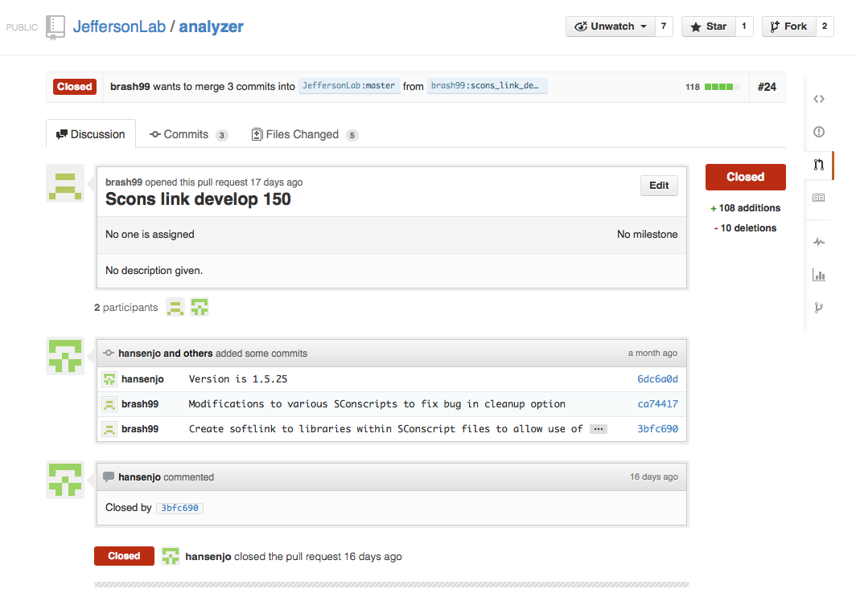
Pull Requests
Users/developers who are “watching” development of the JeffersonLab/analyzer repository are notified by email of pull requests.
Typically, other developers, as well as the gatekeeper, can make comments on the proposed pull request prior to it being accepted (or rejected).

Slide 10
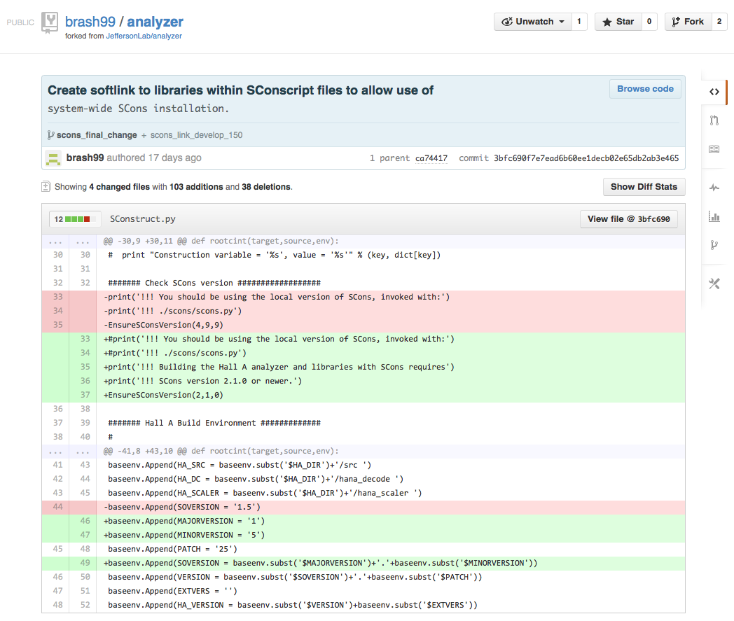
Details of Pull Request

Slide 11
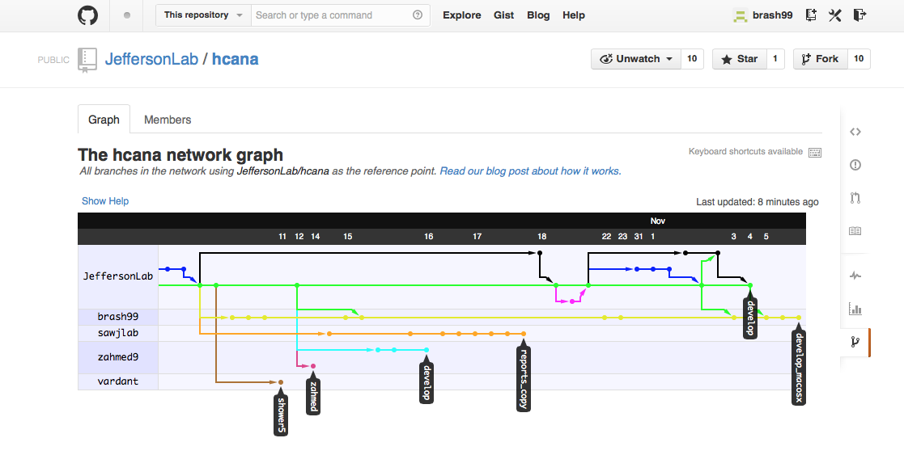
Keeping forks up-to-date
$ git remote add upstream git@github.com:JeffersonLab/hcana.git
$ git fetch upstream
$ git merge upstream/develop

Slide 12
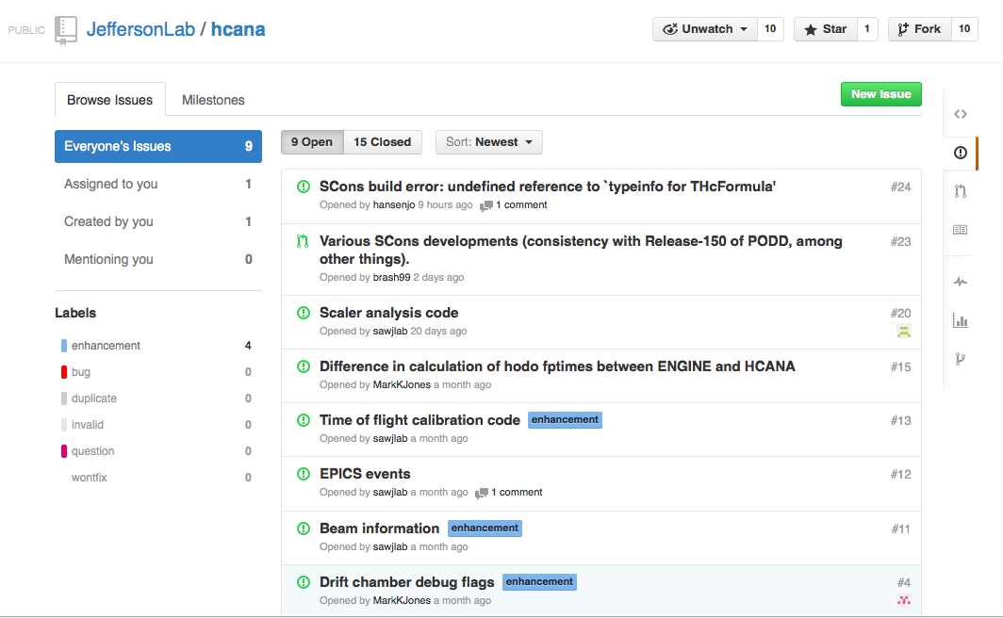
Issue Tracking in Git
X
Issues to be solved can be created at any time, and assigned to a particular developer
When pull requests are made, can be associated with one or more issues, and issue can be closed (if appropriate)

Slide 13
A new build system - SCons
Traditionally, Hall A/C software has been built with “make”
Platform/system/compiler dependent configuration handled within Makefiles (coupled with #ifdef statements within the code itself)
Dependency checking not included by default, and is based on timestamp.
Having an “autoconf”-like configuration is desirable, but GNU Autoconf is highly complex
Makefiles are platform-dependent, and incredibly cryptic – basically unreadable to non-experts – making changes and updates difficult
Libtool (management of libraries) not available for all platforms
Is there something better out there?

Slide 14
A new build system - SCons
SCons is an open-source software construction tool
Written entirely in Python – power of a real programming language in configuration and build scripts … plus, our students know and love Python!
Scripts are much more readable than Makefiles
Integrated functionality similar to Autoconf
Built-in support for C/C++, and easily extensible for other builders (ROOTCINT)
Built-in dependency-checking – based on MD5 signatures, and not timestamps – important for git.
Designed from the ground up for cross-platform builds
Currently used by the JLab DAQ group for EVIO

Slide 15
Major Projects using SCons
ASCEND - A system modeling package for engineering
Cantera – A toolkit for chemical kinetics and thermodynamics
CLAM – A framework to develop sophisticated audio analysis
FreeNOS – A microkernel operating system written in C++
IntensityEngine – A platform for 3D games and virtual worlds
Lumiera – A professional video editor
Madagascar – Geophysical data processing
Nsound – C++ audio synthesis framework
openEHR – Electronic Health Record standard
V8 – Google’s open source Javascript engine
YafaRay – An open source raytracing engine

Slide 16
SCons – Current status
Build and configuration scripts have been written, tested, and committed for both PODD and HCANA
Configuration checks for:
ROOT installation
gcc/g++ compiler installation and functionality
Platform-dependent compiler/linking flags (64/32 bit, Linux/MacOSX)
Currently, we are maintaining the traditional Make system and SCons in parallel (for both PODD and HCANA)

