Slide 1
Jevio evio for the Java programmer
Carl Timmer, Jlab
Physics Data Acquisition Group

Slide 2
Jevio
Authored by Dave Heddle
Beautifully written code
Has graphical event viewer
Originally for use with evio files only
Extended by Carl Timmer
Can be used with buffers of data (i.e. for network programming)
Graphical viewer can see cMsg messages

Slide 3
Capabilities
Read & write evio files
Create & parse buffers of evio data
Graphically view evio data in files
Receive and graphically view evio data in cMsg messages
In future, look at evio data over ET
Supply dictionaries to viewer for clarity (thru file or over cMsg)
Javadoc available
Full manual needs to be written yet

Slide 4
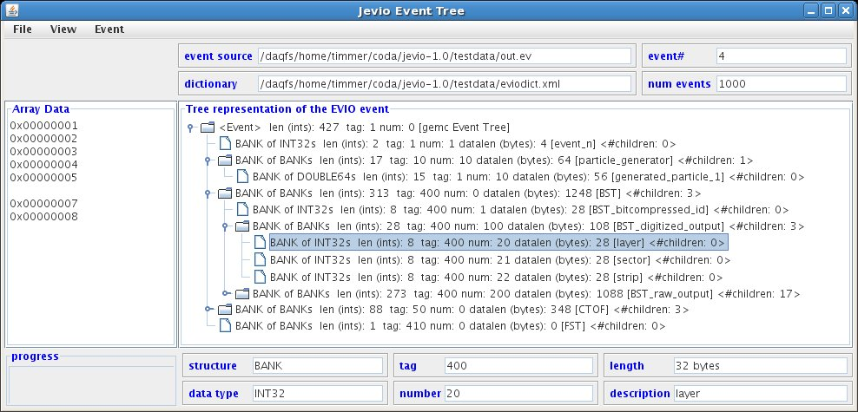
Graphical Viewer

Slide 5
Writing-a-File Example
// Create bank of banks
EventBuilder eventBuilder = new EventBuilder(tag, DataType.BANK, num);
EvioEvent event = eventBuilder.getEvent();
// Create bank of ints
EvioBank bank = new EvioBank(tag, DataType.INT32, num);
// add data to bank of ints
int[] intArray = {1,2,3};
eventBuilder.appendIntData(bank, intArray);
// add int bank to bank of banks
eventBuilder.addChild(event, bank);
// write to file
EventWriter eventWriter = new EventWriter( new File(“myFile”) );
eventWriter.writeEvent(event);
eventWriter.close();

Slide 6
Reading-a-File Example
// open file
EvioFile evioFile = new EvioFile(filename);
// loop thru events in file
while ( (event = evioFile.nextEvent()) != null ) {
// do something with event
System.out.print (“Event = “ + event.toString());
}

Slide 7
Sending data over network
// put event into buffer
EvioEvent event = … ;
ByteBuffer buffer = ByteBuffer.allocate(1000);
buffer.clear();
event.write(buffer);
buffer.flip();
// put buffer into cMsg Message & send
msg.setByteArrayNoCopy(buffer.array(), 0, buffer.limit());
msg.setByteArrayEndian(cMsgConstants.endianBig);
coda.send(msg);

Slide 8
Receiving data over network
// get evio data from cMsg message
Byte[] evioData = msg.getByteArray();
// get endian value
ByteOrder byteOrder = ByteOrder.BIG_ENDIAN;
if (msg.getByteArrayEndian() == cMsgConstants.endianLittle) {
byteOrder = ByteOrder.LITTLE_ENDIAN;
}
// parse event
ByteParser parser = new ByteParser();
EvioBank bank = parser.parseEvent(eviodata, byteOrder);

Slide 9
Conclusions
Java evio package is ready to use
Still needs user manual

