Slide 1
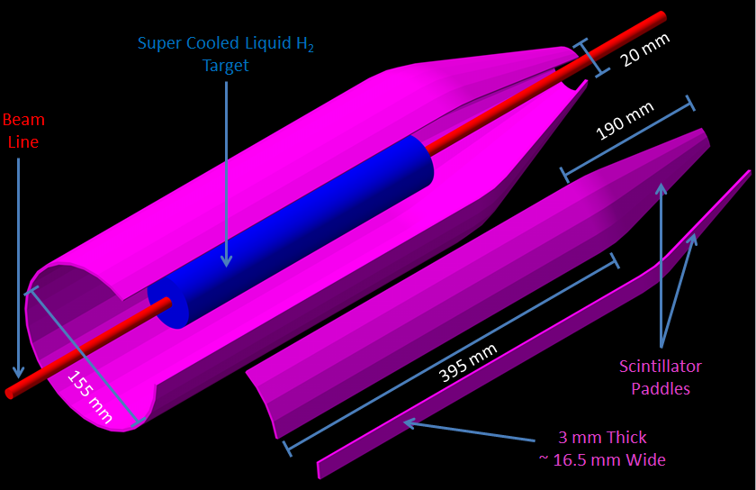
Start Counter Calibrations

Slide 2
Simulation of Random Charged Tracks
Start Counter (ST) paddle geometry is parameterized by 5 values:
Length of the straight section = 396.65 mm
Radius of the bend arc = 120.00 mm
Angle of the arc = 18.5 deg
Length of the nose section = 160.56 mm
Distance of straight section to the beam = 77.52 mm
Charged track vertices generated with the following conditions:
Originate within the target length of 300.00 mm
Occur within the beam diameter of 3.40 mm
Trajectory of track is determined by random angle (θ)

Slide 3
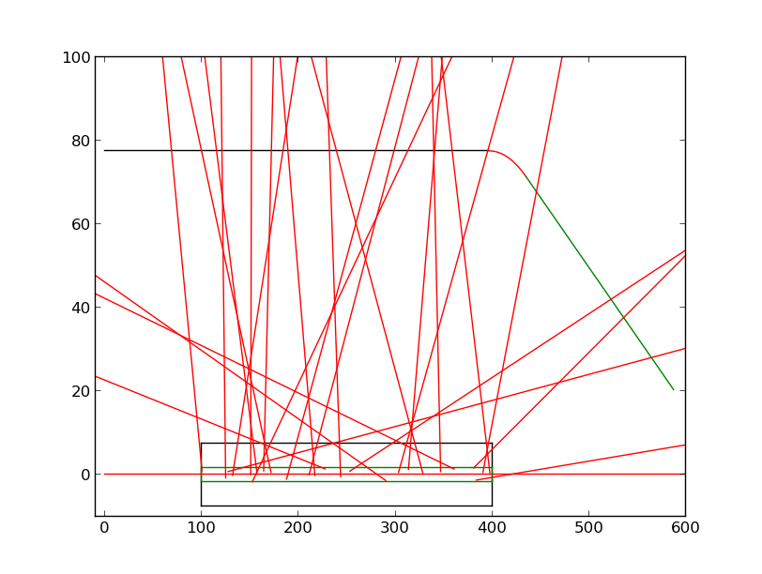
Simulation of Random Charged Tracks
Paddles are comprised of 3 parameterized objects:
Straight
Bend
Nose
Objects are constructed as parametric equations of the form: R = R₀+Vt
R₀ initial position vector
V direction vector
t parameter (0$≤t≤1)$
Charged tracks are objects constructed in a similar manner
y (mm)
z (mm)

Slide 4
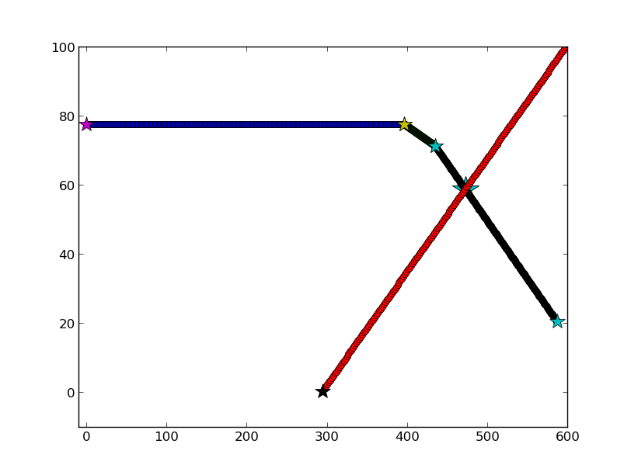
Single Charged Track
Charged tracks have 5 possible outcomes
Hit in the straight section
Hit in the bend
Hit in the nose
Miss by virtue of small forward angle(θ $≲$3 deg)
Miss by virtue of large backwards angle (θ $≳$ 135 deg)
The intersection point of the charged track with the paddle section is found
The distance (D) from the intersection point to the SiPM is calculated
y (mm)
D
z (mm)

Slide 5
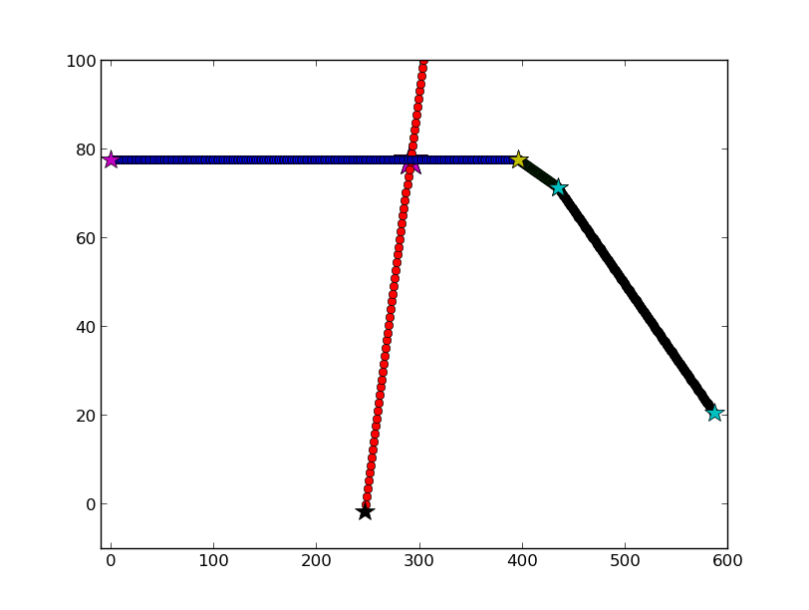
Single Charged Track
Consider a hit in the straight section of Paddle 1
The hit occurs at:
y = 77.52 mm
Z = 291.47 mm
The distance from the hit to the SiPM if found to be 29.147 cm
Correction factors for relevant ADC and TDC values must be determined
y (mm)
z (mm)

Slide 6
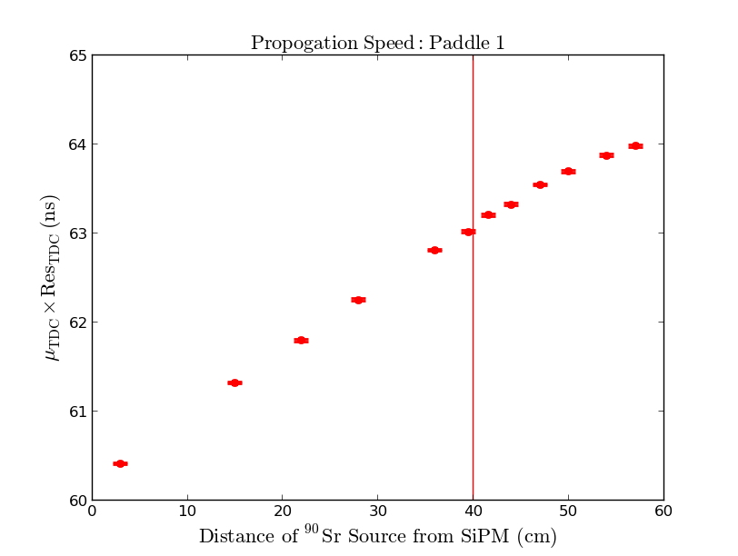
Propagation Speed Correction
The straight section and nose section require two separate linear fits to determine the propagation speed of light within the scintillator medium
Light propagates faster in the nose region due to the geometry
Numerical python (numpy) least squares fitting module was used to implement the fit in the two regions
Levenberg-Marquardt algorithm

Slide 7
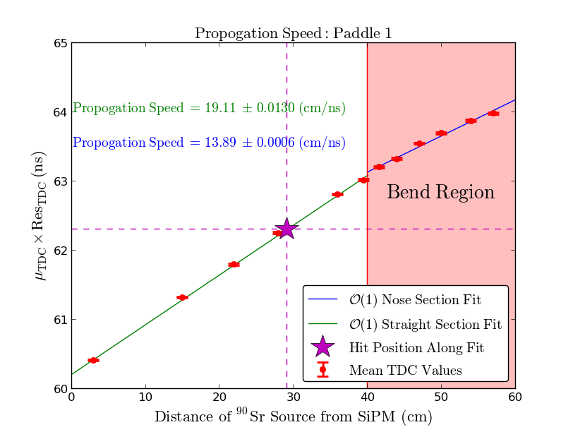
Propagation Speed Correction

Slide 8
Propagation Speed Correction
TDC(x) = A + B*x
x = 29.147 cm
Straight Section
A | A_{err} | B | B_{err} | TDC | TDC_{err}
60.21 | 8.33e-4 | 0.072 | 3.55e-7 | 62.31 | 2.91e-3
Correction factors are determined from extrapolating the TDC fit function evaluated at 0.0 cm
Nose Section
A | A_{err} | B | B_{err}
61.04 | 8.34e-4 | 5.23e-2 | 3.55e-7

Slide 9
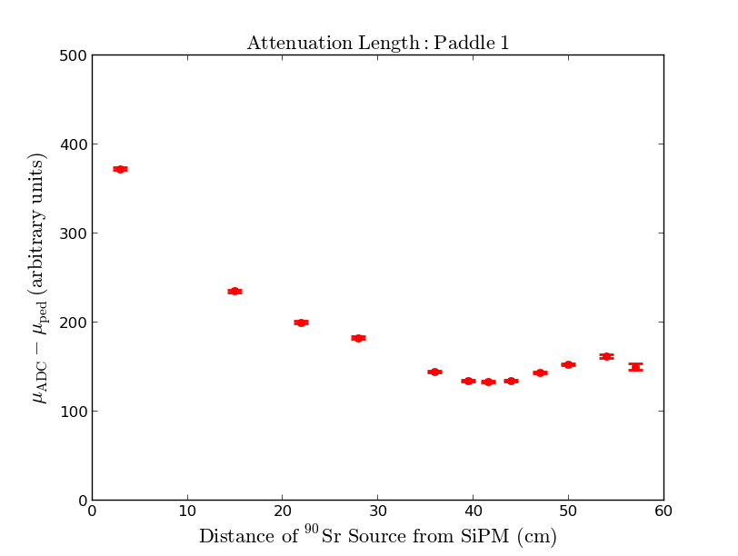
Attenuation Correction
ADC values do not follow a well defined function due to geometrical effects of the bend and nose region
Extensive least square studies were done to determine what function would best fit the data
Exponential functions could not account for the odd behavior in the nose region
Orthogonal produced large error in the calculations along the fit
Polynomials above 6th order would not allow for reliable extrapolation at the extremes
5th order polynomial was chosen
Provides a good χ² and small error along the fit

Slide 10
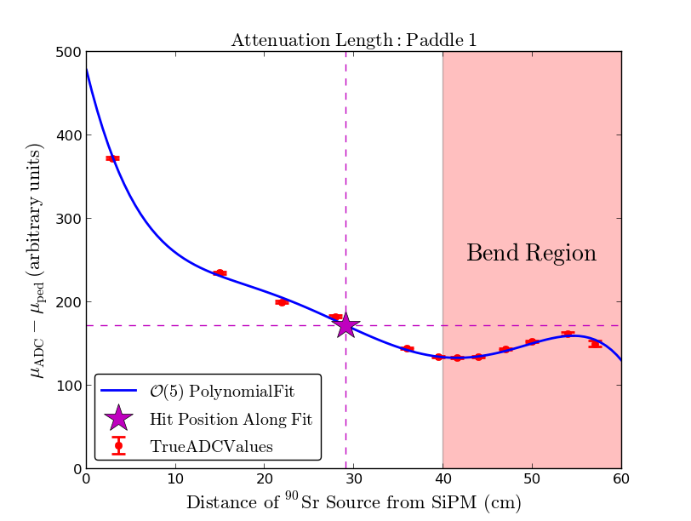
Attenuation Correction

Slide 11
Attenuation Correction
ADC(x) = A + Bx + Cx² + Dx³ + Ex⁴ + Fx⁵
X = 29.147 cm
A | B | C | D | E | F | ADC
4.78e+2 | -4.39e+1 | 3.21 | -1.19e-1 | 2.05e-3 | -1.29e-5 | 171.49
A_{err} | B_{err} | C_{err} | D_{err} | E_{err} | F_{err} | ADC_{err}
4.91 | 6.52e-1 | 6.08e-3 | 9.47e-6 | 2.91e-9 | 1.21e-13 | 0.906
Correction factors are determined from extrapolating the ADC fit function evaluated at 0.0 cm

Slide 12
Future Plans
Translate all Python code to C++
Implement time walk corrections utilizing data from prototypes and LeCroy leading edge discriminator

