Slide 1
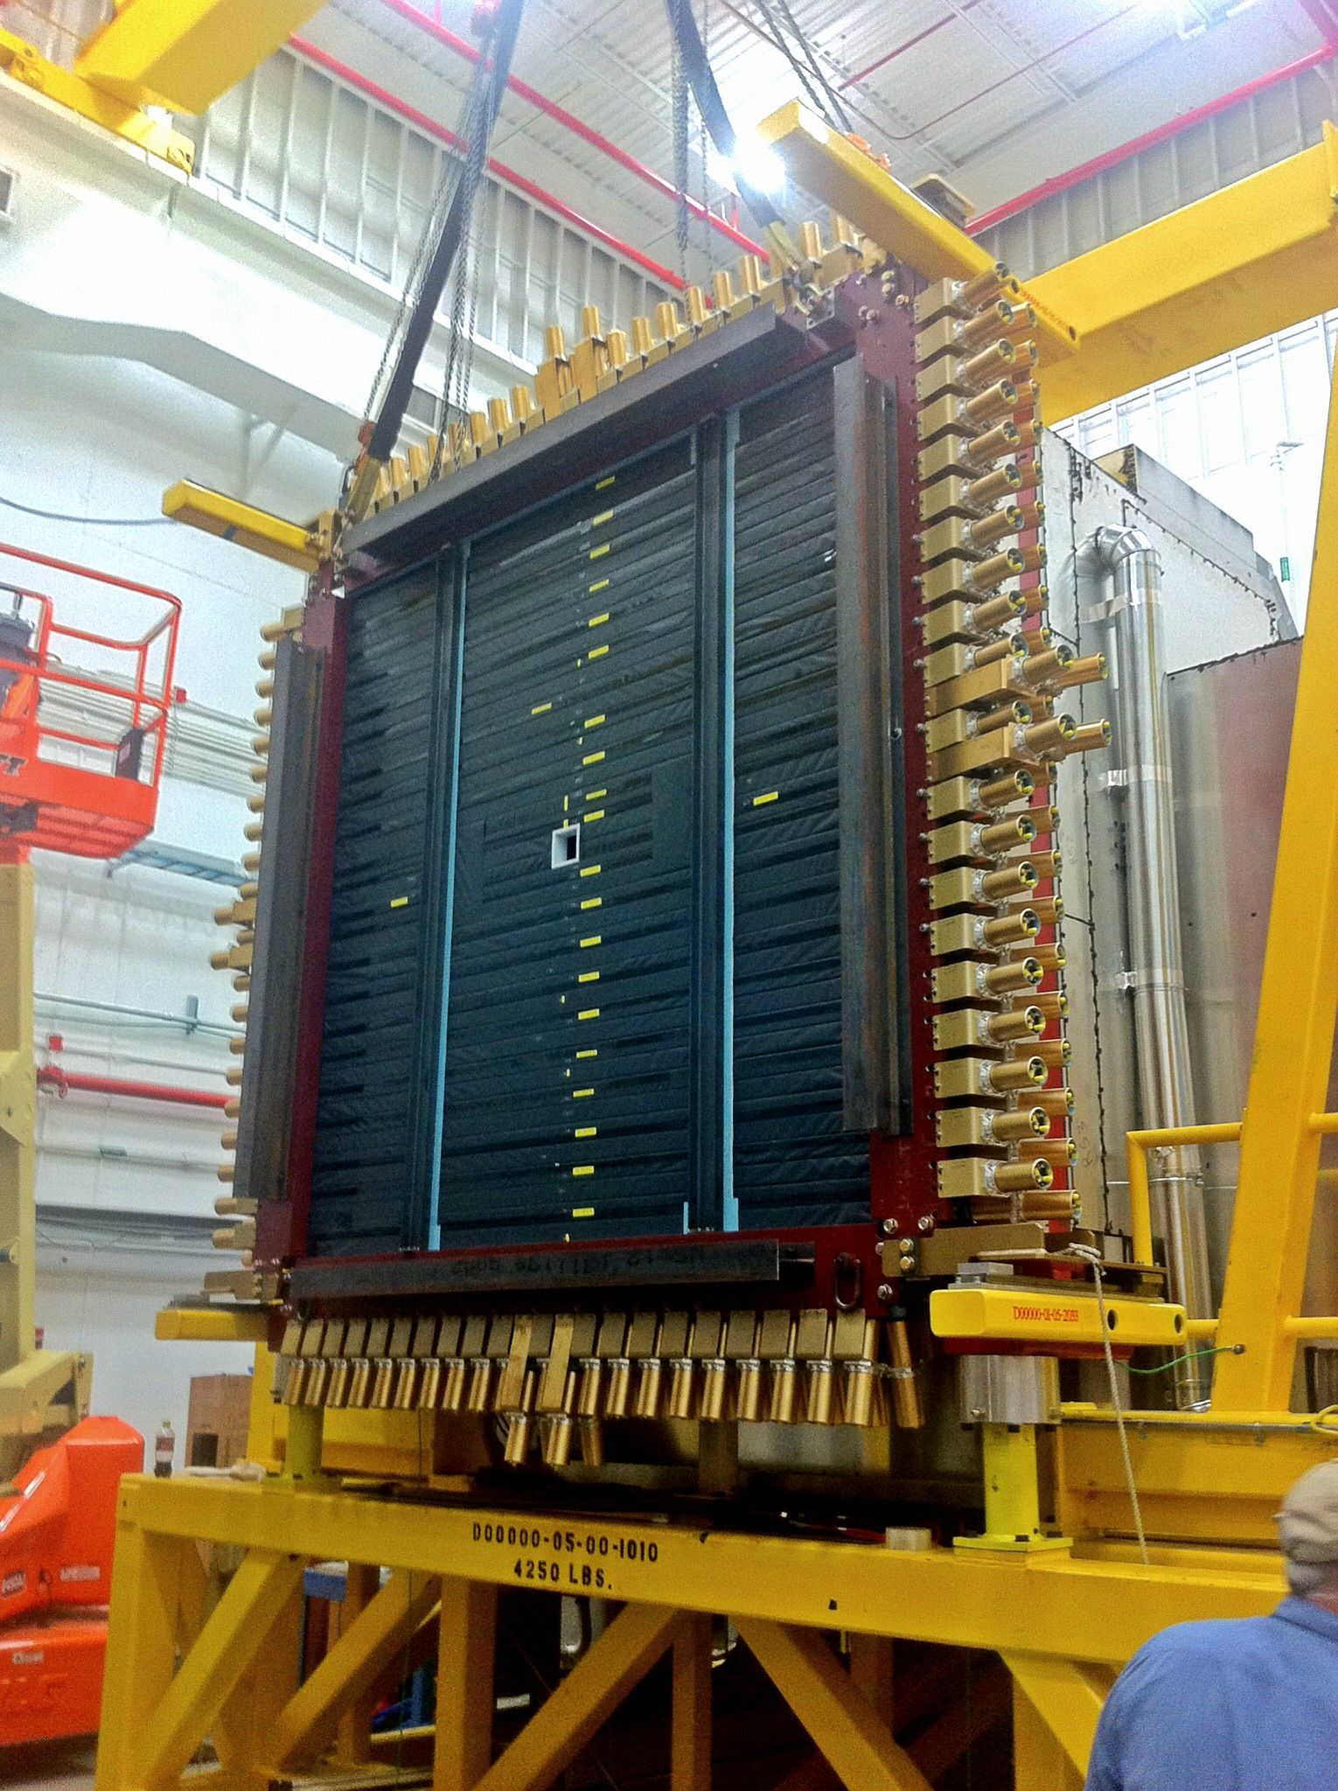
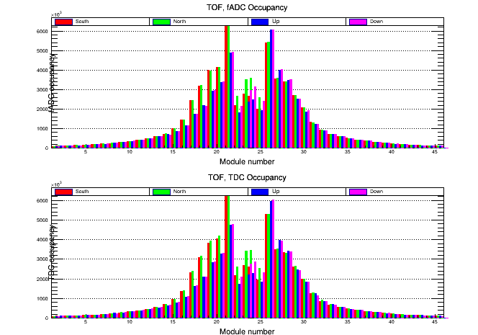
GlueX TOF Calibration
GlueX TOF detector: 2.52m x 2.52m
2 planes
Horizontal (up-stream)
Vertical (down-stream)
Double ended readout: 252cm long 6 cm wide
Beam hole: single ended short paddles
Intensity Monitoring plot
46 pads per plane
42 long paddles
2 times 4 short paddles
North/South horizontal
Up/Down vertical
<number>

Slide 2
Calibration code and scripts
Skim with TOF data: halld_recon/src/plugins/Calibration/TOF_calib/JEventProcessor_TOF_calib.cc
Prerequisite: calibrated base time offsets for raw ADC and TDC data
Output: root tree files containing raw tof ADC and TDC data in units of [ADC] and [ns]
Master Calibration Script: hd_utilities/TOF_calib/DO_CALIB.csh
Mean base line determination: hd_utilities/TOF_calib/src/dopedestals.C
Walk correction (main correction to timing): hd_utilities/TOF_calib/src/walk1.C
Timing offset parameters for each PMT of doubled ended paddles
Take advantage of the fact that there are TWO planes: OVERLAPPING PADDLES!
Use ONE PMT as reference, all other PMTs will be calibrated to that reference
Meantimes: hd_utilities/TOF_calib/domeantime.csh (src/meantime1.C, src/meantime2.C)
Time differences: hd_utilities/TOF_calib/dotimediff.csh (src/timedifference.C)
Determine effective light velocity in paddles: src/tdlook.C
Determine timing offsets for all long paddles with meantime and time-difference paddles: src/consolidate.C
Determine timing offsets for all sort singled ended paddles: src/dofitall.C
Determine relative timing between ADC and TDC timing data to center distribution to zero: src/toadctimeoffsets.C
See: GlueX TOF timing calibration: DocDB 2767
2

Slide 3
Calibration Steps
Don’t forget the base lines
All detectors using fADC250 need to mean base line values
CCDB tables: TOF/pedestals, FCAL/pedestals, BCAL/ADC_pedestals, PHOTON_BEAM/hodoscope/fadc_pedestals, ...
Most if no all these tables are either filled with 0 or filled with wrong values. Depending on how often the pedestal determination fails this can be a serious problem: Github issue 751 in halld_recon
<number>

Slide 4
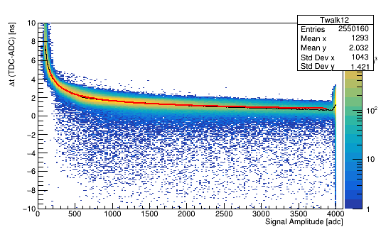
Walk correction in TOF
The walk correction is the first and most important timing correction to the TDC values
TDC time is subject to “walk” due to the use of a LED
=> time depends on signal amplitude
4th generation of walk function:
f(x) = a+b/x+c/x²+d/x⁴+e/x^{1/2}
Application RELATIVE:
tCORR = tTDC – [f(x)-f(REF)]
a cancels, this avoids multiple DC offsets!
<number>

Slide 5
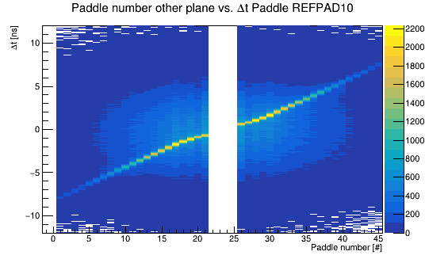
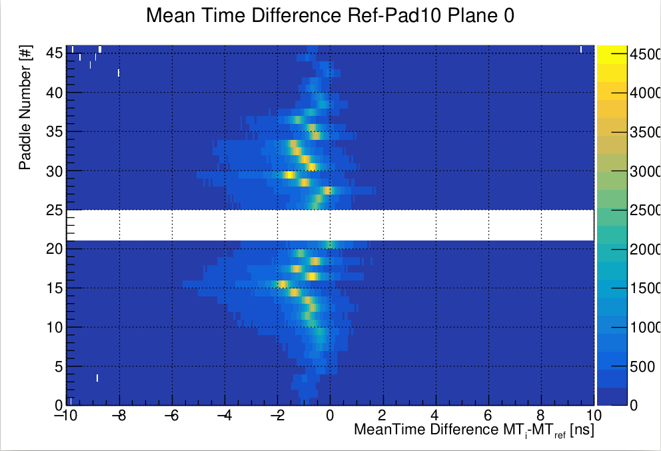
PMT timing offsets
Take advantage of orthogonal planes
Δt = (tdown – tup)/2 : match with paddles from other plane
MT = (tdown + tup)/2 : match with paddles from other plane
Paddle width: 6cm, …., 6cm, 4.5cm, 4.5cm, 3.0cm, 3.0cm, beam hole
<number>

Slide 6
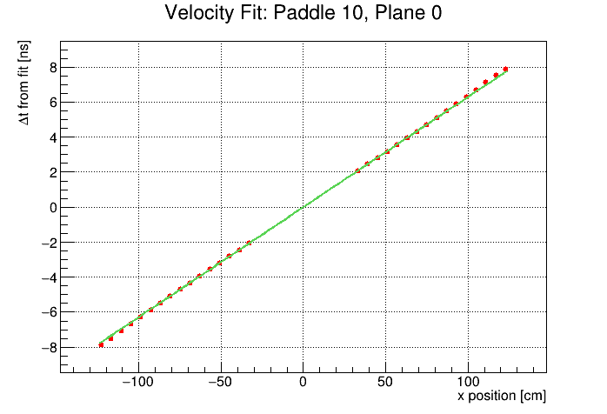
Effective speed of light in paddles
The calibration will provide a means to
determine the effective speed of light
In each paddle. It is of order 16cm/ns
using the paddle position from geometry.
<number>

Slide 7
CCDB tables for TOF
Raw timing offsets: TOF2/base_time_offsets (two values one for adc one for tdc)
ADC Base line offsets: TOF2/pedestals (as many as PMTs)
Walk correction: TOF2/timewalk_parms_5PAR, TOF2/walkcorr_type
TDC timing DC timing offsets: TOF2/timing_offsets_5PAR
Effective speed of light: TOF2/propagation_speed
ADC timing offsets: TOF2/adc_timing_offsets (to match TDC time shifts)
Energy Calibration: TOF2/adc2E
<number>

Slide 8
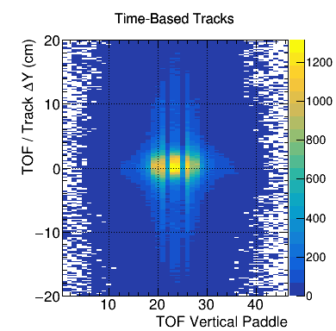
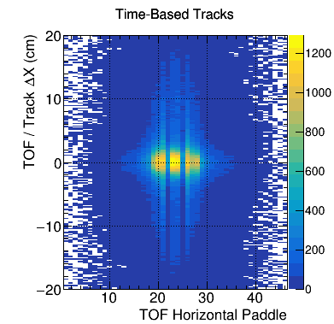
Test Calibration with Tracking
Monitoring Plots
<number>

Slide 9
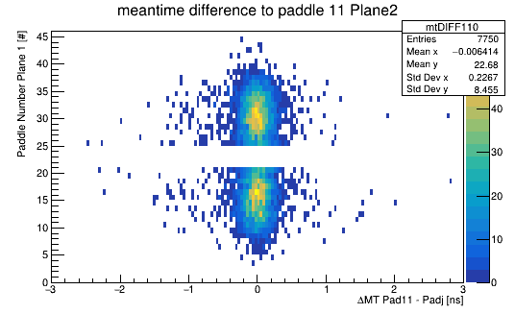
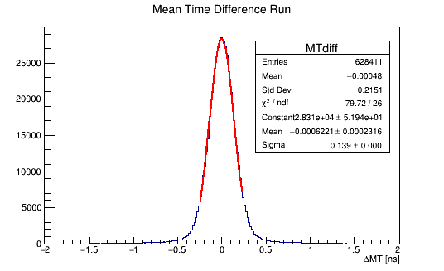
TOF Calibration Test
Single Paddle MT difference with all Paddles from the other plane.
Overall timing resolution (Full TOF):
σ = 139ps/√2 = 98.2ps
<number>

Slide 10
<number>

