Slide 1
ST Calibration Update
Eric Pooser
03/18/2015

Slide 2
Runs Used for the following Calibrations
FCAL Trigger
Runs (1505 – 1525): ≈ 12 M events
50 nA, 10 GeV, 1200 A, 10 mm CH2, 5.0 mm hole
PC = Retracted, Radiator: 2 x 10-5 RL
FCAL/BCAL Trigger
Runs (2397 – 2420): ≈ 125 M events
100 nA, 10 GeV, 1200 A, 10 mm CH2, 5.0 mm hole
PC = 5 x 10-3 RL, Radiator: 2 x 10-5 RL

Slide 3
Time Walk Calibrations
Functional Form
$T_{corr}=T_{hit}−C_{1}\left(A^{c_{2}}−{A_{0}}^{c_{2}}\right)$
A ≡ Pedestal Corrected Pulse Integral
A₀ ≡ Mean of minimum ionizing Landau Peak
For now, A₀ is hard coded to be 3000
Nothing is gained by allowing this value to be a parameter
Future calibrations could implement a fitting procedure which would accurately feed A₀ into the time walk fits on a channel by channel basis

Slide 4
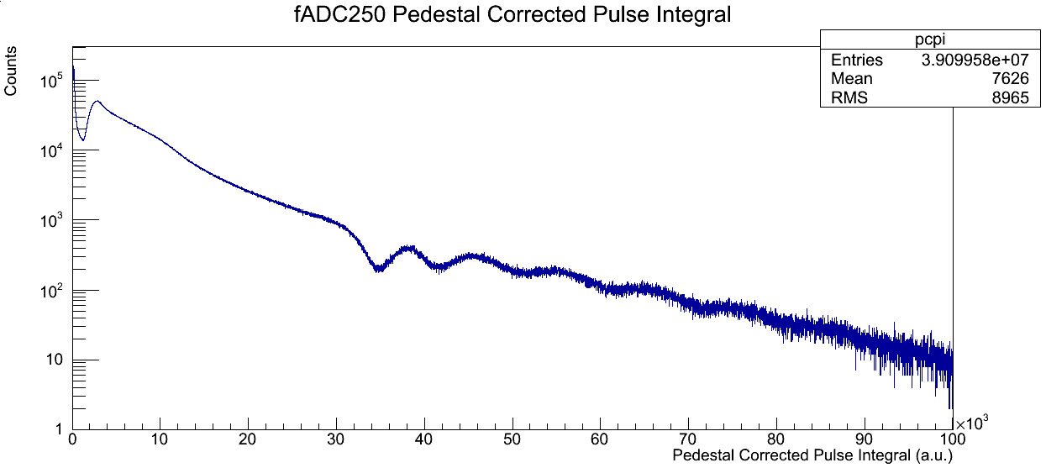
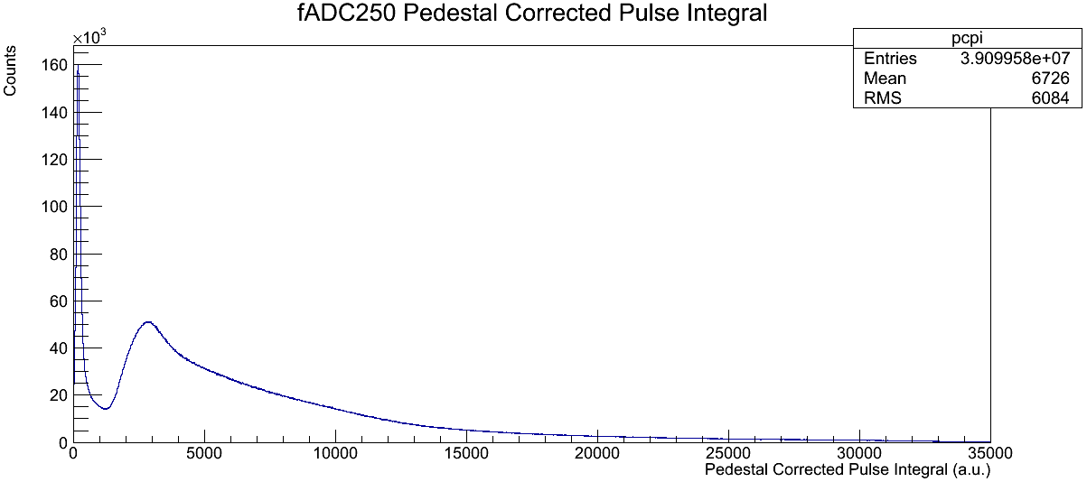
Pedestal Corrected Pulse Integral
Overflow
Dynamic Range of fADC: 0 – 30,000 channels

Slide 5
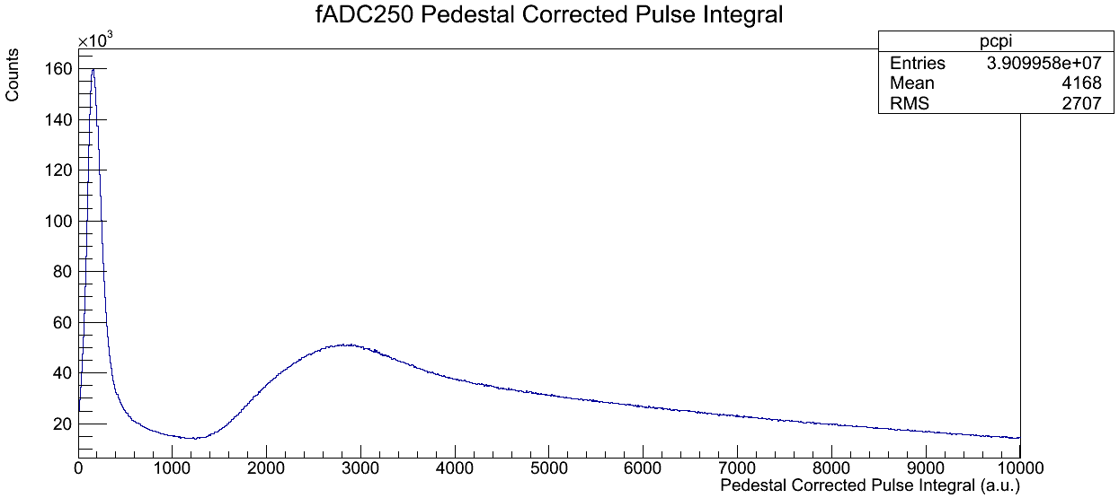
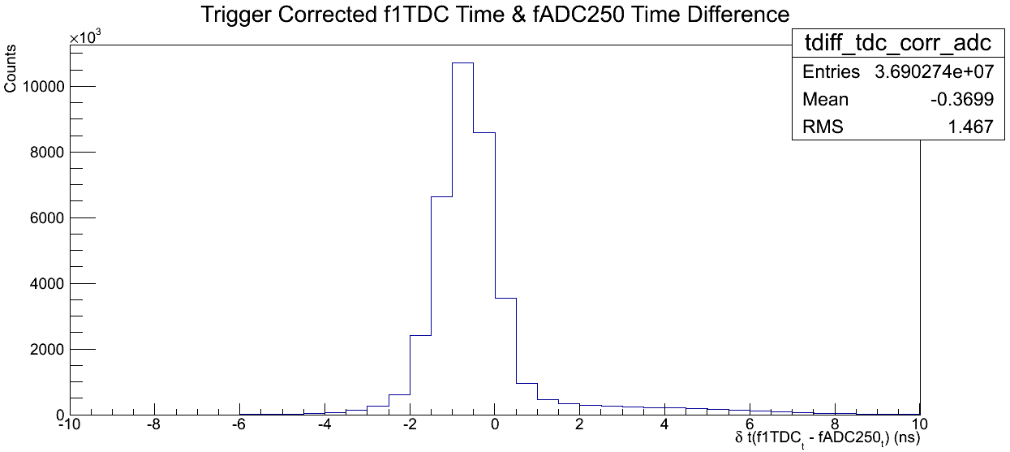
Landau Peak Mean & Hit Times
Landau Peak (μ ≈ 3000 chan)

Slide 6
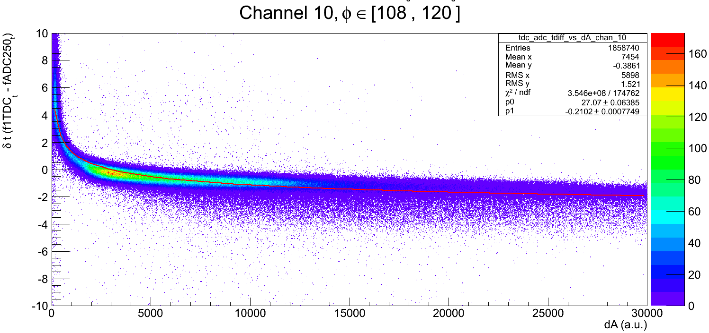
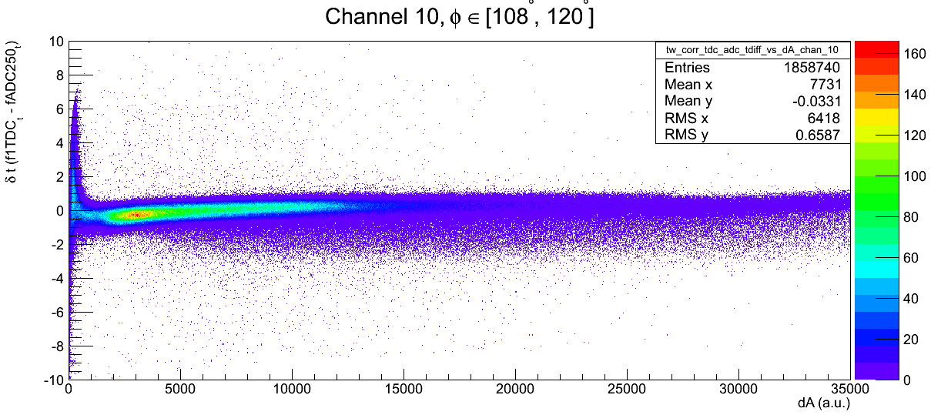
Time Walk Corrections (Before & After)

Slide 7
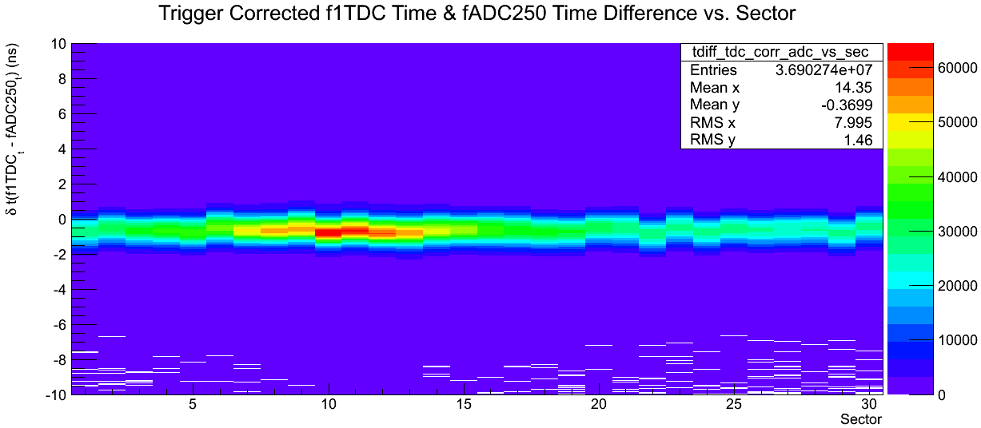
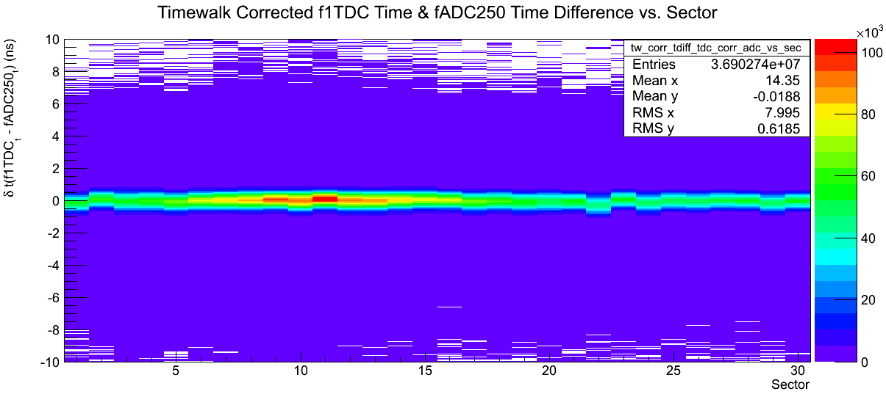
Time Walk Corrections (Before & After)

Slide 8
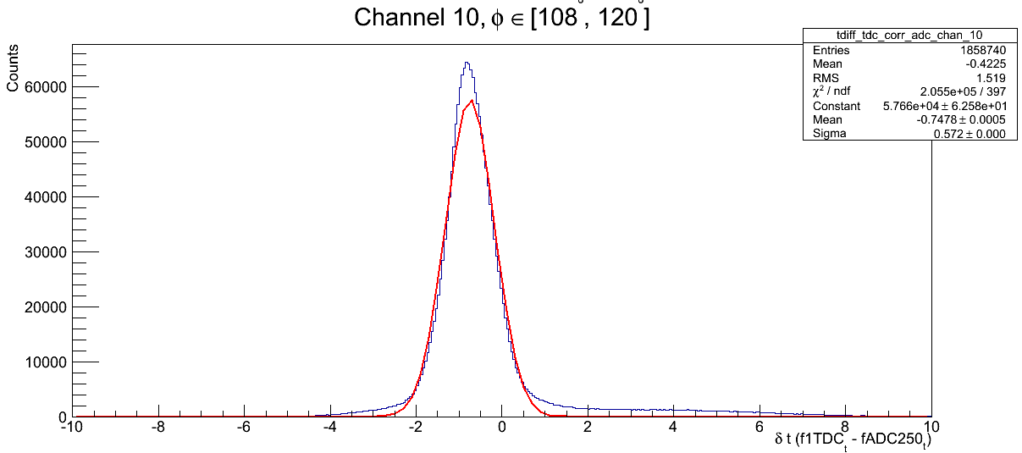
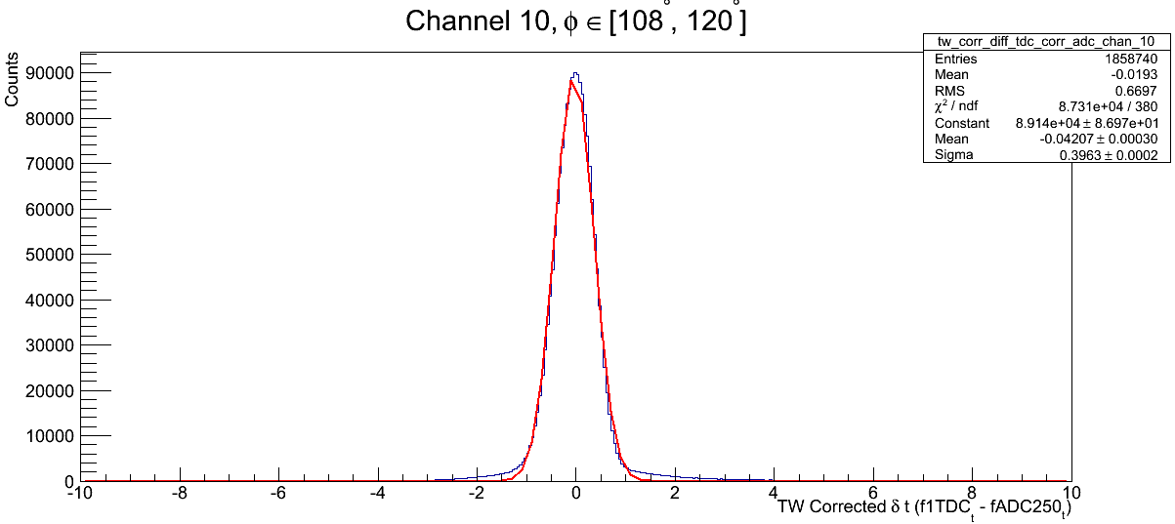
Time Walk Corrections (Before & After)
σ ≈ 575 ps
σ ≈ 400 ps

Slide 9
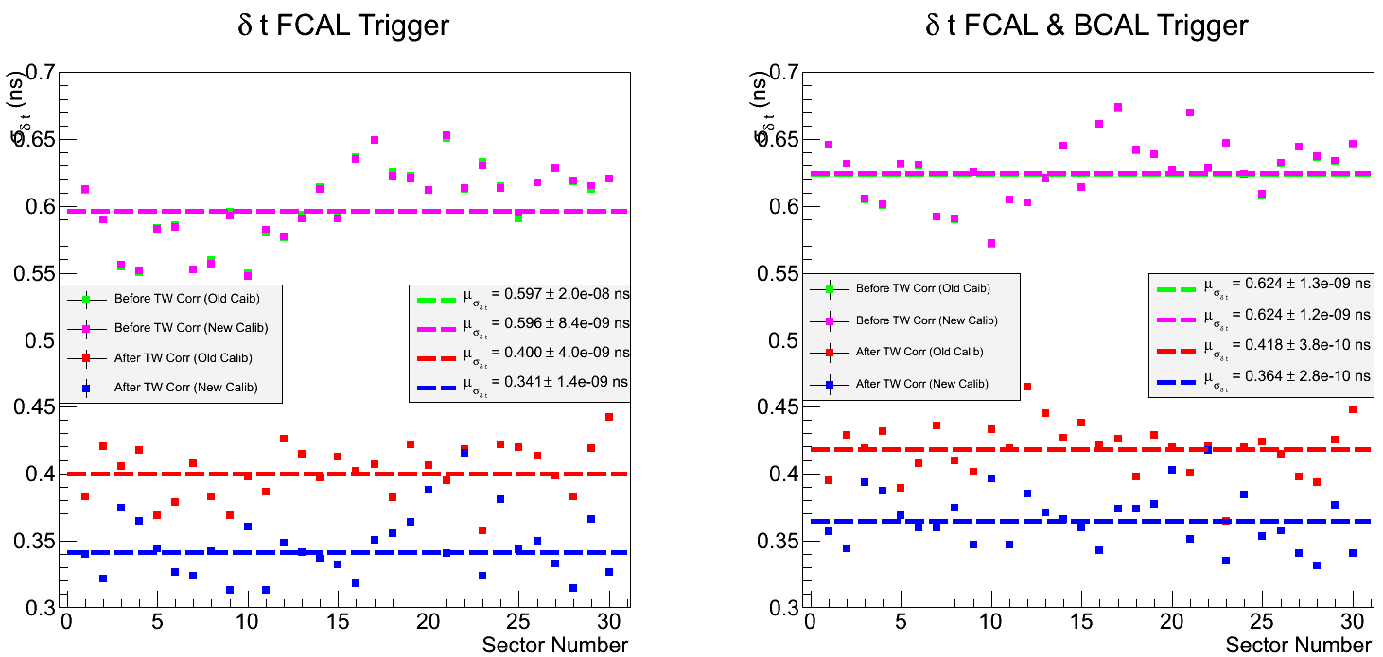
Time Walk Corrections (Before & After)

Slide 10
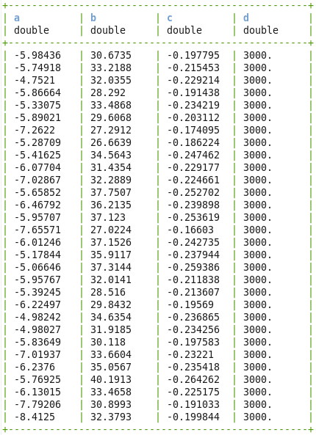
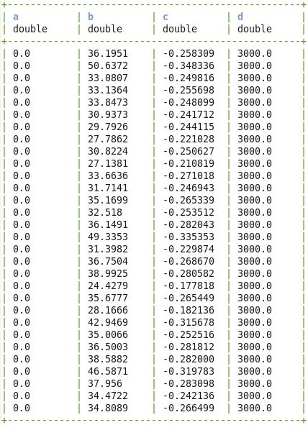
Time Walk Corrections (CCDB)
Old TW Corrections
New TW Corrections

Slide 11
Propagation Time Correction Event Selection
Only events where exactly 2 hits in the ST occurred were selected
The two hits could not be in the same paddle
The events were then grouped into 5 possible scenarios such that the two hits occurred in the following sections of the ST:
Straight section
Bend section
Nose section
Bend & Nose section
Straight, Bend, & Nose section

Slide 12
Propagation Time Corrections (cont.)
The same data used for the TW corrections were used for the propagation time correction studies
Only FCAL/BCAL trigger runs using the new TW corrections are illustrated here
The time difference of the two hits are plotted against the difference of the hits location along the path of the scintillators

Slide 13
Propagation Time Corrections (cont.)
The δt vs δz data were then fit with a polynomial of order 1 and $V_{eff}$ is determined
The correction ${δt}_{corr}={δt}_{hit}− {δz}_{hit}/V_{eff}$ is then applied to the data
TW corrected and propagation time corrected time resolutions are obtained for selected regions of the Start Counter

Slide 14
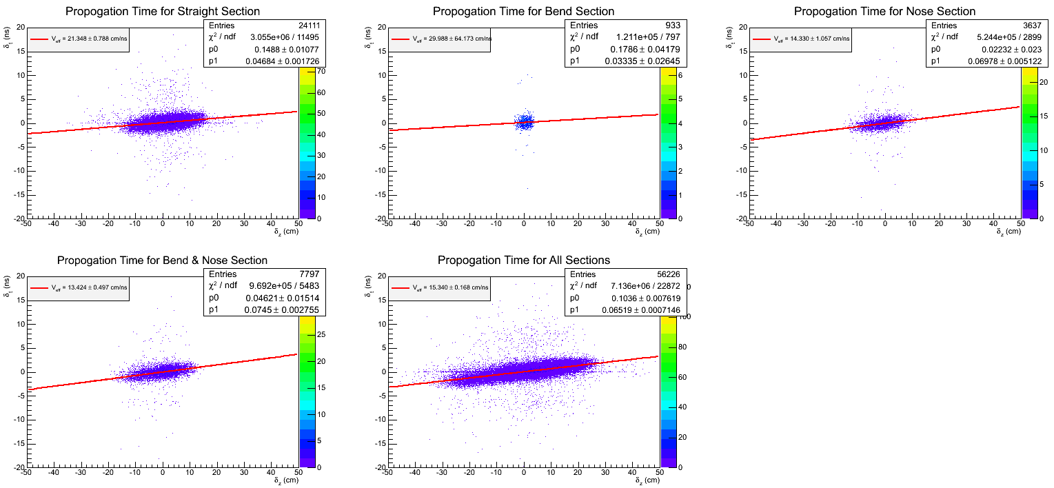
δt vs δz (Uncorrected)
Some of the data is contradictory to bench mark measurements made at FIU
This could simply be a lack of statistics

Slide 15
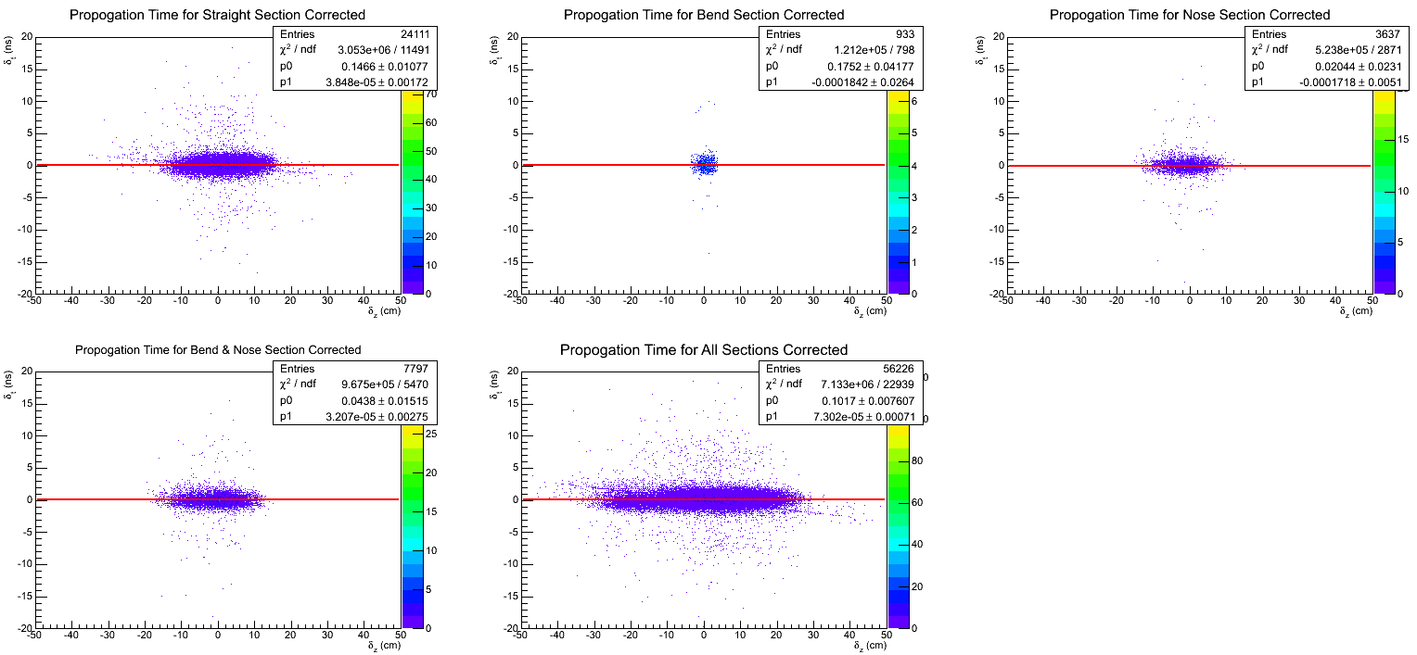
δt vs δz (Corrected)
After the correction, the effective velocity of light in all regions of the ST become essentially infinite

Slide 16
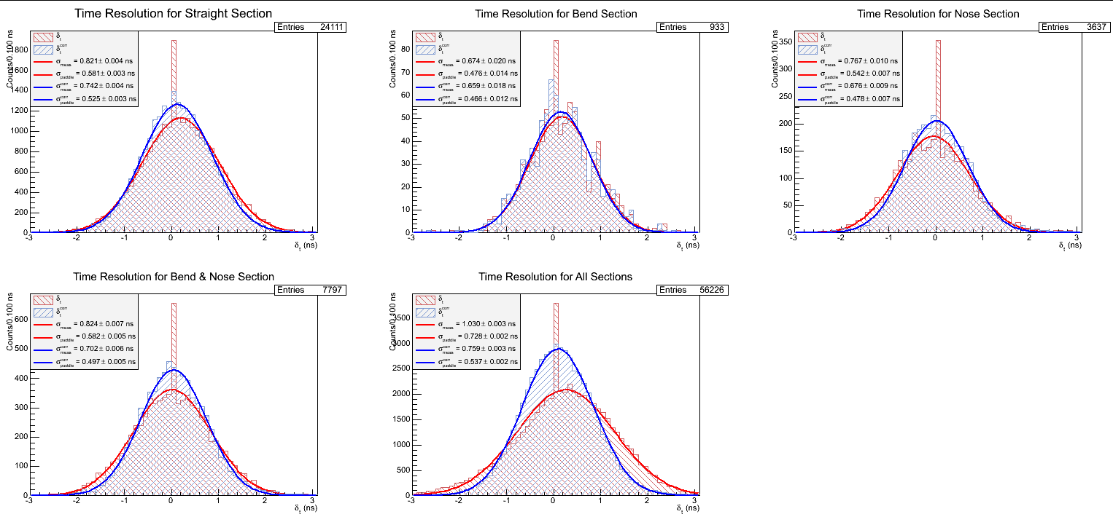
Time Resolutions for Runs (2397 – 2420)
The aforementioned propagation time corrections substantially improve the time resolution measurements
The updated TW corrections provided for better time resolutions (≈ 40 ps )
These preliminary measurements indicate an average time resolution of the entire ST to be approximately 500 ps

Slide 17
Future Plans
Further TW correction studies are needed
Various functional forms need to be investigated
Develop algorithm to locate mean of Landau peak in pedestal corrected pulse integral spectrum
Fall back on benchmark measurements made at FIU regarding propagation time and implement these into the PID library until we have more statistics from the upcoming Spring run
A different algorithm is needed for the two cases (beam data vs. benchmark data)
Develop algorithm to measure propagation time corrections on a paddle by paddle basis
Develop algorithm to select events in 5 cm regions of the paddles so that we may investigate time resolution vs. distance plots so that we may compare beam data to FIU benchmark data

