Slide 1
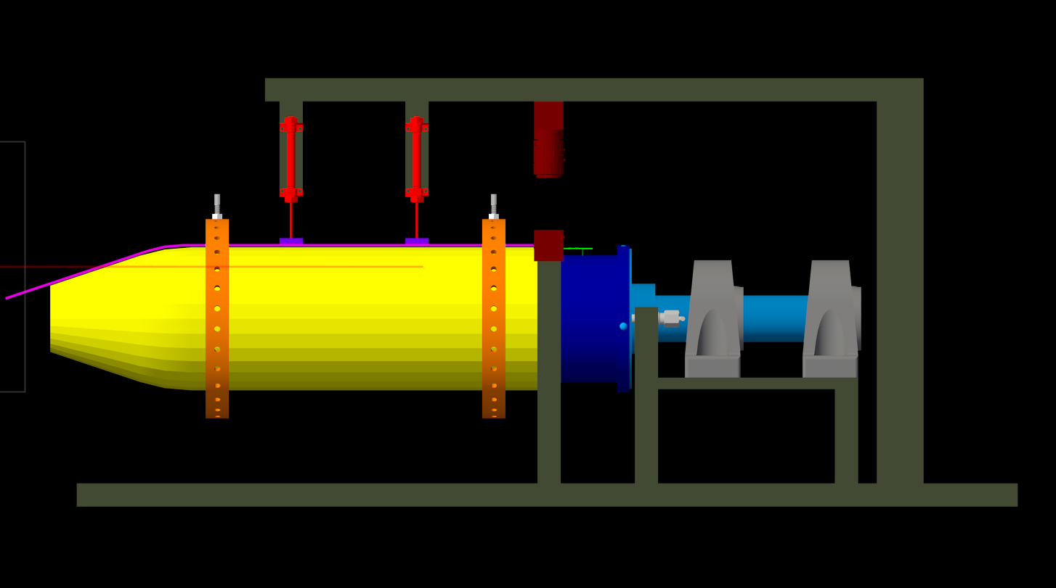
Pneumatic Cylinder (x2)
Swivel Screw (x60)
SiPM (x30)
Scintillator
12 deg Locking Rotation Device
Rohacell
Foam (x62)
Locking Plunger
Support Hub
Acrylic Ring (x2)
CMOS Color Camera
Mounted Steel Ball Bearings (x2)

Slide 2
2’ 4” (Rod is 1” x 1”)
9.75” L, 2” Diameter
1’ 6.25”
1’ 4.25”
(Rod is 2” x 2”)
~ 6” OD
3’ 4” (Rod is 1” x 1”)

Slide 3
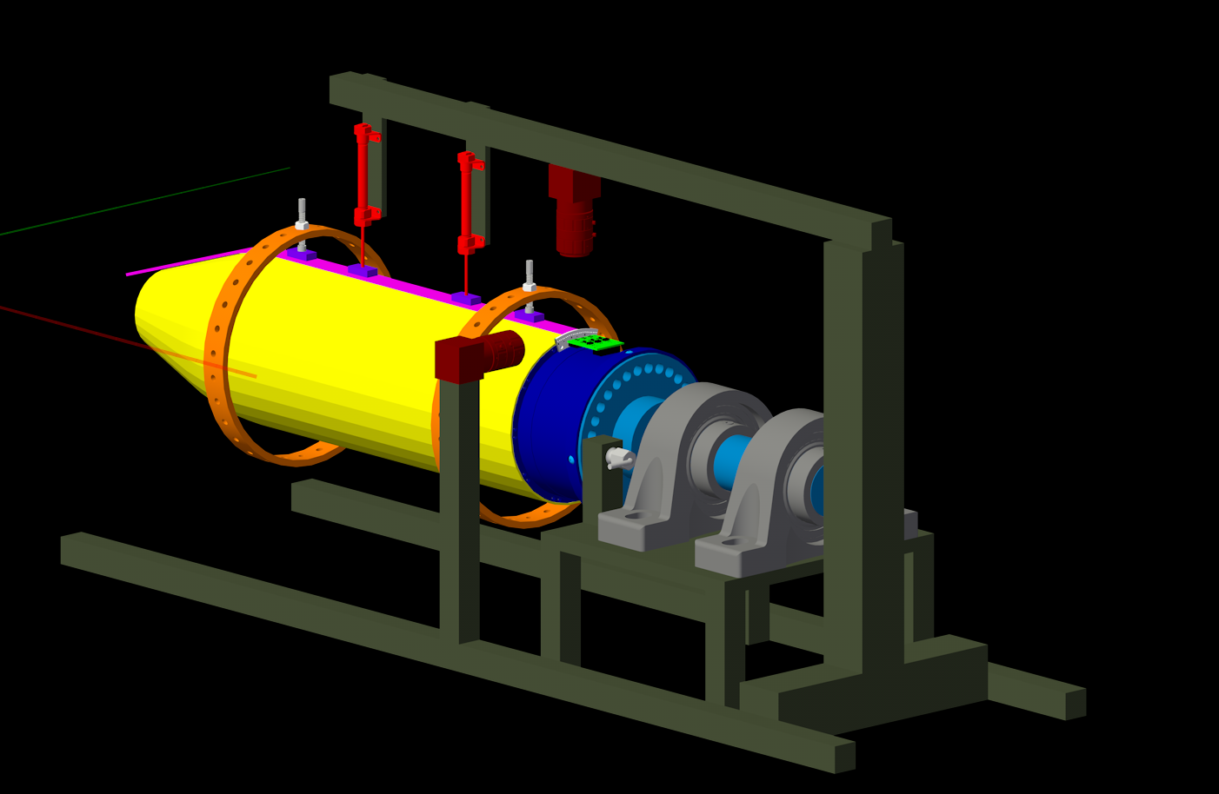
More components can be added as needed. Detachable in order to fit assembled detector into dark box for testing
Detachable if camera mounted to a flex arm proves to be more suitable
Table to support the bearings, locking element, and locking device

Slide 4
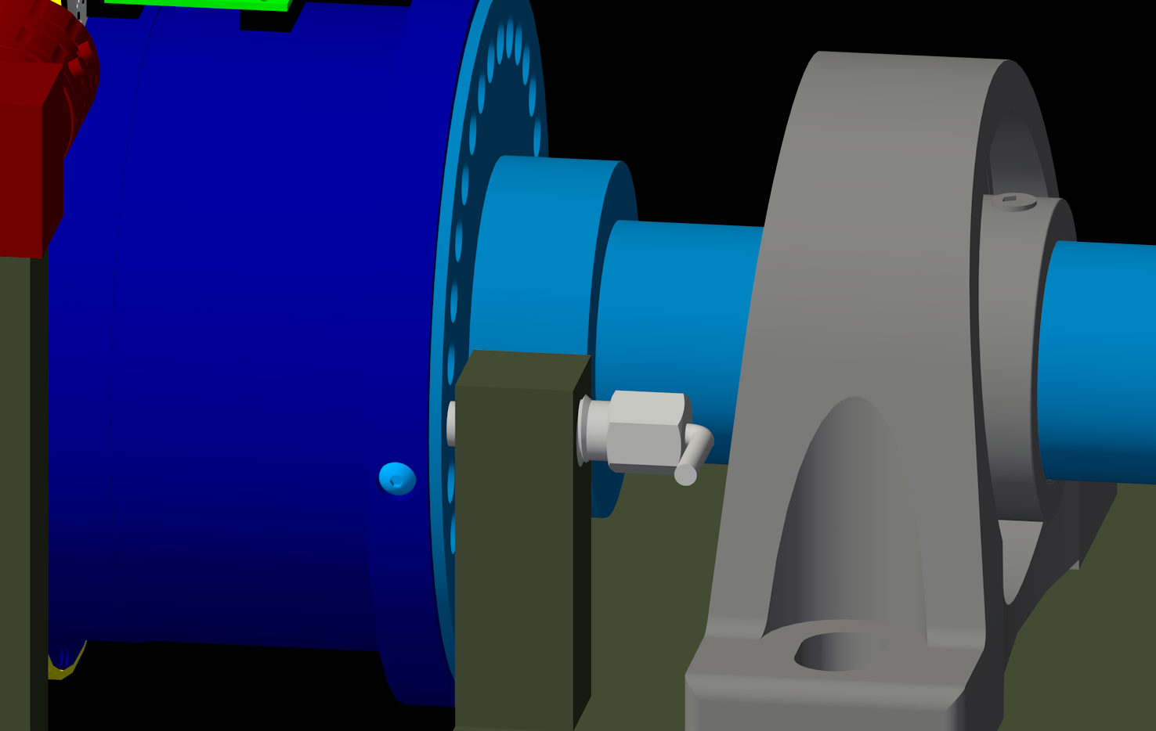

Slide 5
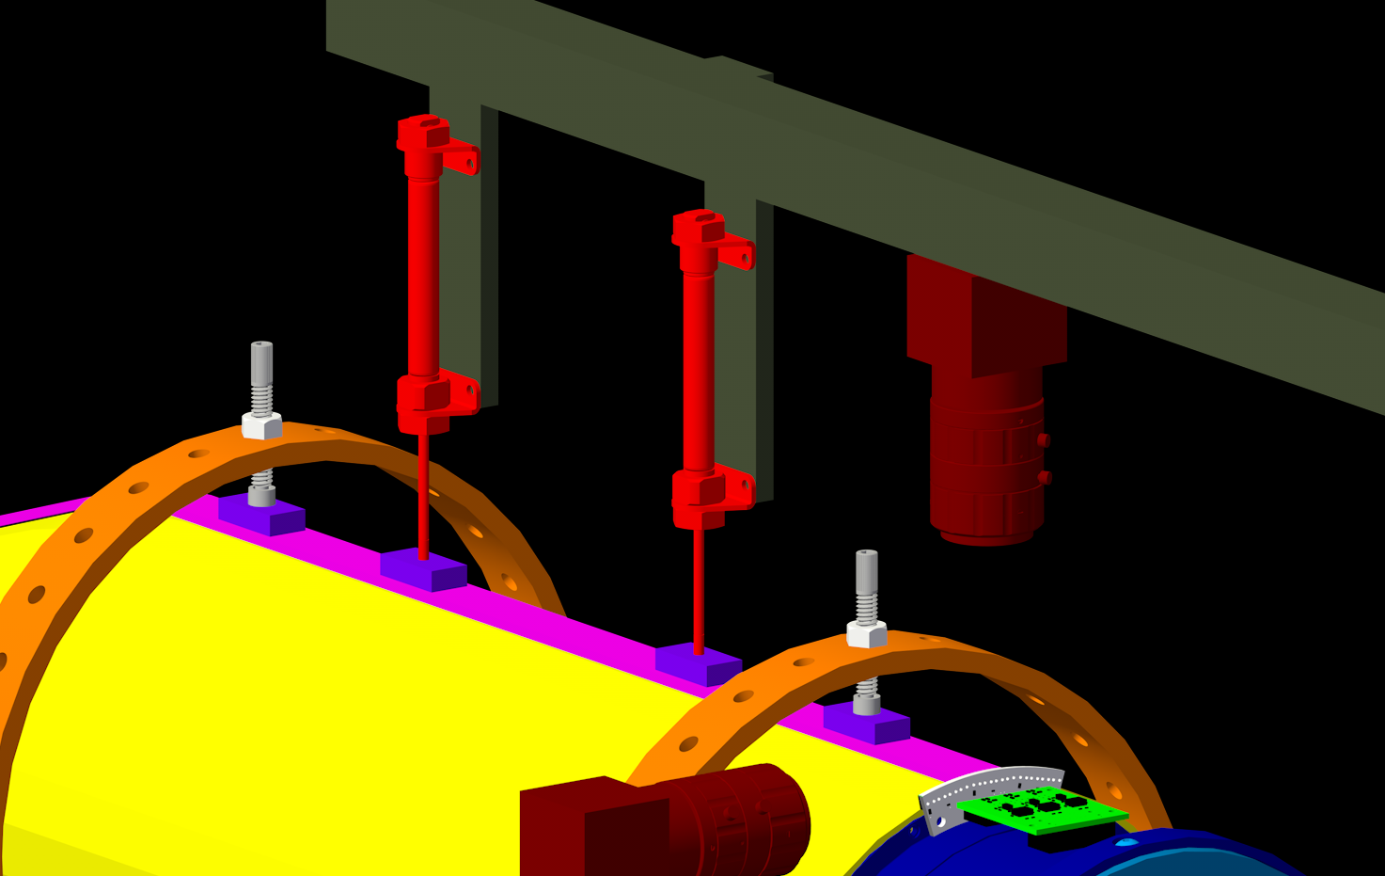
Type of Foam is undetermined. High density memory foam comes to mind.
Rings, Swivel screws + pads, pneumatic cylinders are in house
1 CMOS Camera in House. Might purchase a second one if needed.

Slide 6
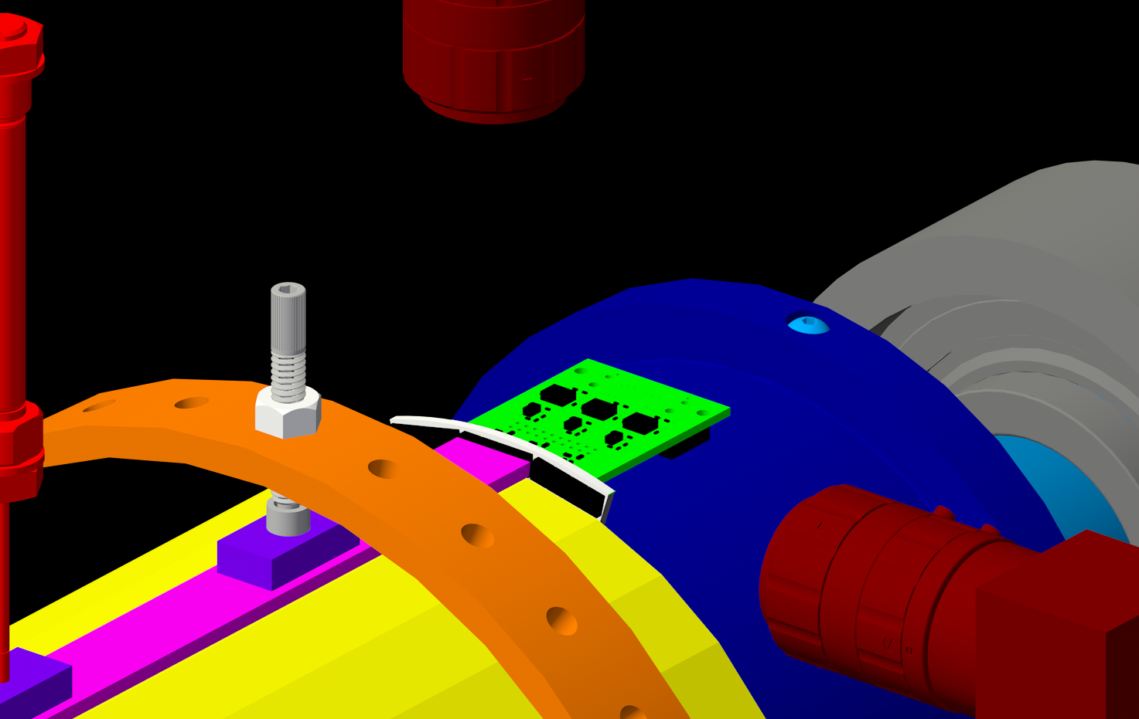
Two fixed positions for reproducible monitoring and measuring of coupling. A third multi-position mount, via flex arm, provides additional alignment information.

