Slide 1
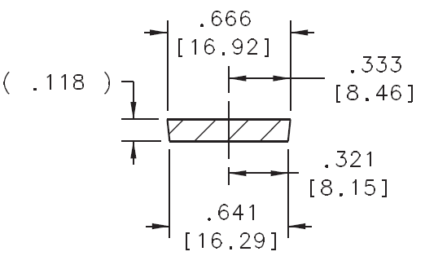
Paddle Measurements w/ Foil
d_{top}
We aimed to continuously measure any variations of design specifications along the straight section of a machined scintillator (paddle 3 was used)
Also aimed to measure the quantity d_{top} at various locations along the straight section
Aluminum foil is 16.5 μm thick
Paddle wrapped in AL should have d_{top} = 16.953 μm (0.6674”)

Slide 2
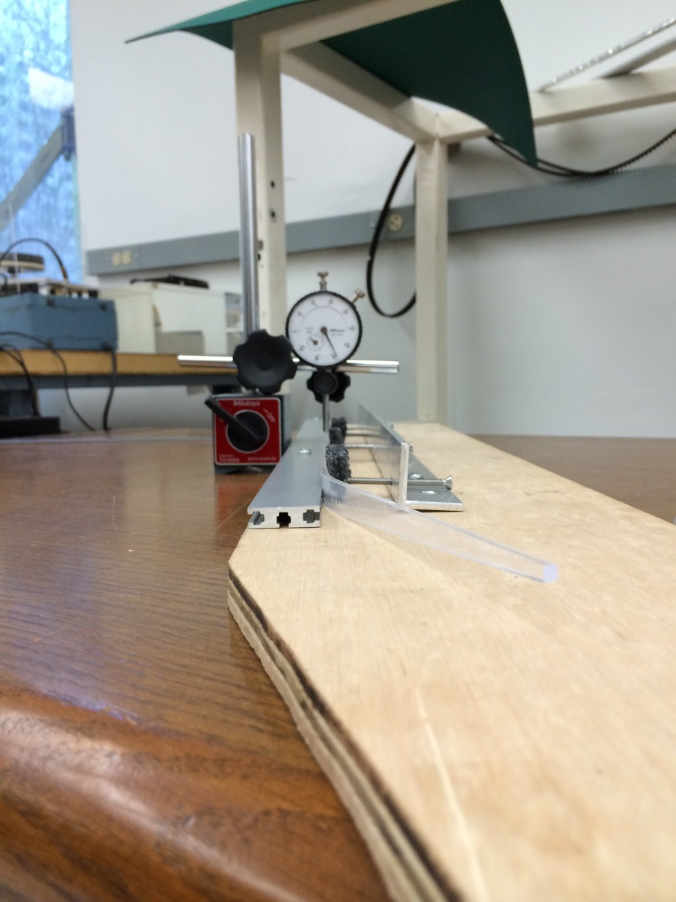
Continuous Measurements
Micrometer (hemispherical probe tip)
Guide Rail & Clamp
Unwrapped Scintillator

Slide 3
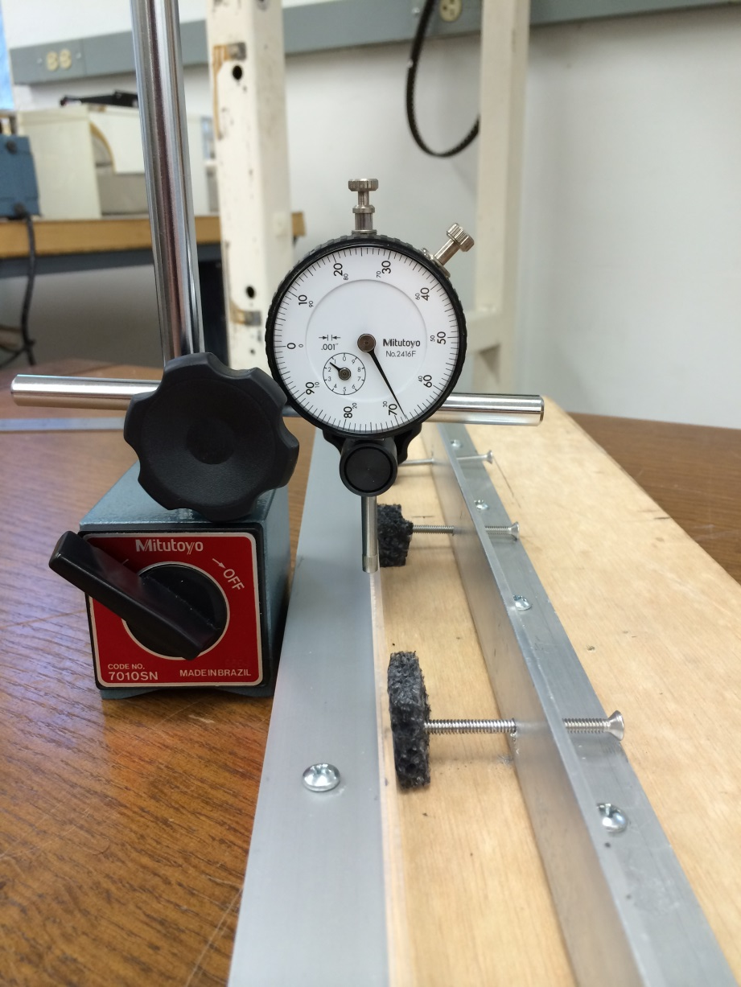
Continuous Measurements (cont.)
Results were unreliable!
If the micrometer probe traverses down the edge of the scintillator the deviations are huge ( 0.0400”)
Any misalignment between the guide rail and the micrometer also results in large deviations
If consistent and reliable measurements were desired using this method, custom tools would need to be developed
Another solution exists!

Slide 4
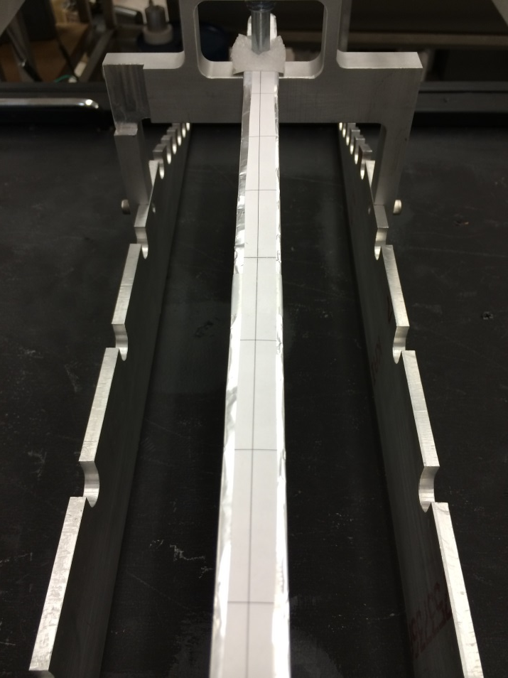
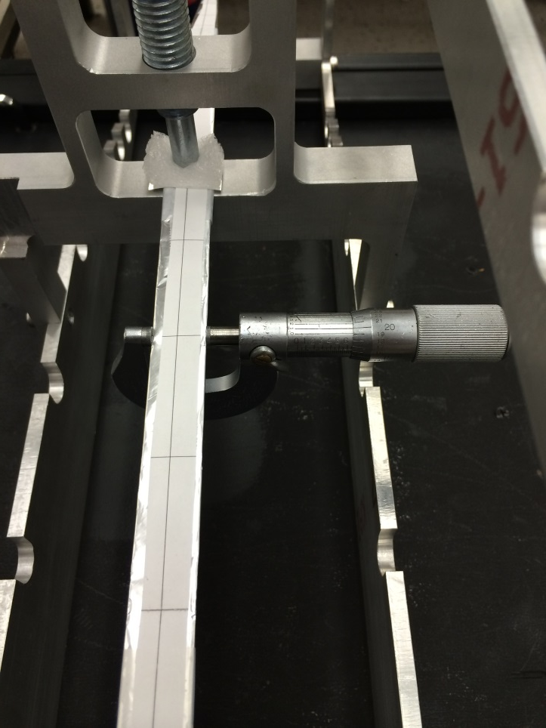
Discrete Measurements
Wrapped Scintillator
Template
Test Stand
Micrometer
Scintillator was wrapped in Aluminum foil
Template was used to increase the reproducibility of the measurements
8 measurements were made along the straight section (39.465 mm apart)
Utilized a 0.0001” resolution micrometer with flat probes
Measured d_{top} at each of the 8 locations (measurements made 3 times)

Slide 5
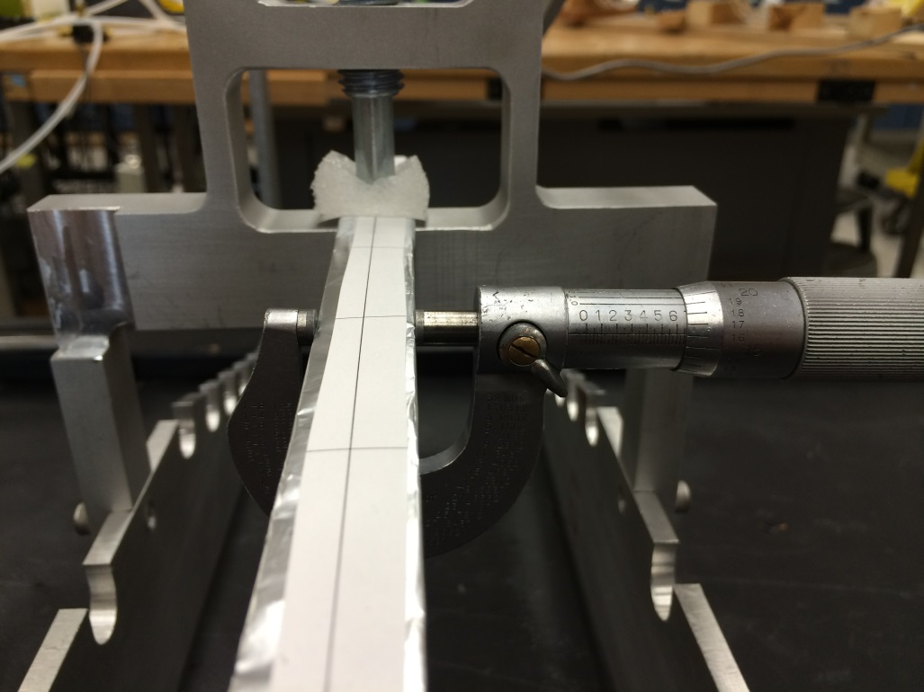
Discrete Measurements (cont.)
Nominal Specs:
Unwrapped: d_{top} = 16.92 mm (0.6661”)
Wrapped: d_{top} = 16.953 mm (0.6674”)
On average:
d_{top} = 19.9151 mm ≈ 19.2 mm
≈ 38 μm under spec
In all instances the wrapped scintillator measured under spec
At worst the paddle was ≈ 62 μm under spec
At best the paddle was ≈ 13.7 μm under spec
The maximal difference between any two measurements was ≈ 48.3 μm
If needed: The other paddles can be measured in this manner

