Slide 1
Trigger Supervisor (TS)
J. William Gu
Data Acquisition Group
TS position in the system
First prototype TS
TS functions
TS test status

Slide 2
TS position in the system
TS: Trigger control (“physical trigger from trigger system” to “physical event to ROC”);
SYNC generation, so that all the front-end crate will be synchronized;
Clock generation: system wide pipeline clock;
BUSY: slow down (or disable) the trigger if the front-end can not handle data readout.

Slide 3
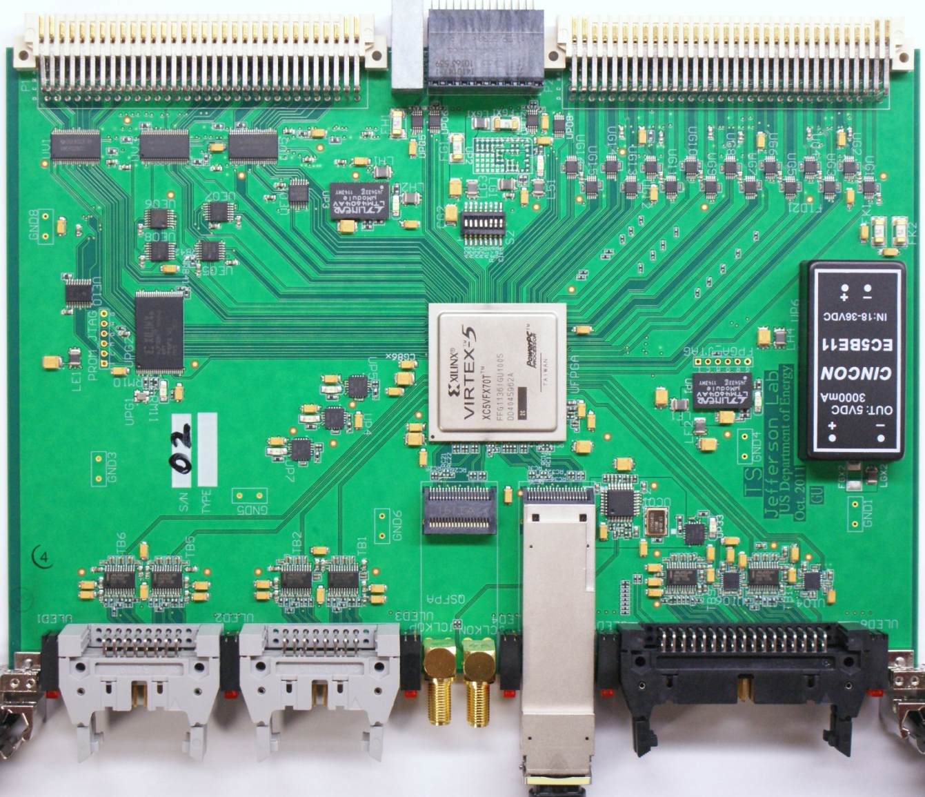
First prototype TS
6 x 4 LEDs board status
VME64x
VME→JTAG (PROM loading)
External
Trigger IN
Two 15-bit or
Four 7-bit
source synced
BUSY
TS clock output, or
QSFP (driving TI)
VXS
TRG/CLOCK/SYNC
(pulse mode or serialized mode)
TS clock input, or
QSFP (driving TI)
Optional:
Trigger to TD,
Busy from TD
10 single-ended
outputs
GTP trigger IN
Two 15-bit, or four 7-bit source synced
12 diff. outputs
16 diff. inputs

Slide 4
TS functions
Trigger: It can accepts up to 30 GTP inputs (from VME P2 backplane) , 30 external inputs (from front panel), and another 15 front panel inputs. It can also generate readout triggers from VME command. (>=) 10-bit trigger (event) types are supported. Every trigger input can be enabled, pre-scaled, and monitored by scalars.
GTP trigger input by Micrel SY55855, CML/PECL/LVPECL to LVDS translator;
Front Panel input by Maxim MAX9602, quad PECL_out ultra-high-speed comparator;
Clock: the onboard 250 MHz oscillator, or external input.
Sync: With the fiber latency measurement (by TI), all the front end crate can be synced to within 4ns (one 250 MHz clock cycle).
Backpressure (or DAQ flow control): with BUSY feedback, and status link (opposite link from the TRIGGER word), the DAQ can work in blocking mode, single event locking mode, or free running mode.
Front Panel output: 12 differential ECL, 10 LVCMOS.

Slide 5
TS functions -- Trigger (event) Type lookup table scheme
15x8
15
8
GTP
Trigger
16x11
6
15x8
5
15
8
Trigger
(event)Type
15x11
15x8
MUX
(with priorities)
15
8
External
Trigger
5
>10
16x11
15x11
15x8
6
15
8
VME triggers
Front Panel
trigger
15x8
4
15
4
MxN
M-bit input, N-bit output memory lookup table.
The table is downloaded by software at startup

Slide 6
TS functions
PROM: Xilinx XCF32P, loaded through VME → JTAG logic;
FPGA: Xilinx XCV5FX70T, upgradable to XCV5FX100T;
I²C: Two I2C paths to Switch Slot#A and slot#B
P2 IO card: One “1→16” fanout, sixteen “1←→ 1 “, which can connect to other slots
P0 signal: the trigger/SYNC can be in pulse mode, which means that the TS can be used to drive the front end crate.
Avago AFBR-79Q4Z: can drive two Trigger Interface (TI) boards directly.

Slide 7
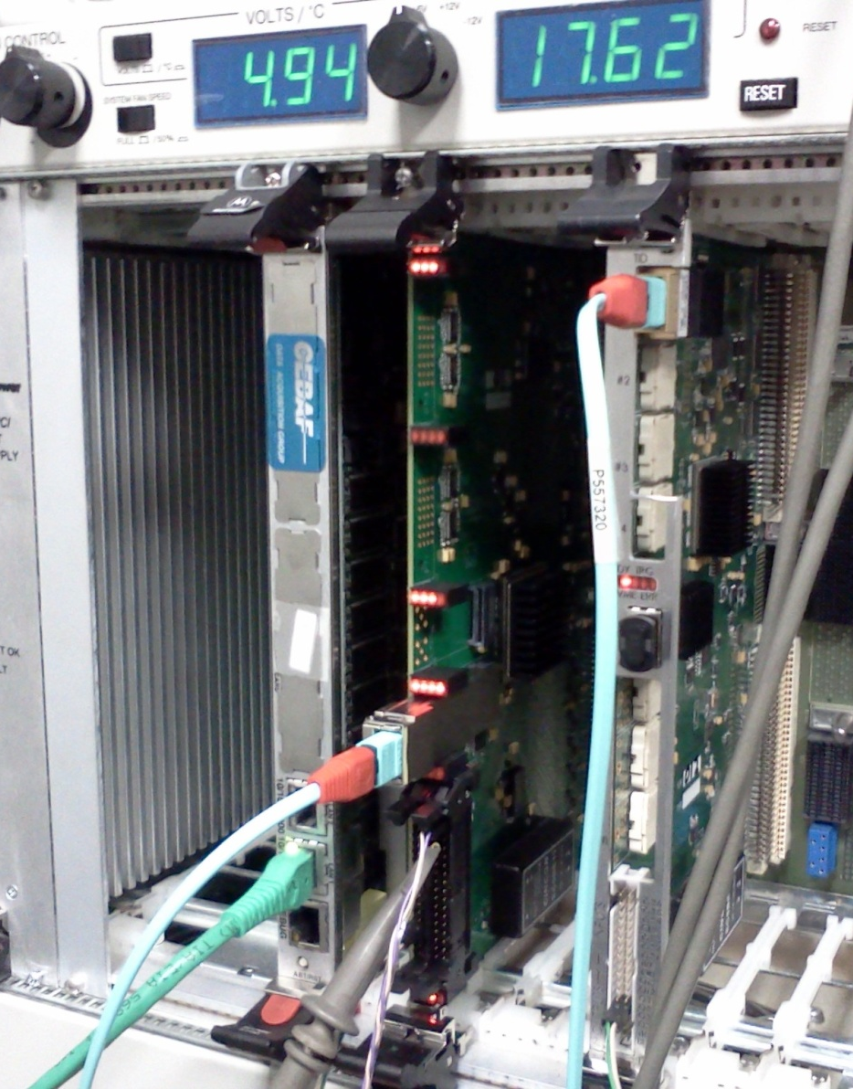
TS test status
FPGA is loaded;
VME working;
TS event readout working;
TS → TI path:
Trigger distribution working;
SYNC distribution working;
Clock distribution working;
Need:
Trigger table programming;
BUSY feedback (back pressure);
Trigger input check (Ext, GTP → TS);
TS → SD → TD → TI distribution test;
Fine tuning, performance optimization.
Ready for Production by Sept. 30th, 2012

