Slide 1
TOF QUESTIONS AND POTENTIAL ISSUES
CURRENT LENGTH OF LONG PADDLE = 252 cm
.006” WRAP ON PADDLES
38 LONG, 4 SPLIT & 4 SHORT PADDLES PER LAYER
AFTER WRAPPING THE LAYER IS 253.34 cm WIDE

Slide 2
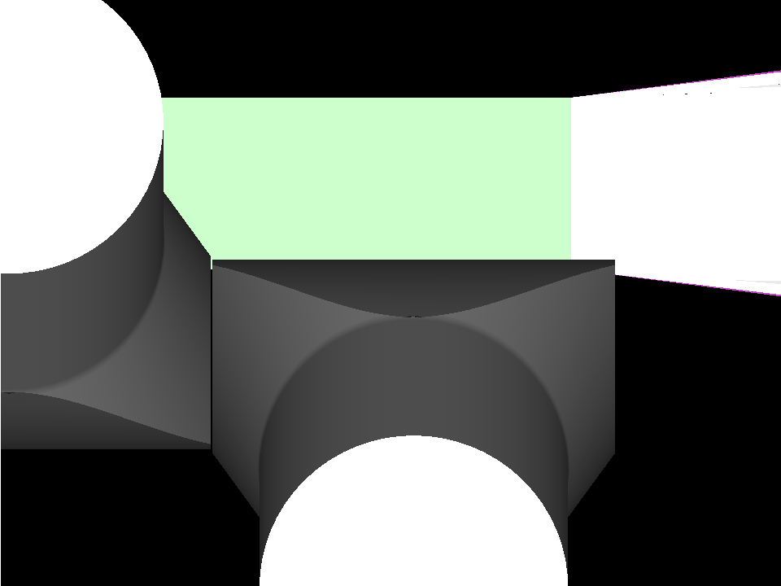

Slide 3
