Slide 1
Resource management

Slide 2
CCDB big tables problem
gzipping doesn’t help.
No partial blob transfers until MySQL 6
‘root’ privileges needed to configure MySQL
Vulnerability for DDos attacks
Since CCDB is ‘do not delete’ storage it will lead to redundant database grow

Slide 3
Usual frameworks application structure
Configs
Resources are:
Static data
Don’t change during app. work
Seldom change during app. Lifetime
Too big to comlile into the application
Qt, Java, GTK Application Mono, MFC, GTK,
Config manager
Data
Data connectors
Resource manager
Resources
Resources

Slide 4
Very simple resource manager
fopen

Slide 5
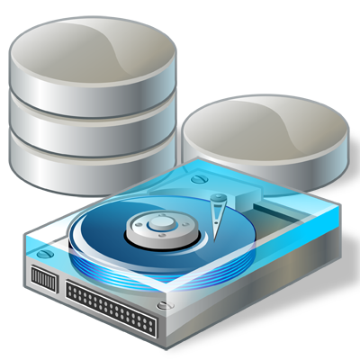
Resource manager idea
NO
mydata
Resorce
Manager
data cached ?
./resources/mydata.dat
Server
Caching
YES
Easy to use
Automated
Flexible
Updatable
Less mistakes
Easy to change
Easy to maintain

Slide 6
What other use for resources
QT 4+, QResource is a part of libqtcore.
GTK, use gtk_rc_* functions to read resources
OSX API NSBundle, CFBundleRef, etc…
Mono – System.Resources namespace
Java – lots of stuff (depends on framework)
wxWidgets – RC, WXR , XRC…

Slide 7
What should we do
Store link to resource in the DB
Make simple resource API through JANA or CCDB.
(we already have most of the code!)
vector<vector> GetTable(“/w/HallD/data/Magnets/table.txt”)
vector<vector> GetTable(“res:Magnets/table”)
“res:” means open files from resource directory (which is known by JANA)
No “res:” means just open that file by that path.

