Slide 1
Calibration and alignment database development
Dmitry Romanov
December 15, 2010

Slide 2
Database layout structure
Variation
FDC/CathodeStrips/pedestals
name
Assignment
Constants Type Table
timestamp
run_range
variation
name
directory
N_rows
N_columns
Run range
min
max
many - 1
Constants
DATA BLOB
Directories
Columns
Event range
- name
- type
min
max
run
id
parentId
name

Slide 3
Deep into variations
/simple/constants
Variations provide branching
Users can create variations to work with their versions of constants
Main branch is called “default” variation
X | Y | Z
01/01/2011
1 | 1 | 1
02/03/2011
1.1 | 1.2 | 1.3
Variation: “john”
Time line
03/11/2011
04/12/2011
3 | 4 | 5
1.11 | 1.22 | 1.33
05/15/2011
3.5 | 4.5 | 5.5
06/01/2011
3.5 | 4.5 | 5.5
…
User enters: /simple/constants User gets: 1.1 ; 1.2 ; 1.3;
User enters: /simple/constants variation: jhon User gets: 3 ; 4 ; 5;
User enters: /simple/constants variation: john User gets: 3.5 ; 4.5 ; 5.5;
User enters: /simple/constants User gets: 1.11 ; 1.22 ; 1.33;
User enters: /simple/constants User gets: 3.5 ; 4.5 ; 5.5;

Slide 4
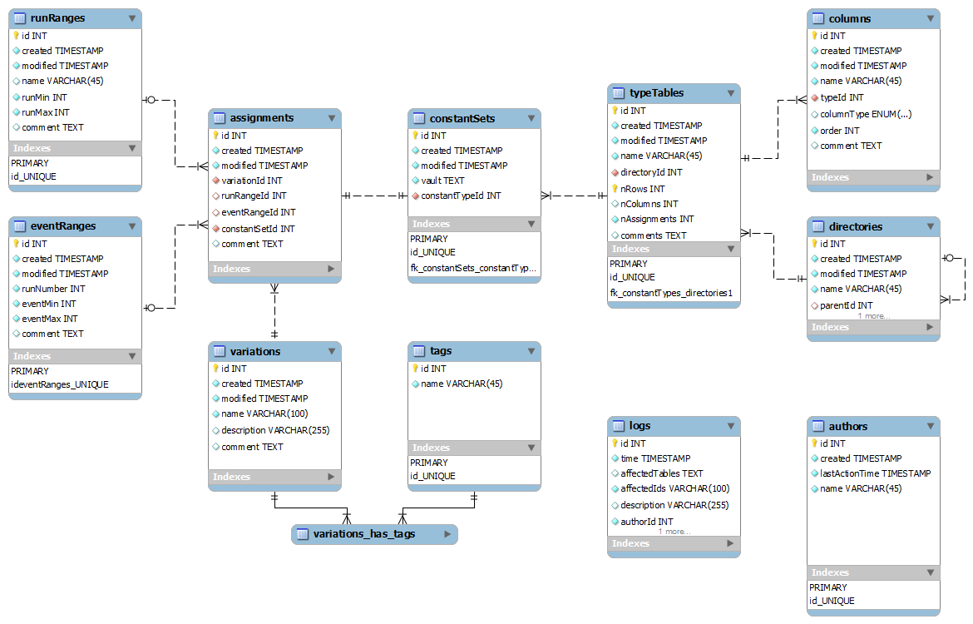
MySQLdatabase layout

Slide 5
Database internals
Run ranges:
Data types:
1001 – 1500 is ok.
1001 – INFINITE_RUN : all runs from 1001
0 – INFINITE_RUN : all runs
bool
int
long
double
string
INFINITE_RUN = 2147483647 Maximum 32-bit unsigned integer
Named run ranges:
Run range
runs: 1001-1500 name:“”
≠
Run range
runs: 1001-1500 name:“marki”
Run Ranges with same runs, but different names are different run ranges.
Data blob
1.12321|1.22345|45|15|This is user string|0.5602e-4|…
What If user’s string “have | in it” ?
USER → Encode(“have | in it”) → “have &pipe; in it” → DB
DB → Decode(“have &pipe; in it” ) → “have | in it” → USER

Slide 6
Overall design
Interfaces
WEB
JANA Users
C++ Users
Python Users
Console
Tools
JQuery
Calib. DB API
C++
SWIG
Python API (C++ wrap)
PHP
MySQL Provider
File DB Provider
My SQL Server
Local DB File

Slide 7
C++ and JANA interface
Two main parts:
1) JCalibrationGenerator A generator class (e.g. JCalibrationGeneratorMySQL)
2) Jcalibration class implementing the backend itself.
Retrieve calibration constants from CCDB (GetCalib())
Discovery of available constants (GetListOfNamepaths()) etc. Jcallibration * calib = jApp->GetCalib() vector<double> constants; calib->GetCalib(constants, “/simple/constants”); calib->GetCalib(constants, “/simple/constants”, /*variation */ “john”); calib->GetCalib(constants, “/simple/constants”, /*variation */ “john”, /*time*/ time);

Slide 8
Performance budget
1 100 000 records with data blobs; 52 double values (8 digits) for each blob.
Queried randomly with 1100 queries.
Core 2 Duo 1800 GHz, 2 Gb – 0.23 sec
Core i7 @ 2800 GHz, 8 Gb – 0.04 sec
Stick to 1 second to load calibration constants
Data queries + network – 0.23 – 0.45 sec
Blob parsing – <0.13 sec
Framework overhead ~ 4%
Pre queries – small
Mutithread concurency - ?
Conclusion: possible to keep in 1 second.

Slide 9
Console tools
Aim: simplicity + better learning curve
If it have directories and names like POSIX file system, let looks like POSIX file system. ls, rm, mkdir, mv, … etc. commands
Interactive mode
>> ls
adc/ dca/
>> cd adc
adc> > ls
../ adc _pedestals adc_scales
adc>> ls -a
adc _pedestals : 3 variations, 5 versions … <full info> adc_scales: 4 variations, 11 versions … <full info>
adc>>dump adc _pedestals --run 1200 --variation mc > /home/user/pedestals.txt
Command line mode
ccdb <connection> dump /adc/adcpedestals --run 1200 --variation mc > /home/user/pedestals.txt

Slide 10
Implementation
Core
Utils as plugins
Interactive mode
DConsoleContext
MySQL Provider
Streams
Commad parser
Utils by command
help.py - Help
/> ls --all_tree
Command line mode
pwd.py - PrintWorkDir
ccdb <connection> ls --all_tree
mkdir.py - MakeDirectory
--all_tree
ls.py - ListObjects
DConsoleContext – singleton model
All utils are derived from DConsoleUtilBase
Each utility has instance that calls RegisterConsoleUtil()
Each utility have to implement GetHelp() …. functions
Thus we get very flexable plugin like system
. . .

Slide 11
Privileges
We have several modes Read mode Update mode “Default” variation update mode
Read mode doesn’t require any passwords
Update mode require password, and user name.
Obtaining a username and password is simple. Like online reistration.
How to store “update” password???

Slide 12
Web interface
Live demo
USER
Web page
JQuery
C++ Cgi HTTP Context
Calib. DB API
C++
PHP
My SQL Server
How compex is it?
$("#black").treeview({url: “cgi-bin/ccdb.cgi?op=ajaxdirs “})

Slide 13
Current progress
File specification is done
File upload to DB in progress
“field” c++ api in progress
Core c++ API done
User c++ API mostly done
Python wrapping – mostly done
Console utils – first working prototype is done
Web interface – protorype is done

