Slide 1
Update on Calibration and alignment database development
Dmitry Romanov
October 05, 2010

Slide 2
DB Structure

Slide 3
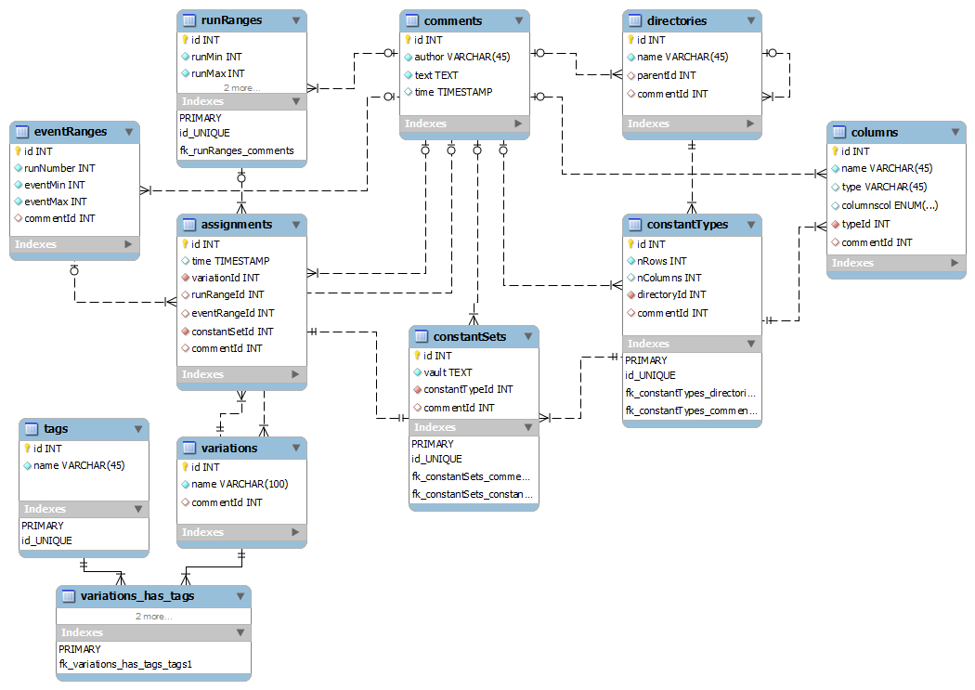
Database diagram
update

Slide 4
Database internals
Run ranges:
Data types:
1001 – 1500 is ok.
1001 – INFINITE_RUN : all runs from 1001
0 – INFINITE_RUN : all runs
bool
int
long
double
string
INFINITE_RUN = 4294967295 Maximum 32-bit unsigned integer
Suggestion: avoid floats
Named run ranges:
Run range
runs: 1001-1500 name:“”
≠
Run range
runs: 1001-1500 name:“marki”
Run Ranges with same runs, but different names are different run ranges.

Slide 5
To use or not to use Cern ROOT
Advantages of using ROOT
Has complete DB framework (works with all common databases)
Database framework accepts connection strings, has a flexible “plugin” structure and is very close to JANA desired architecture.
Maintained by CERN programmers. Designed for such tasks.
Most probably API will not change with new MySQL versions.
ROOT runs on different platforms.
Has miscellaneous classes and modules (Threading, directories)
Has handy debugging tools.
We already bounded to ROOT in JANA
Disadvantages
We will stick to ROOT.

Slide 6
Connector C++
Advantages of using Connector C++
MySQL native library
Maintained by MySQL
Will come with MySQL
Good documentation
Platform independent
Production released
Good API:
Convenience of pure C++ - no C function calls
Support of the object oriented programming paradigma
Shorter development times
Disadvantages
Supports only MySQL

Slide 7
Overall design
Interfaces
WEB
Console
Tools
JANA and C++ Users
Python USERS
PHP
Calib. DB API
C++
Python API
MySQL Provider
File DB Provider
My SQL Server
Local DB File

Slide 8
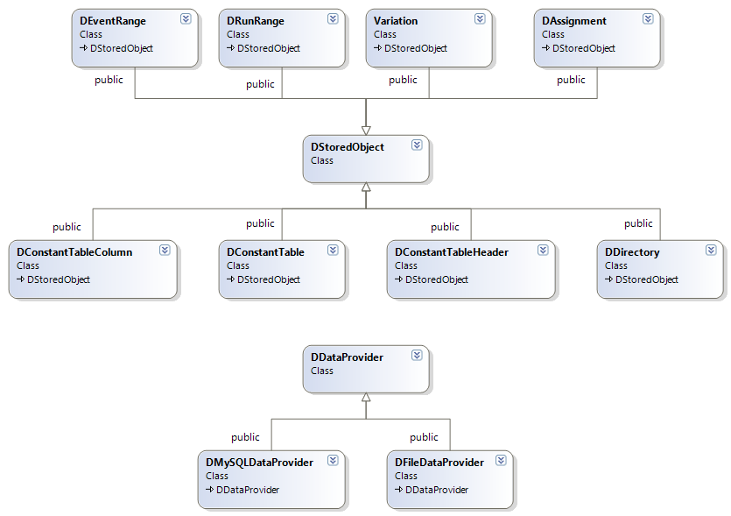
Data model

Slide 9
Roadmap
MySQL structure - done
Data model C++ representation – done
Data model operations (providers) – partially done
JANA integration
Command line tools
WEB representation
Python integration
C++ API
Updates and bug hunting
Unclear
File storage and DB storage conversion
File storage formats

