Slide 1
Scientific Computing using GPUs
Jie Chen

Slide 2
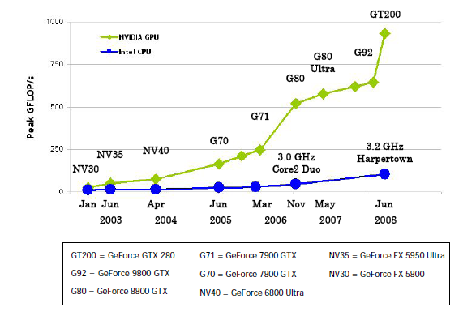
Why GPUs

Slide 3
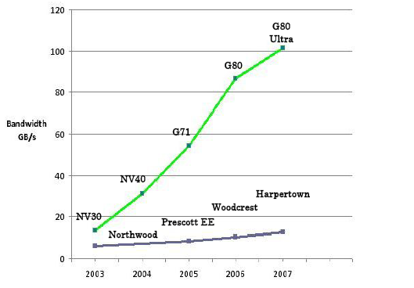
Why GPUs

Slide 4
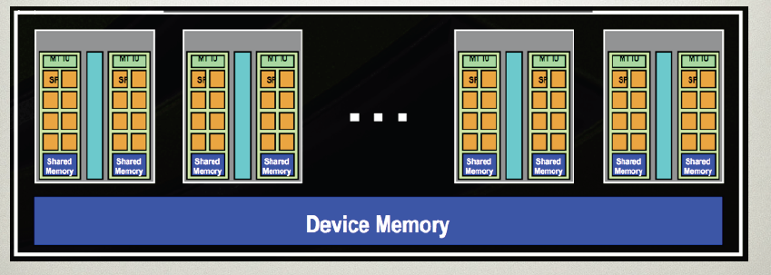
Why GPUs
30 Multi-Processors each contains 8 cores at 1.4 GHz
4GB GDDR3 memory offers ~100GB/s memory bandwidth

Slide 5
What is GPGPU?
General Purpose computation using GPU in applications other than 3D graphics
GPU accelerates critical path of application
Data parallel algorithms leverage GPU attributes
Large data arrays, streaming throughput
Fine-grain SIMD parallelism
Low-latency floating point (FP) computation
Applications – see //GPGPU.org
Game effects (FX) physics, image processing
Physical modeling, computational engineering, matrix algebra, convolution, correlation, sorting

Slide 6
GPGPU
CUDA
Compute Unified Device Architecture
NVIDIA Specific
OpenCL
The open standard for parallel programming of heterogeneous systems
Hardware independent
Industrial Standard
Version 1.0 specification is out, Beta implementations
BrookGPU
ATI Specific
Stream Programming (SIMD)

Slide 7
CUDA Programming Model
The GPU is viewed as a compute device that:
Is a coprocessor to the CPU or host
Has its own DRAM (device memory)‏
Data parallel portions of an application: kernels
A single kernel runs many threads in parallel
Differences between GPU and CPU threads
GPU threads are extremely lightweight
Very little creation overhead
GPU needs 1000s of threads for full efficiency
Multi-core CPU needs only a few

Slide 8
CUDA Thread Model
A kernel is executed as a grid of thread blocks
All threads share data memory space
A thread block is a batch of threads that can cooperate with each other by:
Synchronizing their execution
For hazard-free shared memory accesses
Efficiently sharing data through a low latency shared memory
Two threads from two different blocks cannot cooperate
Host
Device
Grid 1
Kernel 1
Block
(0, 0)‏
Block
(1, 0)‏
Block
(2, 0)‏
Block
(0, 1)‏
Block
(1, 1)‏
Block
(2, 1)‏
Grid 2
Kernel 2
Block (1, 1)‏
Thread
(0, 0)‏
Thread
(1, 0)‏
Thread
(2, 0)‏
Thread
(3, 0)‏
Thread
(4, 0)‏
Thread
(0, 1)‏
Thread
(1, 1)‏
Thread
(2, 1)‏
Thread
(3, 1)‏
Thread
(4, 1)‏
Thread
(0, 2)‏
Thread
(1, 2)‏
Thread
(2, 2)‏
Thread
(3, 2)‏
Thread
(4, 2)‏

Slide 9
CUDA Memory Model
Each thread can:
R/W per-thread registers
R/W per-thread local memory
R/W per-block shared memory
R/W per-grid global memory
Read only per-grid constant memory
Read only per-grid texture memory
(Device) Grid
Block (0, 0)‏
Block (1, 0)‏
Shared Memory
Shared Memory
Registers
Registers
Registers
Registers
Thread (0, 0)‏
Thread (1, 0)‏
Thread (0, 0)‏
Thread (1, 0)‏
Local
Memory
Local
Memory
Local
Memory
Local
Memory
The host can R/W global, constant, and texture memories
Host
Global
Memory
Constant
Memory
Texture
Memory

Slide 10
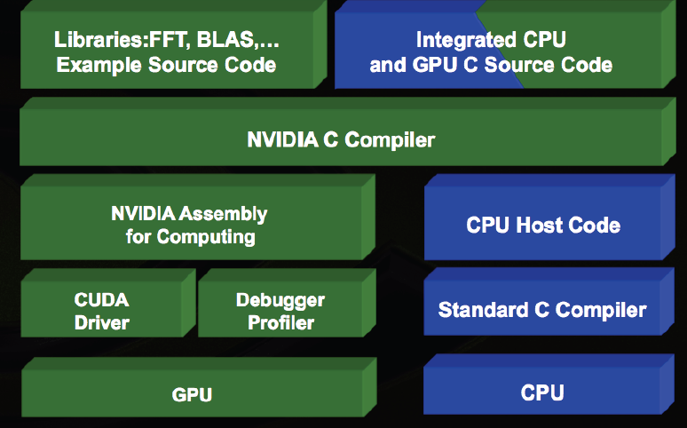
CUDA SDK

Slide 11
CUDA Extended C
Declspecs
global, device, shared, local, constant
Keywords
threadIdx, blockIdx
Intrinsics
__syncthreads
Runtime API
Memory, symbol, execution management
Function launch
__device__ float filter[N];
__global__ void convolve (float *image) {
__shared__ float region[M];
...
region[threadIdx] = image[i];
__syncthreads()
...
image[j] = result;
}
// Allocate GPU memory
void *myimage = cudaMalloc(bytes)‏
// 100 blocks, 10 threads per block
convolve<<<100, 10>>> (myimage);

Slide 12
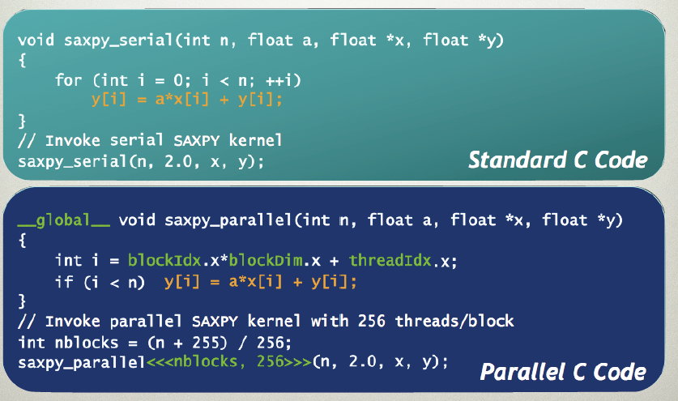
CUDA Program

Slide 13
LQCD Calculation at JLAB
Wilson-Dirac Matrix
M = -1/2 * Dx,x’ + (4 + m)δx,x’
M(U) x = b where U is gauge field, b is source spin vector
Dslash is an application of D to a spinor field.
Quarks live on sites (24 floats each)
Spinor (4 x 3 complex numbers)
Gluons live on links (18 floats each)
Gauge field: 3 x 3 color complex matrices (SU(3) matrix)
Most calculations are multiplications of spinors and gauge field.

Slide 14
LQCD at JLAB
1 output quark site
(24 floats)
2 x 4 input quark site
(24 x 8 floats)
2 x 4 input gluon links
(18 x 8 floats)
1320 Flops/each site
4
Total memory: 4 x 32 x (24 + 4 x18) = 384 MB

Slide 15
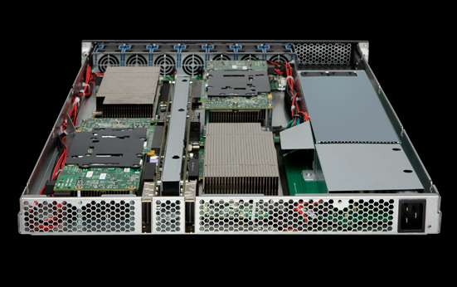
LQCD at JLAB
Dslash/Clover on Intel CPUs
~ 20 Gflops on Nehalem 8 cores.
Dslash/Clover on Tesla GPUs
~80 Gflops on single C1060
Dlassh/Clover on Multiple GPUs
~240 Gflops on 4 C1060 GPUs with MPI

Slide 16
Lessons Learned
Data Parallel
Any non-data parallel code will slow down applications.
Memory layout
Avoid memory access conflicts
Half-warp threads (16 threads) could access all memory in one transaction
Use shared memory or registers
Local and global memory too slow
At least 100 times slower

