Slide 1
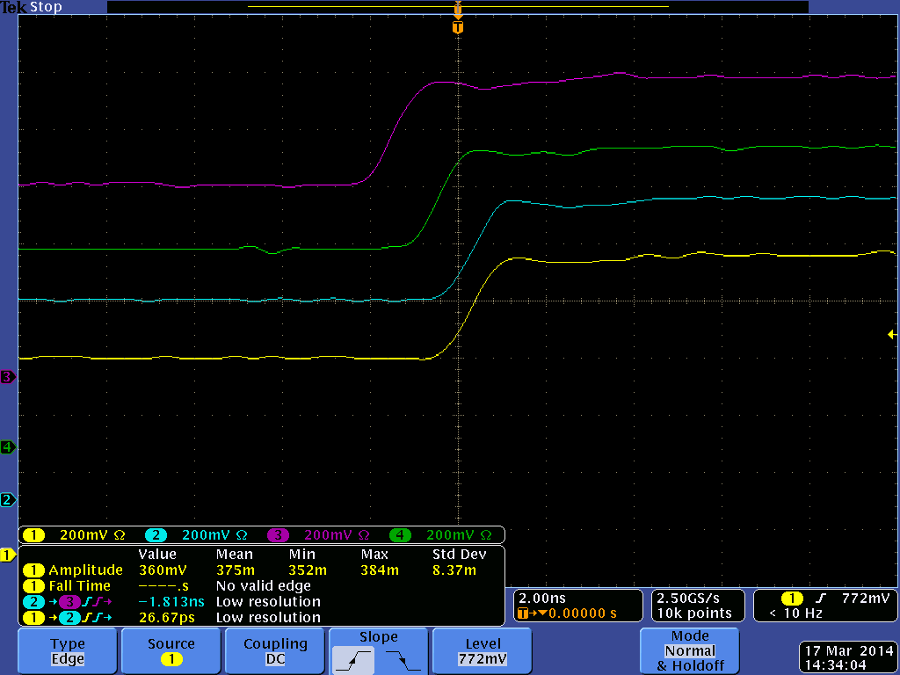
Trigger Setup: Triggers are distributed from the TS to 12 FCAL and 12 BCAL
readout crates. SD front panel trigger (and sync) outputs from
each crate are compared
Trigger alignment between North and South crates of the BCAL and FCAL
For comparison, only one crate is chosen from each side (N and S)
BCAL North (rocbcal1)
FCAL South (rocfcal7)
BCAL South (rocbcal7)
FCAL North (rocfcal1)

Slide 2
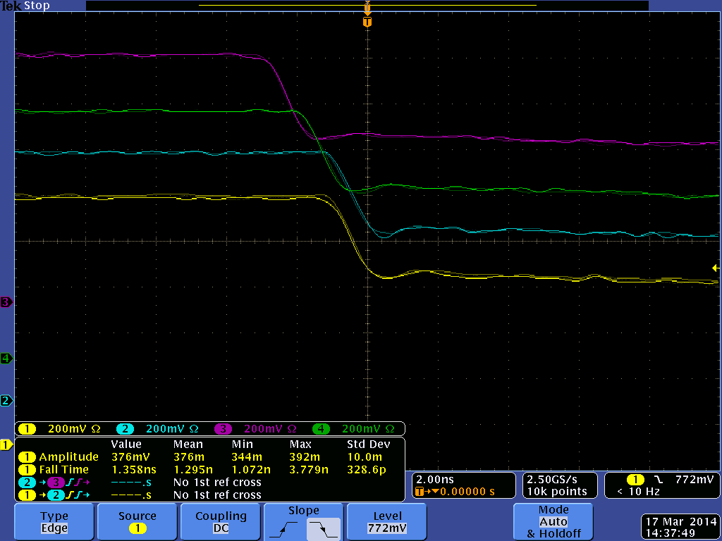
Trigger pulses
BCAL North (rocfcal1)
BCAL North (rocbcal1)
FCAL South (rocfcal7)
FCAL South (rocfcal7)
BCAL South (rocfcal7)
BCAL South (rocbcal7)
FCAL North (rocfcal1)
FCAL North (rocfcal1)

Slide 3
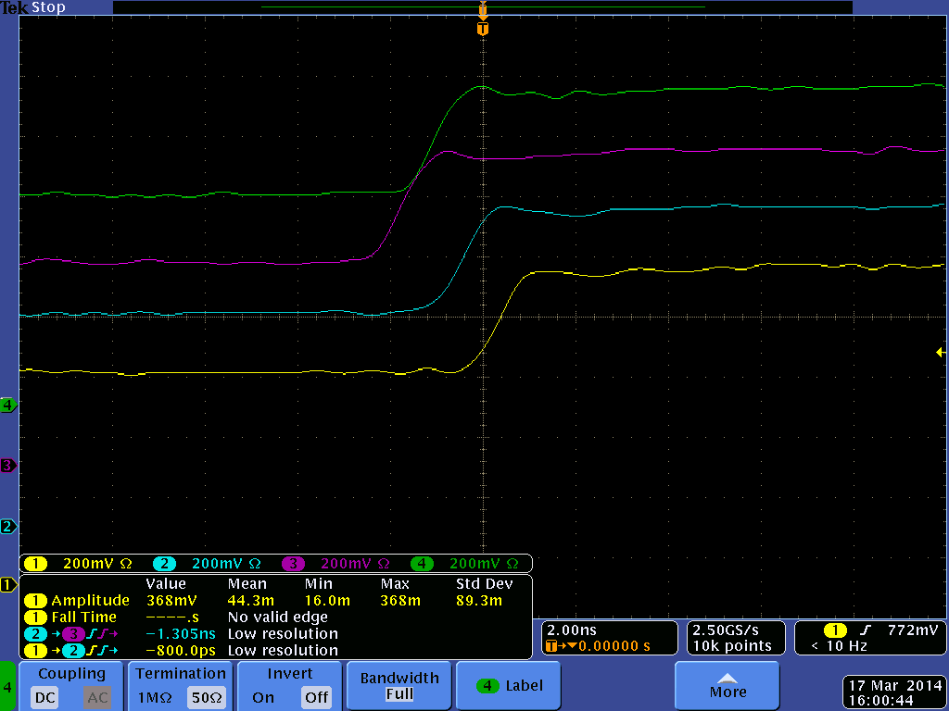
SYNC pulses from FCAL and BCAL crates
FCAL South (rocfcal7)
BCAL North (rocfcal1)
BCAL North (rocbcal1)
FCAL South (rocfcal7)
BCAL South (rocbcal7)
BCAL South (rocfcal7)
FCAL North (rocfcal1)
FCAL North (rocfcal1)

Slide 4
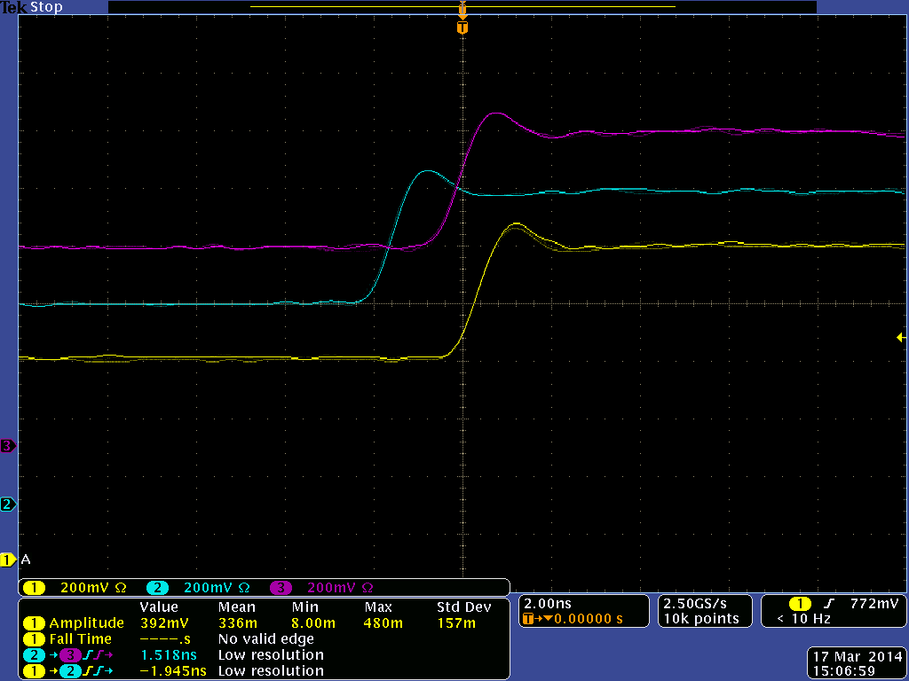
Relative Trigger Alignment: FCAL N6
(crates rocfcal1 – rocfcal6)
BCAL North (rocfcal1)
FCAL South (rocfcal7)
BCAL South (rocfcal7)
rocfcal4
rocfcal3
FCAL North (rocfcal1)
rocfcal6
rocfcal2
rocfcal5
rocfcal1 (reference)
rocfcal1 (reference)

Slide 5
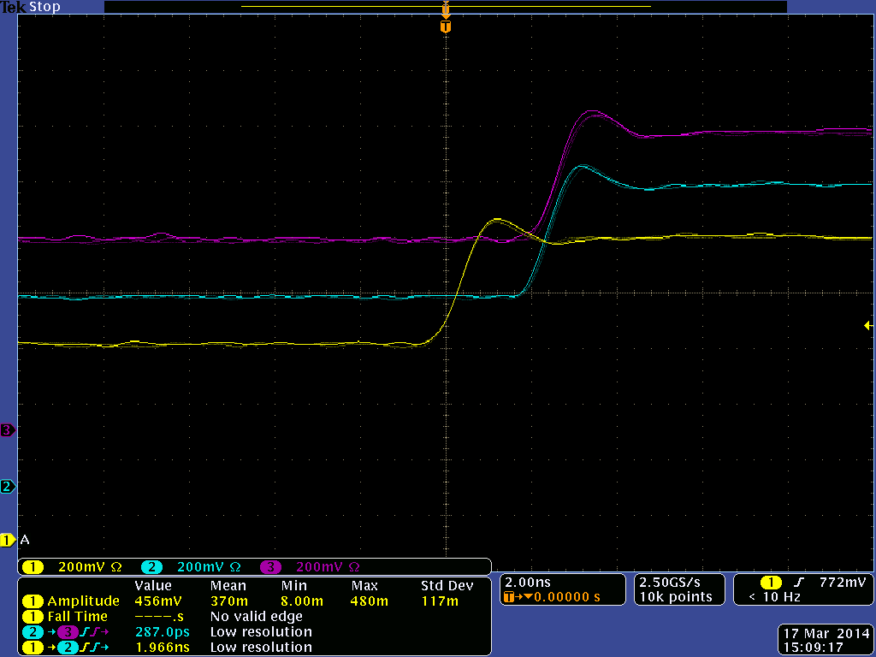
Relative Trigger Alignment: FCAL S6
(crates rocfcal7 – rocfcal12)
rocfcal10
rocfcal9
rocfcal12
rocfcal8
rocfcal11
rocfcal7 (reference)
rocfcal7 (reference)

Slide 6
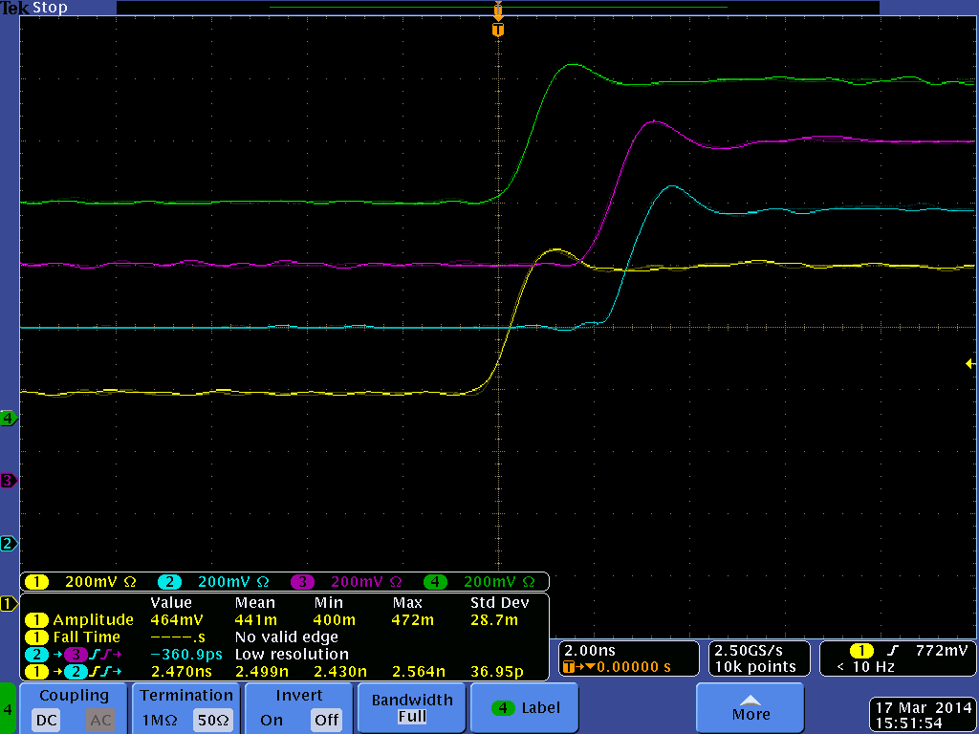
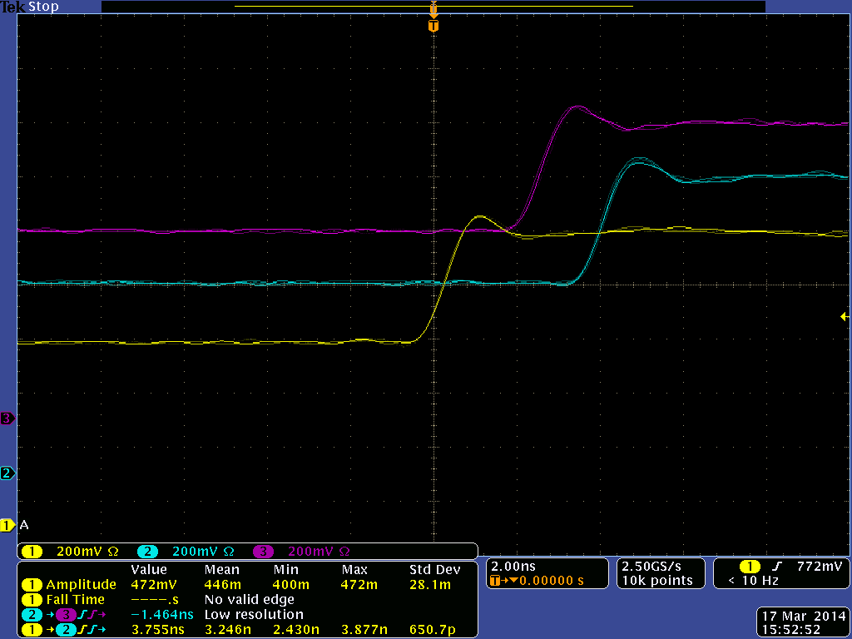
Relative Trigger Alignment: BCAL N6
(crates rocbcal1 – rocbcal6)
rocfcal10
rocbcal4
rocfcal9
rocfcal12
rocbcal3
rocbcal6
rocfcal8
rocfcal11
rocbcal2
rocbcal5
rocfcal7 (reference)
rocfcal7 (reference)
rocbcal1 (reference)
rocbcal1 (reference)

Slide 7
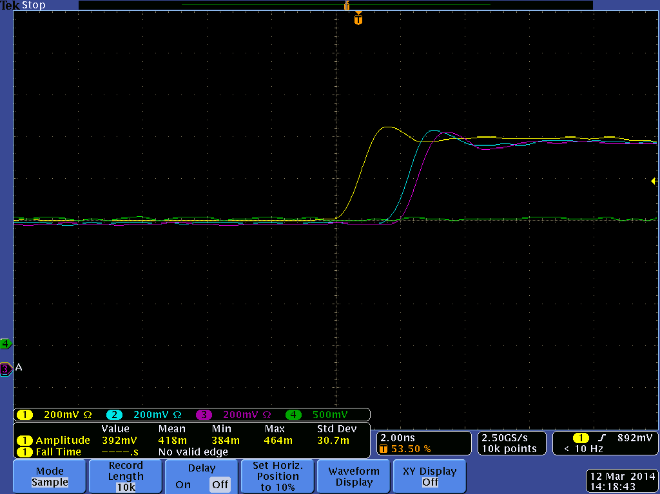
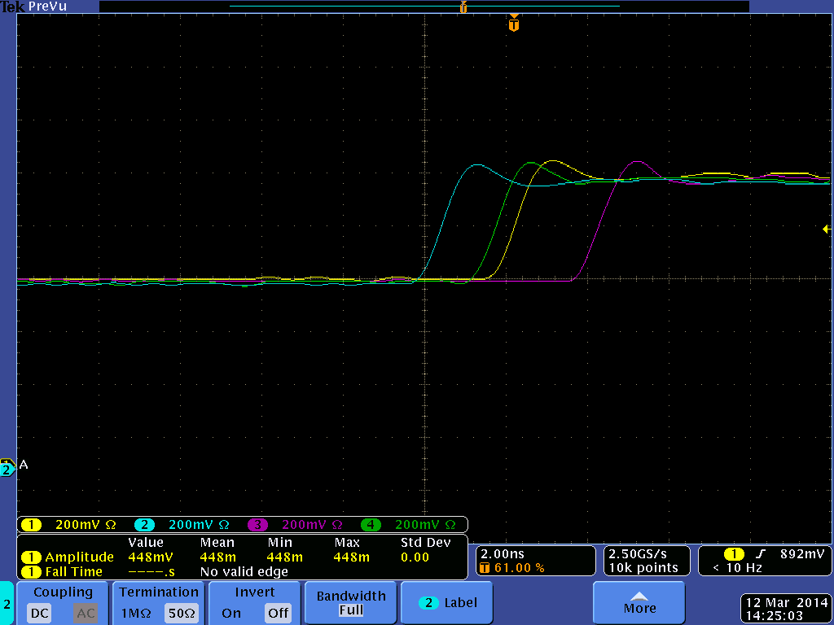
Relative Trigger Alignment: BCAL S6
(crates rocbcal7 – rocbcal12)
rocbcal7 - yellow (reference)
rocbcal8 - blue
rocbcal9 - magenta
rocbcal7 - yellow (reference)
rocbcal10 - blue
rocbcal11 - magenta
rocbcal12 - green
rocfcal10
rocbcal4
rocfcal9
rocfcal12
rocbcal3
rocbcal6
rocfcal8
rocfcal11
rocbcal2
rocbcal5
rocfcal7 (reference)
rocfcal7 (reference)
rocbcal1 (reference)
rocbcal1 (reference)

