Slide 1
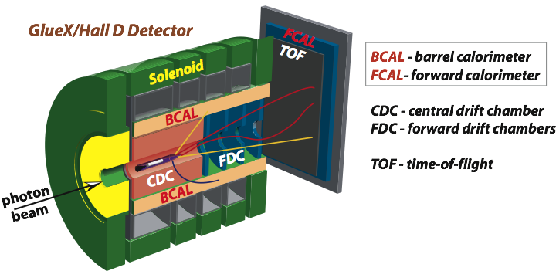


Hall-D Update
A.Somov Jefferson Lab
Hall C Summer Workshop, August 15, 2013

Slide 2
Hall D Physics Program
GlueX detector design has been optimized for the
search for gluonic excitations in the spectra of light mesons
(approved by PAC, 320 days)
Detector is well suited to study many other physics topics using high-intensity photon beam:
A precision measurement of the η→γγ decay width via the Primakoff effect
( approved by PAC in 2010, A⁻ 79 days)
Measuring the charged pion polarizability in the γγ → π⁺ π⁻ reaction
( approved by PAC in 2012, A⁻ 25 days)
Rare eta decays
Charm production near threshold
Photoproduction with nuclear targets
Inverse DVCS
Exclusive reactions at high-momentum transfer
(see Workshop on Photon-Hadron Physics, JLab 2008)
A.Somov Hall C Summer Workshop, 2013 2

Slide 3
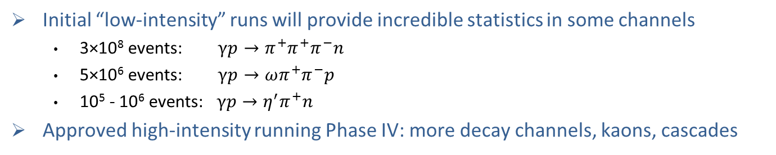
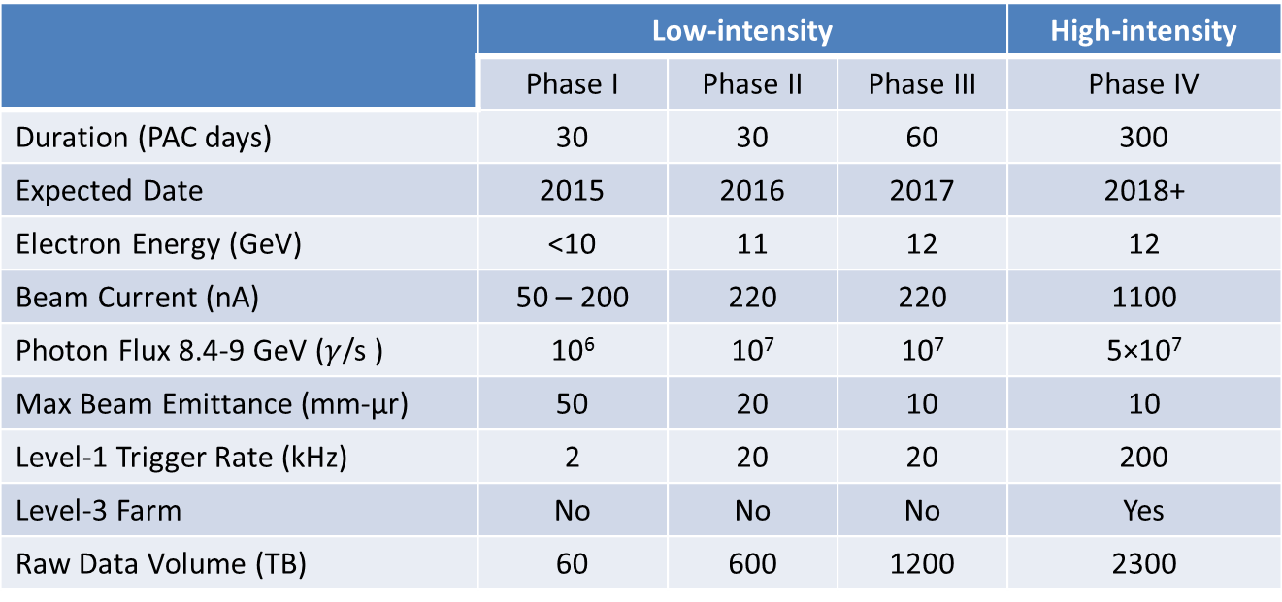
GlueX Experiment
 | Low-intensity |  |  | High-intensity
 | Phase I | Phlase II | Phase III | Phase IV
Duration (PAC days) | 30 | 30 | 60 | 200
Expected Date | 2015 | 2016 | 2017 | 2018+
Electron Energy (GeV) | <10 | 11 | 12 | 12
Beam Current (nA) | 50 – 200 | 220 | 220 | 1100
 | 10⁶ | 10⁷ | 10⁷ | 5×10⁷
Max Beam Emittance (mm-μr) | 50 | 20 | 10 | 10
Level-1 Trigger Rate (kHz) | 2 | 20 | 20 | 200
Level-3 Farm | No | No | No | Yes
Raw Data Volume (TB) | 60 | 600 | 1200 | 2300
Initial “low-intensity” runs will provide incredible statistics in some channels
  3×10⁸ events: $γp→π^{+}π^{+}π^{−}n$
  5×10⁶ events: $γp→ωπ^{+}π^{−}p$
  10⁵ - 10⁶ events: $γp→η^{′}π^{+}n$
Approved high-intensity running Phase IV: more decay channels, kaons, cascades
A.Somov Hall C Summer Workshop, 2013 3

Slide 4
Exotic Mesons
Normal Mesons
Hybrid Mesons
q
q
flux tube in
ground state
m = 0
flux tube in
excited state
m = 1
q
q
J = L + S
P = ( -1 ) ^{L + 1}
C = ( -1 ) ^{L + S}
Quantum Numbers of the exited flux tube
is combined with that of quarks resulting in
conventional and exotic J^{PC}
0⁻⁺ 0⁺⁺
1⁻⁻ 1⁺⁻ 1⁺⁺
2⁻⁻ 2⁻⁺ 2⁺⁺
0⁻⁻ 0⁻⁺ 0⁺⁻ 0⁺⁺
1⁻⁻ 1⁻⁺ 1⁺⁻ 1⁺⁺
2⁻⁻ 2⁻⁺ 2⁺⁻ 2⁺⁺
J^{PC}:
A.Somov Hall C Summer Workshop, 2013 4

Slide 5
Mass Predictions of Hybrid Mesons
The mass of J^{PC} = 1⁻⁺ exotic hybrid predicted by
lattice calculations
Mass spectrum of exotic meson predicted by lattice QCD
arXiv:1004.930, 2010
arXiv:1004.551, 2010
Various model calculations for hybrid meson masses
The lightest hybrid meson nonet predicted by lattice QCD is J^{PC} = 1⁻⁺
Predicted hybrid meson mass region for experimental search: 1.5 GeV – 2.9 GeV
A.Somov Hall C Summer Workshop, 2013 5
Notes:
Ordering of the hybrids is a QN ordering
Note vertical labels

Slide 6
Initial Exotic Hybrid Search Modes
J^{PC} | Exotic Meson | Possible Decays
0 ⁺ ⁻ | h₀ | b₁π⁰ → (ωπ⁰) π⁰ → π⁺π⁻π⁰π⁰π⁰
1⁻⁺ | π₁ | ρ π → πππ b₁π → π⁺π⁻π⁰π⁰π⁰ f₁ π → (ηππ) π
 | η₁ | a₁π → (ρ⁰π⁺) π⁻ → π⁺π⁻π⁺π⁻
2⁺ ⁻ | b₂ | a₂π
 | h₂ | ρπ b₁π
many photons
all charged
Multiparticle final states:
- (p,n) + πππ, ππππ, πππη, ππππη
- 70% of decays involve at least one π⁰
- 50% involve more than one π⁰
A.Somov Hall C Summer Workshop, 2013 6

Slide 7
Experimental Status
Exotic mesons have been searched in several experiments:
GAMS, VES, CBAR, E852, COMPASS, CLAS
Exotic Meson Candidates (J^{PC} = 1⁻⁺)
π₁(1400) → ηπ
Seen by several experiments. Interpretation unclear:
dynamic origin, 4-quark state (?) Not a hybrid.
π₁(1600) → η′π
π₁(1600) → ρπ
π₁(1600) → b₁π
π₁(1600) → f₁π
First seen by VES, E852, COMPASS
3π controversial:
- signal disappeared in E852 analysis with about10 times larger
statistics. Added J^{PC} = 2⁻⁺ wave in the analysis
- still seen by COMPASS (preliminary)
- 3π not seen in photoproduction (CLAS)
May be a hybrid
π₁(2000) → f₁π
π₁(2000) → b₁π
Seen by E852 ( but not seen by VES )
Statistics is limited
May be a hybrid
More data is needed to study the nature of exotic meson candidates
A.Somov Hall C Summer Workshop, 2013 7

Slide 8
Meson Photoproduction
Pion Beam
Photon Beam
π
γ
X
X
N
N
N
N
Combine exited glue QN with those of quarks
J^{PC} = 1⁻ ⁻ or 1⁺⁺
Spin flip is needed to form
exotic quantum numbers
J^{PC} = 0⁻⁺, 0⁺⁻, 1⁻⁺, 1⁺⁻,2⁻⁺,2⁺⁻
No Spin flip needed
Photon Polarization
helps to determine the production mechanism (naturality of exchanged particle)
additional constrain in partial wave analysis
A.Somov Hall C Summer Workshop, 2013 8

Slide 9
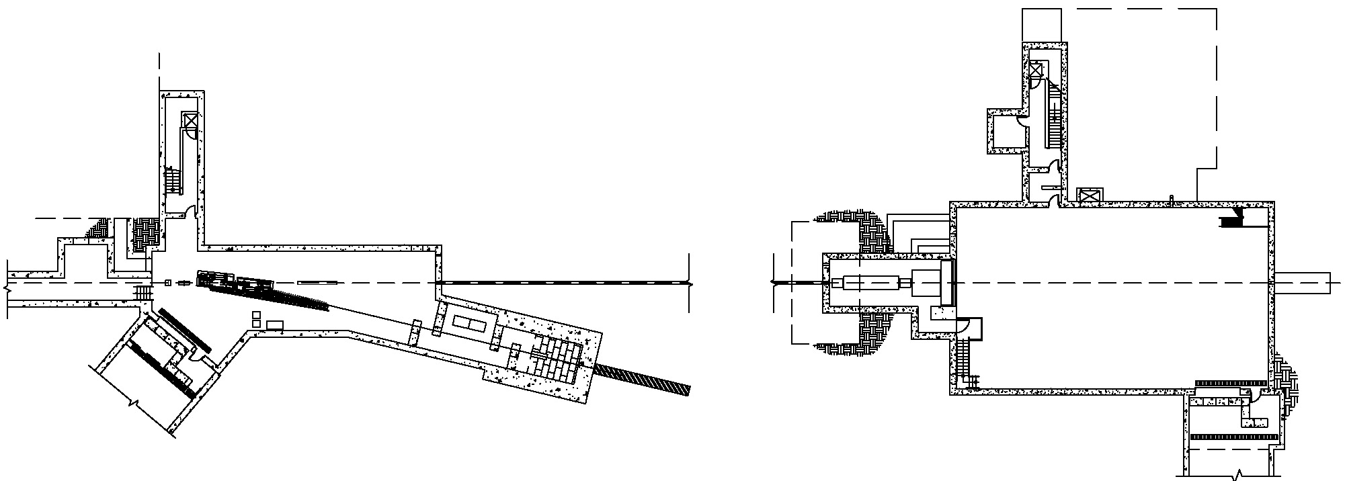
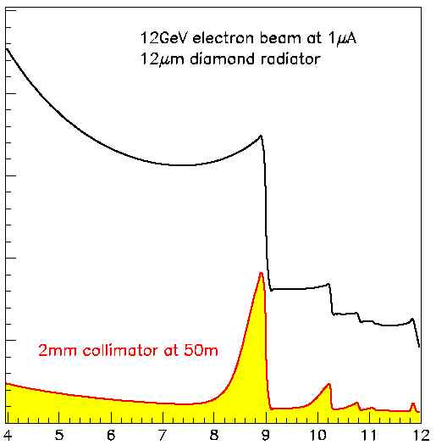
Photon Beam for Hall-D
Coherent Bremsstrahlung
photon beam
GlueX detector
Photon
Beam dump
Radiator
75 m
e⁻
Electron beam dump
Experimental
Hall D
Tagger Area
Collimator Cave
Bremsstrahlung beam photons are produced by a
12 GeV electron beam incident on a 20 μm thick
diamond crystal (Tagger Area)
flux
before collimator
Photon
Spectrum
40 %
polarization
Pass bremsstrahlung photons through the collimator
- increase the fraction of linearly polarized photons
- main coherent bremsstrahlung peak is 8.4<E_{γ}<9.0 GeV.
Photon flux 10⁸ γ/sec in the peak (Collimator CAVE)
collimated
GeV

Slide 10
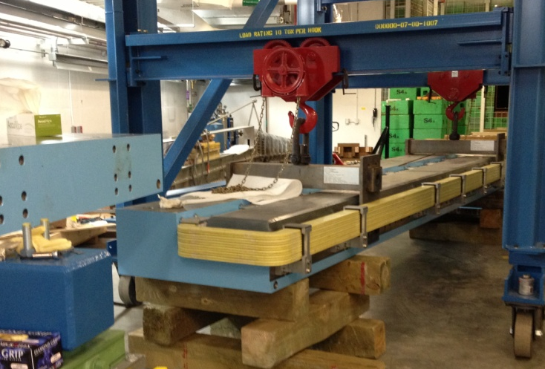
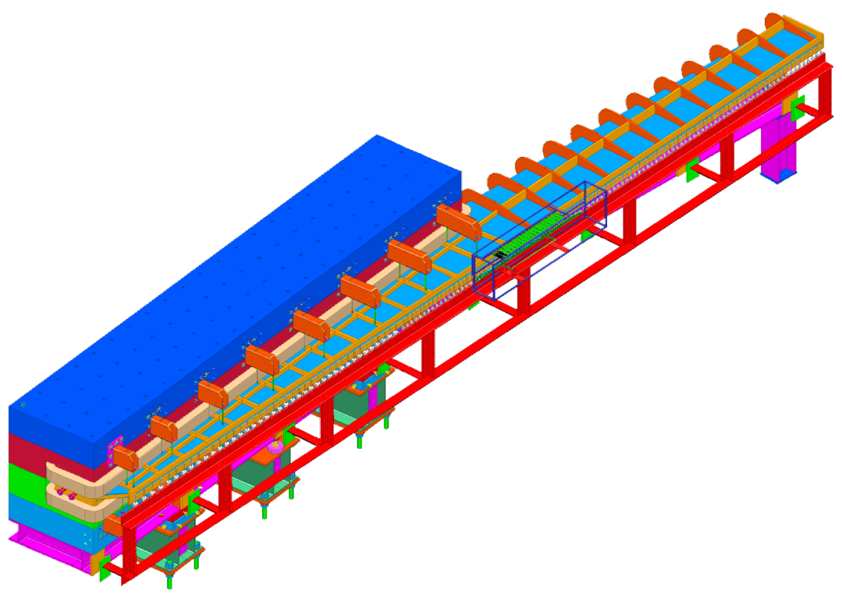
Tagged Photon Beam
Electrons to the
beam dump
Photons to Hall D
6 m long dipole magnet B = 1.5 T
- installed in the Tagger Hall
- ready for mapping
Microscope
detect tagged electrons in
the coherent peak region
Radiator
Fixed Array Hodoscope
12 GeV
e beam
cover large energy range 3 GeV < E _{γ} < 11.78 GeV
use for the radiator orientation
detect tagged ellectrons with E_{γ} > 9 GeV during data runs
A.Somov Hall C Summer Workshop, 2013 10

Slide 11
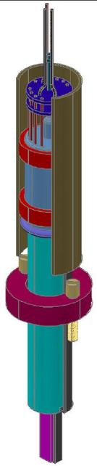
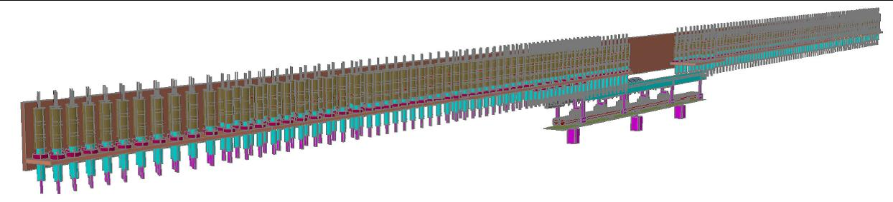
Tagging Detectors
Microscope
100 x 5 array of square 2 mm scintillating fibers
SiPM light sensors
120 readout channels (FADC250, F1TDC)
University of Connecticut
Fixed Array Hodoscope
Catholic University
274 scintillator counters (originally install 218).
4 cm high, 6 mm thick, width 3 mm – 21 mm
9.1 GeV < E γ < 11.78 GeV: continues energy coverage
3.0 GeV < E γ < 8.1 GeV: 60 MeV bins in E _{γ}, 30 – 50% sampling rate
R9800 PMTs, Jlab designed divider/amplifier (FADC250, F1TDC)
A.Somov Hall C Summer Workshop, 2013 11

Slide 12
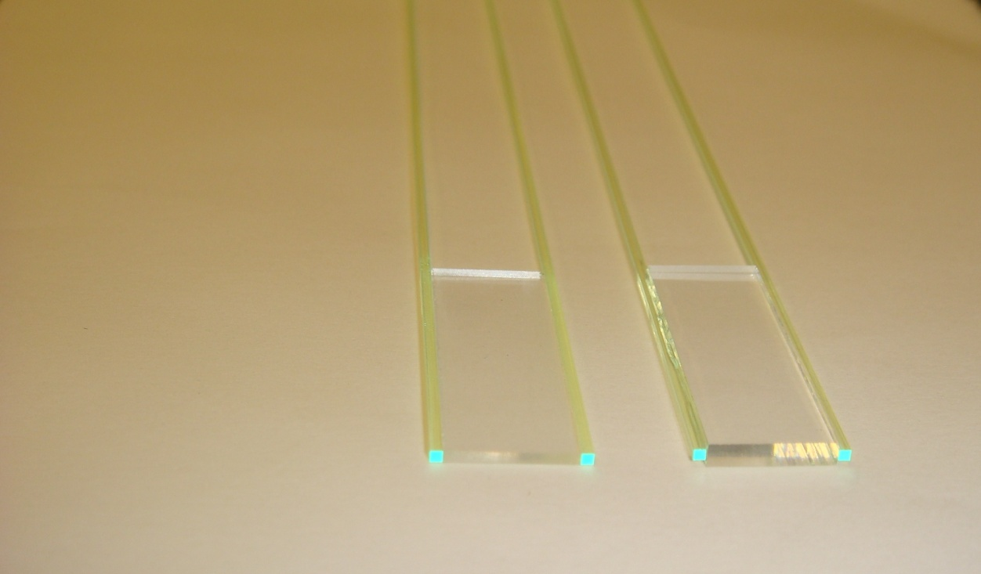
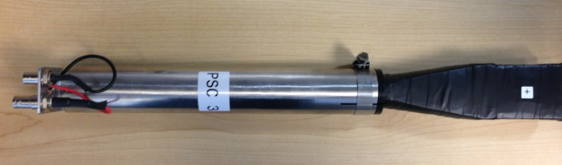
Pair Spectrometer
Magnet
Vacuum Chamber
Measure polarization of
collimated photon beam
Luminosity monitor
Tagger calibration
Converter
Triplet polarimeter
18D36
1.8 T
Concrete
and lead
walls
Hodoscope
290 channels
SiPM (FADC250)
Low-granularity counters
16 counters
R6427 PMTs ( FADC250, F1TDC)
Collimator Cave
Hodoscope
( JLab, MEPhI )
Counters
105 tiles (2 mm)
40 tiles (1 mm)
( UNCW )
WLS
20 cm
2 mm tile
Z = 1 cm
1 mm tile
3 cm
e
3 GeV
X = 25 cm
6.25 GeV
A.Somov Hall C Summer Workshop, 2013 12

Slide 13
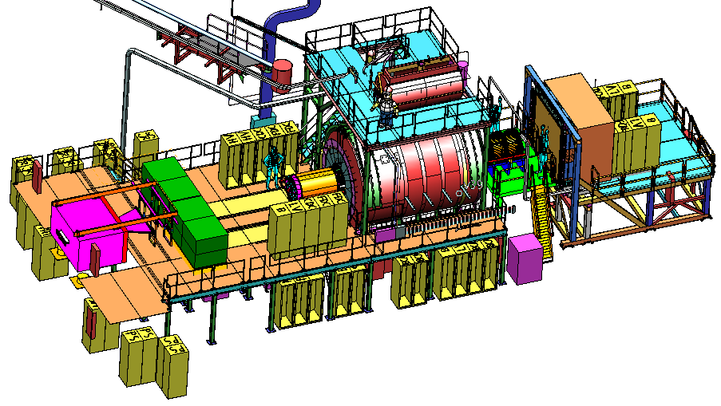
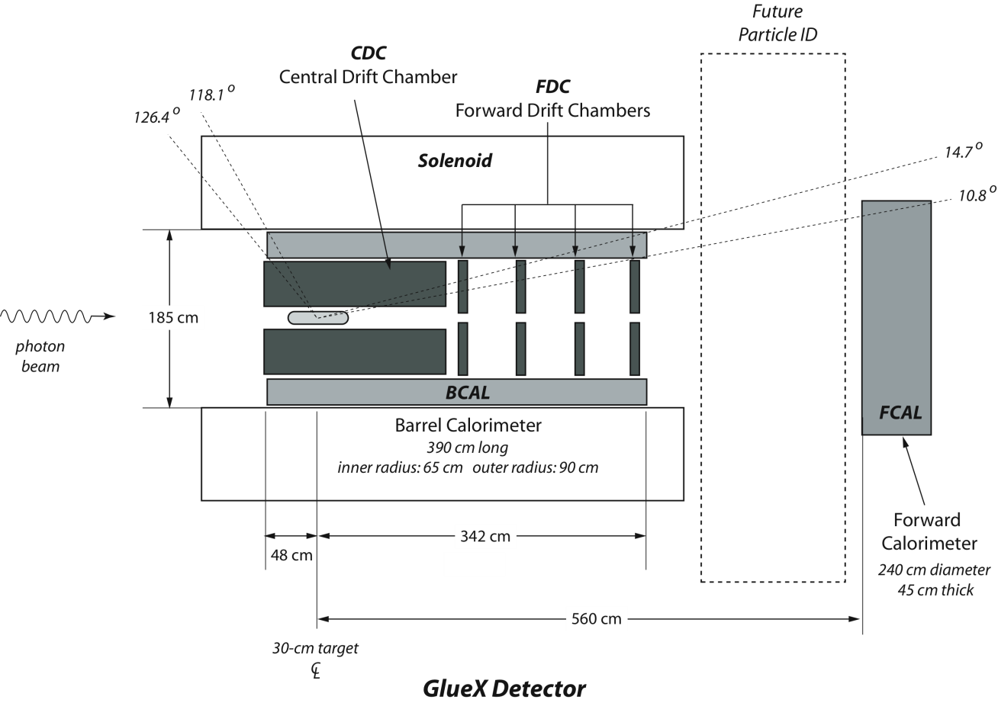
GlueX Detector
2.2 T Solenoid
Magnet
Beam photons incident of LiH₂ target
-5 10⁷ γ/sec in the energy range 8.4 – 9.0 GeV
Tracking:
Central Drift Chamber
Forward Drift Chamber
Calorimetry:
Barrel Calorimeter
Forward Calorimeter
PID:
Time of Flight wall
Start Counter
Barrel Calorimeter

Slide 14
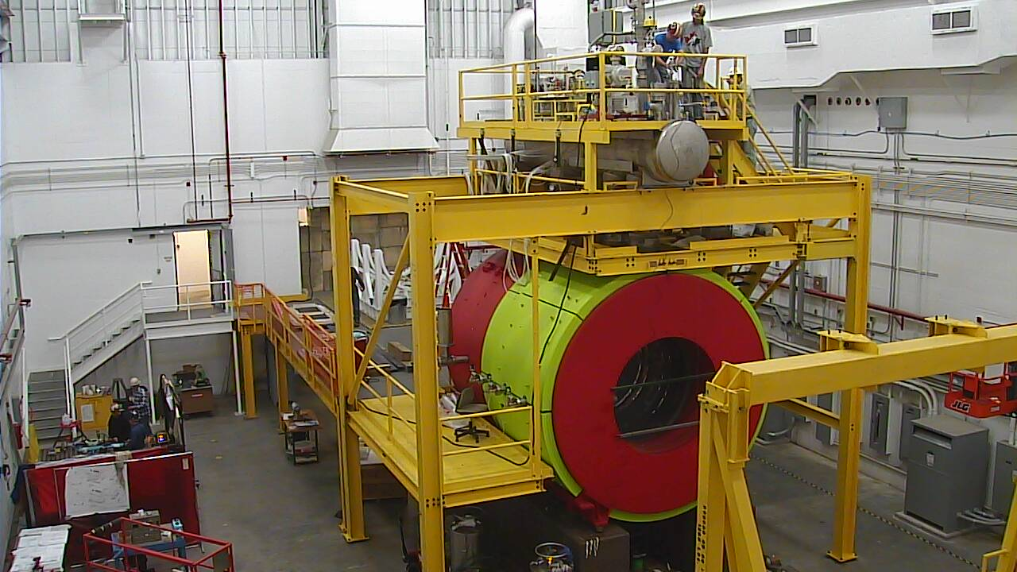
Solenoid
Used for LASS at SLAC, for MEGA at Los Alamos, refurbished for GlueX
Bore ID = 1.85 m, length 4 m, B_{max} = 2.2T
Four separate coils
A.Somov Hall C Summer Workshop, 2013 14

Slide 15
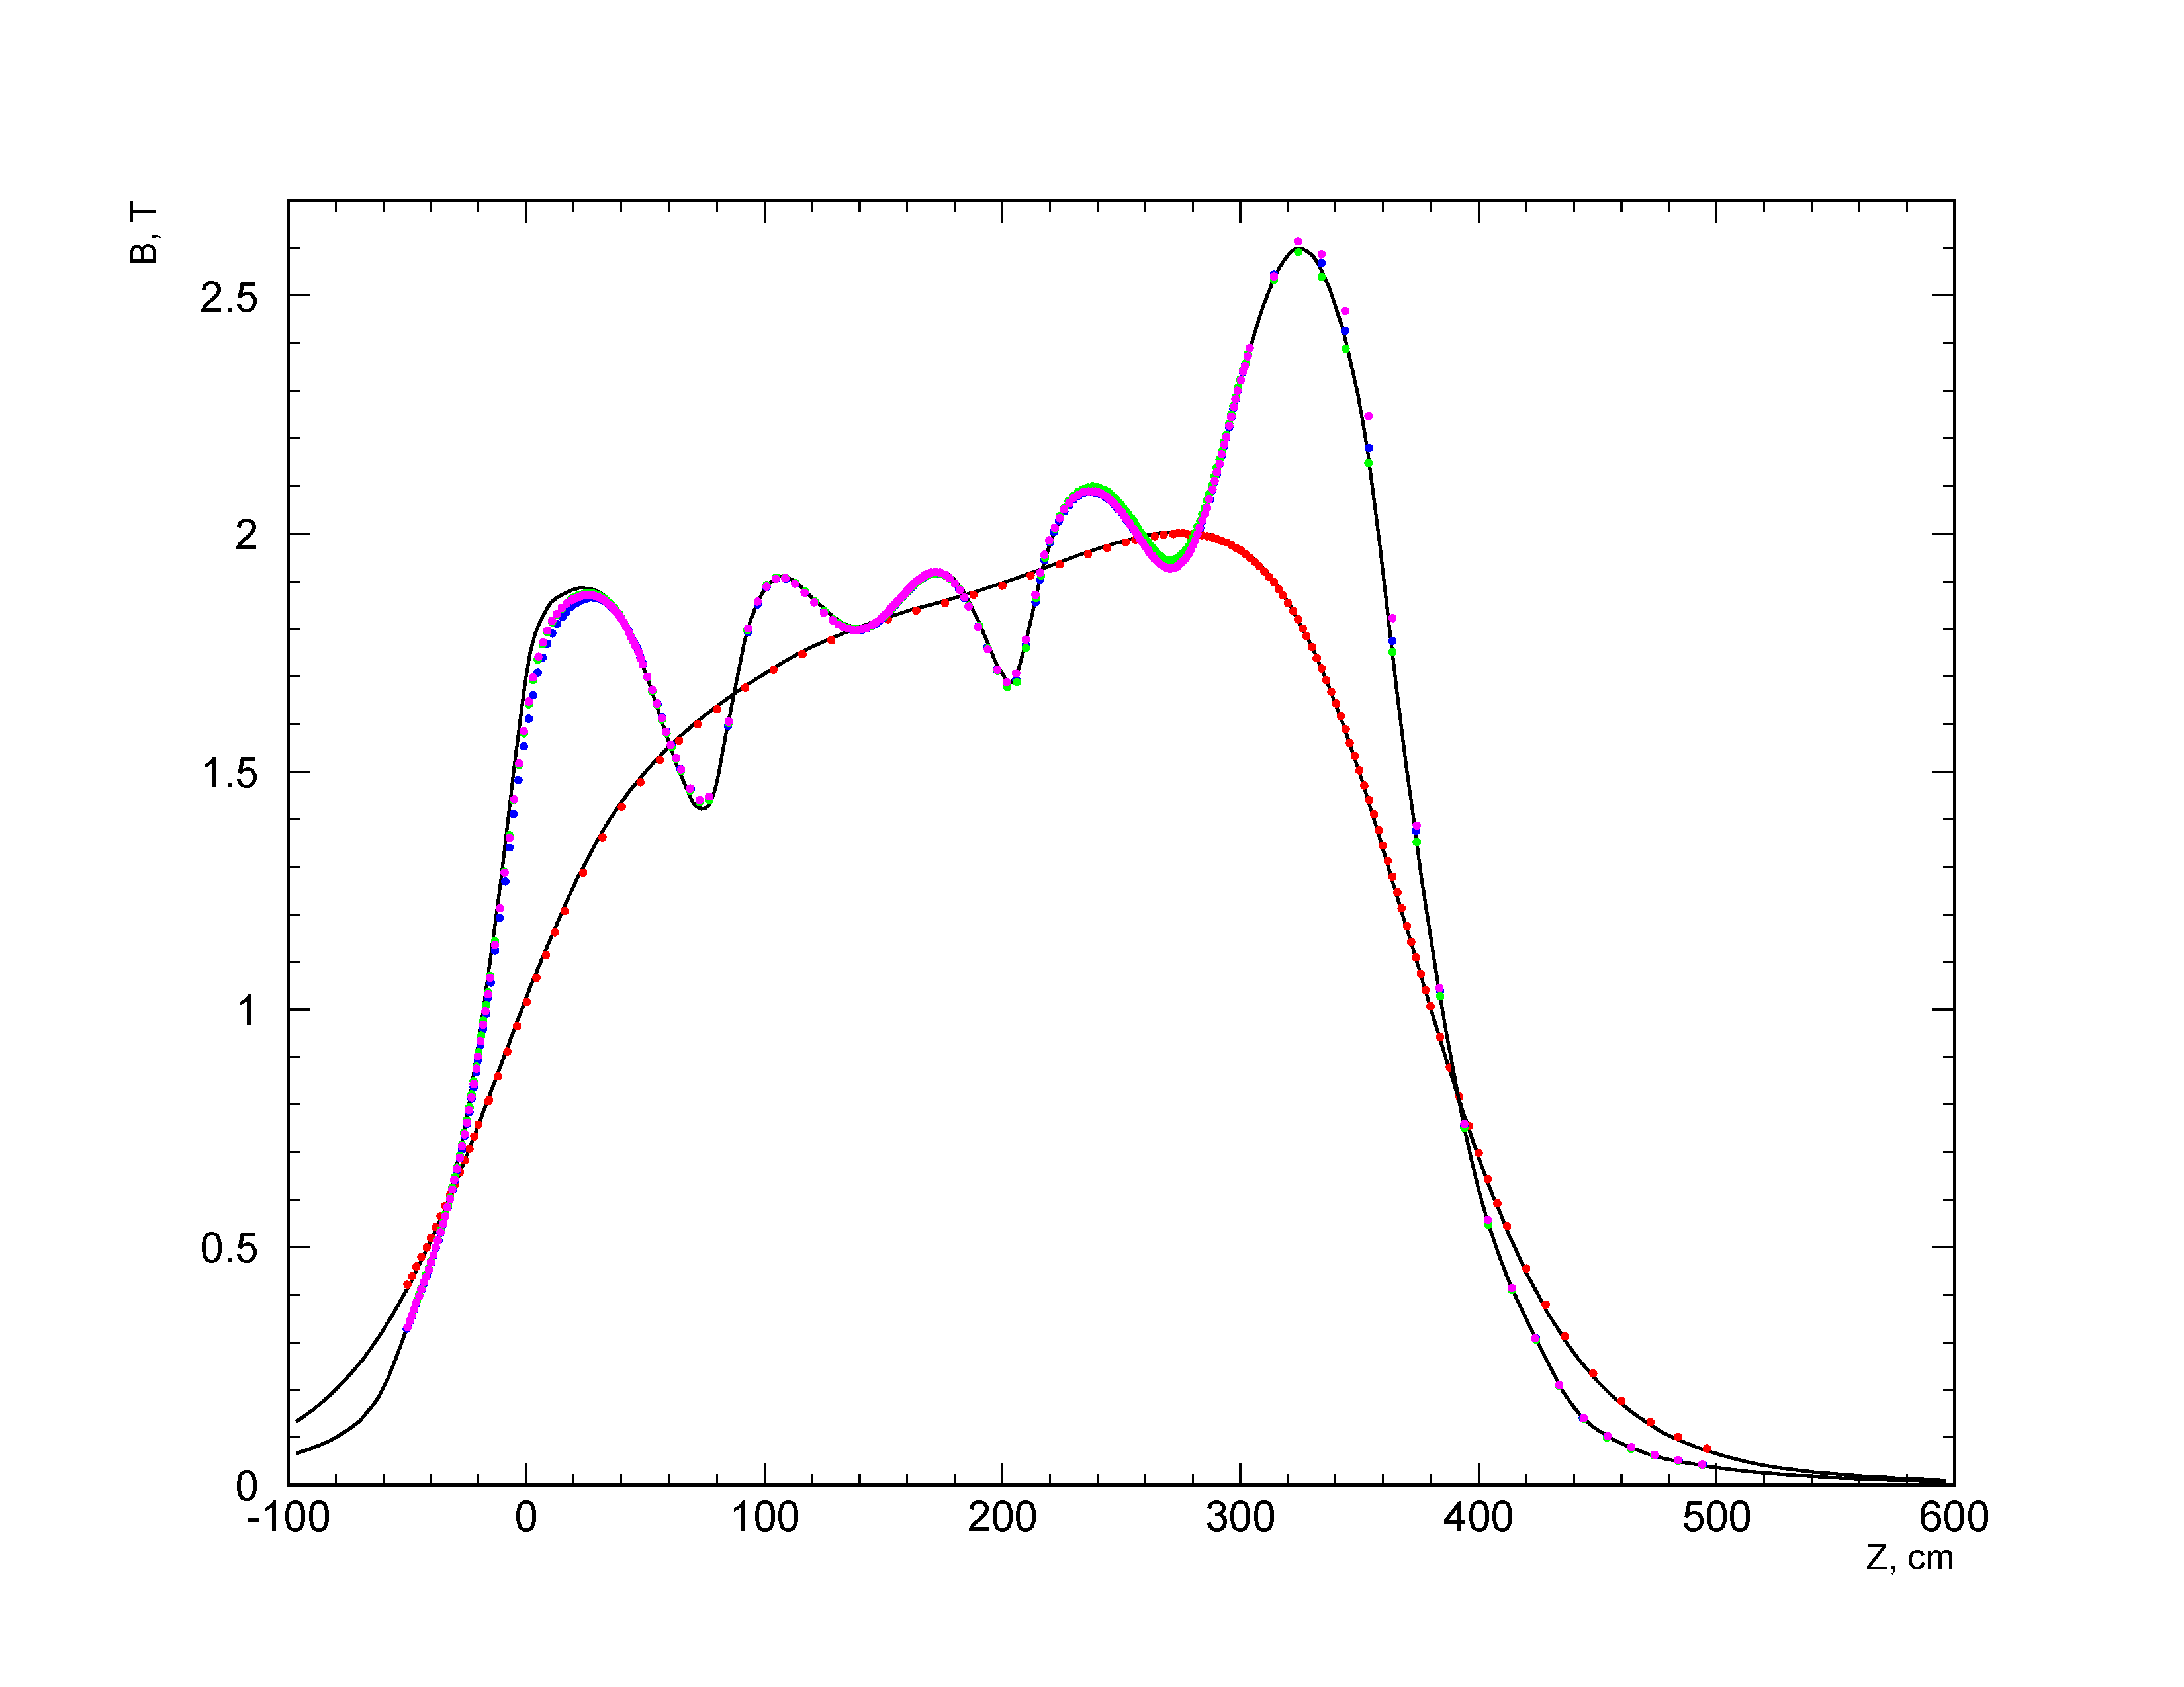
Solenoid: Field Mapping
1300 A current
coil 4
B (T)
R = 81 cm
coil 3
coil 2
coil 1
R = 0 cm
Poisson calculations
Z (cm)
A.Somov Hall C Summer Workshop, 2013 15

Slide 16
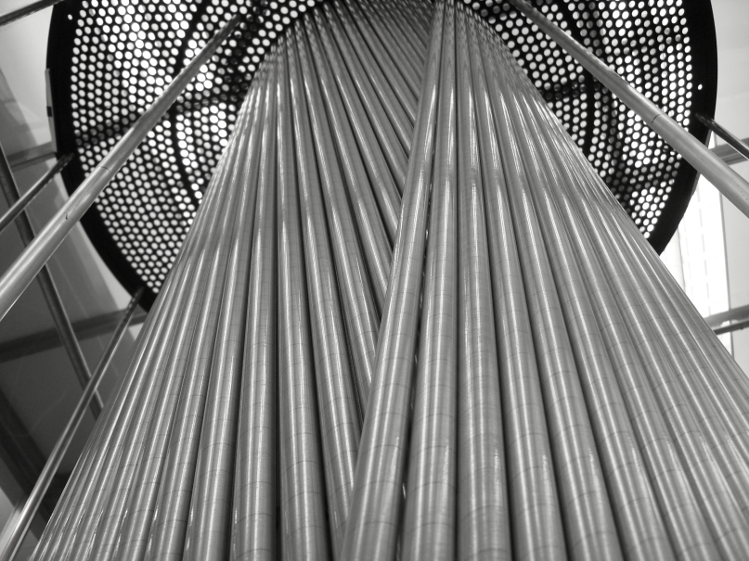
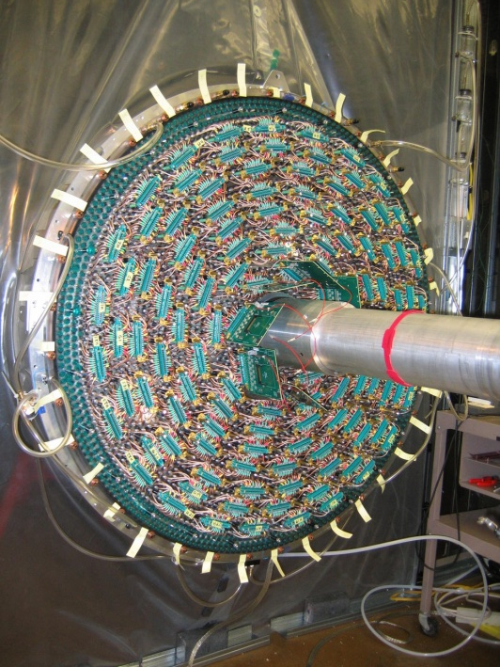
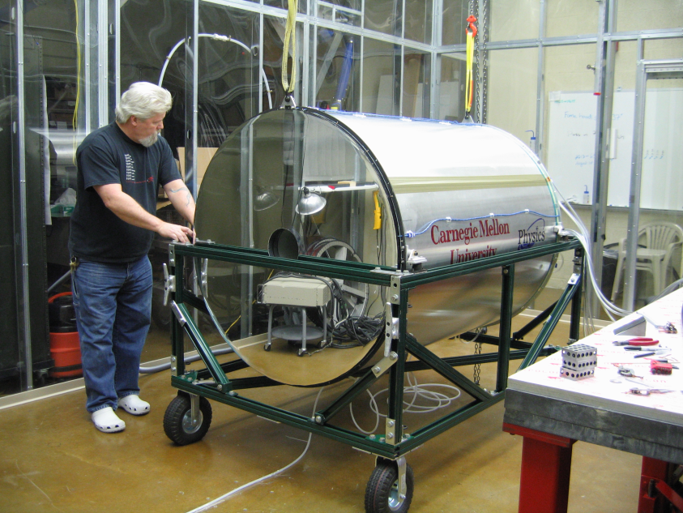
Central Drift Chamber
Assembling: stereo tubes
Angular coverage 6° < θ < 155°
3522 straw tubes, r = 8 mm (FADC125)
12 axial layers, 16 stereo layers +/- 6°
De/dx for p < 450 MeV/c
σ_{ϕ} ~ 150 μm, σ_{z} ~ 1.5 mm
Carnegie Mellon University
Installing connectors
Assembled at CMU
A.Somov Hall C Summer Workshop, 2013 16

Slide 17
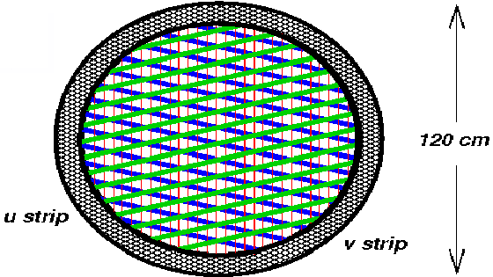
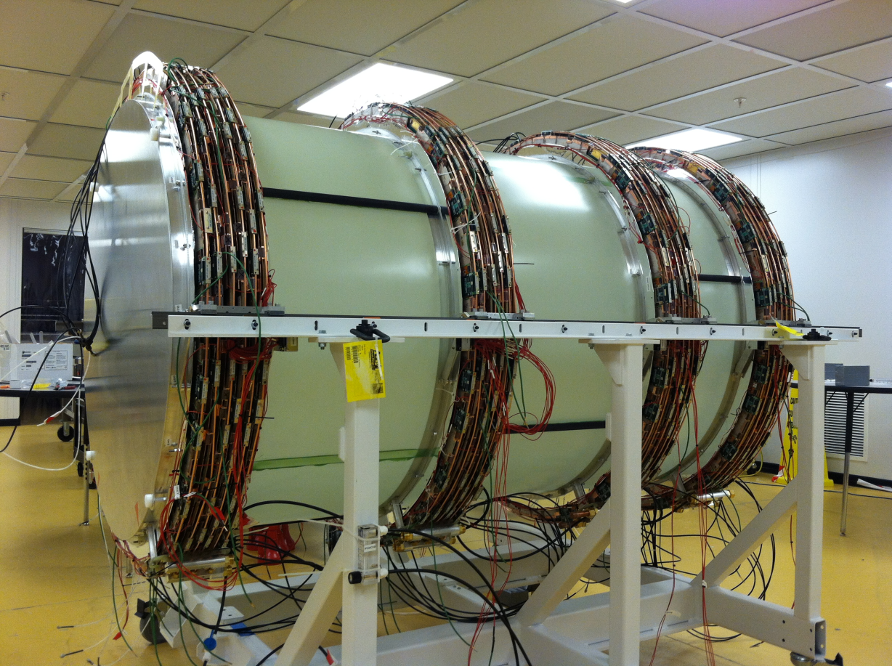
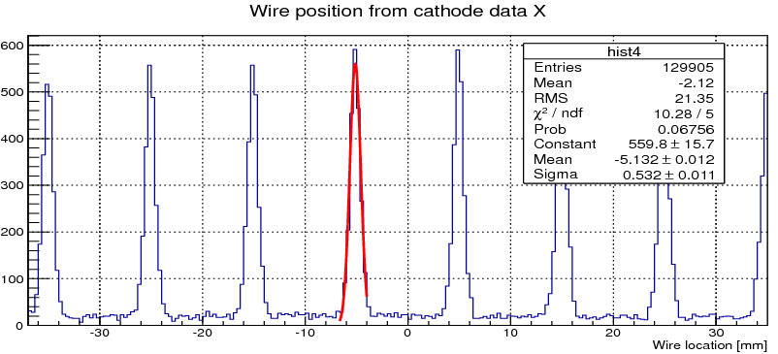
Forward Drift Chamber
Angular coverage 1° < θ < 30°
Gas mixture 40/60 Ar/CO₂
4 packages, 6 cathode – wire - cathode
chambers in each package
2300 anode wires (F1TDC)
10200 cathode strips (FADC-125)
Resolution σ_{xy} ~ 200 μm for wires and strips
cathode – wire - cathode
Wire position measured using strip hits
Four FDC packages have been assembled
at JLab

Slide 18
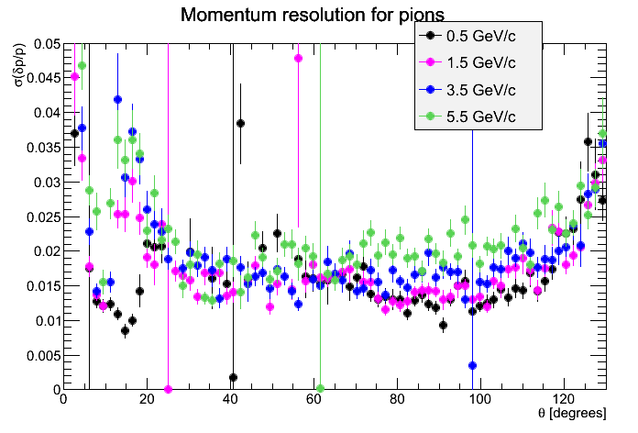
Tracking Performance
CDC/FDC
transition region
A.Somov Hall C Summer Workshop, 2013 18

Slide 19
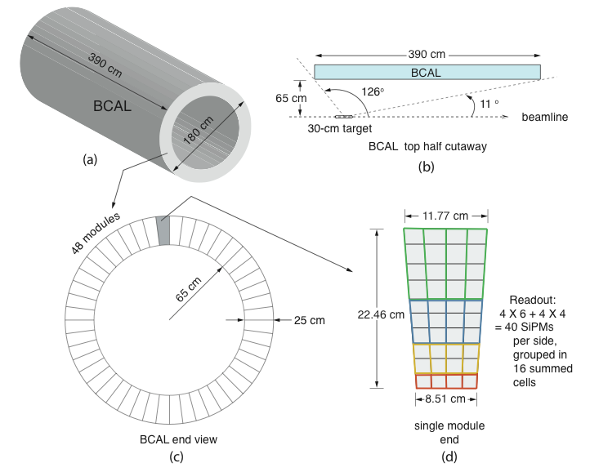
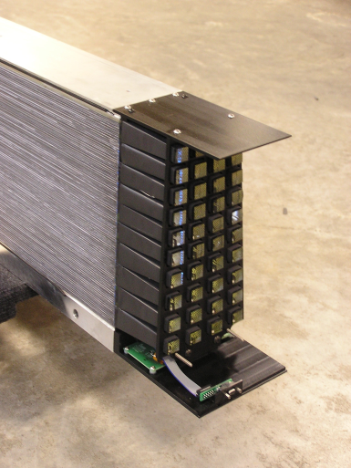
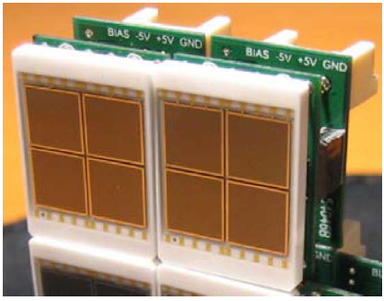
Barrel Calorimeter (BCAL)
Angular coverage 11° < θ < 120 °
191 layers Pb:ScFib:Glue (37:49:14%)
Double side readout, 3840 SiPMs
1536 FADC250 channels
1152 F1TDC channels
σ_{E} / E (%) = 5.5/√E ⊕ 1.6
σ_{Z} = 5 mm / √E
σ_{t} = 74 ps / √E ⊕ 33 ps
University of Regina, USM
BCAL module
SiPM
12 mm
A.Somov Hall C Summer Workshop, 2013 19

Slide 20
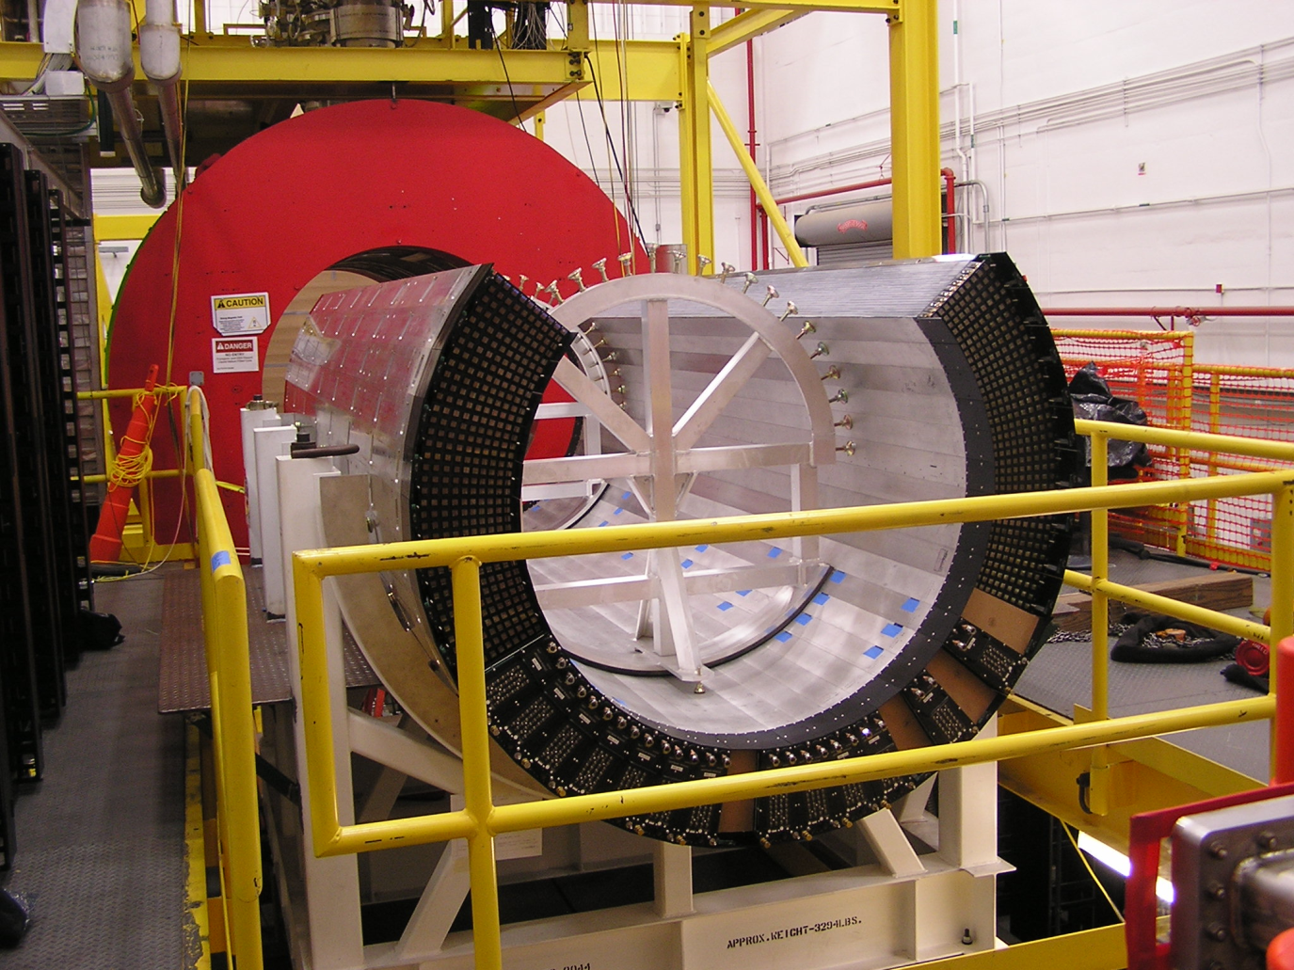
Barrel Calorimeter
Installation in the Hall D
A.Somov Hall C Summer Workshop, 2013 20

Slide 21
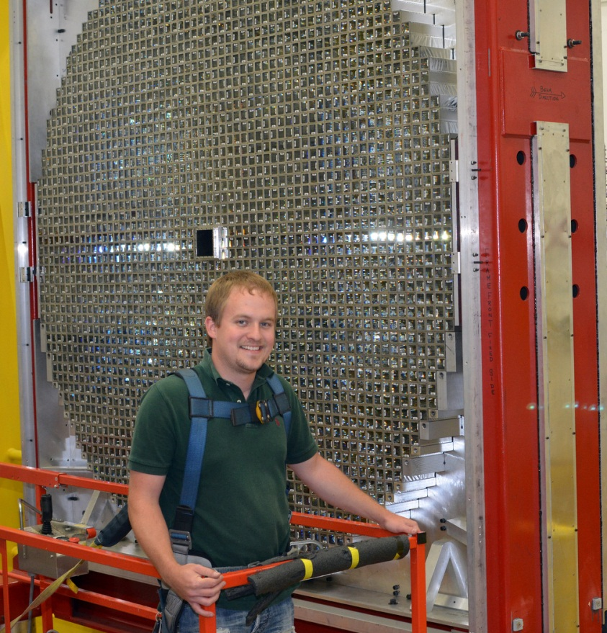
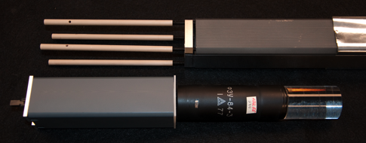
Forward Calorimeter
Lead Glass Calorimeter
Angular coverage 2° < θ < 11 °
2800 lead-glass F8-00 blocks: 4 x 4 x 45 cm³
FEU84-3 PMTs and Cockroft-Walton bases
σ_{E} / E (%) = 5.7/√E ⊕ 2.0
σ_{xy} = 6.4 mm / √E
Prototype test at Hall-B in 2012
σ_{E} / E ~ 20 % for 100 MeV electrons
Indiana University
Calorimeter assembled in Hall-D
PMT
Base
Light Guide
A.Somov Hall C Summer Workshop, 2013 21

Slide 22
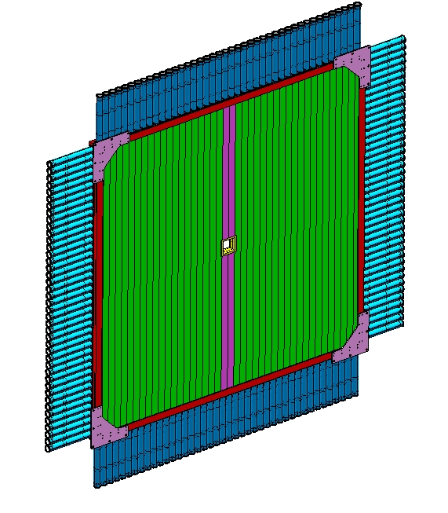
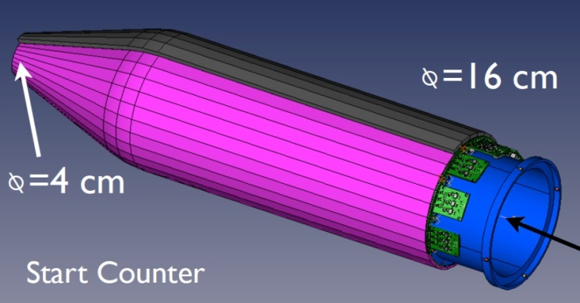
PID Detectors
12 cm square opening
Split paddles
Forward Time-of-Flight
PMT’s
Time resolution: ~70 ps
4σ K/π separation up to 2 GeV
184 readout channels
FADC250 and CAEN 1290 TDCs
Florida State University
Start Counter
Scintillator bars
252 cm
Use to identify beam bunches
Thirty 2 mm thick scintillator paddles
Readout by SiPMs (four per paddle)
FADC250 and F1TDC
Florida International University
A.Somov Hall C Summer Workshop, 2013 22

Slide 23
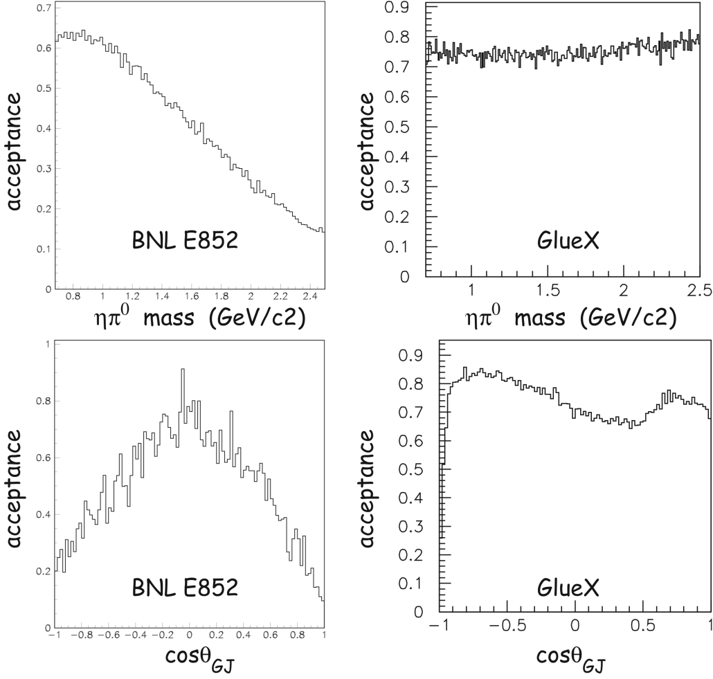
Detector Acceptance
GlueX Acceptance
Acceptance vs. M_{x}
E852 experiment contains the largest
sample of exotic meson candidates
GlueX has more uniform acceptance
as a function of the exotic meson mass
GlueX angular acceptance for ηπ is
expected to be better than that of E852
Acceptance vs. cos θ_{GJ}
A.Somov Hall C Summer Workshop, 2013 23

Slide 24
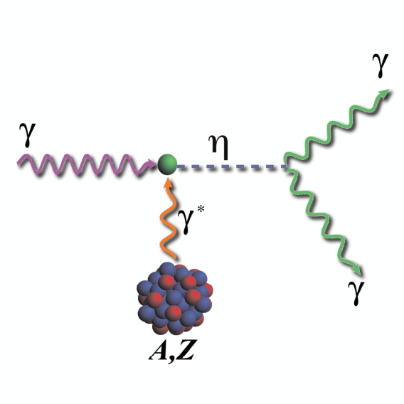
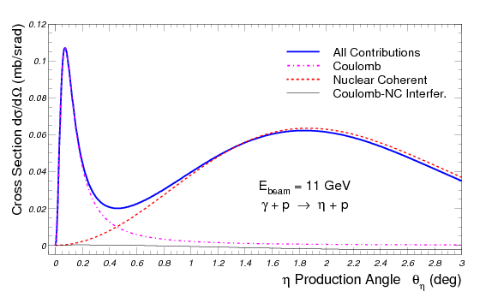
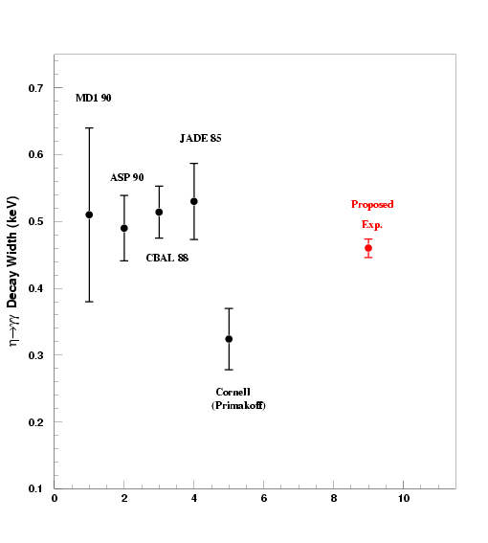
Measurement of Γ(η→γγ) via Primakoff Effect
Physics:
• Light quark mass ratio
• η - η′ mixing angle
      Γ(η→3π) ∝ |A|² ∝ Q⁻⁴
Measurements:
• Primakoff θ < 0.5°
• Fit to
Γ(η→γγ) Hall-D projection
Approved: A- 79 days
11.0-11.7 GeV Incoherent tagged photons
Pair spectrometer to control photon flux
Solenoid detectors (for background rejection)
30 cm LH2 and LHe4 targets (~3.6% r.l.)
Forward Calorimeter (FCAL) for η→γγ
Add CompCal detector for overall control of systematic error
A.Somov Hall C Summer Workshop, 2013 24
Notes:
24

Slide 25
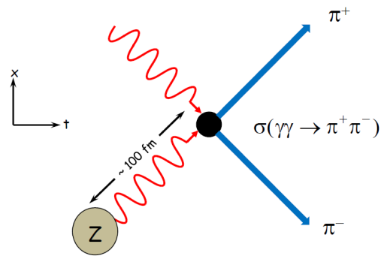
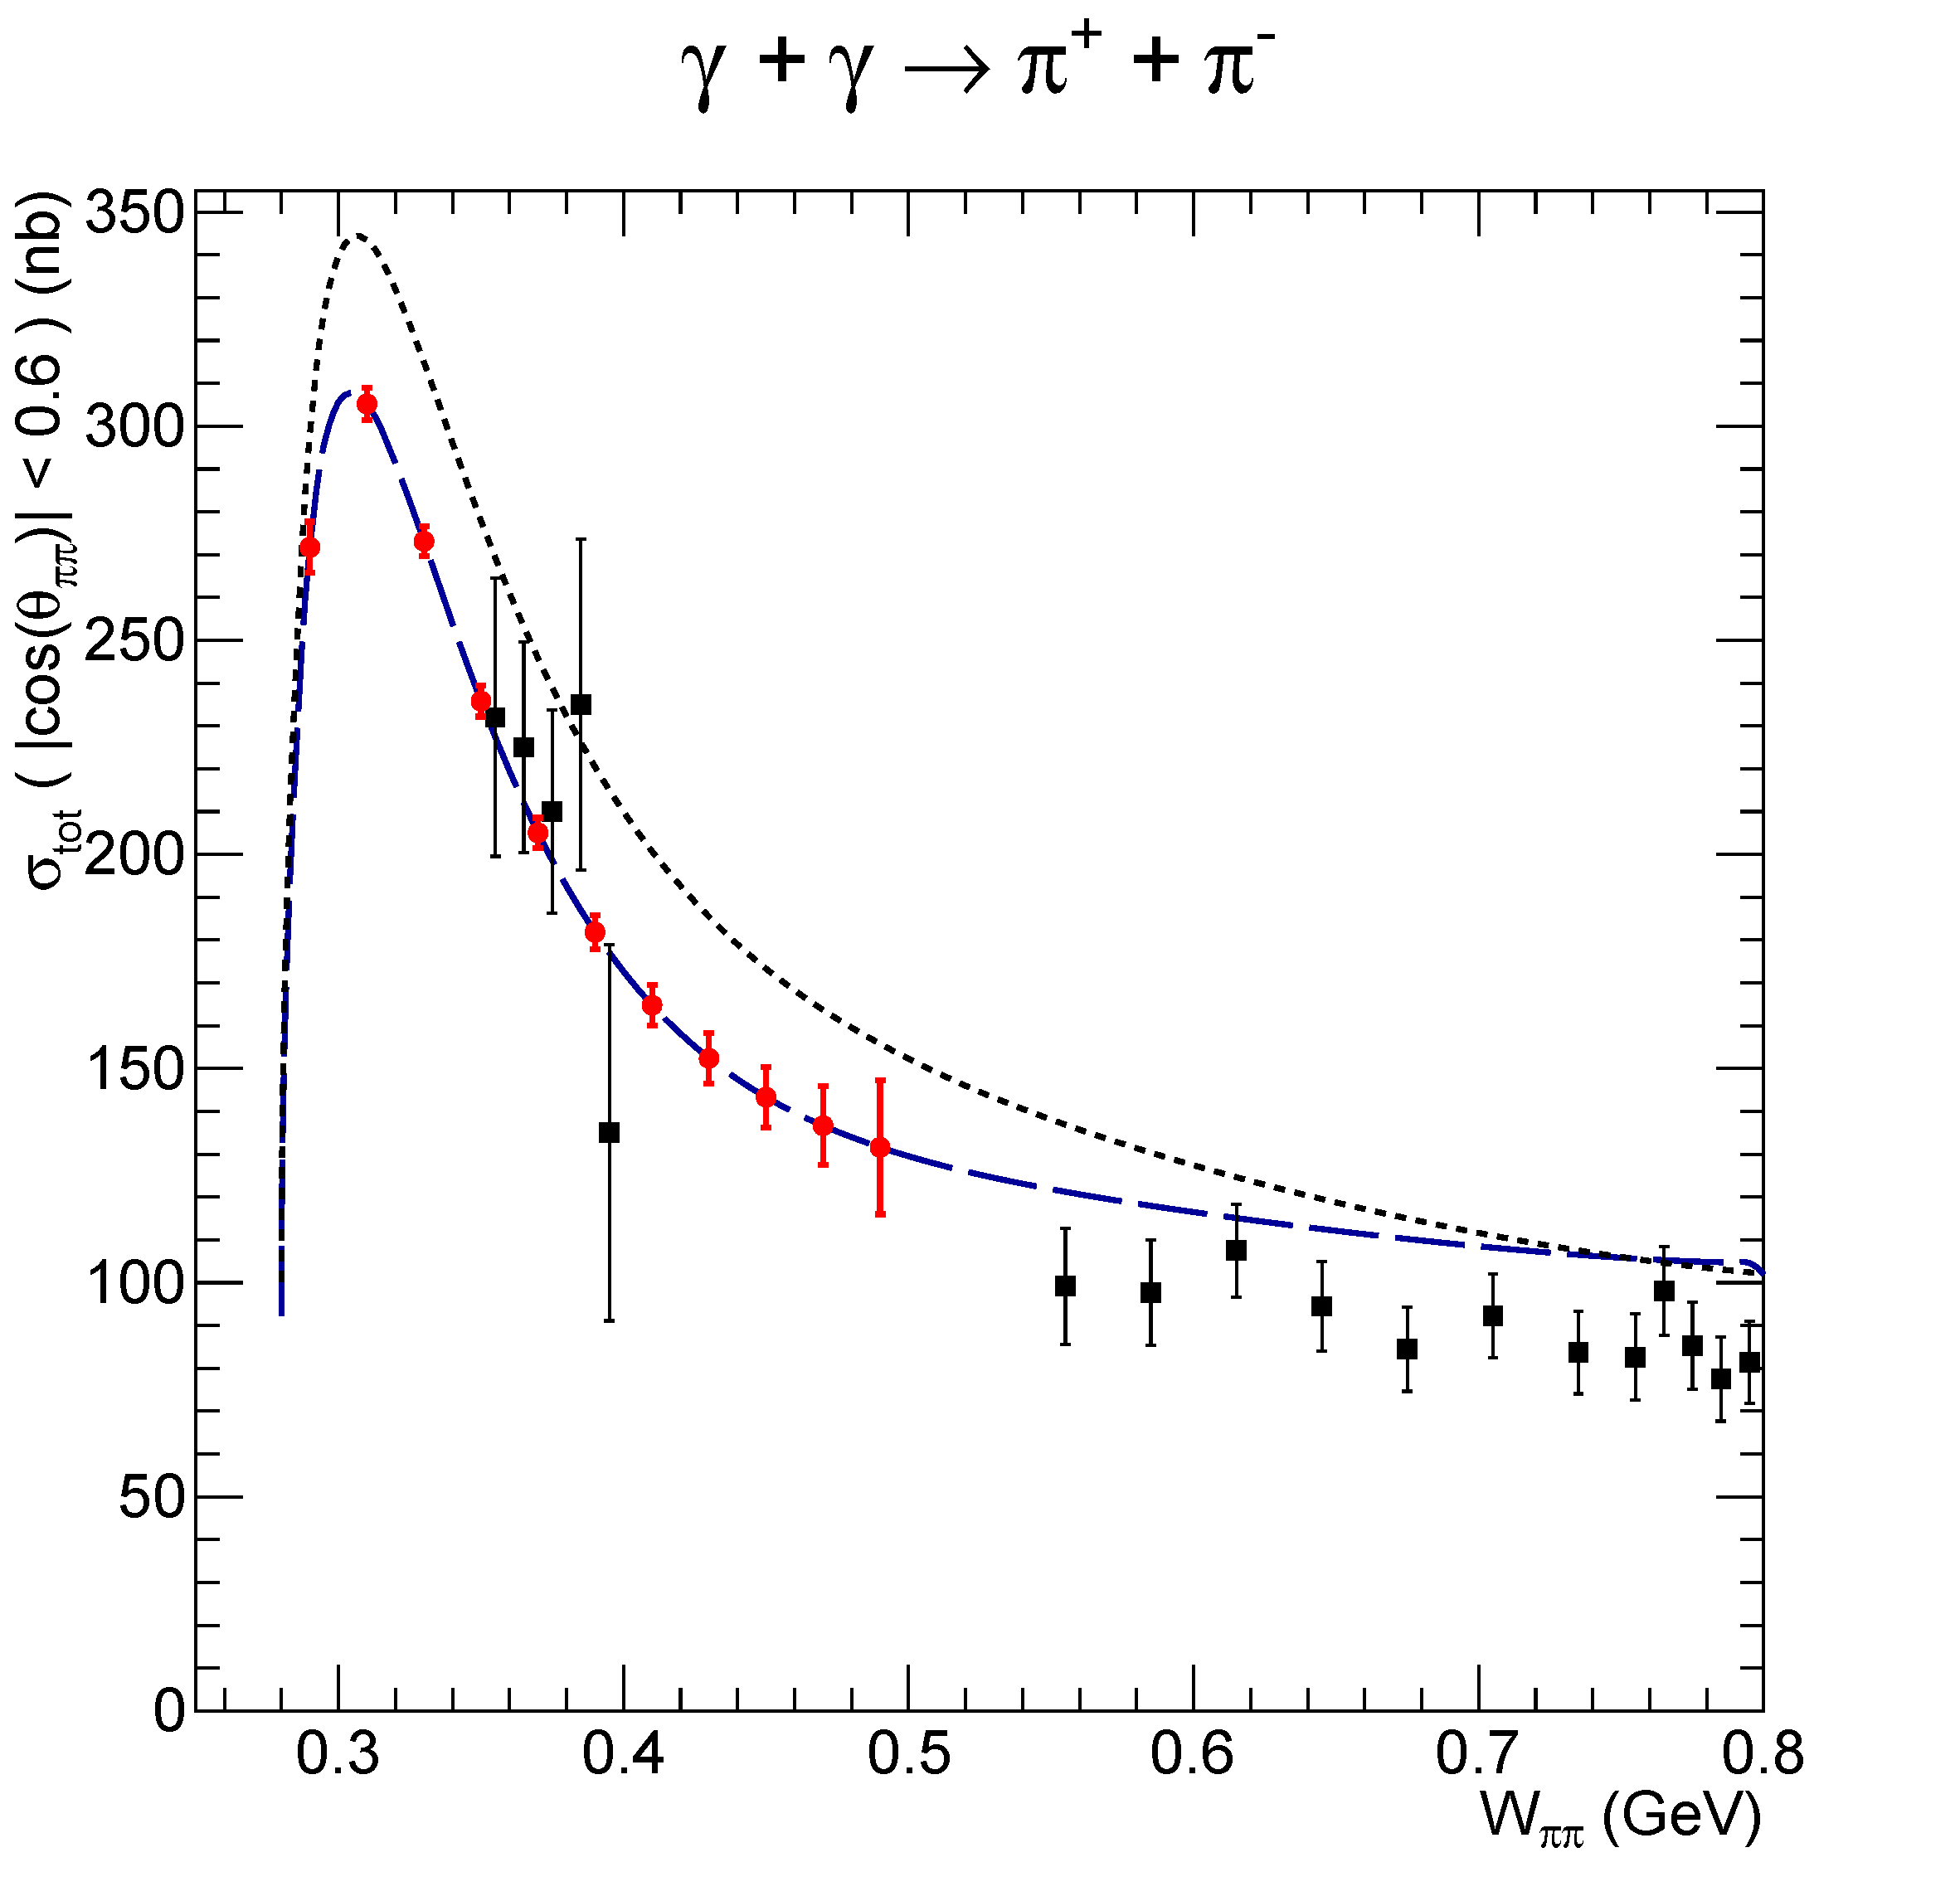
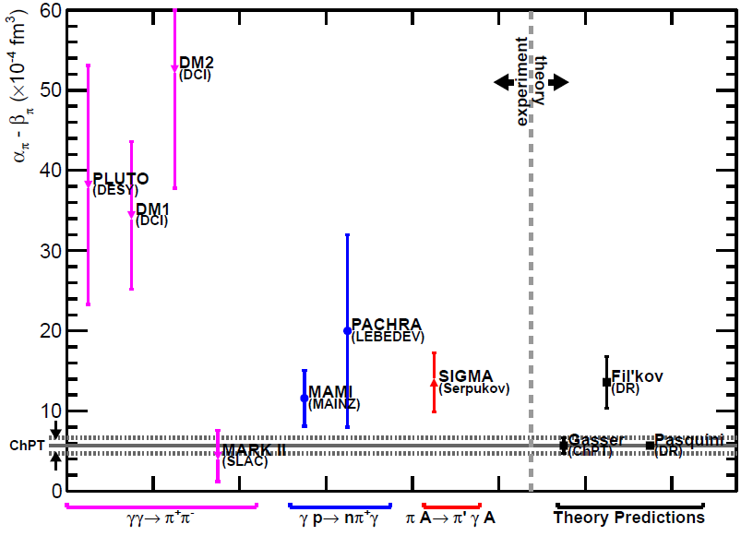
Charged Pion Polarizability
Use Primakoff production γ A → π⁺ π⁻ A to measure
γγ->π⁺π⁻ relative to μ⁺μ⁻ production
Photon energy of interest 5.5 – 6 GeV, polarization 76 %
Major background from rho decays and μ⁺μ⁻
Requires new muon detector
α- β = 13 10⁻⁴ fm³
α- β = 5.7 10⁻⁴ fm³
A.Somov Hall C Summer Workshop, 2013 25
Notes:
25

Slide 26
Physics under Discussion: Rare eta Decays
Mode | Branching Ratio (PDG) | Physics Highlight | Role in proposal
π⁰ 2γ | ( 2.7 ± 0.5 ) × 10 ⁻ ⁴ | χPTh @ Ο(p⁶) | priority
3γ | <1.6 × 10 ⁻ ⁵ | C | priority
2π⁰ | <3.5 × 10 ⁻⁴ | CP, P | priority
4γ | <2.8 × 10 ⁻⁴ | Suppressed (<10⁻¹¹) | ancillary
2π⁰ γ | <5 × 10 ⁻ ⁴ | C | ancillary
π⁰ γ | <9 × 10 ⁻ ⁵ | C, L, gauge inv. | ancillary
3π⁰ γ | <6 × 10 ⁻ ⁵ | C | ancillary
4π⁰ | <6.9 × 10 ⁻ ⁷ | CP, P | ancillary
3π⁰ | (32.57±0.23)% | Quark mass m_{d}-m_{u} | ancillary
2γ | (39.31±0.20)% | Anomaly, η−η’ mixing | By PR12-10-011
Notes:
26

Slide 27
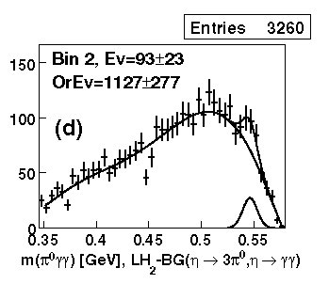
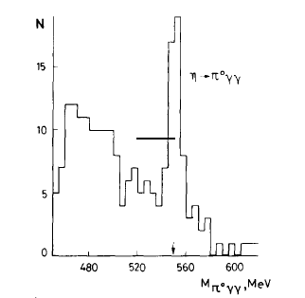
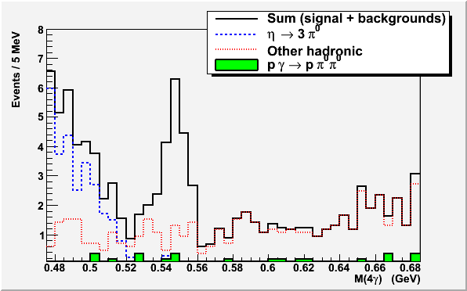
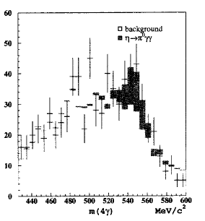
η → π⁰γγ : Advantages at JLab
GlueX detector for recoil detection
High resolution, high granularity PbWO₄ Calorimeter
  improved invariant mass, energy and position resolutions
  fewer overlapping showers, thus reducing background from η→ 3π⁰
  Fast decay time (~20ns) and Flash ADCs → reduced pile-up
Low energy η-production
High energy η-production
GlueX 1 day of running
KLOE
GAMS
CB

Slide 28
Summary
The installation of the GlueX detector is in progress in Hall D. The first ‘engineering’
beam is expected in the Hall in April 2014. Commissioning runs are expected in the fall 2014
Three experiments have been approved in Hall D so far: the GlueX. Promakoff eta
production, charged pion polarizability (424 days in total)
Being optimized for the search of exotic mesons, the detector is well suited for many
other physics topics
- The detector is designed to have excellent acceptance for both charged particles
and photons in the final state
A.Somov Hall C Summer Workshop, 2013 28

Slide 29
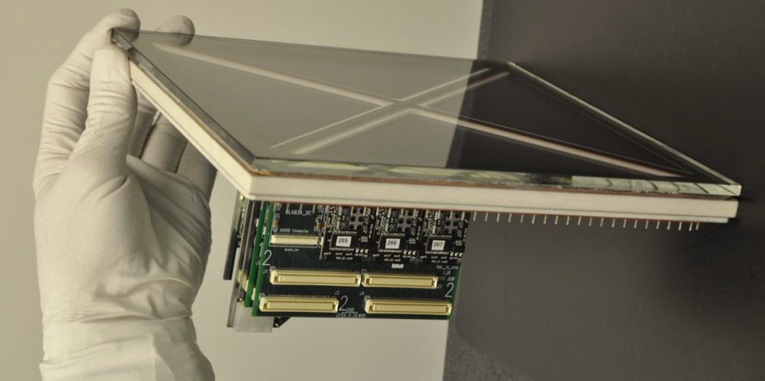
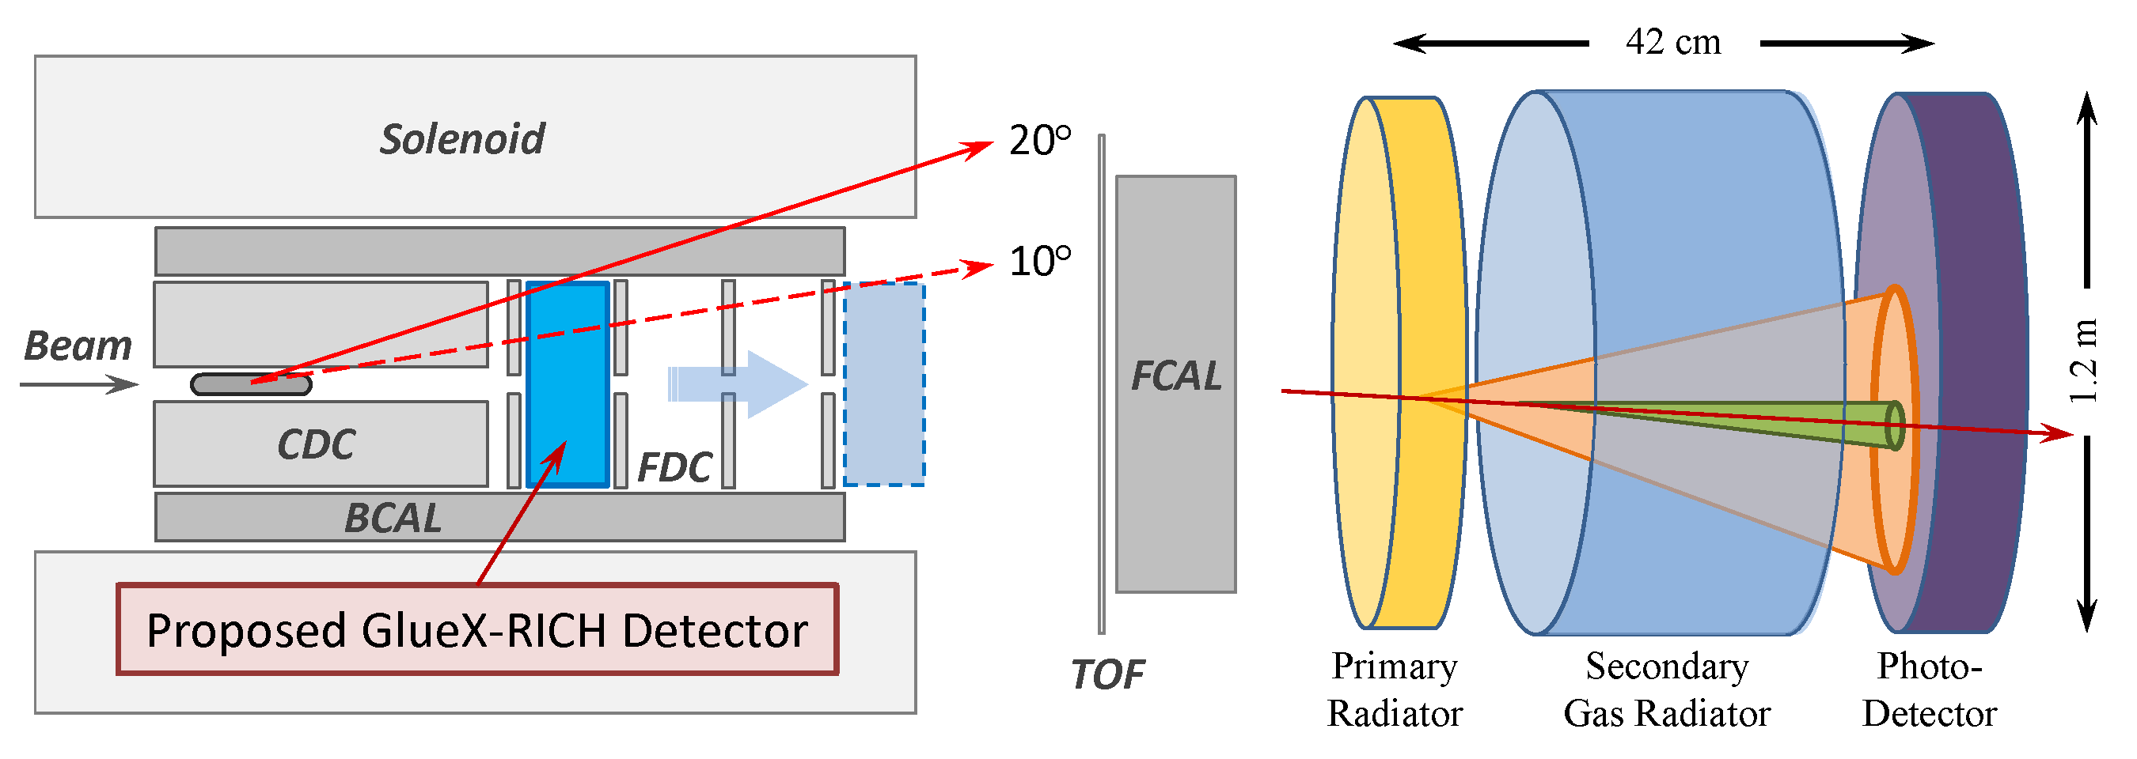
GlueX-RICH Detector
Dual Radiator: Aerogel + C₄F₁₀
Micro-Channel Plate photodetector (MCP-PMT) readout
  Developed by Large-Aera Picosecond Photo Detector (LAPPD) collaboration, in stage II
  Good sensitivity to visible light
  Good timing and position resolutions
Ceramic body MCP-PMT Prototype

Slide 30
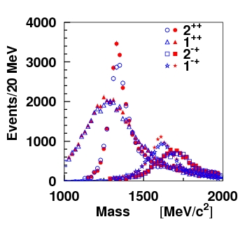
Partial Wave Analysis Study
Simulation of Partial Wave Analysis for γ p → n π⁺π ⁻ π⁺
Input amplitudes for: a₁(1260) 1 ⁺ ⁺ , a₂(1320) 2 ⁺ ⁺ , π₂(1670) 2 ⁻ ⁺ , π₁(1600) 1 ⁻⁺
• π₁(1600) constitutes about 2.5% of the total sample. σ (π₁) = 20 nb.
• data sample corresponds to about 1% of the reconstructed statistics
for 1 year of running at low luminosity
Unbiased shapes of the 3π mass distributions and
phase differences obtained from the fit
1⁻⁺

Slide 31
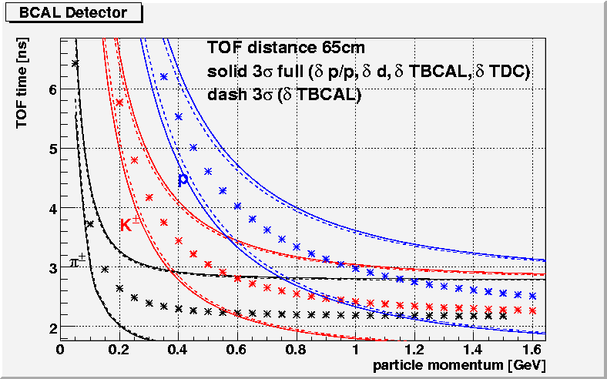
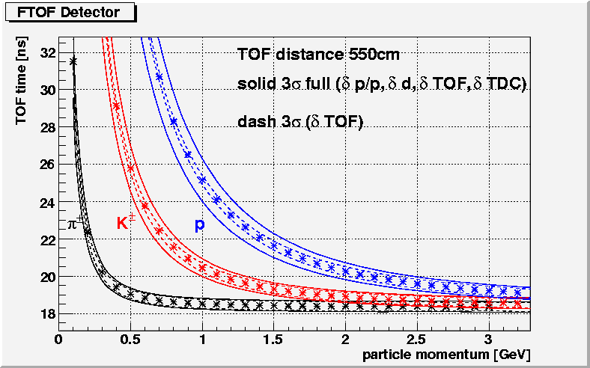
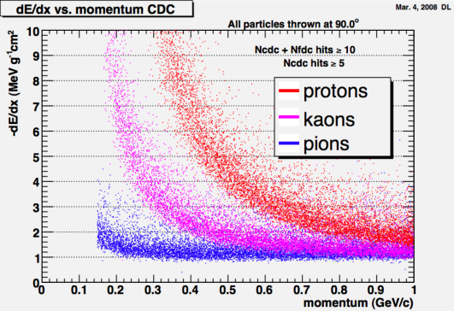
TOF & PID
12 cm square opening
Split paddles
PMT’s
Scintillator bars
252 cm
πp separation <450MeV/c
πK separation <275MeV/c

Slide 32
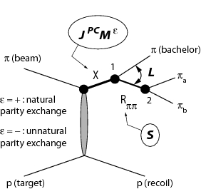
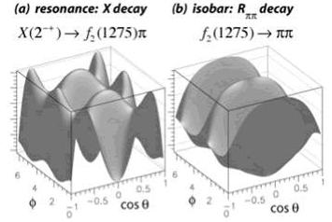
Requirements for Search of Exotic Mesons ?
Photon Beam Requirements:
• Sufficient beam energy to cover exotic candidate mass energy between 1.5 – 3 GeV
• Photon polarization (determine spin/parity of final state )
• Luminosity
Detector Requirements:
• Hermetic detector
• Large/uniform acceptances
• Energy and momentum resolution
Example of E852 3π analysis
Partial Wave Analysis
Kinematic variables: θ_{GJ} ϕ_{GJ} θ ϕ m_{ππ}
Bin in 3π mass and fit for the intensity of J^{PC} states
Gottfried-Jackson frame
Helicity frame

Slide 33
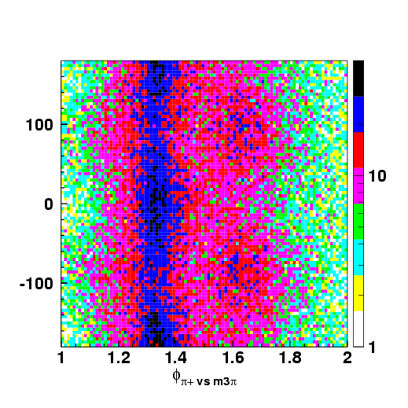
Photon Linear Polarization
γ p → n π⁺π ⁻ π⁺
E_{γ} > 8 GeV allows to see M_{X} ~ 2.8 GeV
Linear polarization of photons provides azimuthal
angle dependence of decay products
- allows one to distinguish parity of the exchange
particle
a₂
π₂
η=+1
η=−1
φ_{GJ}
η=+1
η=−1
Linearly polarized photon beam
• electrons incident on the diamond radiator
• coherent bremsstrahlung
• use collimator to increase the polarization fraction
η=+1
m_{3π} [GeV/c²]

